Slide 2
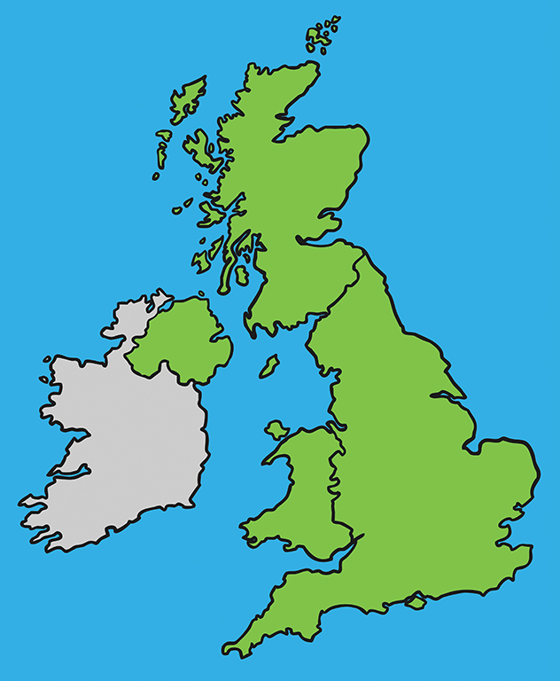

United Kingdom
The official name of the UK is ‘The United Kingdom of Great Britain and Northern Ireland’.
It is made up of 4 countries: England, Scotland, Wales and Northern Ireland.
Scotland
Northern
Ireland
England
Wales

Slide 3
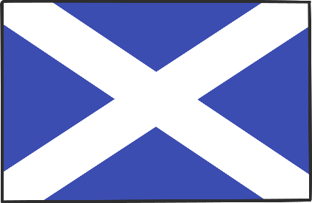

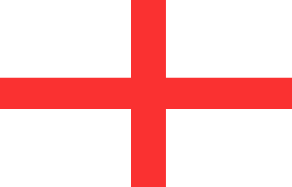
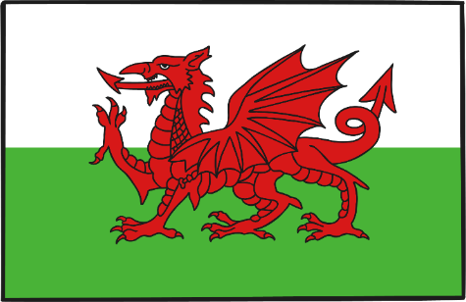
United Kingdom
These are the flags of each country:
Scotland
Northern Ireland
England
Wales

Slide 4

United Kingdom
The flag of the UK combines the crosses of three patron saints:
St Andrew: Scotland
St Patrick: Northern Ireland
St George: England
United Kingdom

Slide 5

Population
England has the largest population (number of people who live there) in the UK.
The population of the UK is around 64 million!

Slide 6
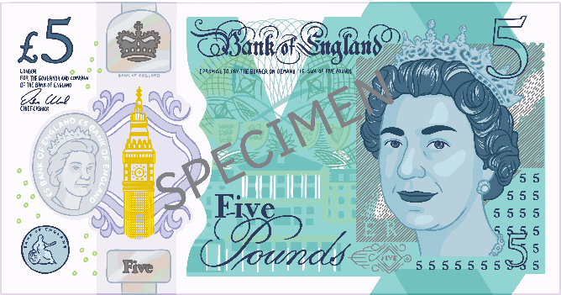
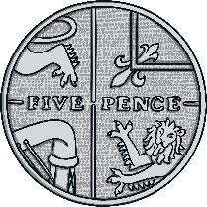
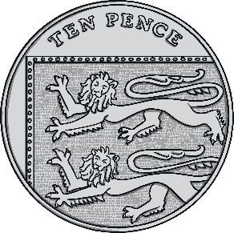
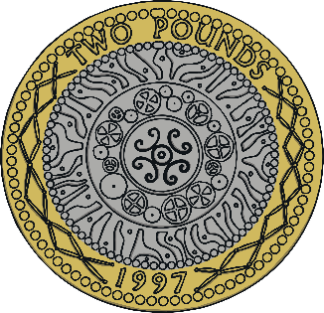
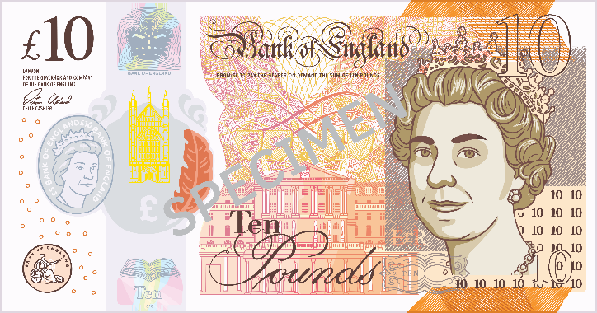
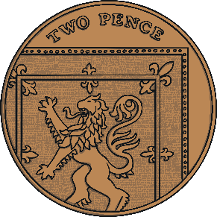
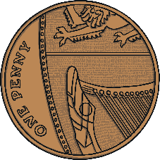
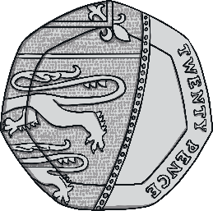
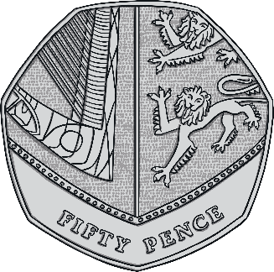
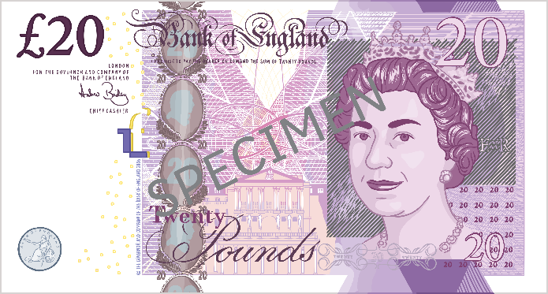
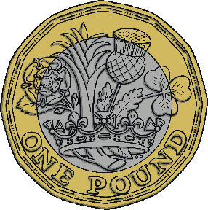
Currency
The currency in the UK is the pound sterling.

Slide 7

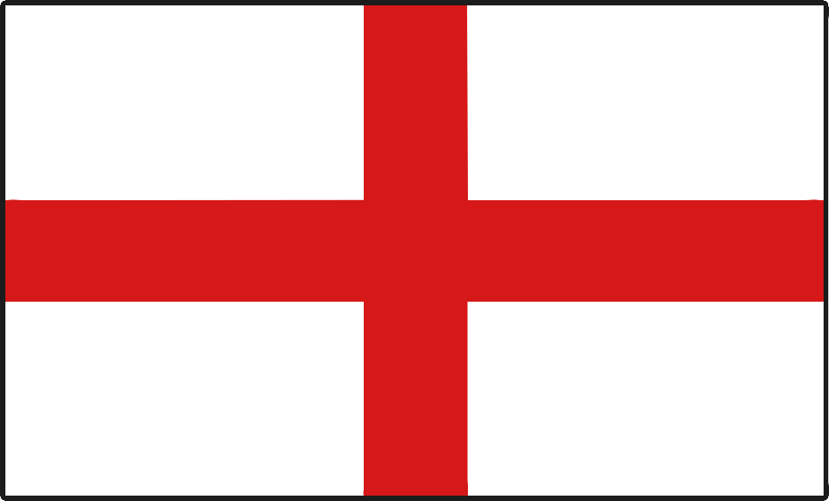
England National Flower
A rose is the English national flower.

Slide 8

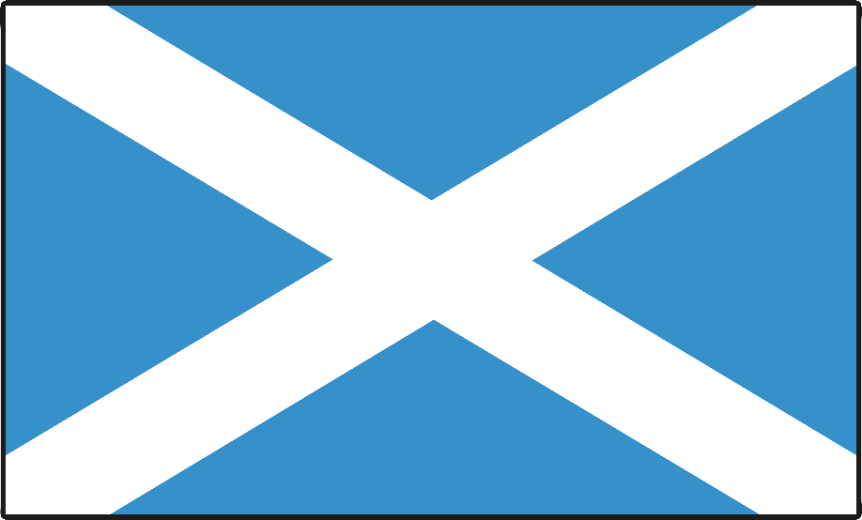
Scotland National Flower
A thistle is the Scottish national flower.

Slide 9

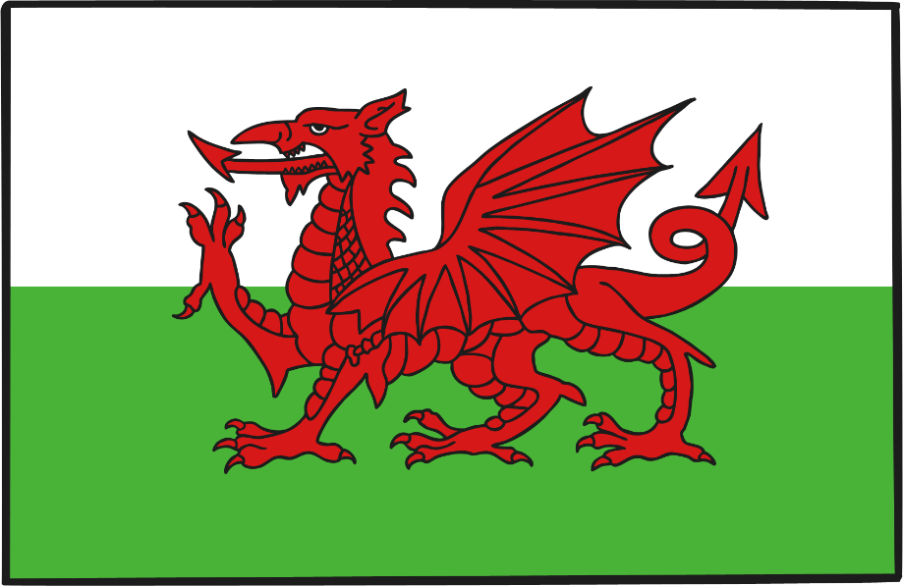
Wales National Flower
A daffodil is the Welsh national flower.

Slide 10
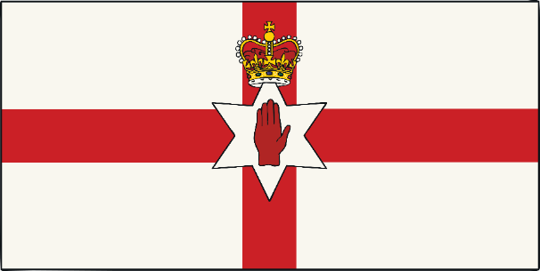

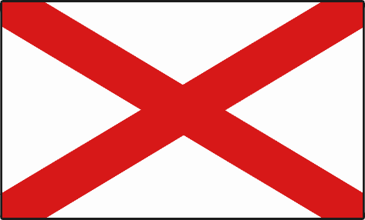
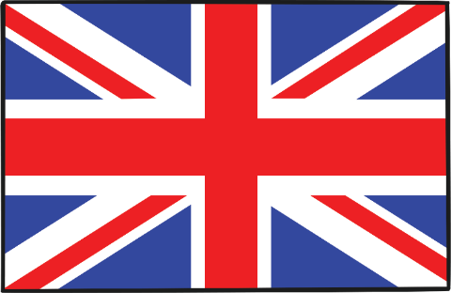
Northern Ireland National Flower
A shamrock is the Northern Irish national flower.

Slide 11
Capital Cities
England
London
Scotland
Edinburgh
Edinburgh
Belfast
Wales
Cardiff
Northern Ireland
Cardiff
London
Belfast

Slide 12
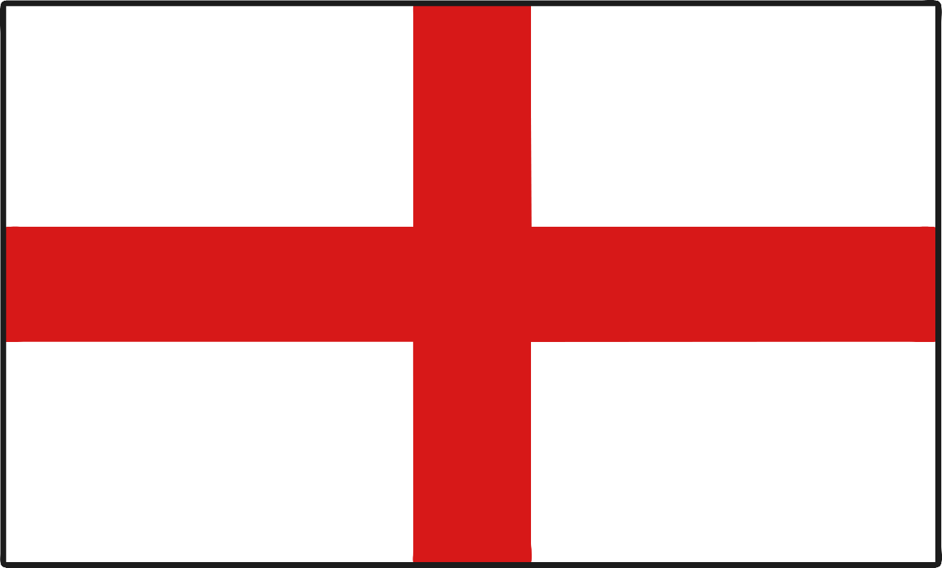
London
The capital city of England is London.

Slide 13
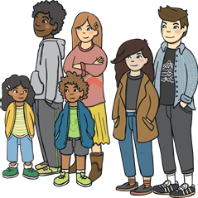

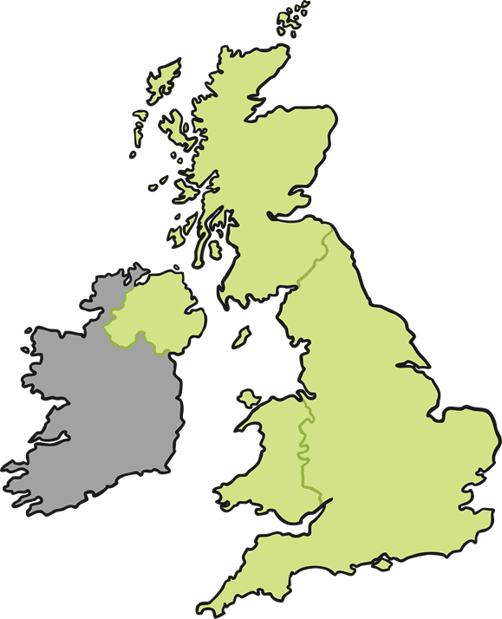
Facts about London
London is the biggest city in Britain and Europe. 8,900,000 people live in London (2018).
London

Slide 14
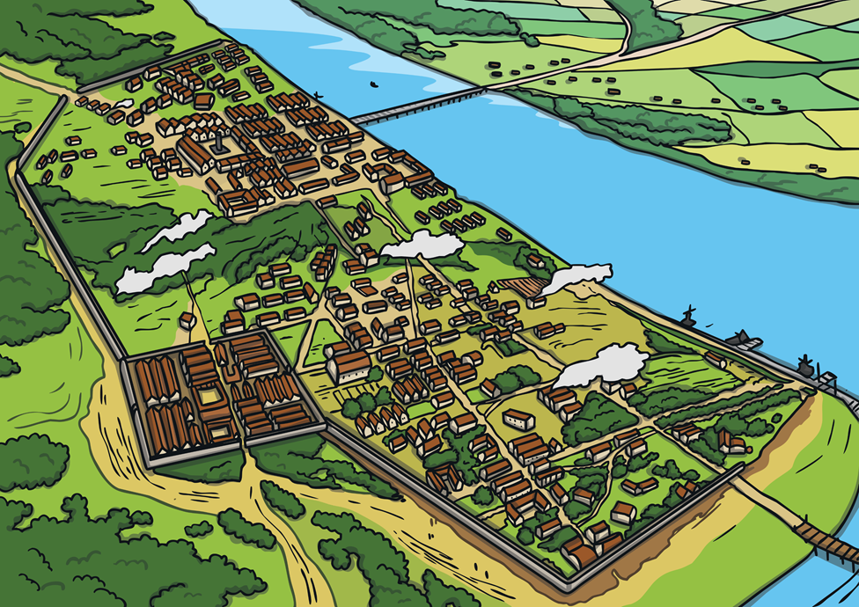
Invaders and Settlers
The Romans were first to settle where London is today, they named it Londinium.

Slide 15
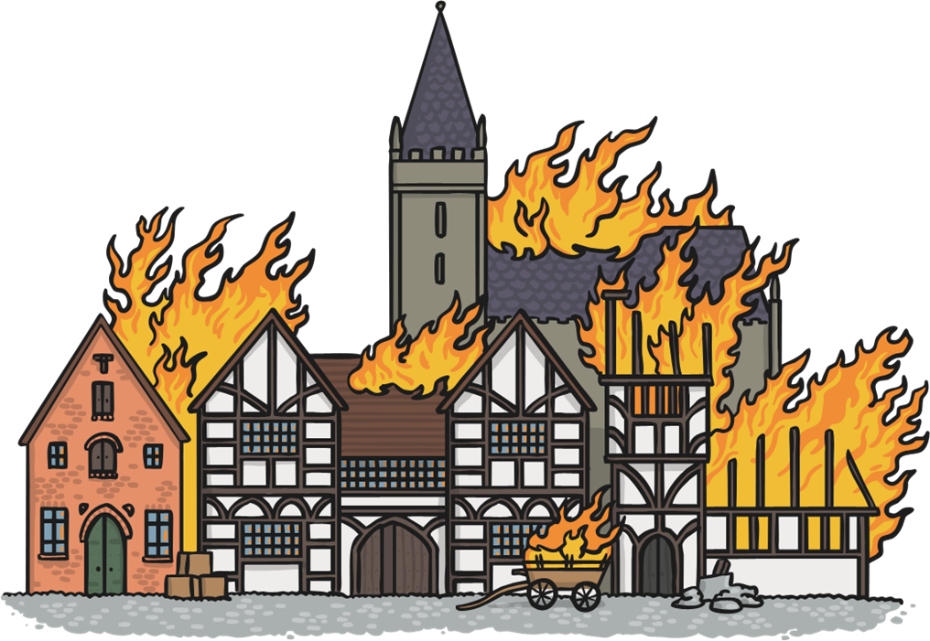
The Great fire of London
In 1666 the Great Fire of London swept through central parts of London. Much of the city had to be rebuilt.

Slide 16
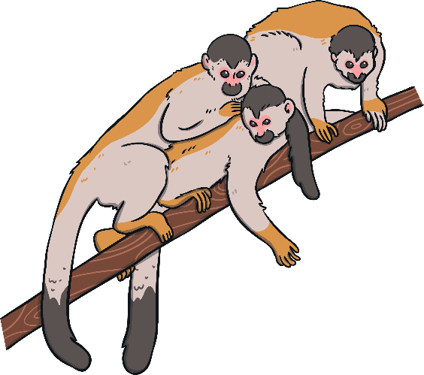

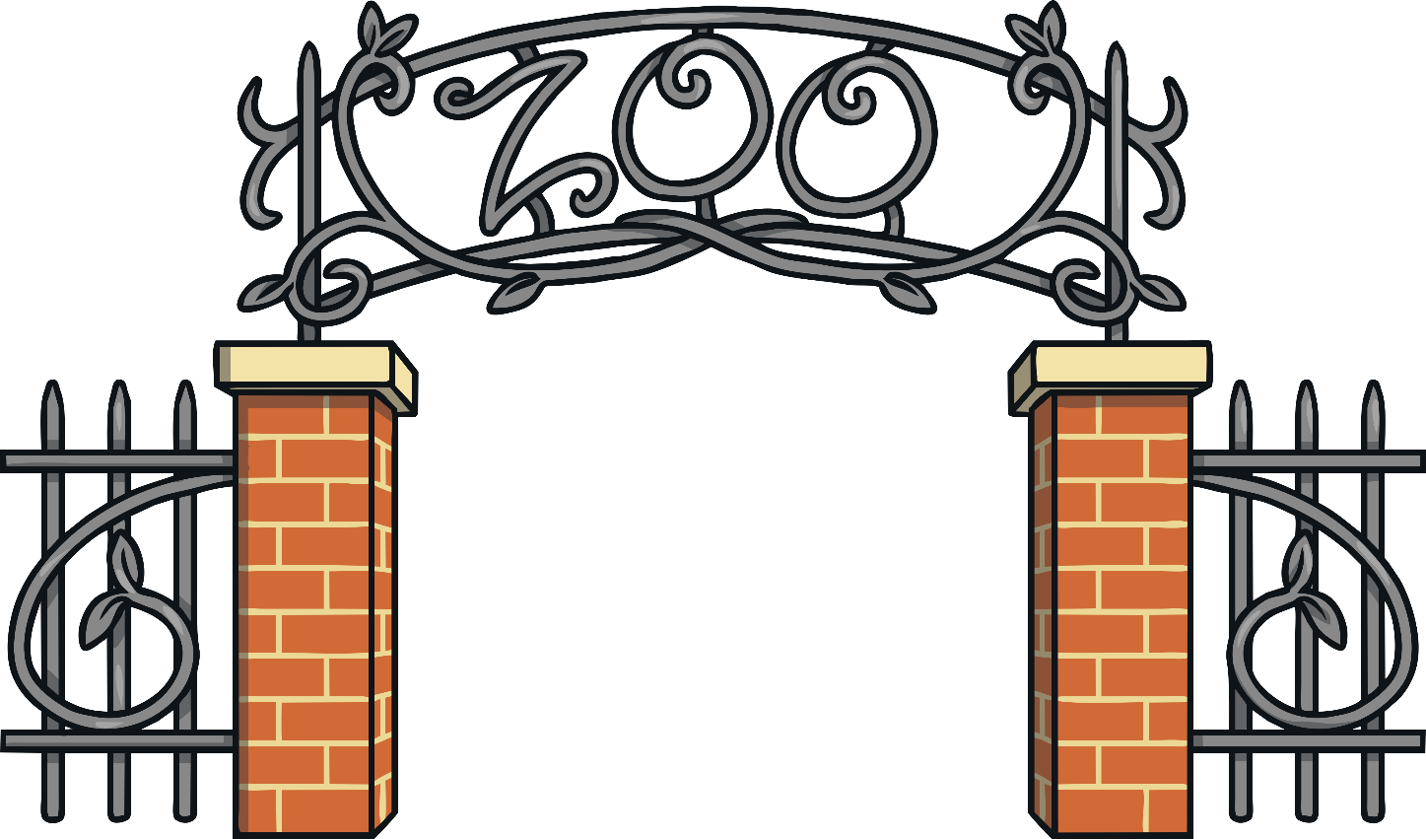
London Zoo
London Zoo was the world’s first public zoo. It opened in 1829.

Slide 17
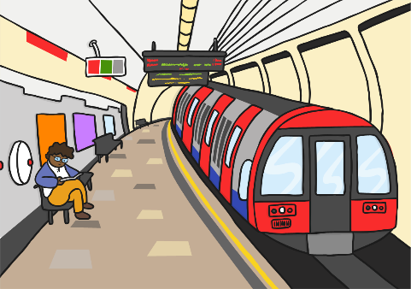
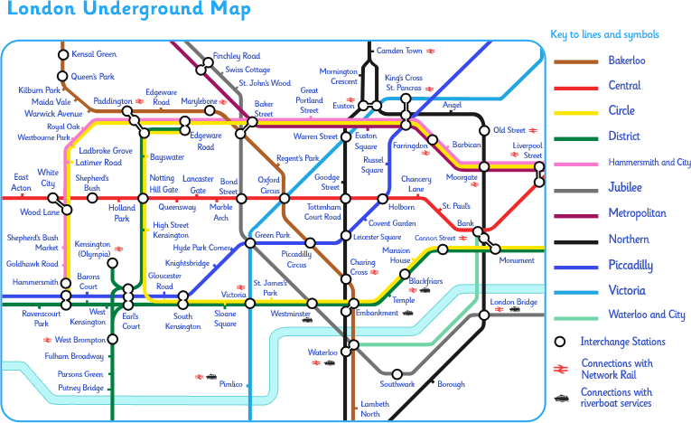

London Underground
The London Underground is the oldest underground railway network in the world.

Slide 18
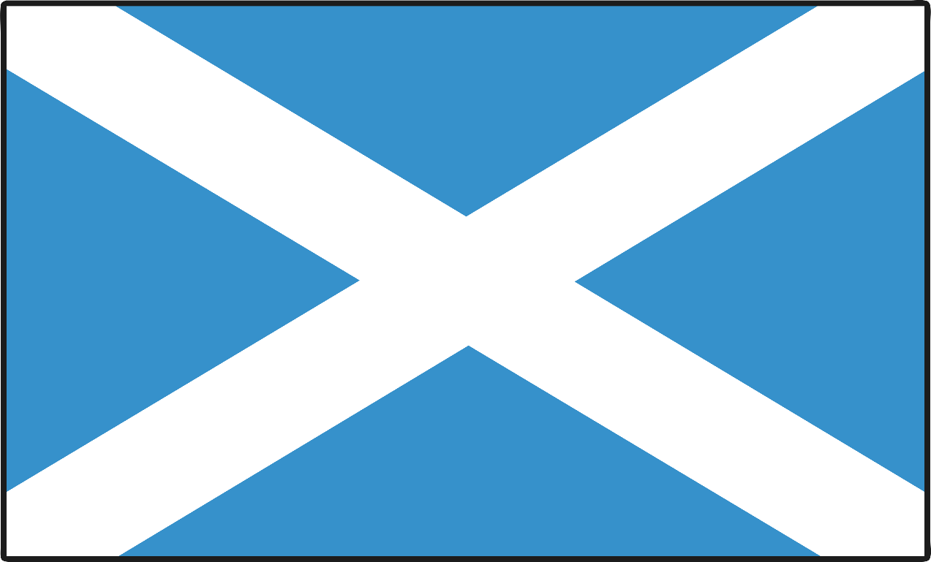
Edinburgh
The capital city of Scotland is Edinburgh.

Slide 19
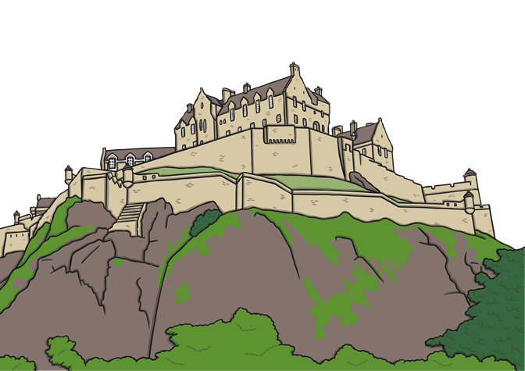
Facts about Edinburgh
Edinburgh is the second biggest city in Scotland. It is estimated 489,000 people live in Edinburgh (2019).
The main spoken language is English. In addition to this 1.4% of the population also speak Gaelic.
Edinburgh

Slide 20
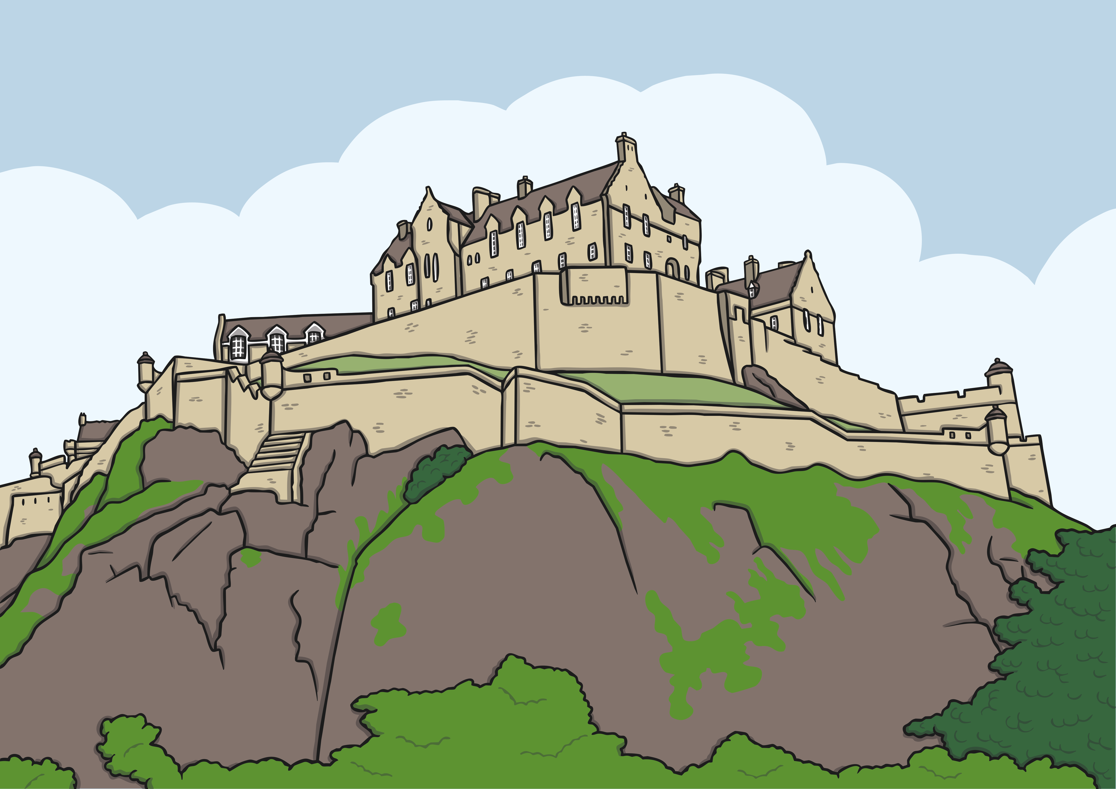
Edinburgh Castle
Edinburgh castle is built on an extinct volcano.

Slide 21
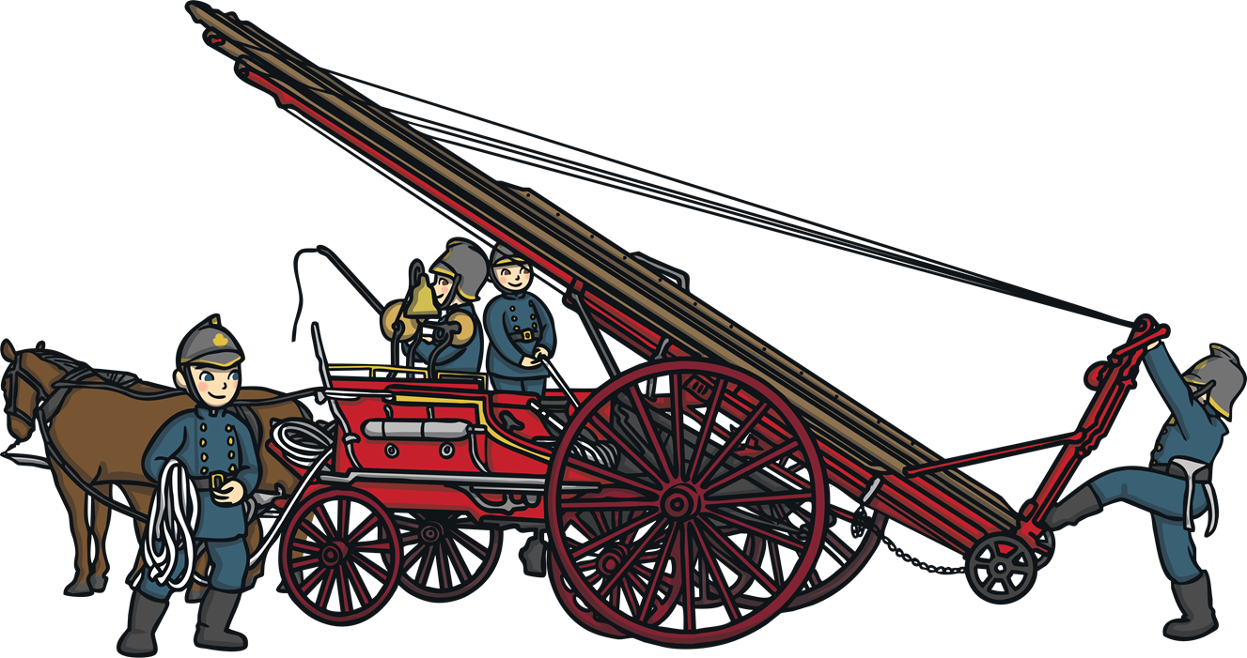
Edinburgh Fire Service
Edinburgh was the first city in the world to have its own fire service.

Slide 22

Alexander Graham Bell
Alexander Graham Bell, who invented the telephone, was born in Edinburgh.

Slide 23
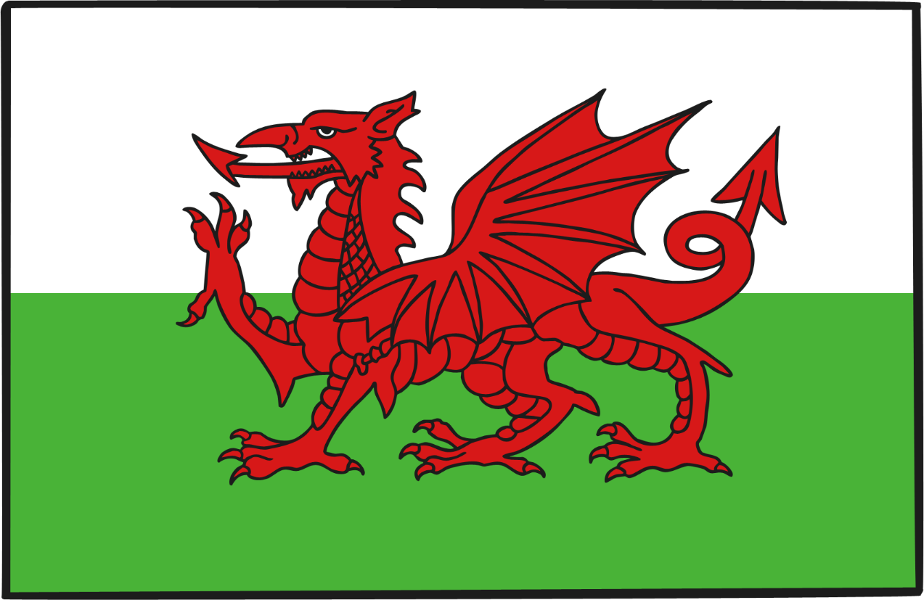
Cardiff
The capital city of Wales is Cardiff. It is the smallest capital city in Europe.

Slide 24
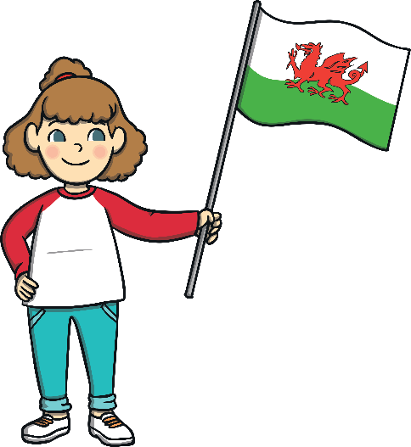
Facts about Cardiff
Cardiff is the largest city in Wales. It is estimated that 477,627 people live there (2020). The main spoken language is English and only 10% of the population in Cardiff speaks Welsh.
Cardiff

Slide 25
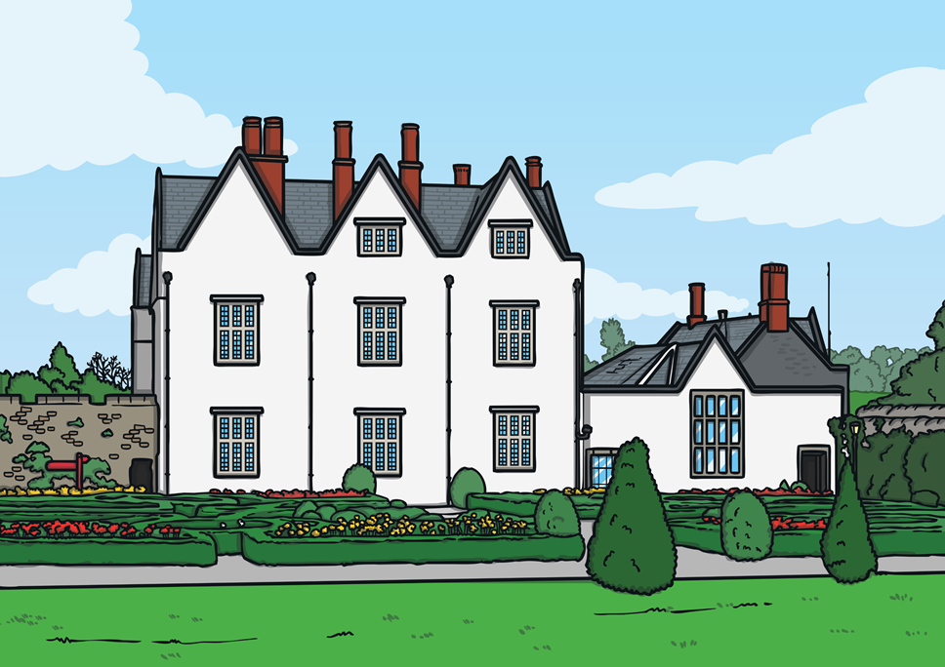
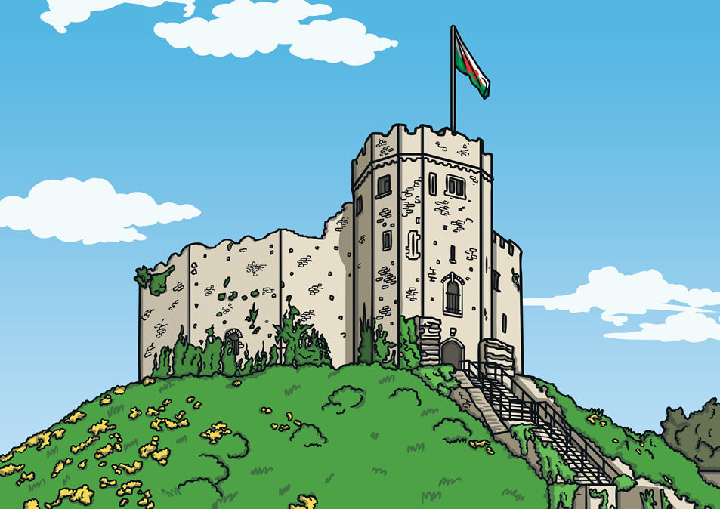
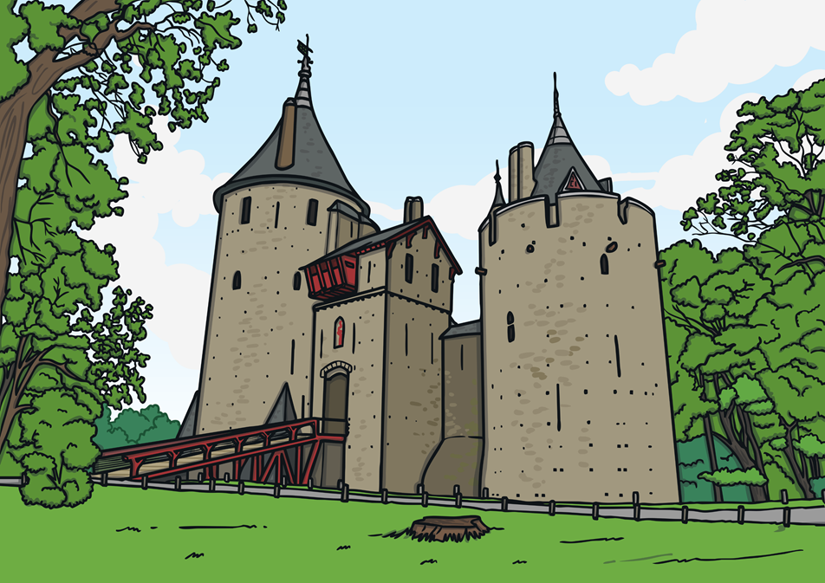
City of Castles
There are three castles still standing in Cardiff: Cardiff Castle, St Fagan’s Castle and Castell Coch Castle.
Cardiff Castle
St Fagan’s Castle
Coch Castle

Slide 26
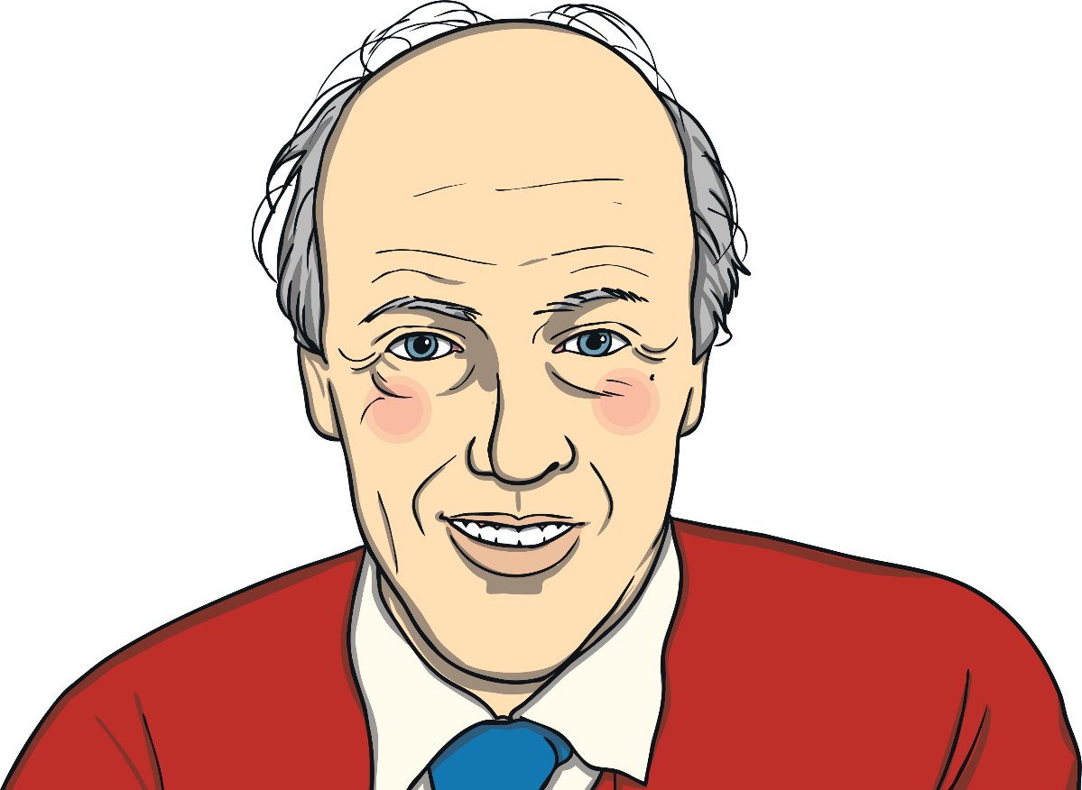
Roald Dahl
Roald Dahl, a famous children’s author, was born in Cardiff.

Slide 27
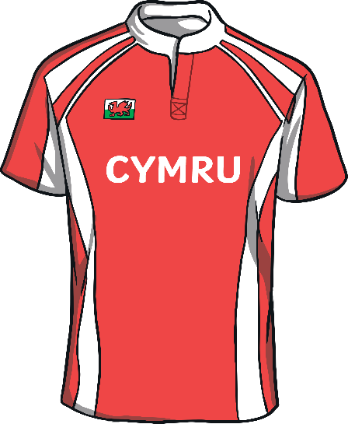
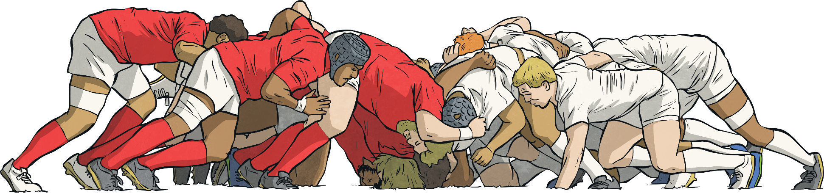
The Principality Stadium
The Principality Stadium is home of the Welsh national rugby team. It was opened in 1999 and used to be known as the Millennium Stadium.

Slide 28
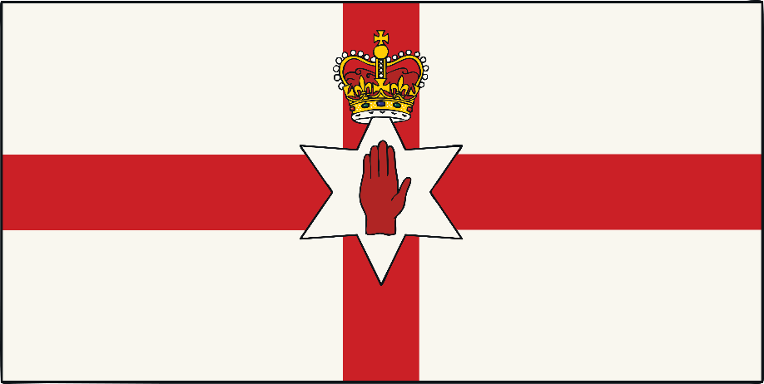
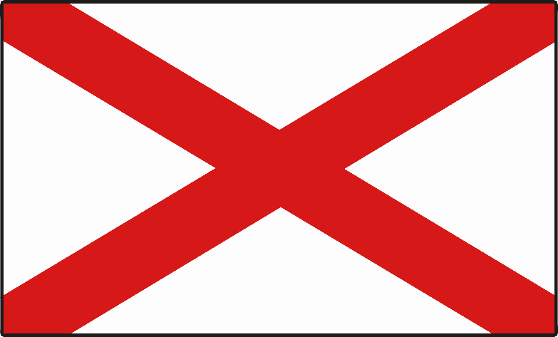
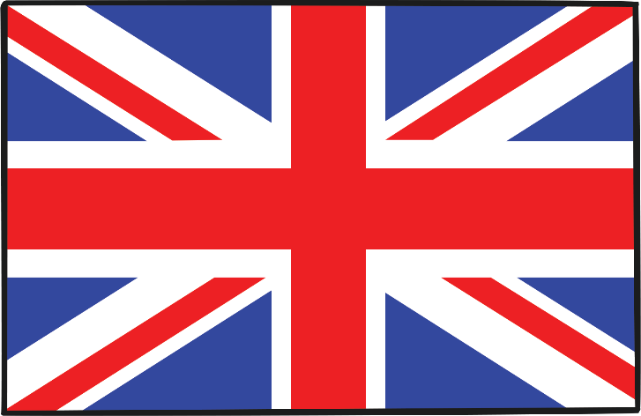
Belfast
The capital city of Northern Ireland is Belfast.

Slide 29
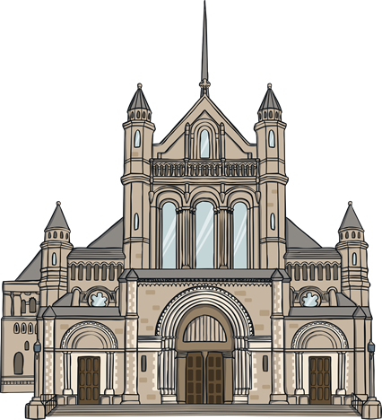
Facts about Belfast
Please include an illustration of a UK map labelling Belfast and some people alongside to show population
Belfast
Belfast is the largest city in Northern Ireland.
It is estimated 585,000 live in and around the Belfast area (2019).

Slide 30
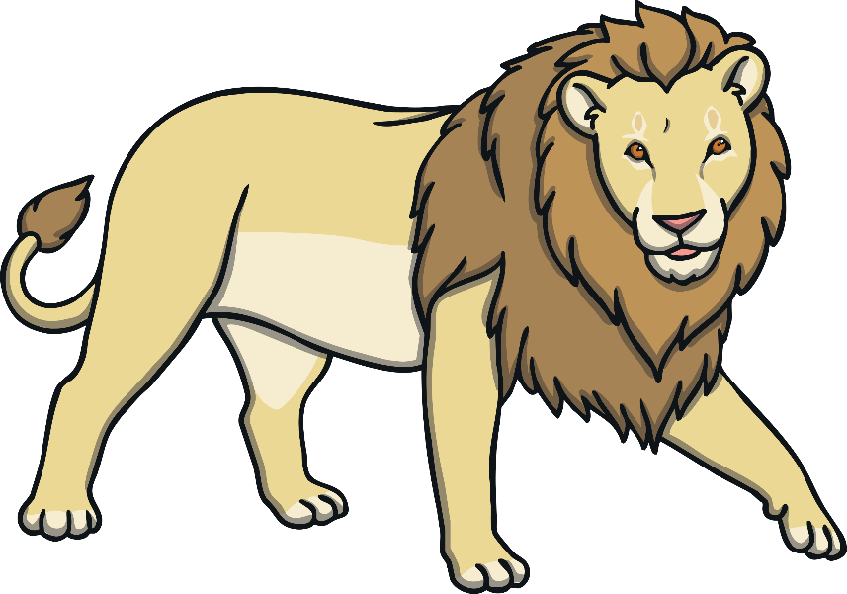

C.S Lewis
CS Lewis, author of The Chronicles of Narnia, was born in Belfast.

Slide 31
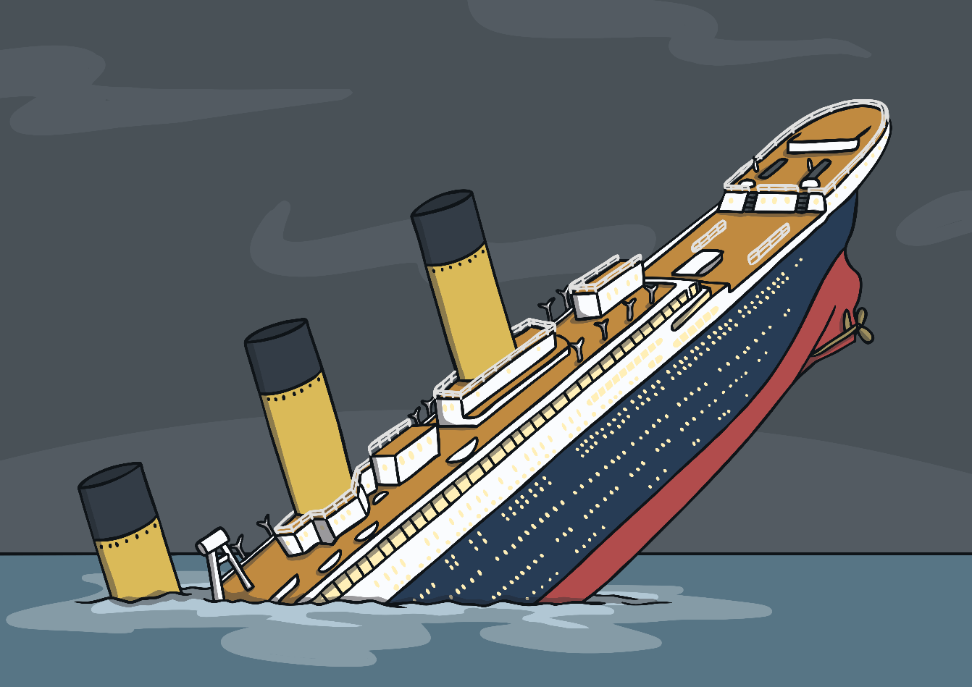
The Titanic
The world famous ship, The Titanic, was constructed in Belfast.

