Slide 1
Use of commas after fronted adverbials

Slide 2

Focus
I can recognise a fronted adverbial in a sentence.
I can use a comma to punctuate a fronted adverbial.

Slide 3

Use of commas after fronted adverbials
An adverbial phrase is a group of words that behaves just like an adverb. It gives details about where, when, how or why something happened.
Before painting, Ash mixed a burnt orange colour.
He liked to paint in the open air.
adverbial to express time
He cleaned his brushes, in order to get bold colours.
adverbial to express place
Ash selected his colours with a great deal of care.
adverbial to express cause
adverbial to express manner

Slide 4

Use of commas after fronted adverbials
An adverbial phrase gives more detail than a single adverb.
Talk about the difference between the two sentences below.
Ash selected his paint colours slowly.
Ash selected his paint colours with a great deal of care.

Slide 5
Use of commas after fronted adverbials
An adverbial can be moved to the start of a sentence to draw attention to a particular point.
Ash selected his paint colours with a great deal of care.
With a great deal of care, Ash selected his colours.
fronted adverbial
adverbial
Fronted adverbials are often used in creative writing. They show how time is passing, set the mood of a scene, build suspense, or give information about what is going on inside a character’s head.

Slide 6
Use of commas after fronted adverbials
An adverbial that is placed at the start of a sentence is called a fronted adverbial.
Every Monday, Ash liked to go to the Paint Zone class.
In the studio, Ash was allowed to use a large canvas.
Usually, he worked with other young artists.
A fronted adverbial can be a phrase or a single adverb.

Slide 7
Use of commas after fronted adverbials
,
When a sentence begins with a fronted adverbial, a comma is used to separate it from the main clause.
In the evening, Ash liked to paint.
In the evening, Ash liked to paint.
In the evening, Ash liked to paint.
In the evening, Ash liked to paint.
fronted adverbial
comma
main clause
Notes:
Remind children that an independent clause must make complete sense on its own.

Slide 8


Use of commas after fronted adverbials
,
A comma after a fronted adverbial is correctly placed if the words that follow are a main clause and make sense on their own. Which two sentences are punctuated correctly?
On Monday evenings, Ash liked to go to Paint Zone.
On Monday evenings, Ash liked to go to Paint Zone.
With great care, Ash mixed his paints.
With great Ash mixed his paints.
After school Ash, finished his painting.
After school, finished his painting.
Notes:
Remind children that an independent clause must make complete sense on its own.

Slide 9

Use of commas after fronted adverbials
Decide where the comma should go in each sentence below.
After school Ash did some painting.
After school, Ash did some painting.
With great care he worked on his picture.
With great care, he worked on his picture.
At the weekend Ash added more colours.
At the weekend, Ash added more colours.
Under a tall tree Ash set up his easel.
Under a tall tree, Ash set up his easel.
Due to the evening light everything looked golden.
Due to the evening light, everything looked golden.
With smooth brushstrokes Ash painted the sky.
With smooth brushstrokes, Ash painted the sky.
After finishing Ash left his painting to dry.
After finishing, Ash left his painting to dry.
Reveal Answers

Slide 10
Use of commas after fronted adverbials
Complete these sentences by adding a fronted adverbial. Remember to use a comma.
Extend your writing by adding more sentences that include a fronted adverbial, a comma, and then a main clause.
, I ate my breakfast. (When?)
, I played a game with my friends. (Where?)
, I finished my work. (How?)
, I read my favourite book. (How often?)

Slide 11
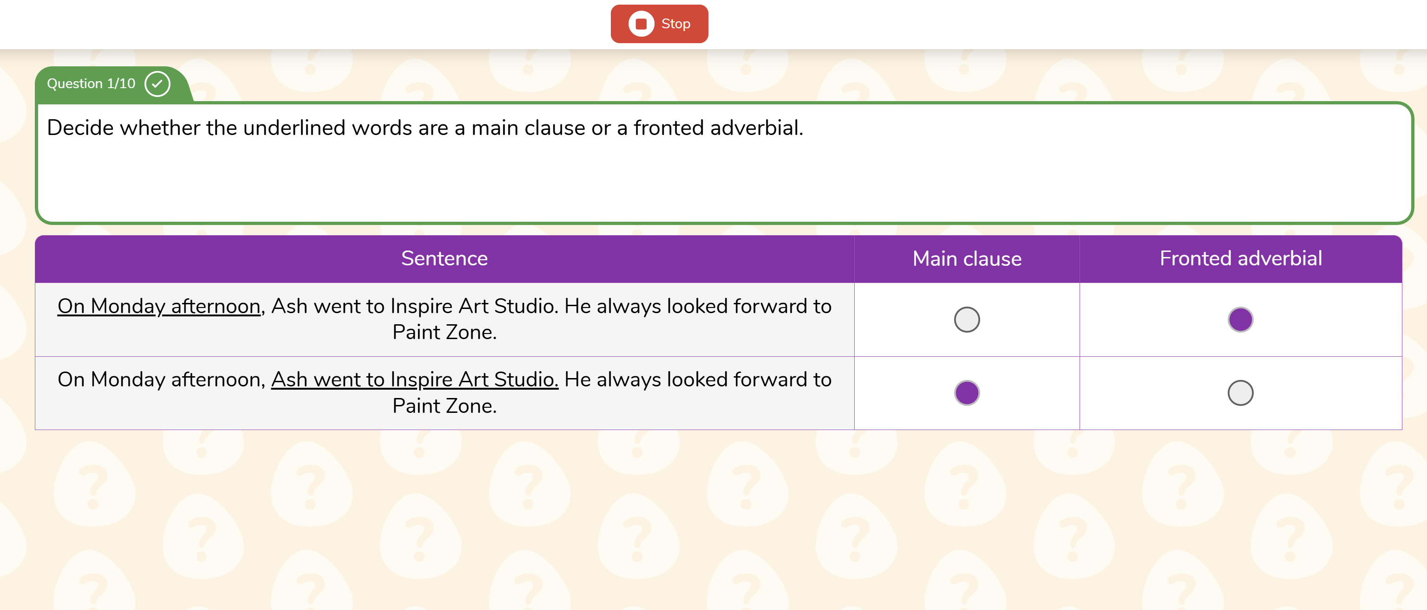
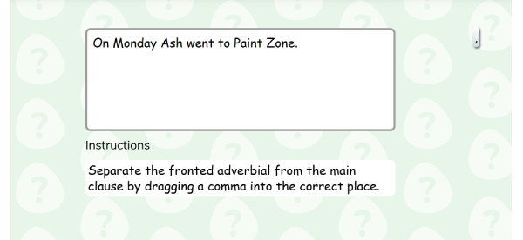
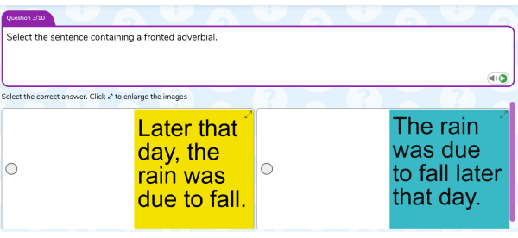
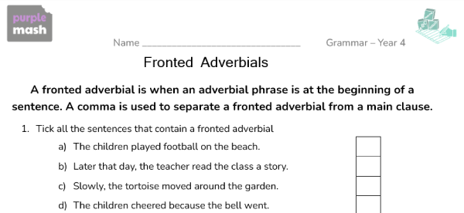
Use of commas after fronted adverbials
Activity 1
Find the Fronted Adverbial Read about Ash’s painting troubles and see if you can identify the main clause and fronted adverbials.
Activity 2
Cloze Separate each fronted adverbial from the main clause by dragging a comma into the correct place.
Activity 3
Quiz Answer questions about using fronted adverbials.
Activity 4
Worksheet Consolidate learning.

