Slide 1
Lesson 5: Effects
Year 2 – Creating media – Digital photography
Notes:
Last updated: 12-02-21
Resources are updated regularly — the latest version is available at: ncce.io/tcc.
This resource is licensed under the Open Government Licence, version 3. For more information on this licence, see ncce.io/ogl.

Slide 2
Lesson 5: How can photographs be changed?
Objectives
To know how to use tools to change an image
I can recognise that images can be changed
I can use a tool to achieve a desired effect
I can explain my choices

Slide 3
How could you change the appearance of a photo?
Introduction

Slide 4

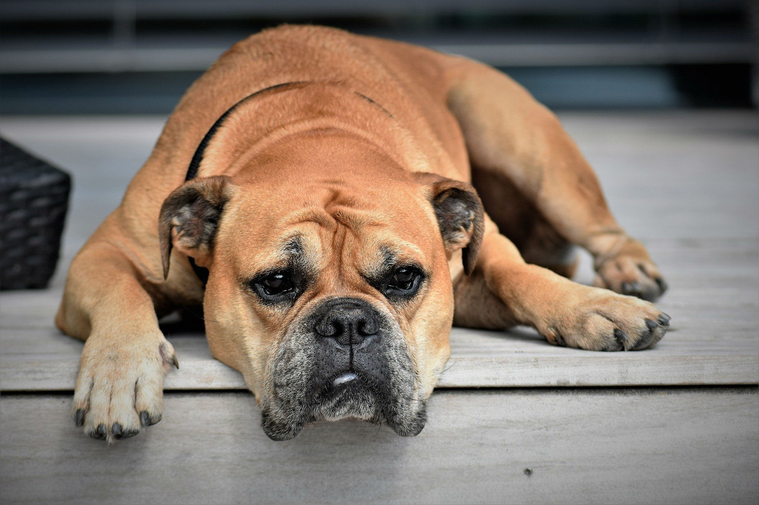

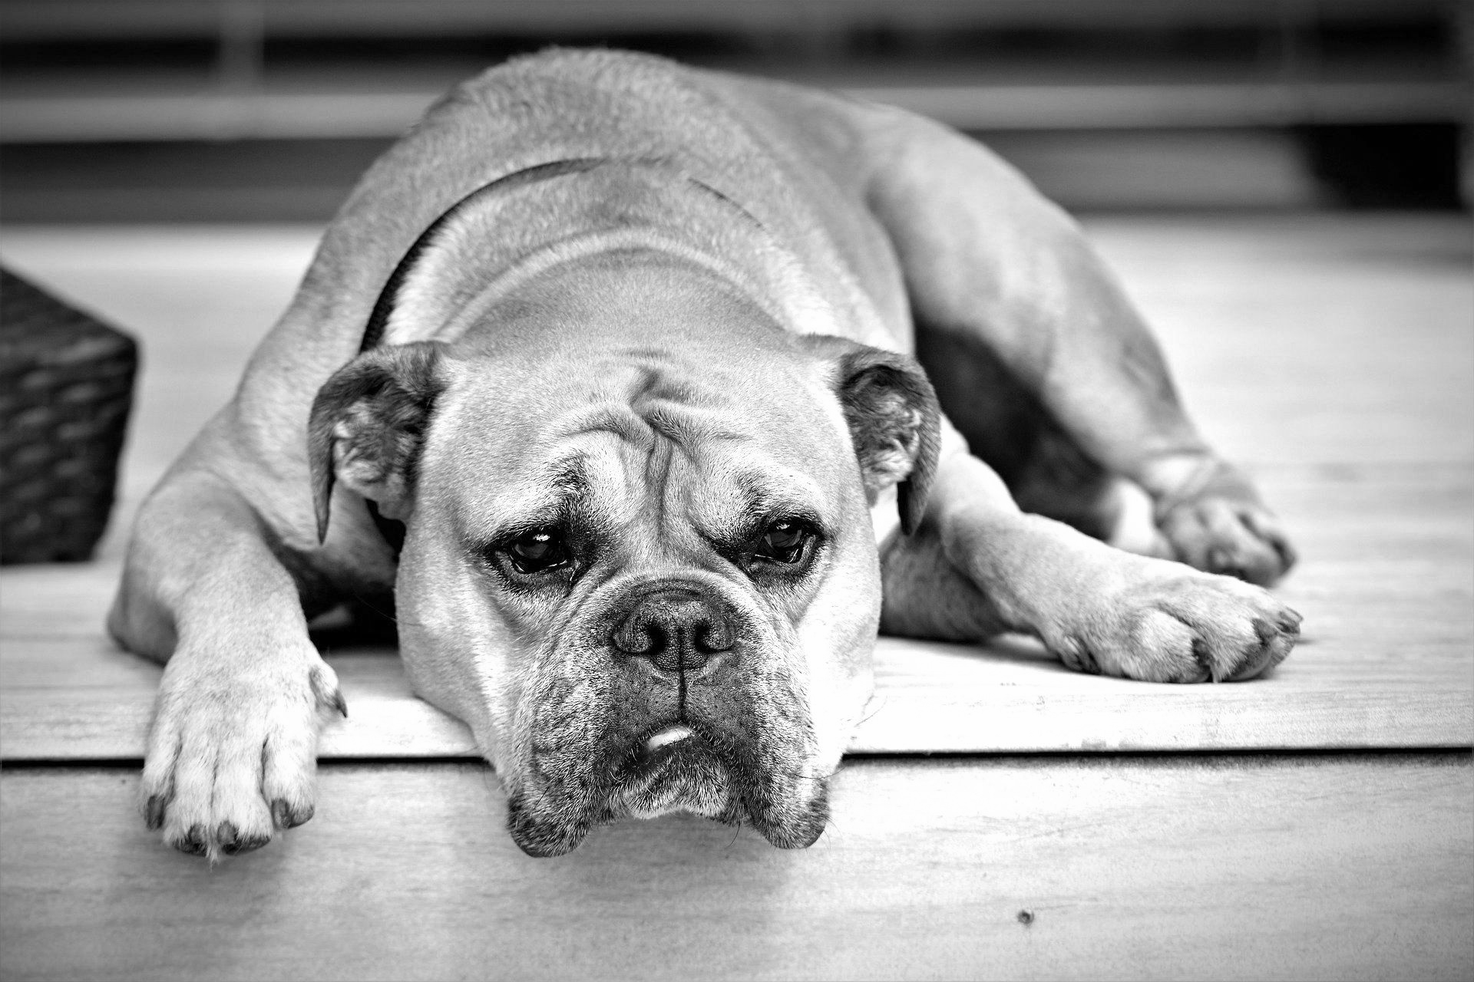
Changing colours
Introduction
Today we will change some photographs by adjusting their colours.
A
B
C
How have the colours been changed in images A, B, and C?
Notes:
Image source: https://pixabay.com/photos/dog-animal-continental-bulldog-pet-2437110

Slide 5
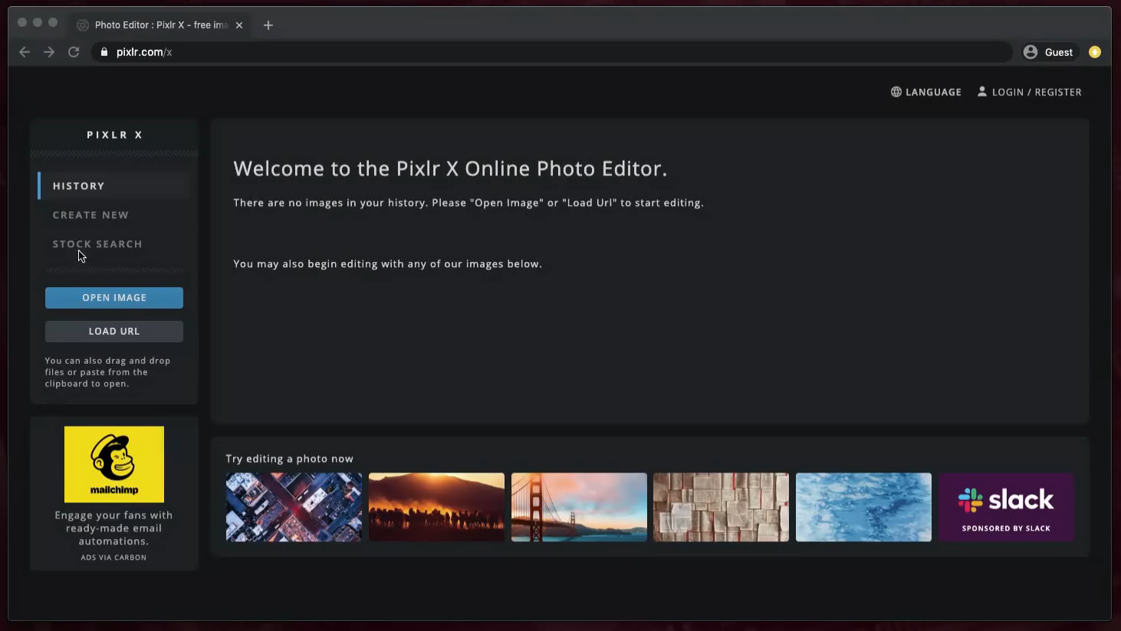
Using filters in Pixlr
Activity 1

Slide 6
Now try for yourself
Activity 1
See if you can make an image… go to https://pixlr.com/x
Black and white
More blue
More red

Slide 7
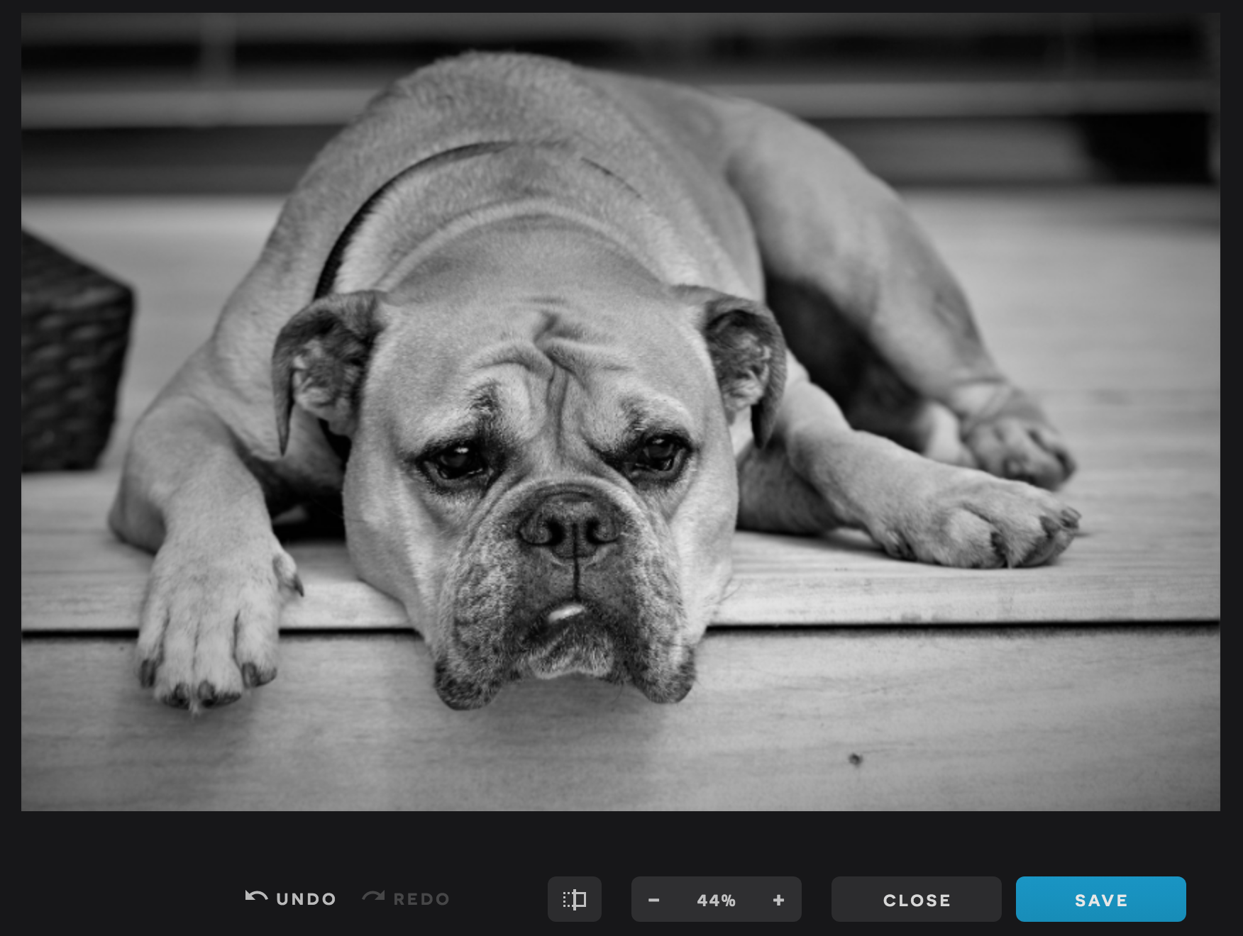
Activity 2
Saving
Choose SAVE

Slide 8
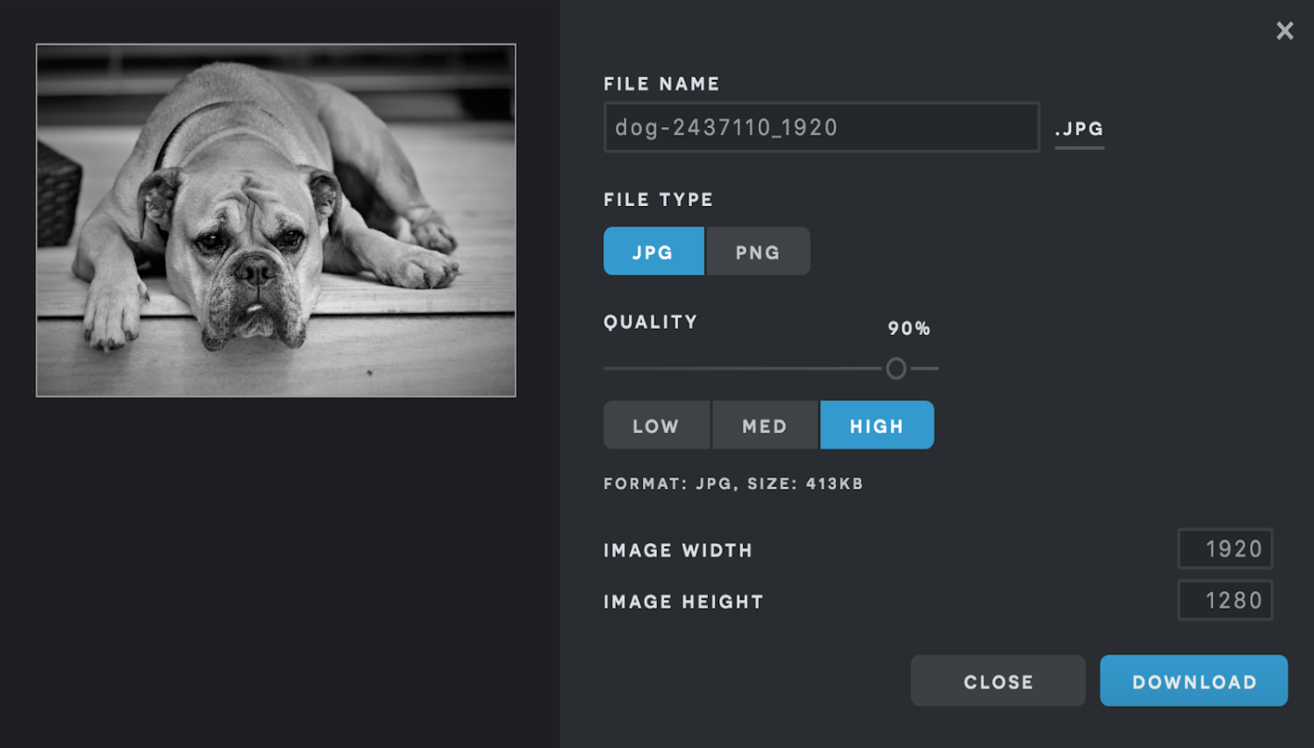
Activity 2
Saving
Choose a file name
Click DOWNLOAD

Slide 9


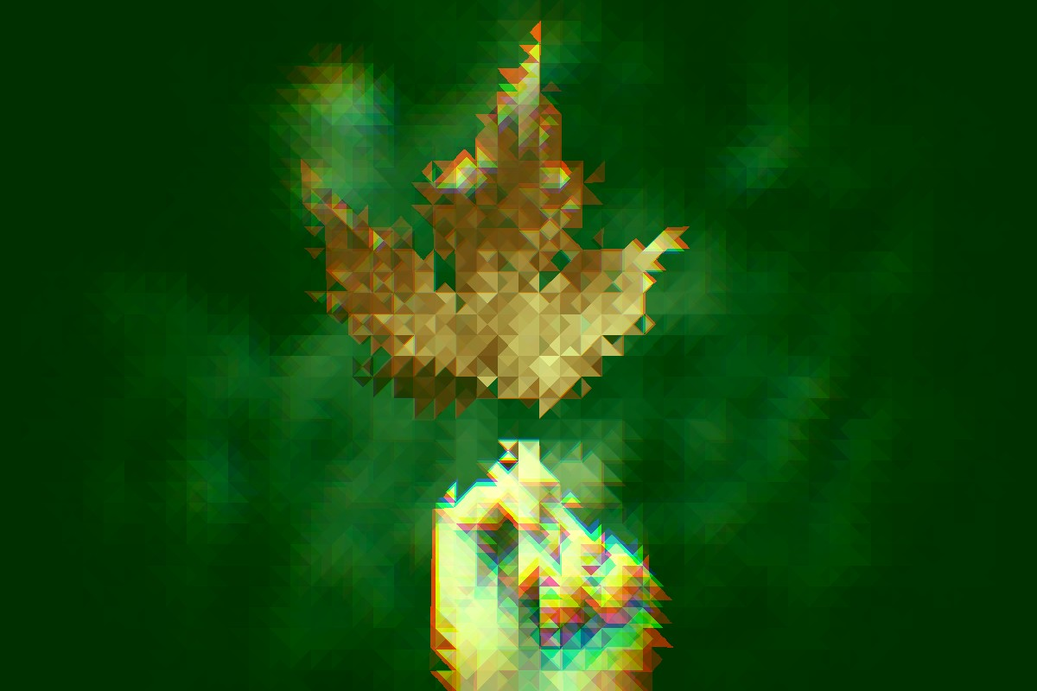
Activity 3
Can you combine more than one effect to create a new image?
Hint: Try changing another effect (not just colour).
Notes:
Image from modified in Pixlr - Source: https://unsplash.com/photos/L0cbdz6_eYU

Slide 10

Assessment
How confident are you? (1–3)
I can recognise that images can be changed
I can use a tool to achieve a desired effect
I can explain my choices
3 – Very confident
2 – Unsure
1 – Not confident
Notes:
Image source: https://pixabay.com/vectors/thumb-up-hand-like-confirm-go-top-307176

Slide 11
Next lesson
Summary
In this lesson, you...
Recognised that images can be changed
Used a tool to create an effect
Explained your choices
Next lesson, you will…
Look at how to spot whether an image is original or has been changed

