Slide 1
Lesson 3: What makes a good photograph?
Year 2 – Creating media – Digital photography
Notes:
Last updated: 12-02-21
Resources are updated regularly — the latest version is available at: ncce.io/tcc.
This resource is licensed under the Open Government Licence, version 3. For more information on this licence, see ncce.io/ogl.

Slide 2
Lesson 3: What makes a good photograph?
Objectives
To describe what makes a good photograph
I can identify what is wrong with a photograph
I can discuss how to take a good photograph
I can improve a photograph by retaking it

Slide 3
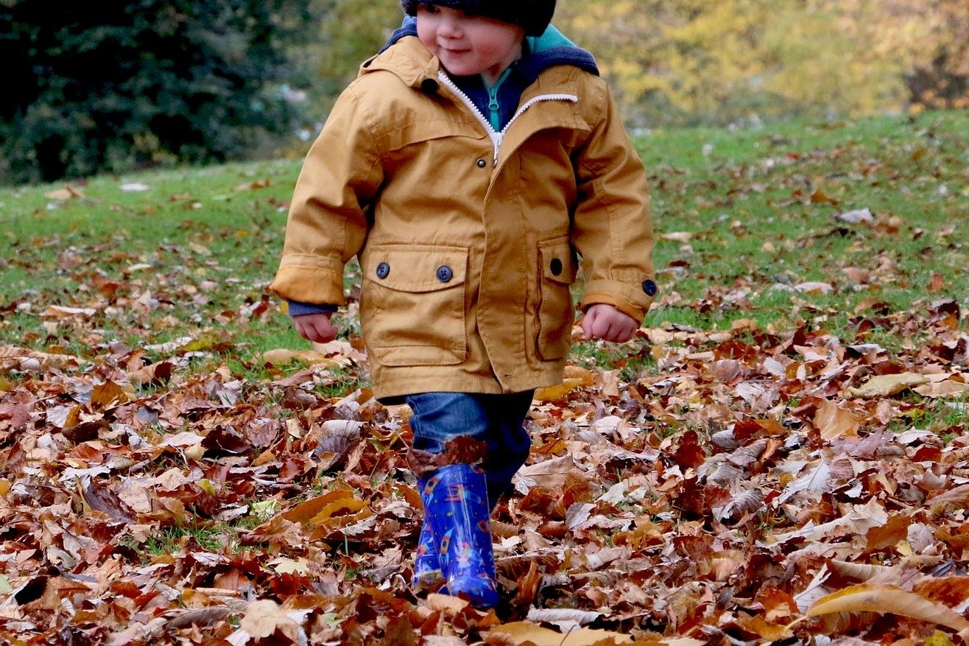
How could you improve this photograph?
Introduction
Notes:
Image source: https://pixabay.com/photos/child-cute-outdoor-autumn-fall-1031171

Slide 4

How could you improve this photograph?
Introduction
Notes:
Image source: https://pixabay.com/photos/boy-portrait-person-children-male-183306

Slide 5
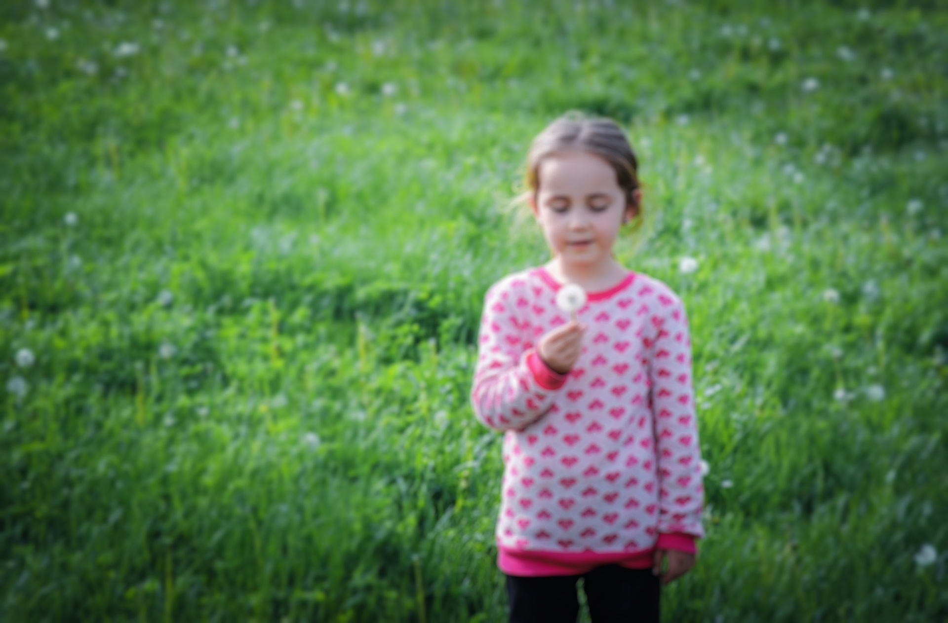
How could you improve this photograph?
Introduction
Notes:
Image source:
https://pixabay.com/photos/kids-woman-little-girl-cute-1387118

Slide 6
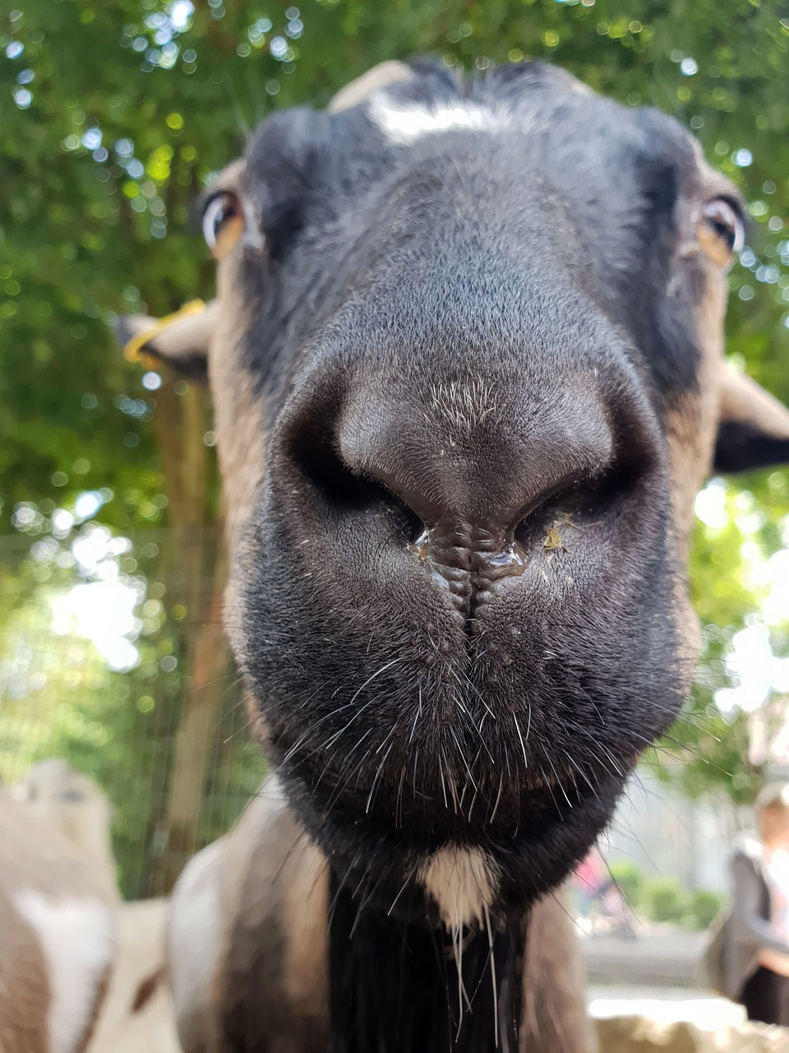
How could you improve this photograph?
Introduction
Notes:
Image source: https://pixabay.com/photos/goat-portrait-close-up-funny-nose-3667130

Slide 7
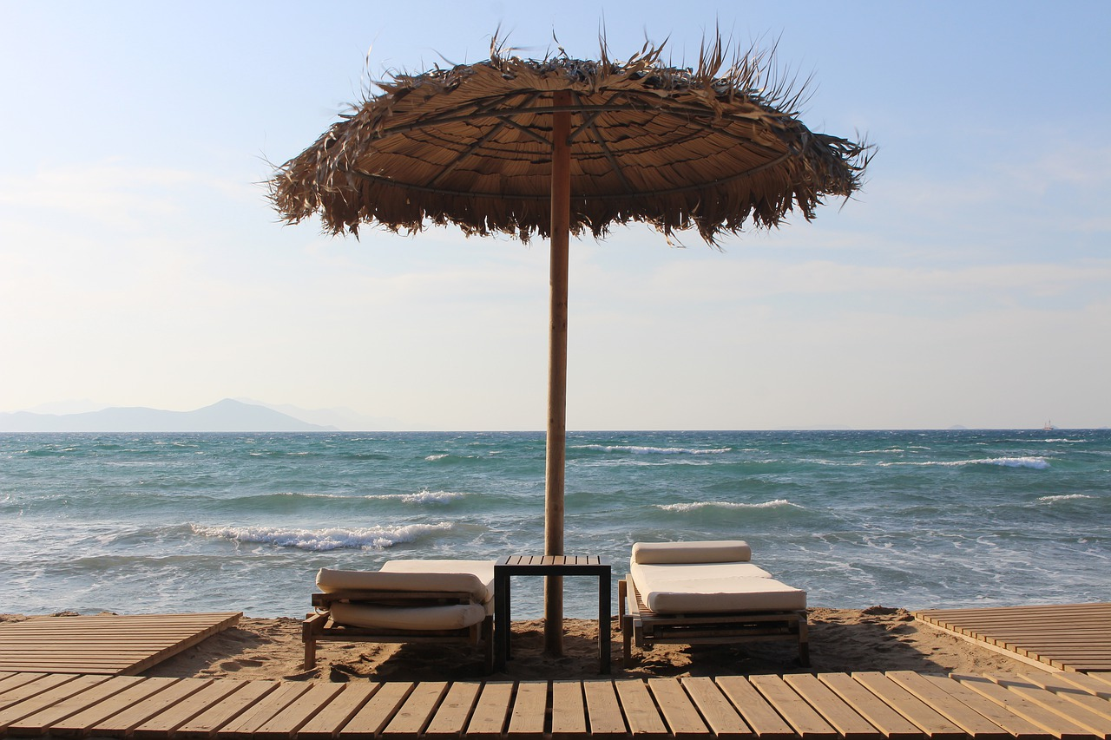

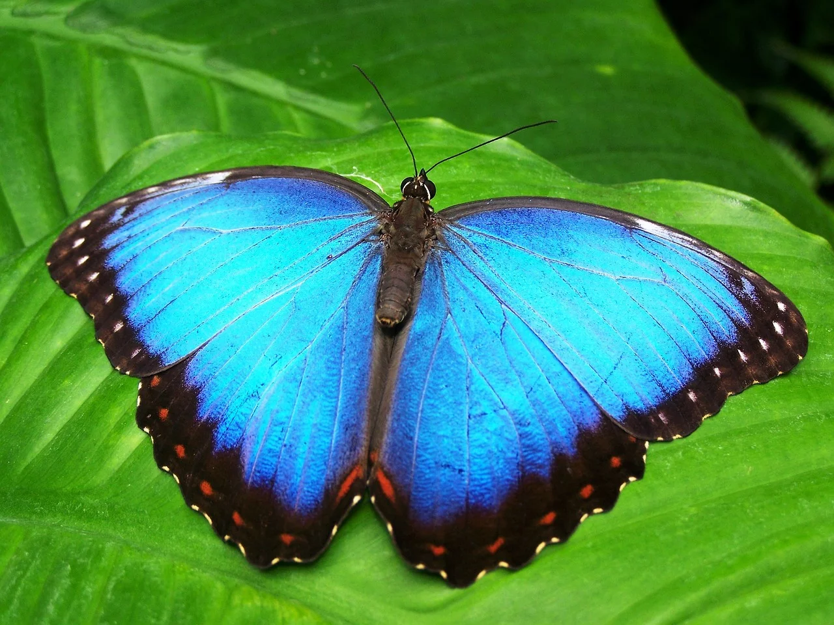

Taking a good photograph
Activity 1
Framing: Have you included everything you wanted to?
Subject: Are you close enough that you can see the detail?
Positioning: Is it obvious what the main subject of the photograph is?
Notes:
Image sources:
https://pixabay.com/photos/beach-greek-vacation-hotel-resort-4552226/
https://pixabay.com/photos/boys-portraits-kids-children-286243
https://pixabay.com/vectors/check-mark-tick-mark-check-correct-1292787
https://pixabay.com/photos/butterfly-blue-insect-142506

Slide 8
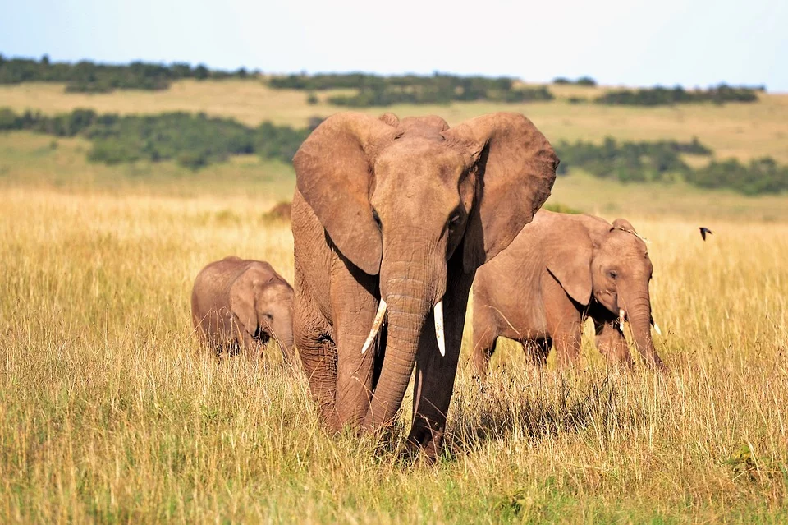
Which photo of an elephant is better?
Activity 1
Notes:
Image source: https://pixabay.com/photos/animals-elephants-kenya-tusks-2178578

Slide 9
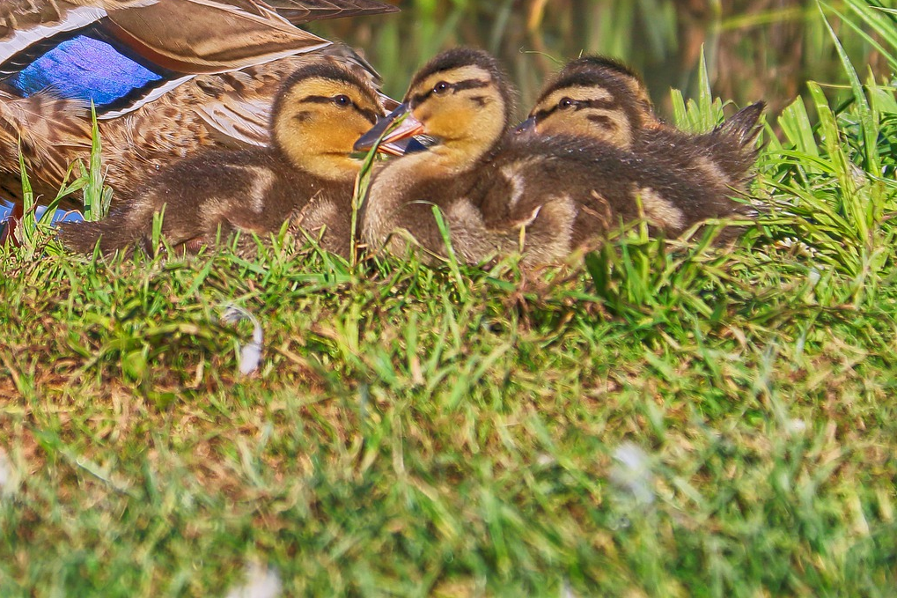
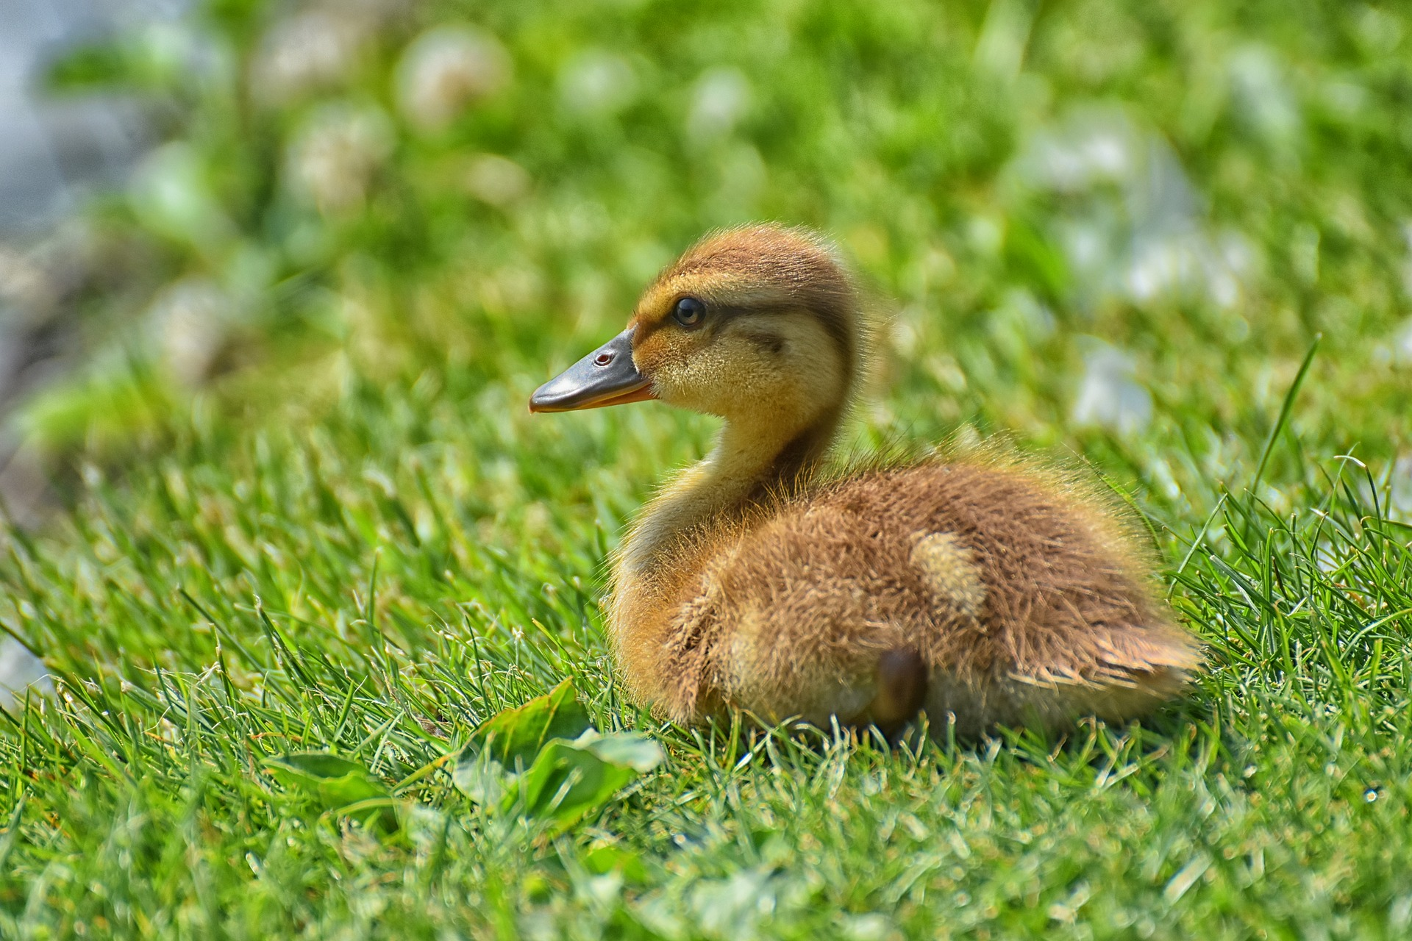
Which photo of a duckling is better?
Activity 1
Notes:
Image sources:
https://pixabay.com/photos/ducks-family-mom-children-nature-4613366
https://pixabay.com/photos/chicks-ducklings-mallard-cute-bird-4003579

Slide 10
Which photo of the boy is better?
Activity 1
Notes:
Image source: https://pixabay.com/photos/boys-portraits-kids-children-286243

Slide 11

Which photo of the sun chairs is better?
Activity 1
Notes:
Image B is better because of its positioning. The parasol and chairs are not completely in the shot in image A.
https://pixabay.com/photos/beach-greek-vacation-hotel-resort-4552226/
https://pixabay.com/photos/summer-holiday-beach-chair-parasol-829758/

Slide 12
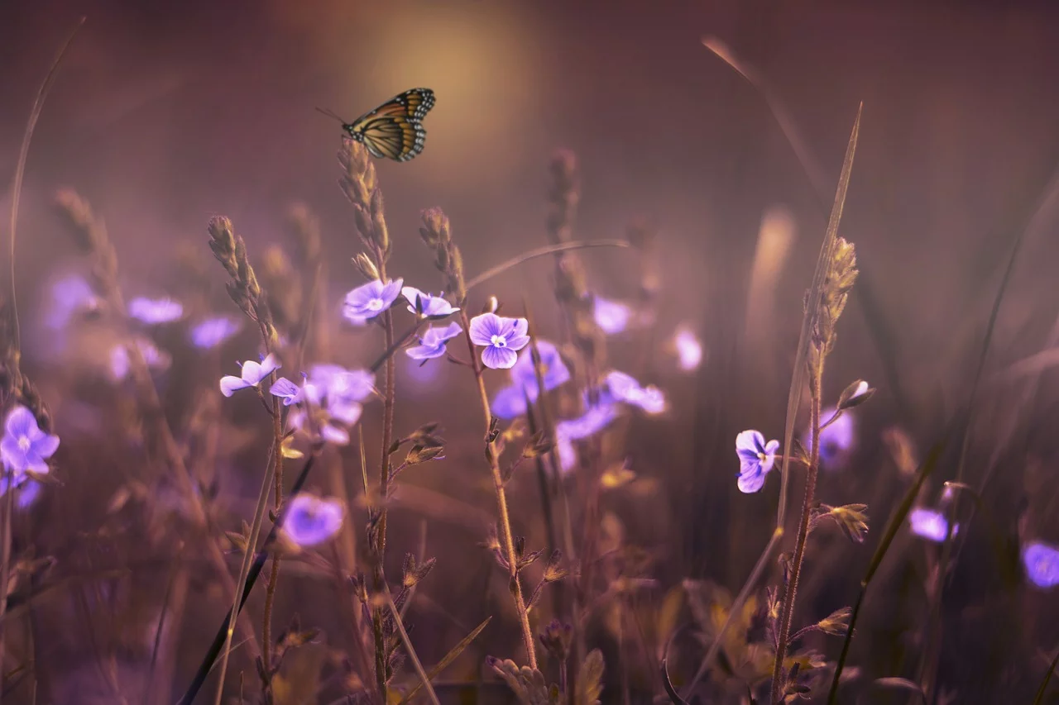
Which photo of a butterfly is better?
Activity 1
Notes:
Image A is better because of the detail. You can tell that photo A is of a butterfly, whereas in photo B there is too much to focus on.
Image sources:
https://pixabay.com/photos/butterfly-blue-insect-142506
https://pixabay.com/photos/flowers-butterfly-lilac-violet-402094

Slide 13
Now it’s your turn to take some photographs
Activity 2
In pairs, take photographs of:
A classroom display
A view out of the classroom window
A group of coloured pencils
13

Slide 14

Paper framing
Activity 2
Use the paper frame template to help you plan your photograph and to decide whether your photo will look better in portrait or landscape.
Partner A uses the paper frame to plan the composition
Partner B takes the photograph
Swap roles for each photo you take.
Notes:
Image source: https://pixabay.com/photos/shore-craft-holding-paper-2847368

Slide 15
Reviewing
Activity 2
Framing: Have you included everything you wanted to?
Subject: Are you close enough that you can see the detail?
Positioning: Is it obvious what the main subject of the photograph is?
Notes:
Image sources:
https://pixabay.com/photos/beach-greek-vacation-hotel-resort-4552226/
https://pixabay.com/photos/boys-portraits-kids-children-286243
https://pixabay.com/photos/butterfly-blue-insect-142506

Slide 16
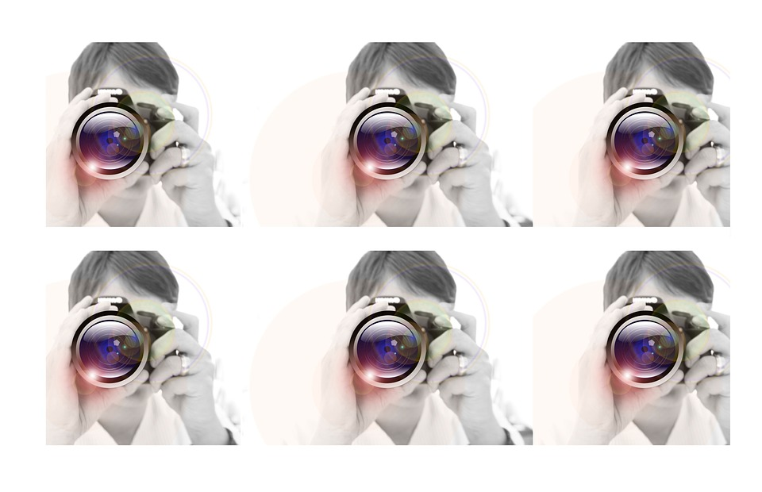
Retaking
Activity 3
Rate the photographs you have taken.
Choose a photograph to retake. How will you make it better?
Now take the photograph again. Can you make it better?
Notes:
Image source: https://pixabay.com/photos/woman-camera-photography-64145

Slide 17

Before and after
Plenary
Share your before and after photo with a friend.
Why is this one better than the original?
Does your partner agree?
Notes:
Image source: https://pixabay.com/vectors/checklist-collaboration-characters-150938

Slide 18

Assessment
How confident are you? (1–3)
I can identify what is wrong with a photograph
I can discuss how to take a good photograph
I can improve a photograph by retaking it
3 – Very confident
2 – Unsure
1 – Not confident
Notes:
Image source: https://pixabay.com/vectors/thumb-up-hand-like-confirm-go-top-307176

Slide 19
Next lesson
Summary
In this lesson, you…
Learnt how to compose good-quality photos
Next lesson, you will…
Learn about how light and focus can be adjusted to capture clearer photographs

