Slide 1
Lesson 1: Taking photographs
Year 2 – Creating media – Digital photography
Notes:
Last updated: 12-02-21
Resources are updated regularly — the latest version is available at: ncce.io/tcc.
This resource is licensed under the Open Government Licence, version 3. For more information on this licence, see ncce.io/ogl.

Slide 2
Lesson 1: Taking photographs
Objectives
To use a digital device to take a photograph
I can recognise what devices can be used to take photographs
I can talk about how to take a photograph
I can explain what I did to capture a digital photo

Slide 3


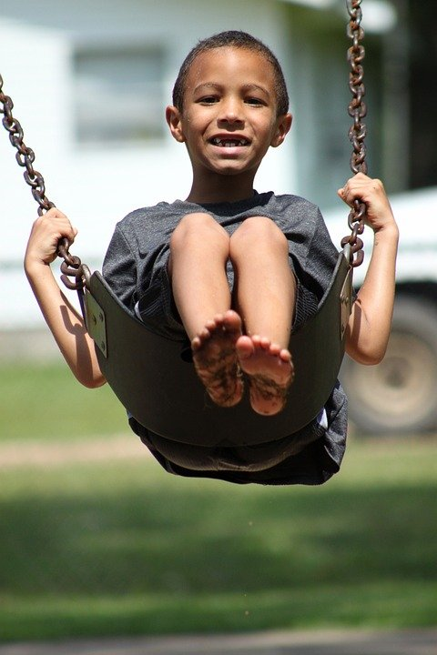



What is different about these images?
Introduction
Notes:
Child blowing bubbles: https://pixabay.com/photos/kid-soap-bubbles-child-fun-1241817/
Child with paint on hands: https://pixabay.com/photos/child-colors-nepal-india-finger-3194977/
Child on a swing: https://pixabay.com/photos/kid-boy-swinging-young-swing-386642/
Two children in uniform: https://pixabay.com/vectors/asian-cartoon-child-kids-mural-1294104/
Child with toys: https://pixabay.com/illustrations/girl-biracial-african-black-563719/
Child reading: https://pixabay.com/vectors/boy-reading-book-specs-spectacles-34619/

Slide 4
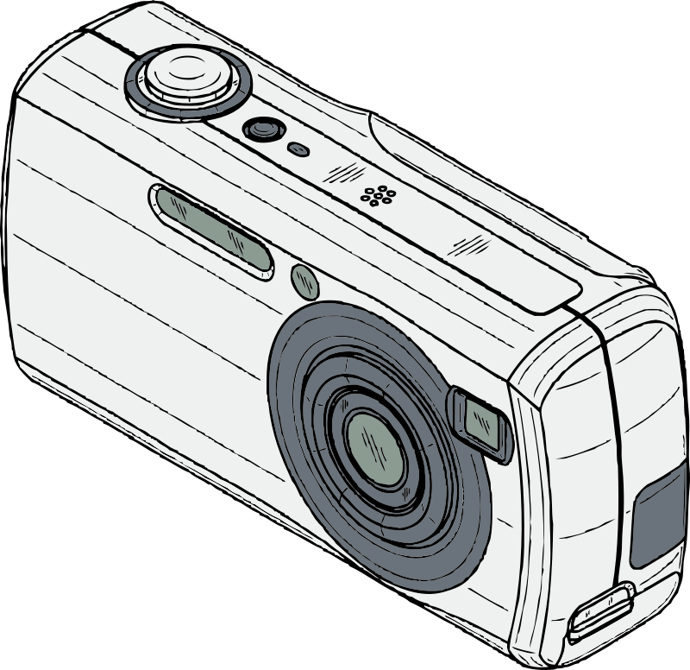

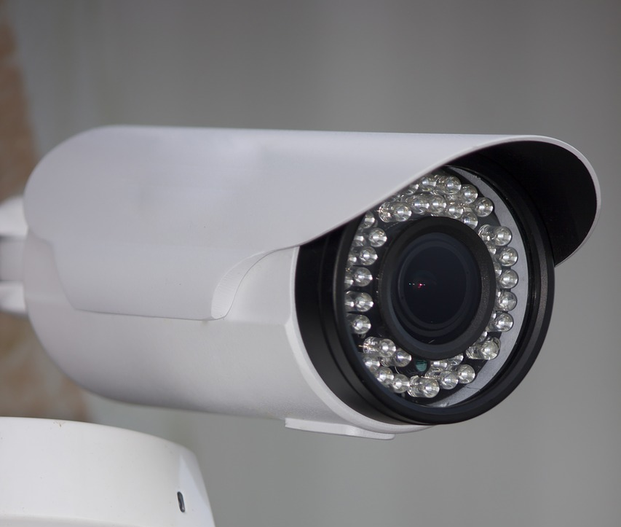



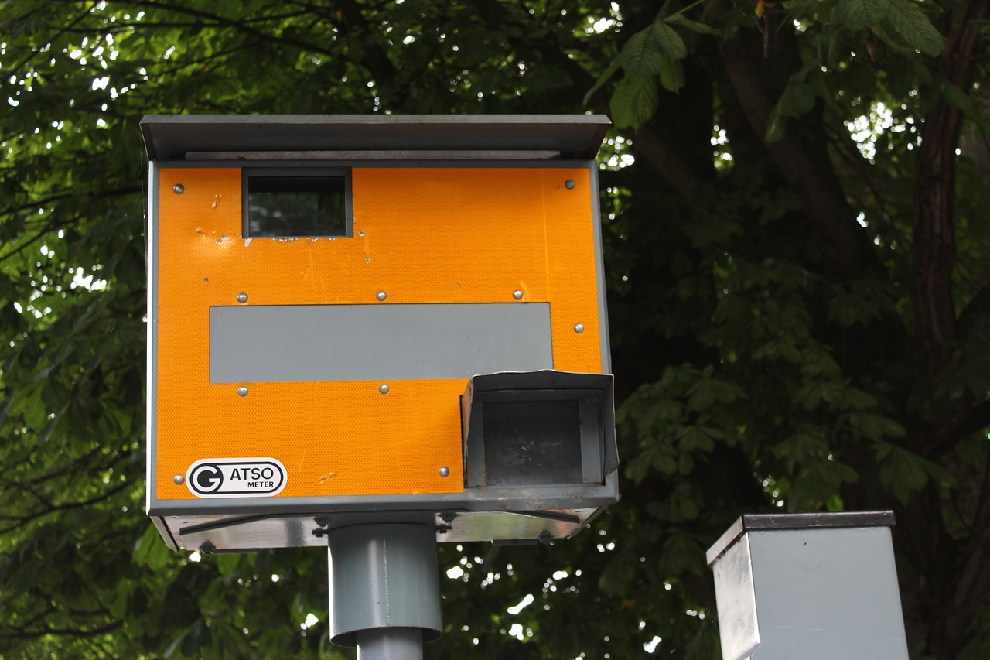
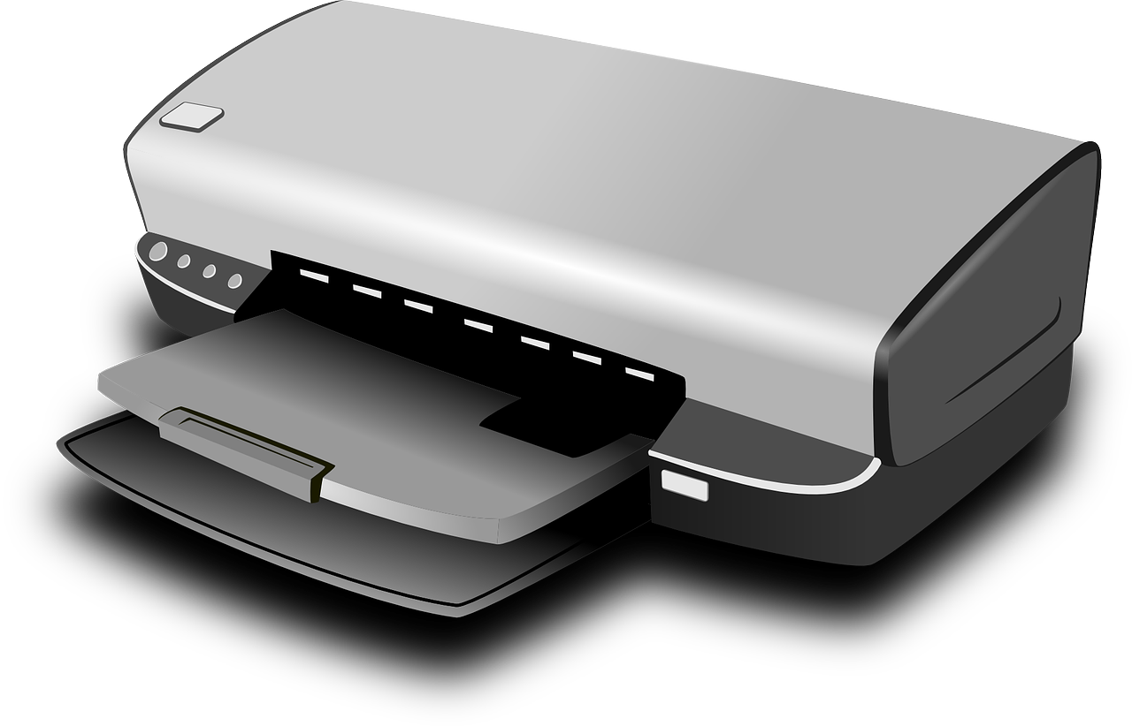

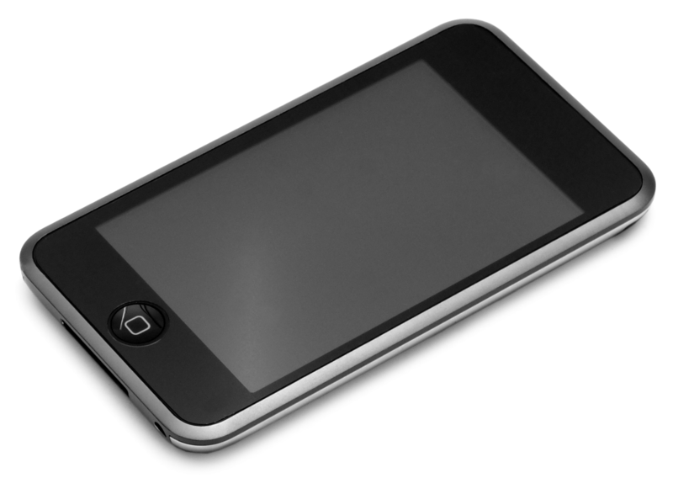
Can you sort these devices?
Activity 1
Can take photographs
Cannot take photographs
4
Notes:
Computer desktop: https://pixabay.com/vectors/computer-desktop-pc-workstation-1295529/
Laptop: https://pixabay.com/vectors/laptop-notebook-mobile-computer-154091/
Tablet image: https://openclipart.org/
USB stick: https://pixabay.com/vectors/usb-disk-disc-storage-technology-47552/
Printer: https://pixabay.com/vectors/printer-computer-hardware-inkjet-159612/
Interactive whiteboard: https://pixabay.com/vectors/whiteboard-presentation-board-297484/
Speed camera: https://pixabay.com/photos/gatso-speed-camera-uk-1856324/
Security camera: https://pixabay.com/photos/cctv-pir-camera-work-wiltshire-2796208/

Slide 5
Answers
Activity 1
Can take photographs
Cannot take photographs
5
Notes:
Computer desktop: https://pixabay.com/vectors/computer-desktop-pc-workstation-1295529/
Laptop: https://pixabay.com/vectors/laptop-notebook-mobile-computer-154091/
Tablet image: https://openclipart.org/
USB stick: https://pixabay.com/vectors/usb-disk-disc-storage-technology-47552/
Printer: https://pixabay.com/vectors/printer-computer-hardware-inkjet-159612/
Interactive whiteboard: https://pixabay.com/vectors/whiteboard-presentation-board-297484/
Speed camera: https://pixabay.com/photos/gatso-speed-camera-uk-1856324/
Security camera: https://pixabay.com/photos/cctv-pir-camera-work-wiltshire-2796208/

Slide 6


Have you ever seen someone take a photograph?
Activity 2
What did they taken a photo of?
What did they use to take a photo?
What did they do to take the photograph?
Notes:
Ask learners to suggest the names of any devices they know and list these. Encourage learners to talk about any experiences they have had of using any of these devices to capture photographs in the past.

Slide 7

When is it OK to take someone’s photo?
Activity 2
Taking photos can be lots of fun, but not everyone wants to be in them.
Before taking anyone’s photo, you should ask them if it’s OK. If they say that it is OK, you can take it.
If they say they don’t want to, find someone else to take a photo of!
Notes:
It’s important that learners know that they should not take photos of people without them knowing and agreeing to it. Equally, no one should take their photo without asking first.
Image: https://pixabay.com/illustrations/balloon-talk-language-german-males-2557031/

Slide 8
Photography bingo
Activity 2
A building | A person | A close-up of an object
An action shot | A selfie | Something in the distance
Notes:
Explain the task for the photography bingo activity and share some initial ideas.

Slide 9
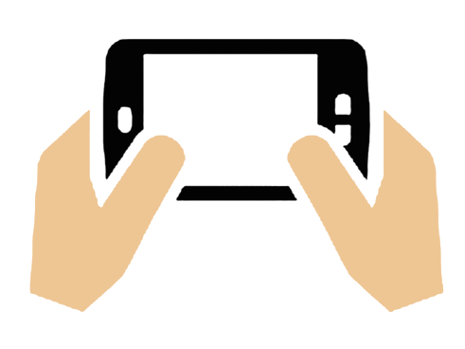




How do you take a good photograph?
Activity 2
Hold the device firmly with both hands.
Point the camera lens at the subject.
Look into the viewing window or screen.
Move the device until you see everything clearly.
Press the capture button.

Slide 10
Photos showcase
Plenary
Show your partner the best photo that you took with the camera.
Explain:
Why do you like this one?
What did you have to do to take it?

Slide 11

Assessment
How confident are you? (1–3)
I can recognise what devices can be used to take photographs
I can talk about how to take a photograph
I can explain what I did to capture a digital photo
3 – Very confident
2 – Unsure
1 – Not confident
Notes:
Image source: https://pixabay.com/vectors/thumb-up-hand-like-confirm-go-top-307176

Slide 12
Next lesson
Summary
In this lesson, you...
Learnt about devices that you can use to take photographs and explored taking photographs with different subjects
Next lesson, you will…
Learn how to take photos in portrait and landscape formats and how to choose which one to use

