Slide 1

Year 4: Autumn 2 Week 6
Spelling Resources – Year 4 Autumn 2
Consolidation
Notes:
Consolidation

Slide 2
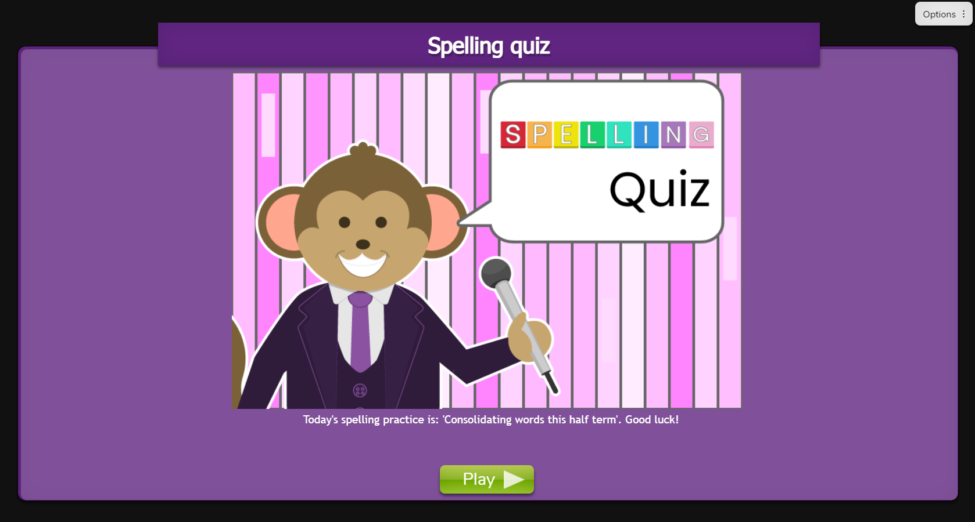



Day 1
illegal
ordinary
breathe
preparation
admiration
illiterate
illicit
illustration
disappoint
disappear
adoration
sensation
disinfect
Slide 2
Daily Online Quiz:
Daily Look Say Cover Write Check.
Need more support? Contact us:
Tel: +44(0)208 203 1781 | Email: support@2simple.com | Twitter: @2simplesoftware
Notes:
Go through today’s words to consolidate. You may want to set the quiz as a 2Do or use the Look Say Cover Write Check.

Slide 3
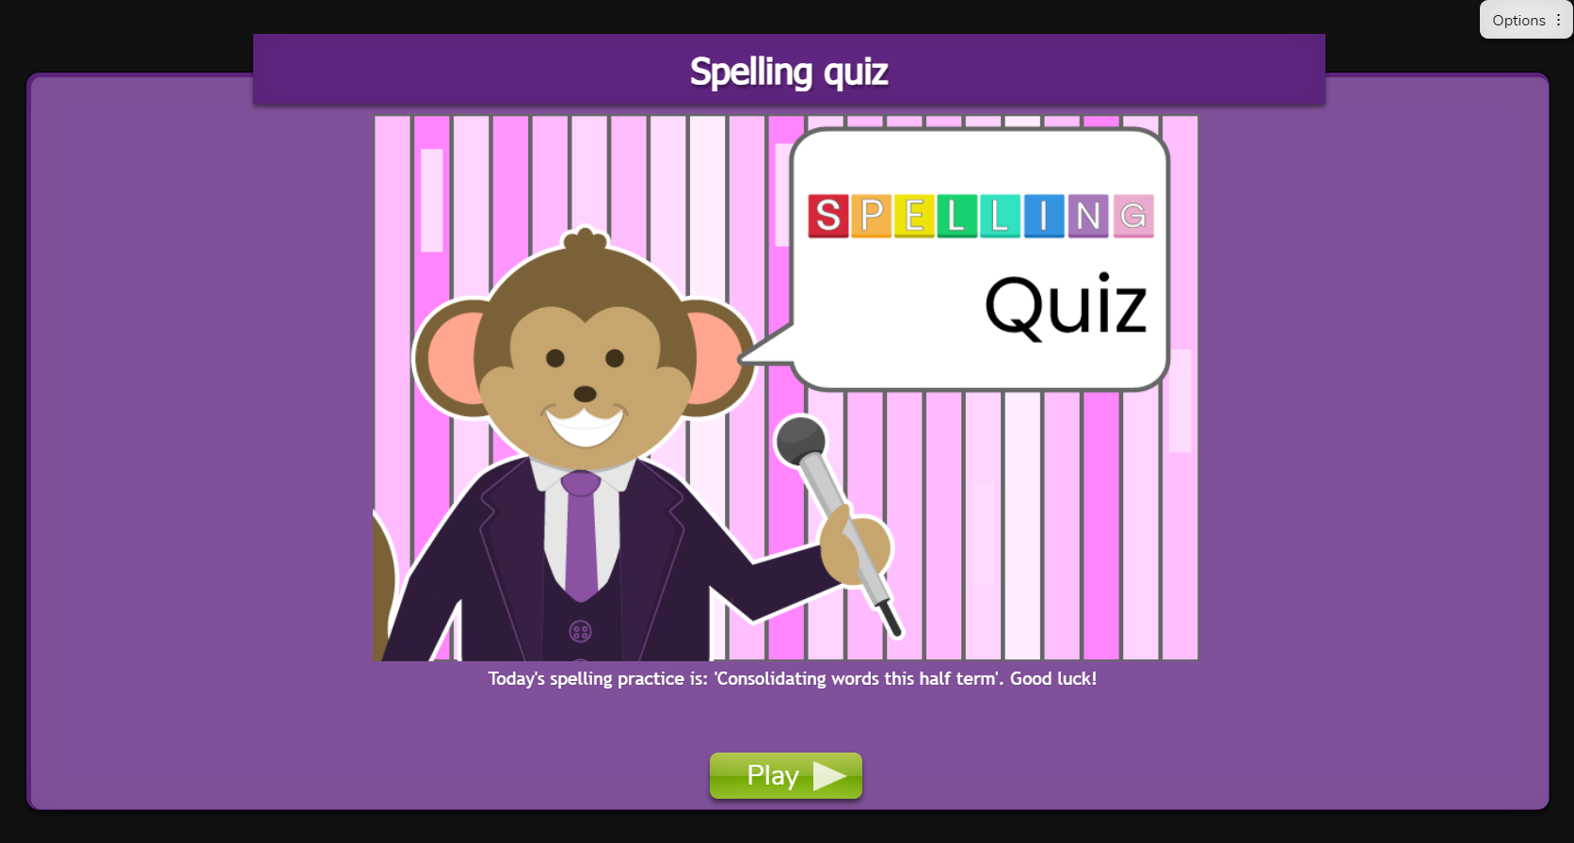
Day 2
information
disconnect
illumination
illusion
illusive
misbehave
mislead
gardener
limiting
increase
recent
quarter
misfortune
Slide 3
Daily Online Quiz:
Daily Look Say Cover Write Check.
Need more support? Contact us:
Tel: +44(0)208 203 1781 | Email: support@2simple.com | Twitter: @2simplesoftware
Notes:
Go through today’s words to consolidate. You may want to set the quiz as a 2Do or use the Look Say Cover Write Check.

Slide 4
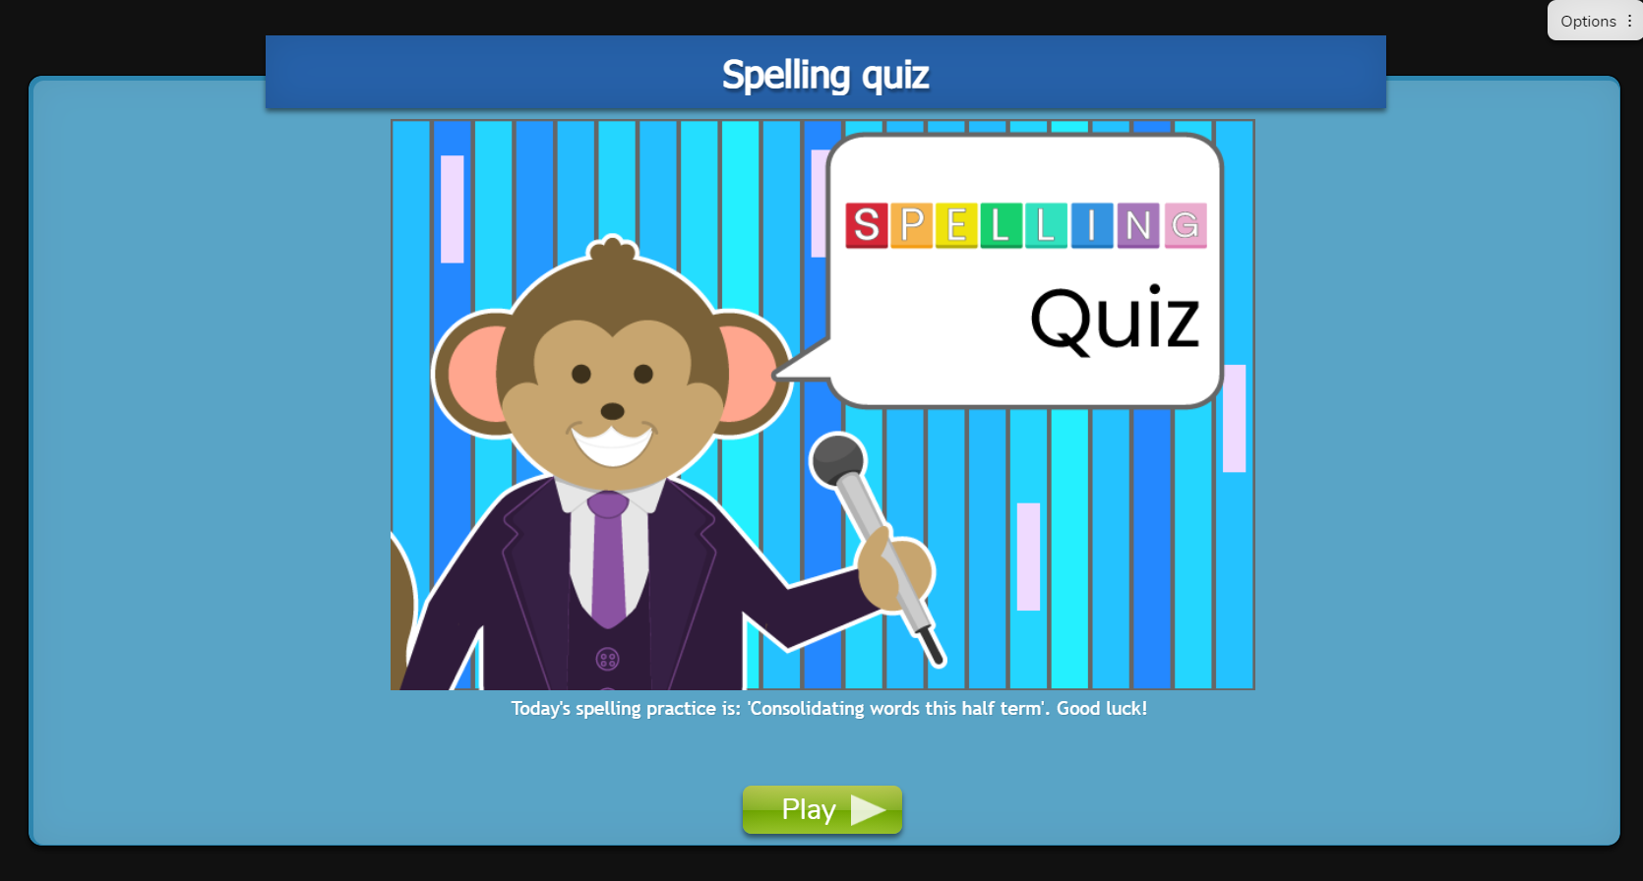
Day 3
Slide 4
notice
group
island
limitation
disagree
illegible
illuminate
illogical
foundation
qualification
beginning
beginner
Daily Online Quiz:
Daily Look Say Cover Write Check.
Need more support? Contact us:
Tel: +44(0)208 203 1781 | Email: support@2simple.com | Twitter: @2simplesoftware
Notes:
Go through today’s words to consolidate. You may want to set the quiz as a 2Do or use the Look Say Cover Write Check.

Slide 5

Day 4
Slide 5
forgetting
forgotten
gardening
limitations
preferred
disobey
experimentation
exploration
examination
certain
suppose
misspell
Daily Online Quiz:
Daily Look Say Cover Write Check.
Need more support? Contact us:
Tel: +44(0)208 203 1781 | Email: support@2simple.com | Twitter: @2simplesoftware
Notes:
Go through today’s words to consolidate. You may want to set the quiz as a 2Do or use the Look Say Cover Write Check.

Slide 6

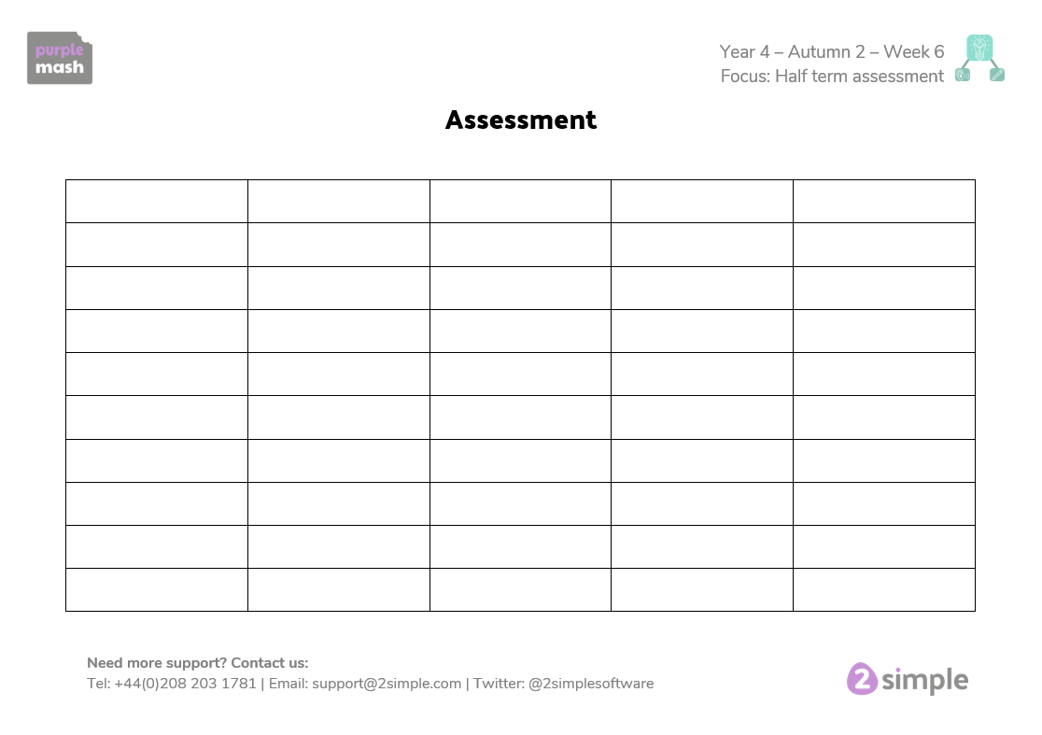
Day 5 - Assessment
Slide 5
Today we are going to see how many words you can remember.
Just try your best! ☺
Good Luck!
Need more support? Contact us:
Tel: +44(0)208 203 1781 | Email: support@2simple.com | Twitter: @2simplesoftware
Notes:
Complete the assessment to track the children’s progress. Read out the words in the grid and ask the children to write them down.

