Slide 1
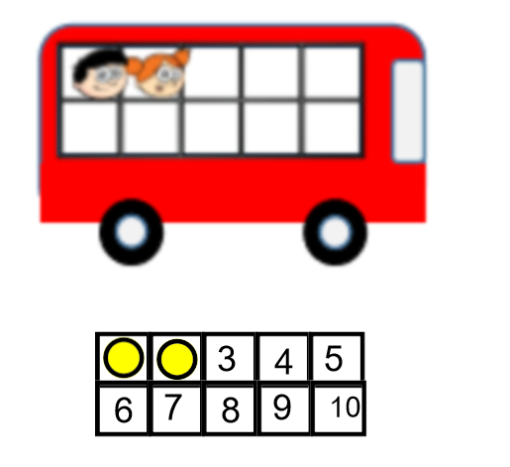
First, there were 2 people on the bus.

Slide 2
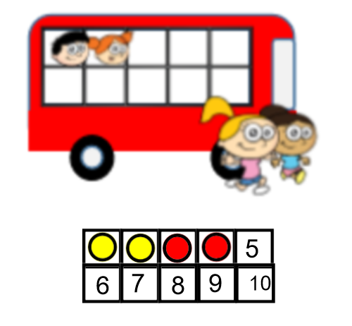
Then,2 more people got on the bus.

Slide 3
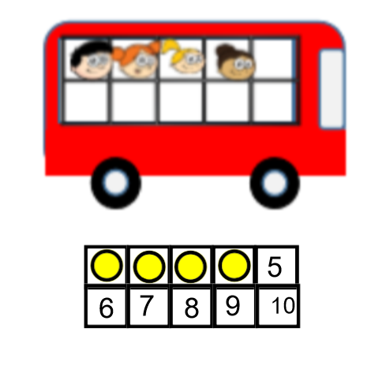
Now, there are 4 people on the bus.

