Slide 1
LKS2 Fractions 1
Lesson 2

Slide 2
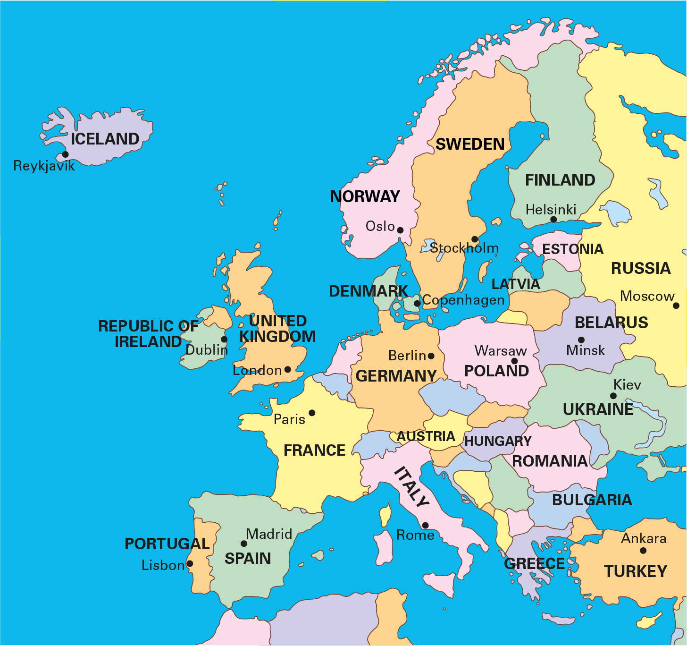
True or false?
If the United Kingdom is the whole, then Europe is a part of the whole.

Slide 3
If Europe is the whole, then the United Kingdom is a part of the whole.

Slide 4
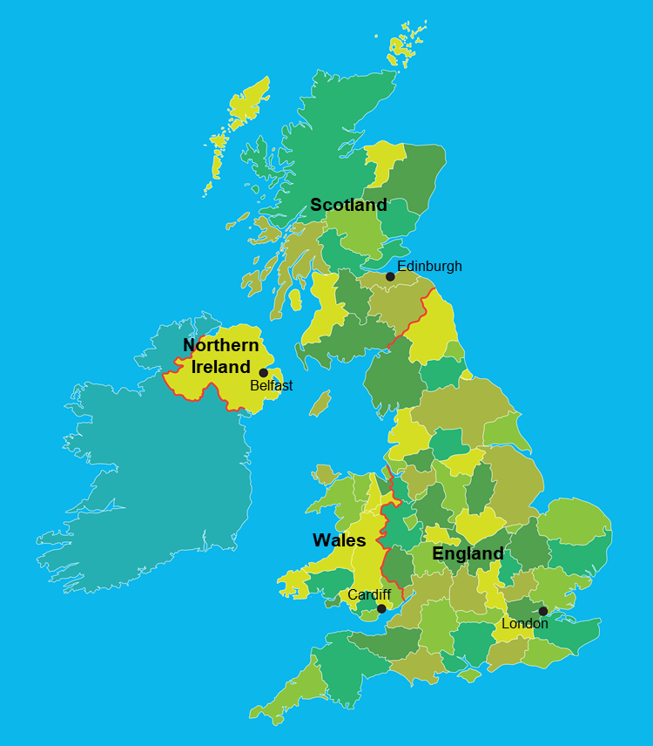
Which statement is correct?
If the United Kingdom is the whole, then England is a part of the whole.
OR
If England is the whole, then the United Kingdom is a part of the whole.

Slide 5
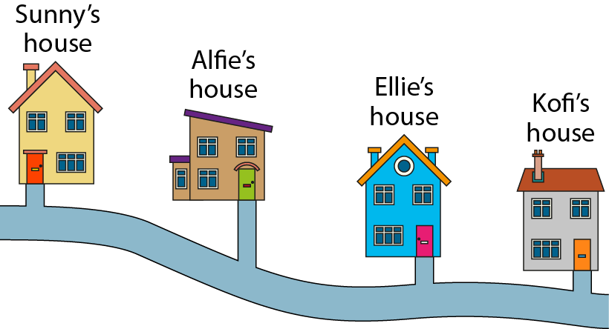
Complete the stem sentence:
If the journey from Sunny’s house to Kofi’s house is the __________, then the journey from Sunny’s house to Alfie’s house is a _______________.
whole
part of the whole

Slide 6
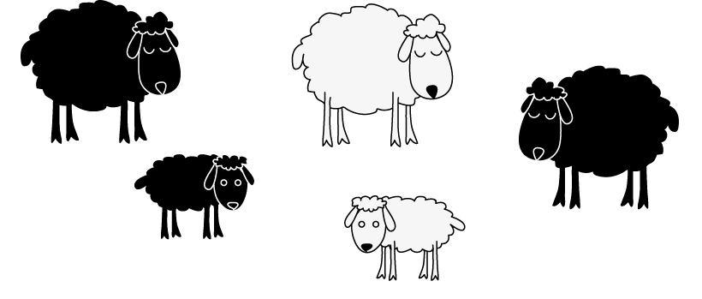
I was thinking…
Am I right?
If the black sheep are the whole, then the white sheep are a part of the whole.

Slide 7
What is the same?
What is different?

Slide 8
If all the sheep are the whole, the white sheep could be a part of the whole.

Slide 9
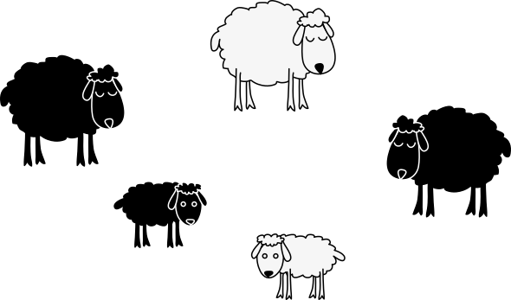
What do you notice about the parts compared to the whole?
The whole is bigger than the parts.
The parts are smaller than the whole.

Slide 10
What do you notice about the parts compared to the whole?
The whole is the sum of all of the parts.

Slide 11


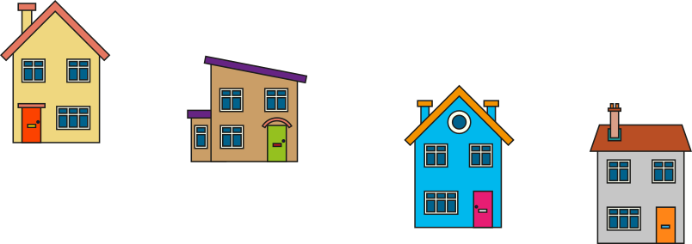


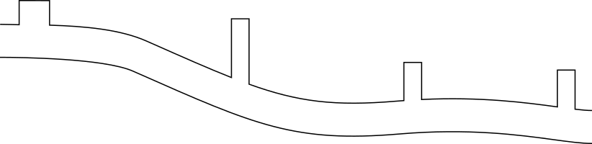





Which is the largest: a part or the whole?
A part is always smaller than the whole.

Slide 12

Are the parts always smaller than the whole?

Slide 13
If Europe is the whole, the United Kingdom is a part of the whole.
A part is always smaller than the whole.

Slide 14
Which of these statements are true?
The United Kingdom can only be the whole, it cannot be a part of the whole.
The United Kingdom can not only be the whole, but also be a part of the whole.

Slide 15

Part or whole?
If Europe is the whole, the United Kingdom is a part of the whole.
If the United Kingdom is the whole, England is a part of the whole.

Slide 16
Think of a statement when France is the whole.

Slide 17
My friend thinks that the journey from Sunny’s house to Ellie’s could be the whole? What do you think?

Slide 18

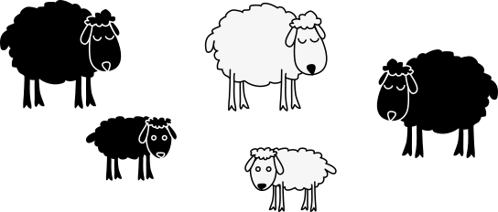
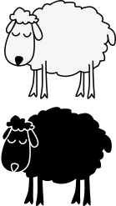
If the white sheep are the whole, what could a part of the whole be?

Slide 19


Are these statements true or false?
If all of the sheep are the whole, the sheep in the pen are a part of the whole. | If the black sheep are the whole, the little black sheep is part of the whole.
If all of the white sheep are the whole, the black sheep are a part of the whole. | If all of the sheep in the pen are the whole, all of the white sheep are a part of the whole.

Slide 20
Practice activity
Think of a walk you love to do. What are the parts of this journey?
If you have an atlas or have access to Google Earth, think about different parts that make the whole.
If your arm is a part, what is the whole and what are the other parts of the whole?
Think of a whole, challenge someone to work out the parts of the whole.

Slide 21
https://www.ncetm.org.uk/classroom-resources/vl-lower-key-stage-2-fractions-1-video-lessons/

