Slide 1




Money Problem Solving
Have a go at solving the problems
on the following slides

Slide 2








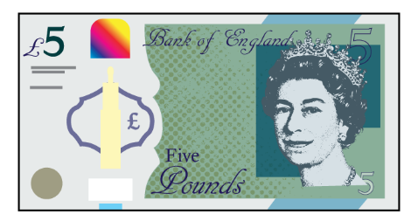
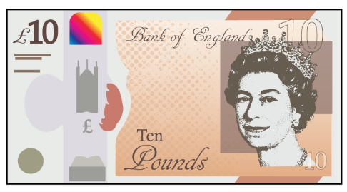

Whitney thinks that she has £10 and 3 p.
Is she correct?
Explain your answer.

Slide 3

Dora thinks there is more than £5 but less than £6
Is Dora correct?
Convince me.

Slide 4




Rosie has £5
Has she got enough money to buy a car and two apples?
What combinations of items could Rosie buy with £5?
£3 and 35 p
£2 and 55 p
85 p
75 p

Slide 5

Dora spends £7 and 76 p on a birthday cake.
She pays with a £10 note.
How much change does she get?
The shopkeeper gives her six coins for her change.
What coins could they be?

Slide 6
Amir has £4
He buys a pencil for £1 and 20 p and a book for £1 and 45 p.
Which bar model represents the question?
Explain how you know.
Use the correct bar model to help you calculate how much change Amir receives.
£4
?
£1 and 20 p | £1 and 45 p | ?
£4 | £1 and 20 p | £1 and 45 p

