Slide 1

How to catch a cake goblin!
My Plan
So when a cake goblin comes to eat the cake he will fall in!

Slide 2
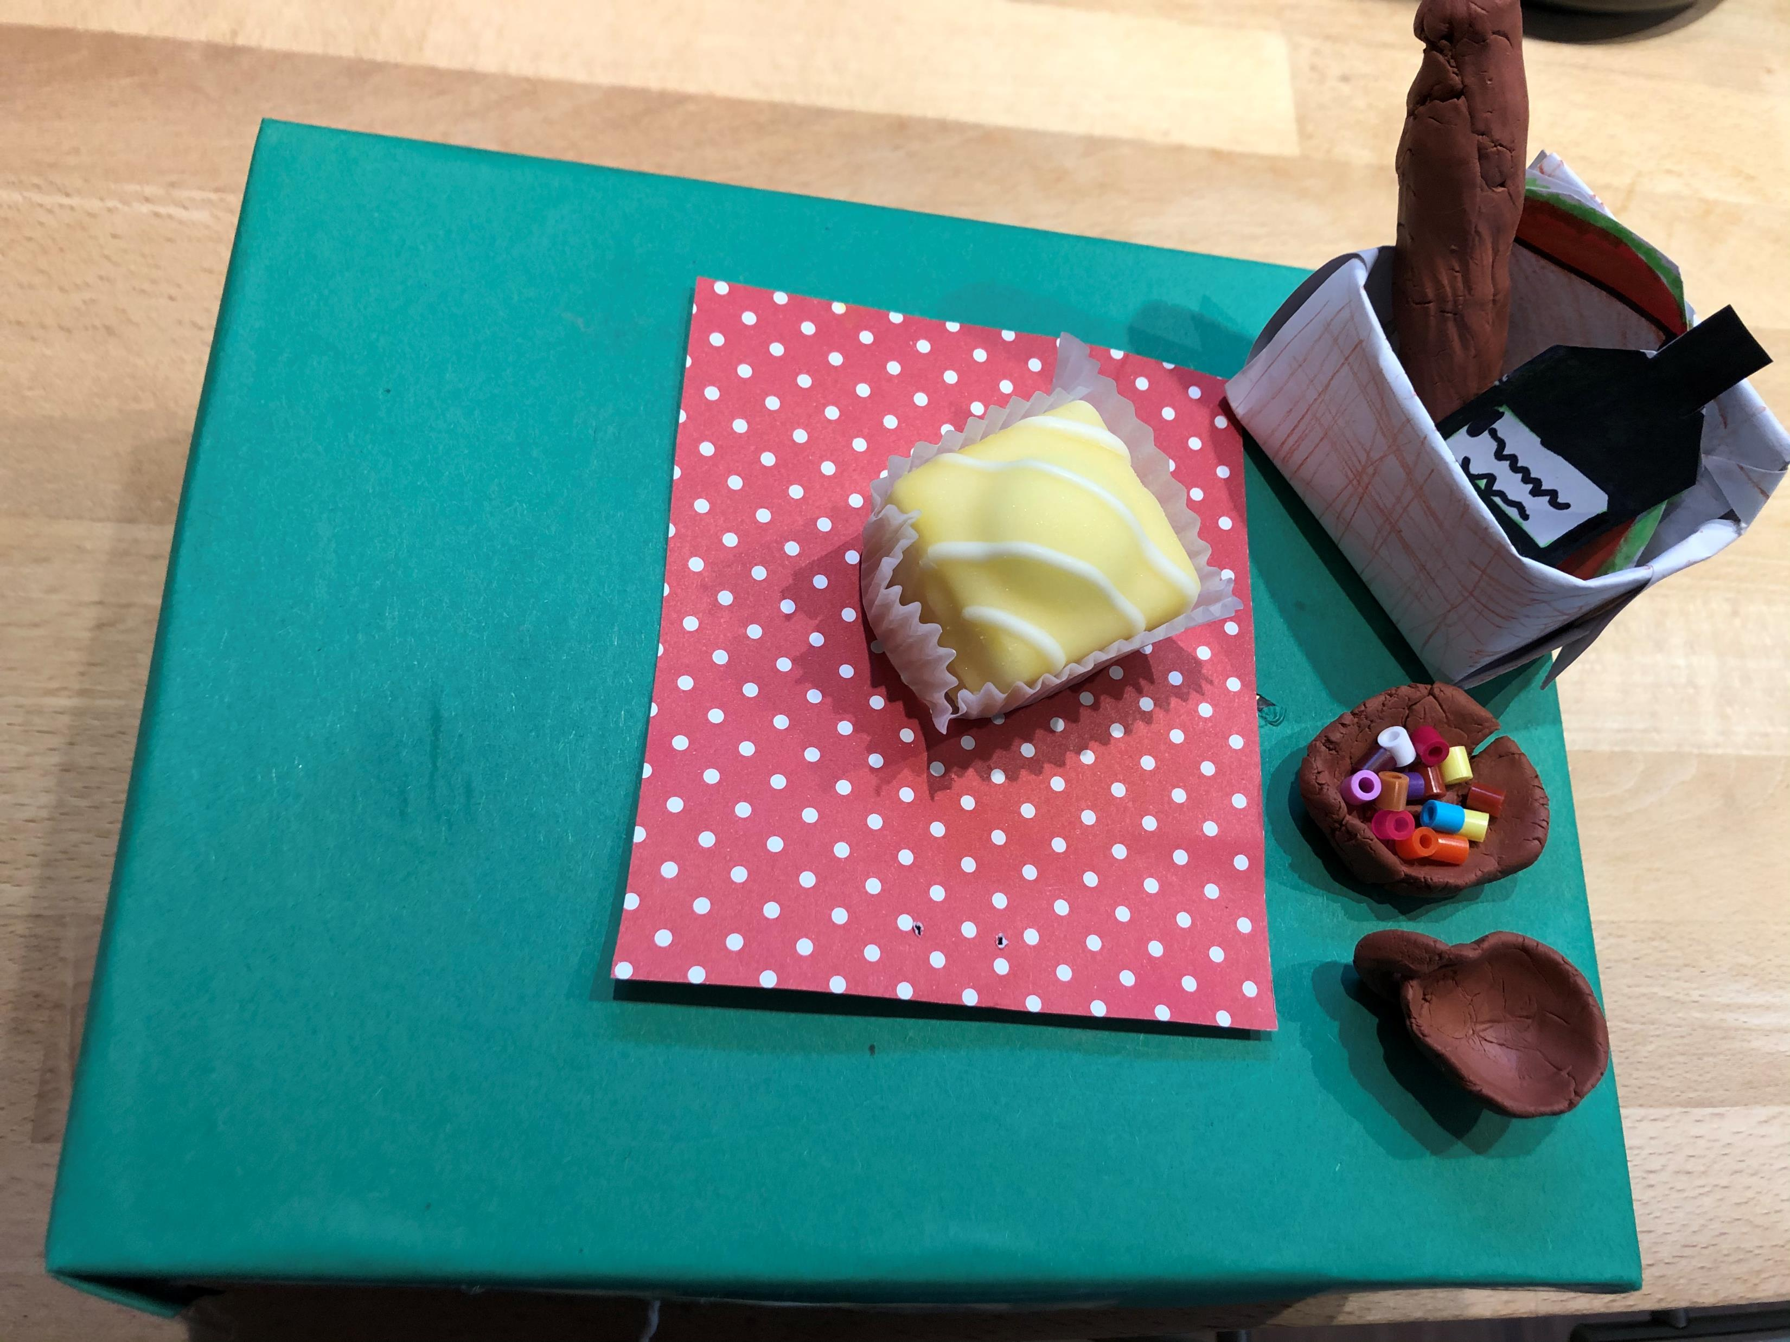
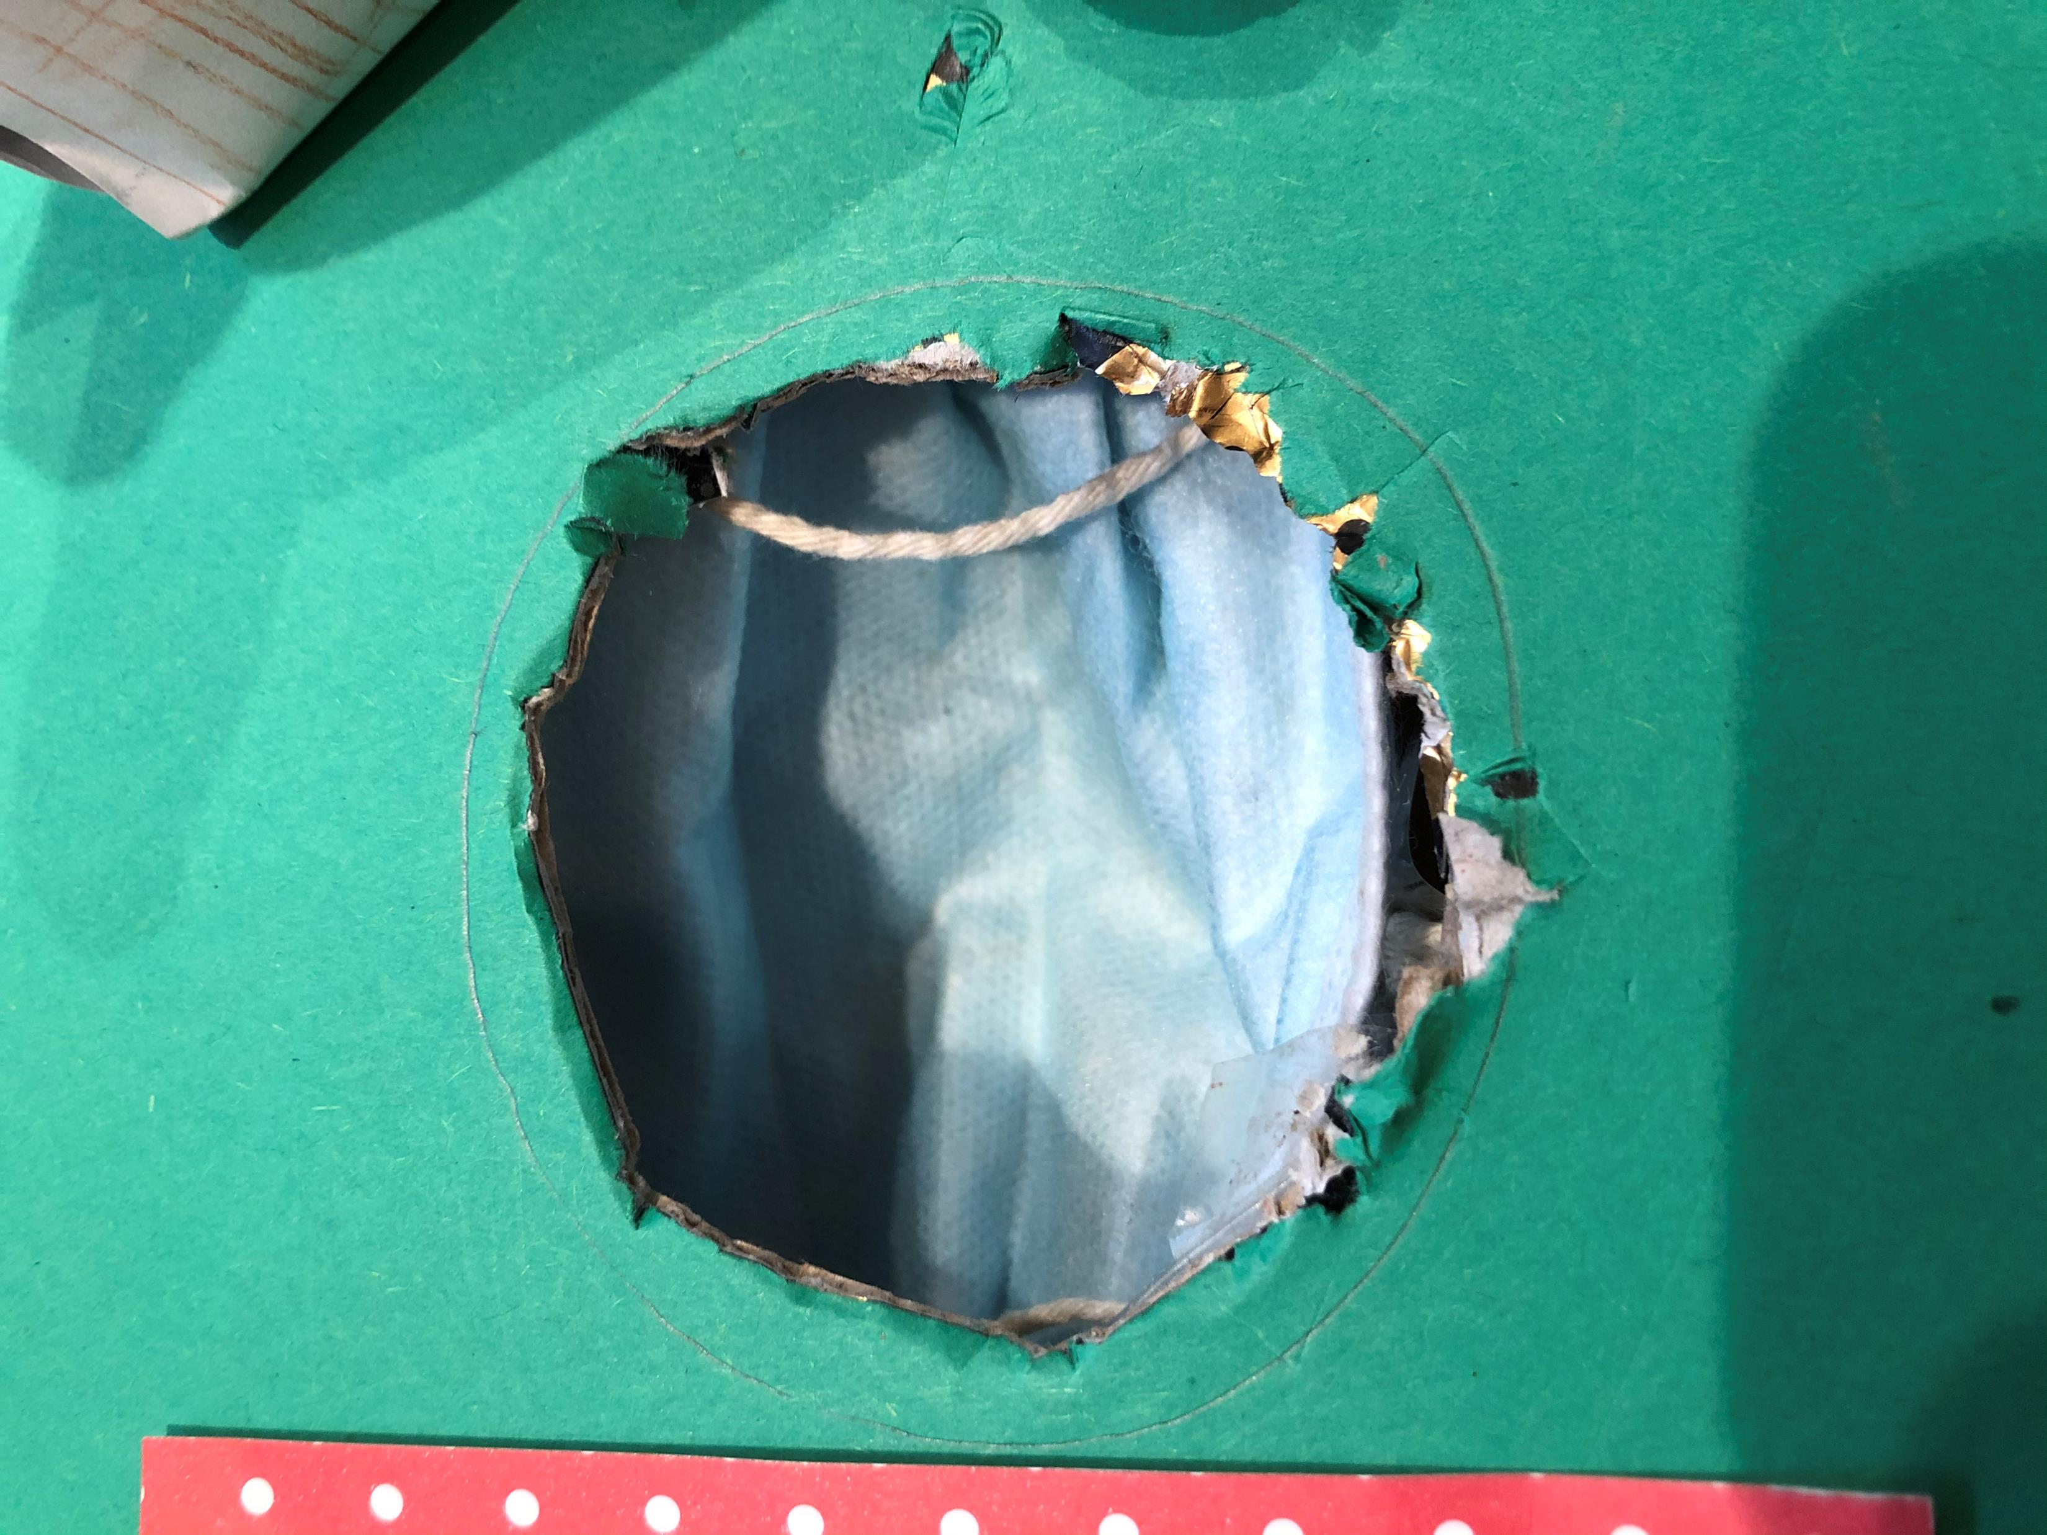
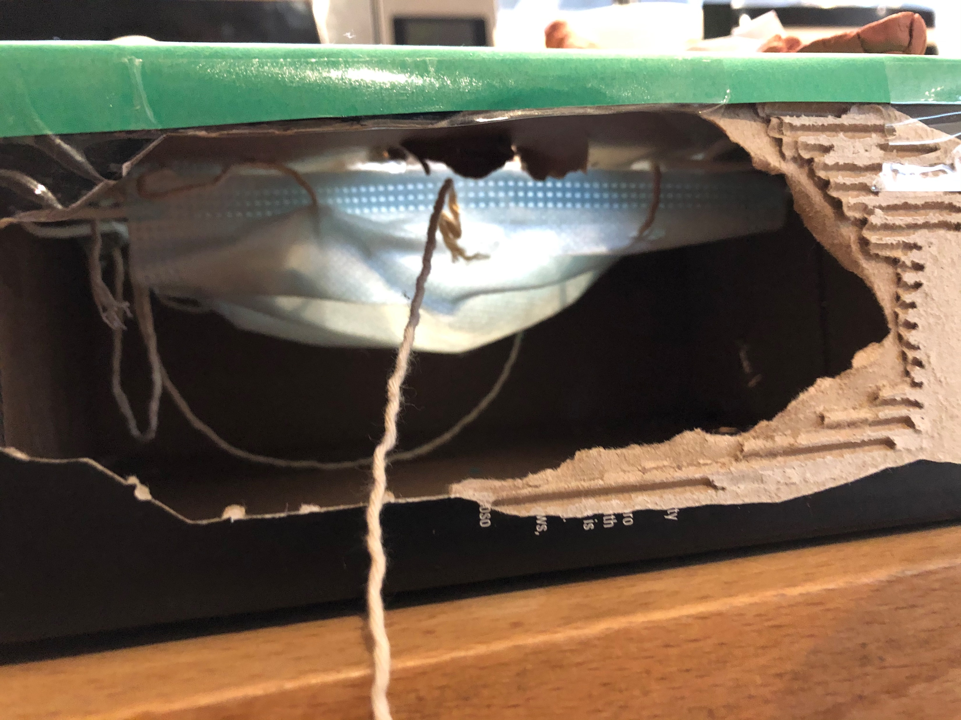
1. YOU DIG A HOLE IN YOUR GARDEN THAT A CAKE GOBLIN CAN FIT THROUGH
2. cut a hole in the side so you can pull the goblin out of the trap.
3. make a picnic basket out of paper and colour it in. Then make food to put in the basket Then put it on the table cloth.
4.Put a table cloth under the basket but on top of the hole.

Slide 3
5. Put a yummy cake on the table cloth.This will tempt the
Cake goblin on to the trap.
6. Make a net trap to catch the goblin(my example is attach some rope to a face mask and attach the mask to the inside of the hole.
7. When the Goblin falls in the trap you then pull
the rope which brings out the trap with the goblin in

