Slide 1
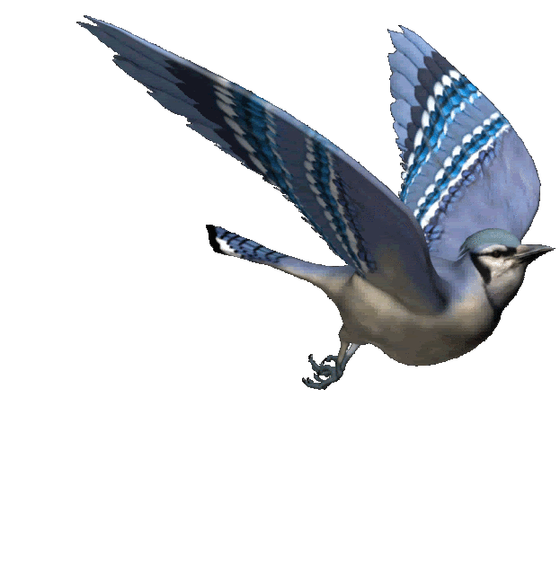
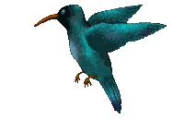
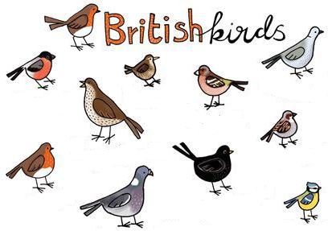
Today we are learning to
identify and name a variety of common British birds.

Slide 2
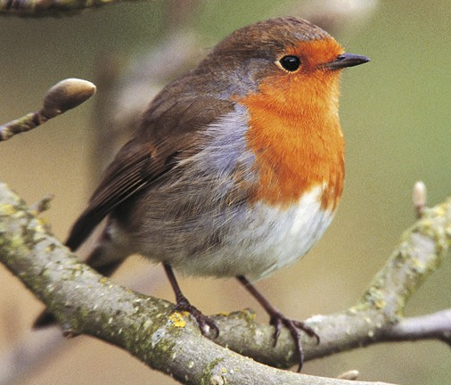
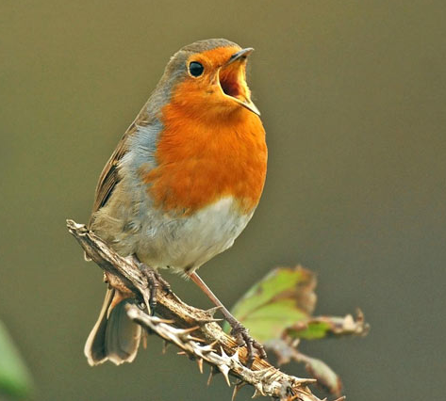
This is a Robin.
Robins eat worms.
You usually will see Robins alone in the garden.
They sing in winter as well as in the spring.

Slide 3
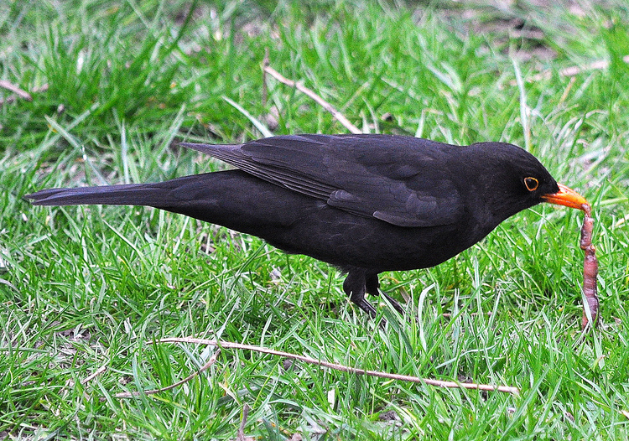
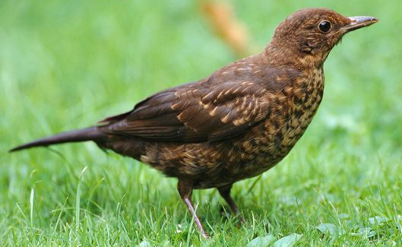
These are Blackbirds
Male Blackbirds are black and female blackbirds are brown.
They eat worms.
Blackbirds like to scratch around in autumn leaves and like to feed from the ground.

Slide 4
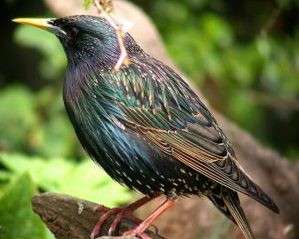
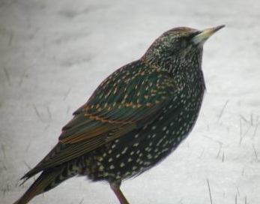
Feathers in summer
Feathers in winter
This is a Starling.
Starling are smaller than blackbirds, with a short tail, pointed head, triangular wings.
It nests in a hole in a wall, tree or building.
A Starling eats insects and seeds.

Slide 5
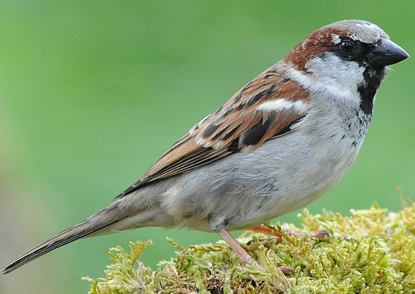
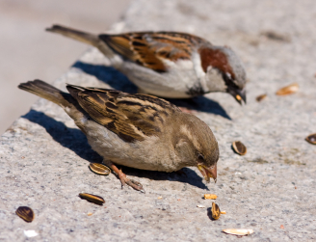
These are House Sparrows.
A male House Sparrow has a black bib and face mask. The female House Sparrow has a brown head.
The House Sparrow likes to live near people.
Its chunky beak is good at cracking seeds open.

Slide 6
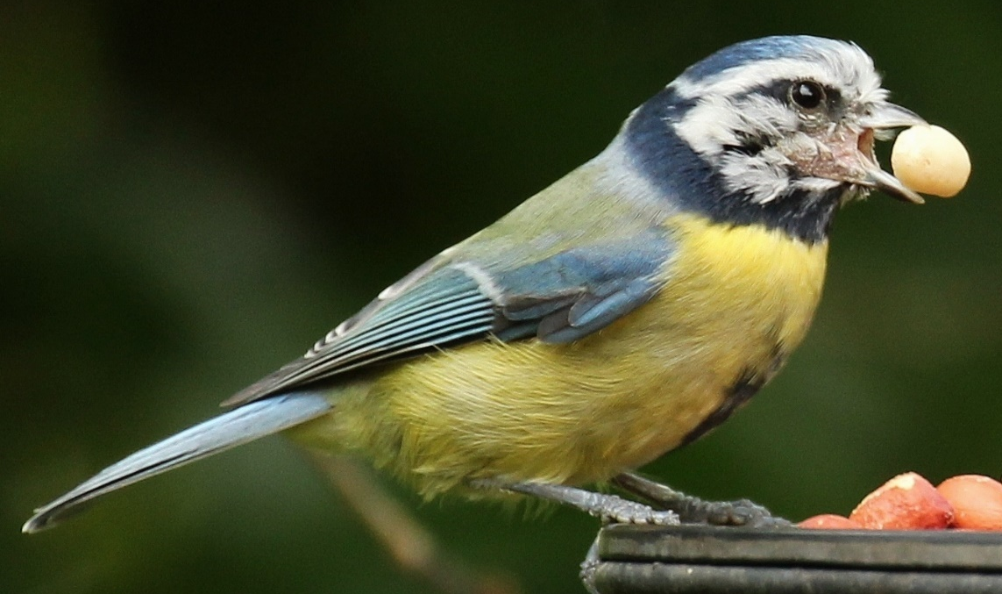
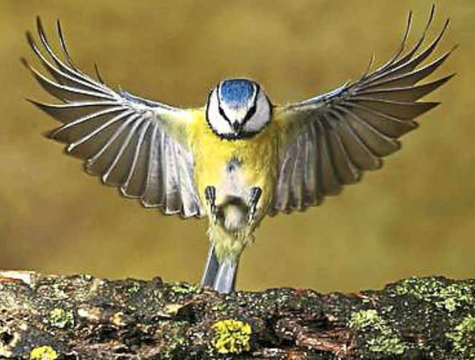
This is a Blue Tit.
Blue Tits eat caterpillars, nuts and seeds.
You can find Blue Tits in trees, but rarely on the ground.
They nest in holes in trees, including nest boxes.

Slide 7
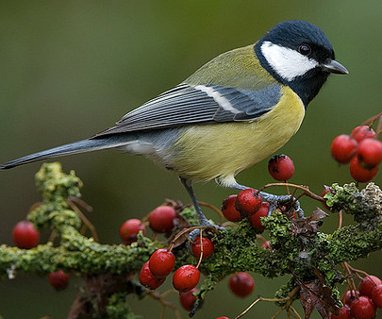
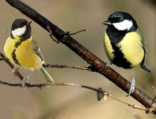
These are Great Tits.
The Great Tit is the largest European tit and it is about the size of a House Sparrow.
They nest in holes in a tree or wall, or among the twigs of old nests.
A Great Tit eats insects, such as caterpillars and spiders, seeds and berries.

Slide 8
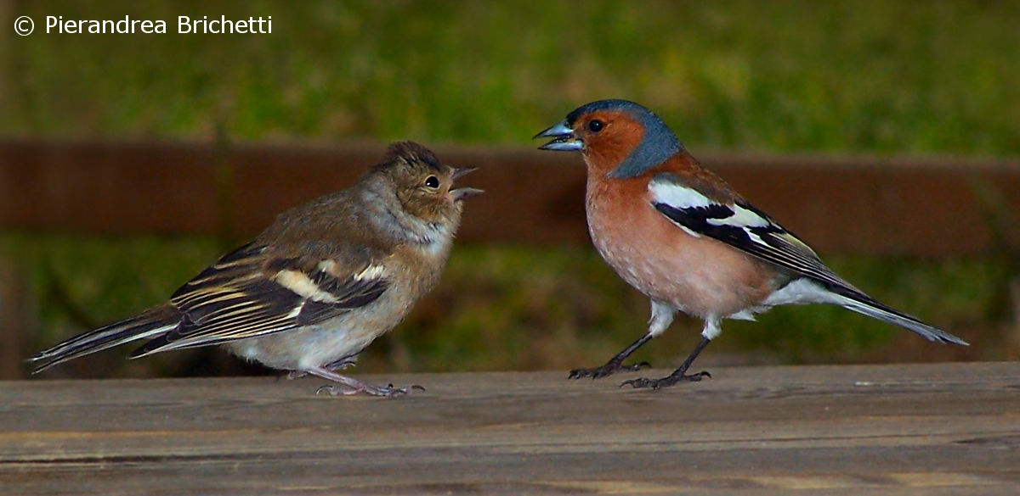
These are Chaffinches.
The red front on a Chaffinch means that the bird is a male. A Female Chaffinch has a brown face and body.
They live almost everywhere in the UK.
A Chaffinch eats seeds but feeds it babies insects.

Slide 9
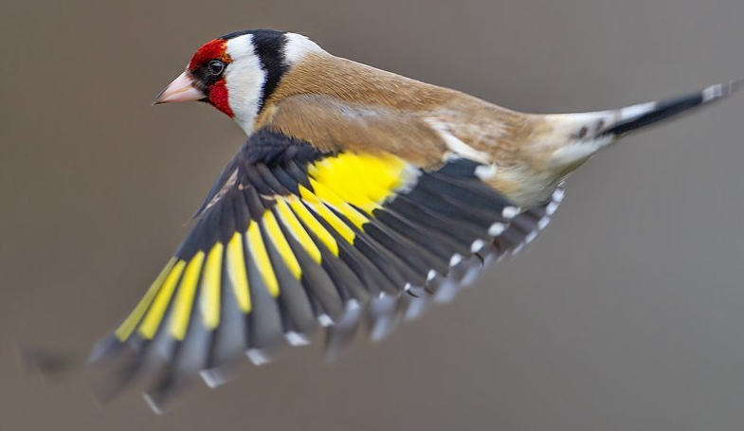
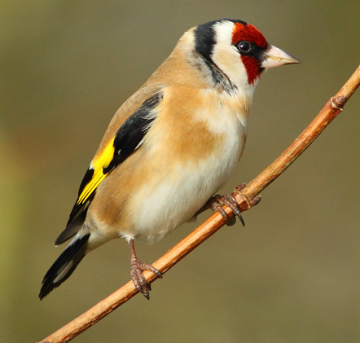
This is a Goldfinch.
Goldfinches eat seeds and insects.
In winter many UK Goldfinches migrate as far south as Spain.
Their long fine becks help them with hard to reach seeds.

Slide 10
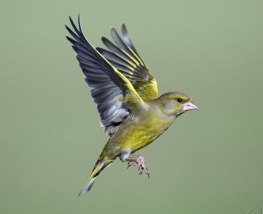
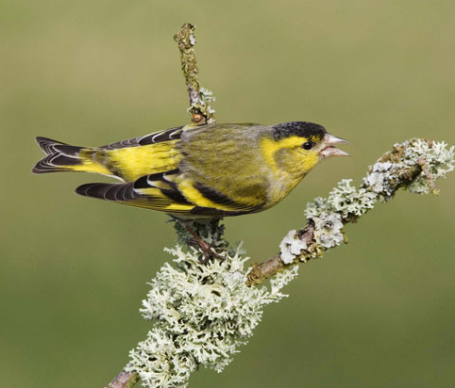
This is a Greenfinch.
A Greenfinch is green with bright yellow flashes on its wings and tail.
It nests in trees or bushes.
A Greenfinch eats seeds, buds and berries.

Slide 11
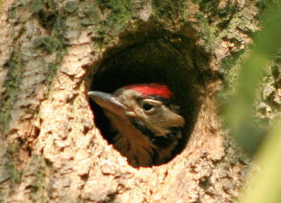
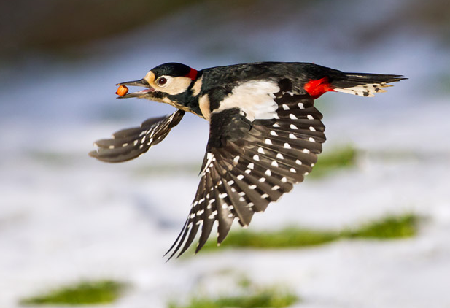
This is a Great Spotted Woodpecker.
The Woodpecker's tongue is extremely long and sticky for taking out insects, like ants, from their nest chambers.
It nests in trees.
A Great Spotted Woodpecker eats insects, seeds and nuts.

Slide 12
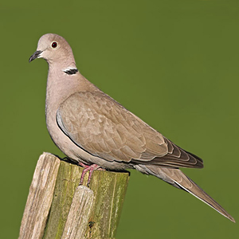
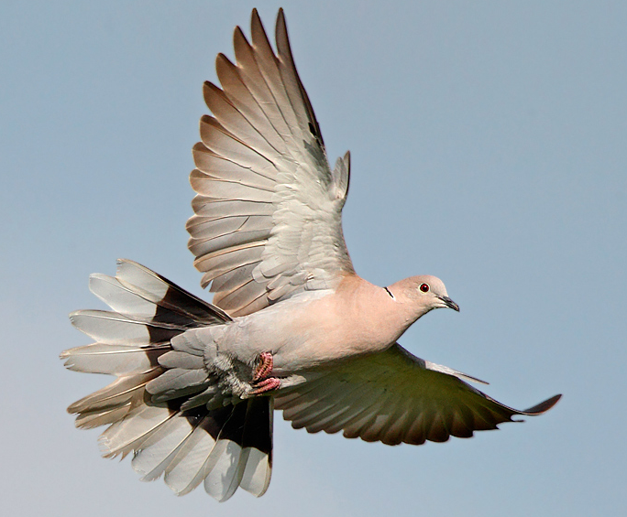
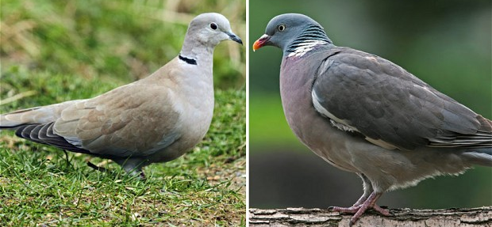
This is a Collared Dove
A Collared Dove is small, slim dove with quite a long tail.
It is much smaller than a Wood Pigeon.
A Collared Dove eats seeds and grain.

Slide 13
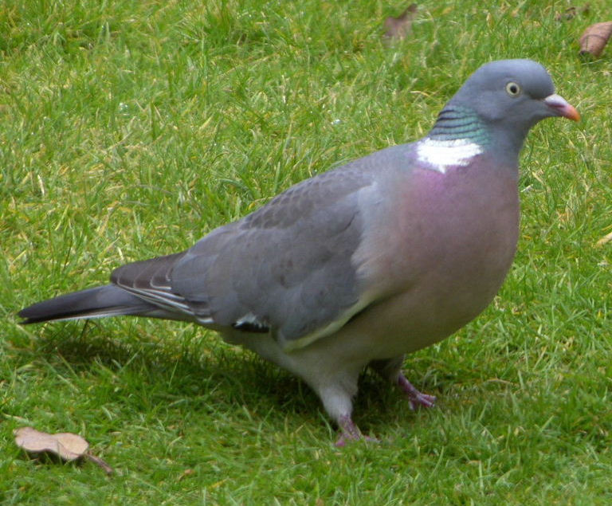
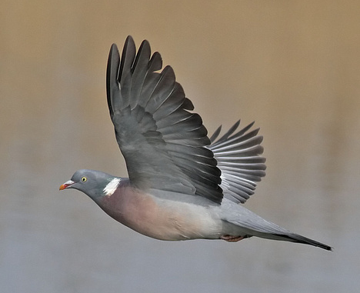
This is a Woodpigeon.
A Woodpigeon is normally grey with a pinkish breast and green, white and purple patch on the neck.
Their nest is made from twigs and is found in trees or on buildings.
A Woodpigeon eats crops like cabbages, sprouts, peas and grain. They also eat buds, shoots, seeds, nuts and berries.

