Slide 1

oe

Slide 2

The rule for digraphs, like ai, ee, oa and ue, is…
when 2 vowels join together, the first does the talking.
This means that you say the ‘name’ of the first letter.

Slide 3

I am the first vowel so the sound says my name!
o
e

Slide 4
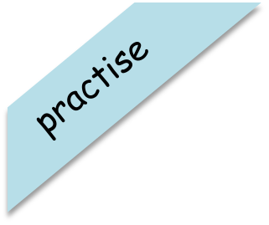
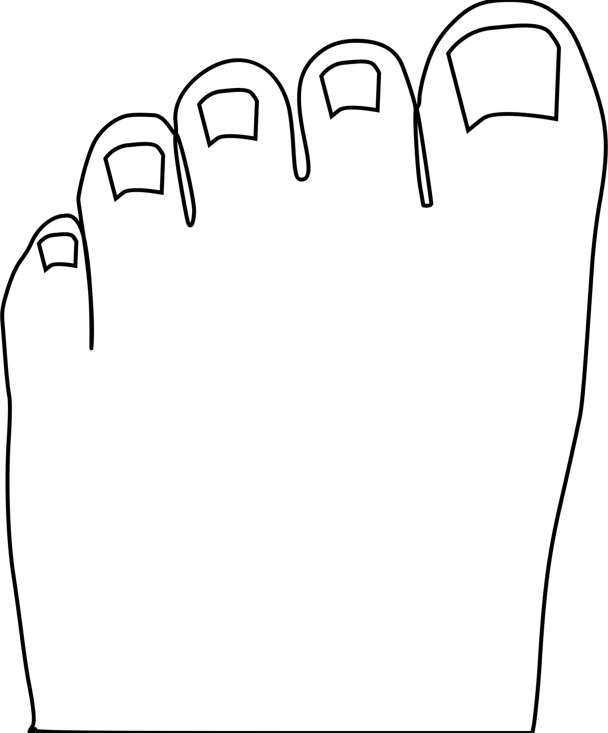
Have a go at reading these words. Click to see the picture:
toes

Slide 5
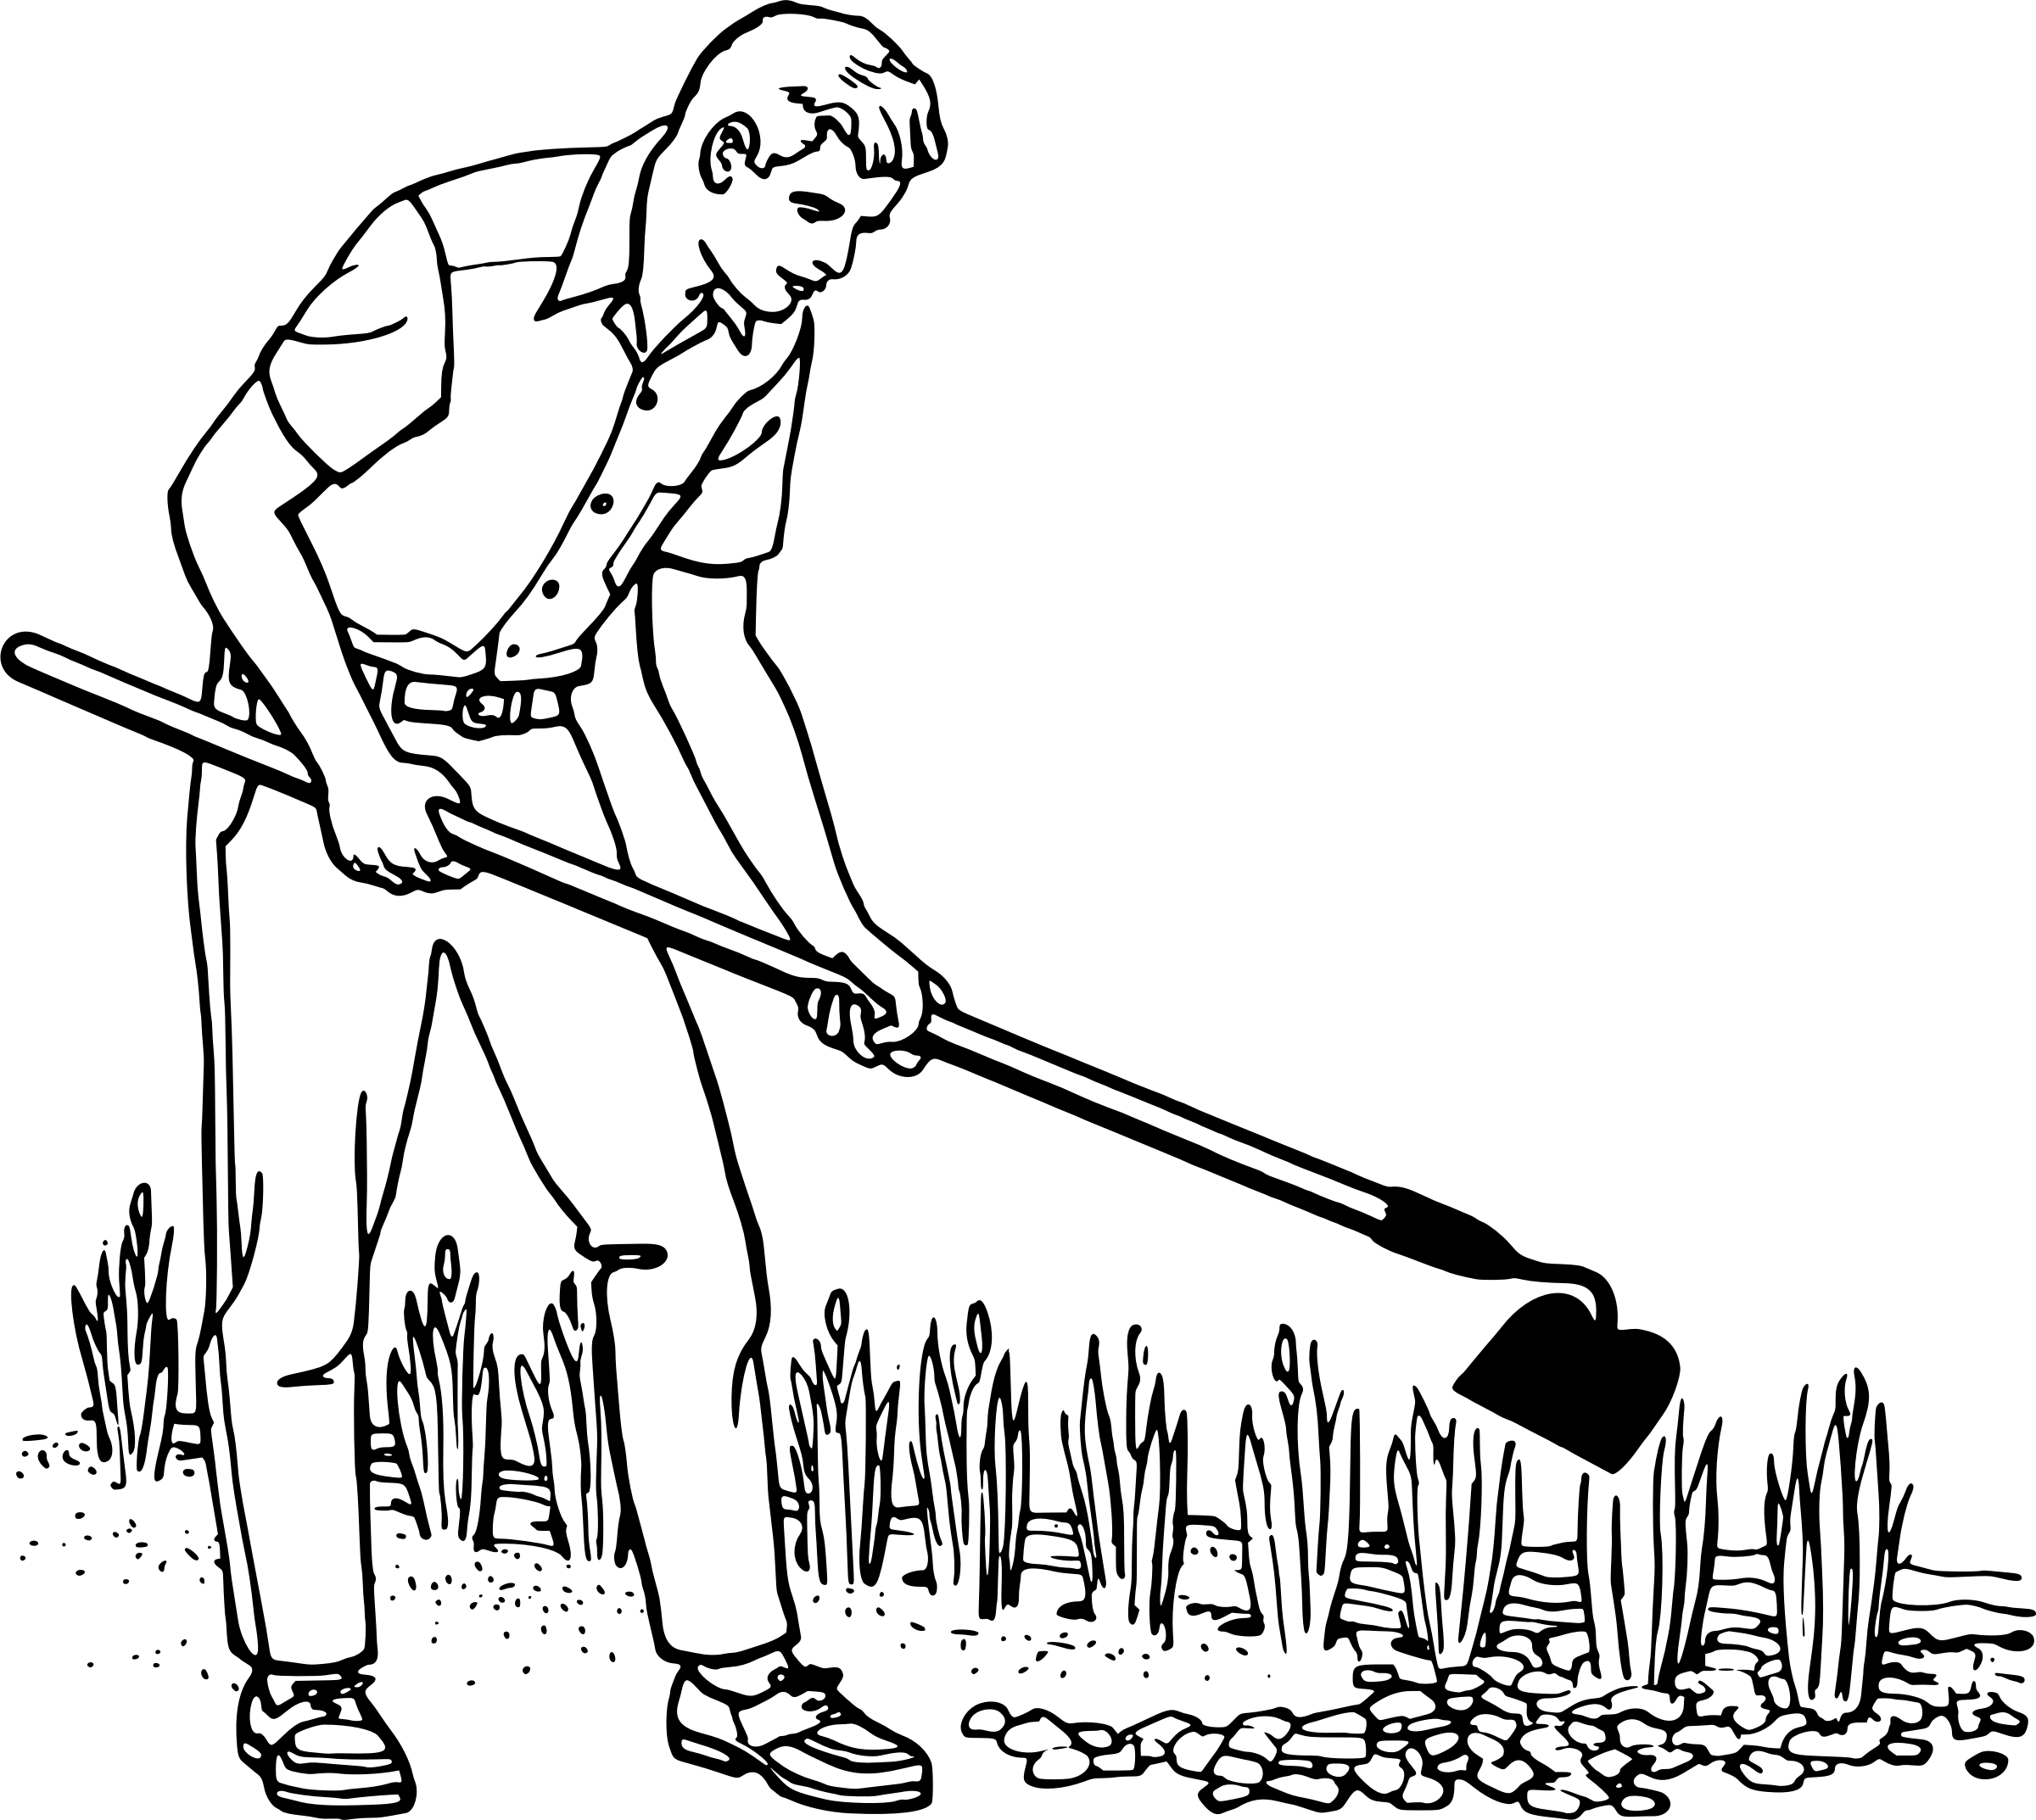
Have a go at reading these words. Click to see the picture:
hoe

Slide 6

Have a go at reading these words. Click to see the picture:
tomatoes

Slide 7
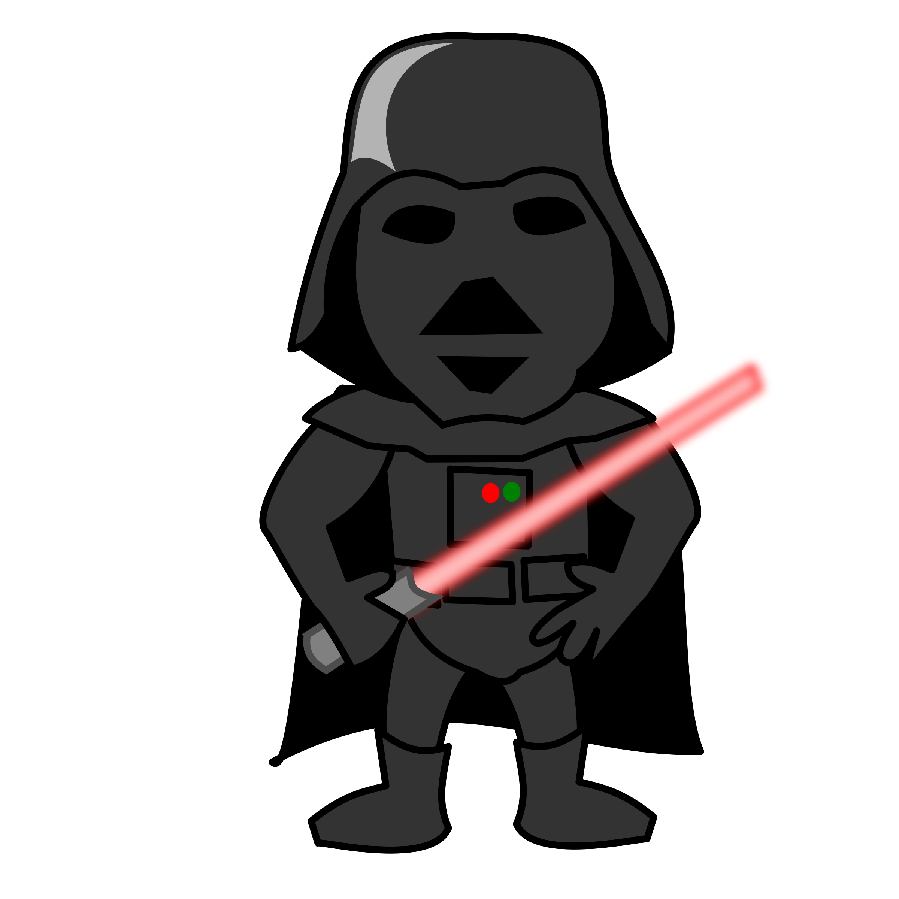
Try and spell out this word (either orally, on whiteboards, with letter fans or magnetic letters)
f
oe

Slide 8
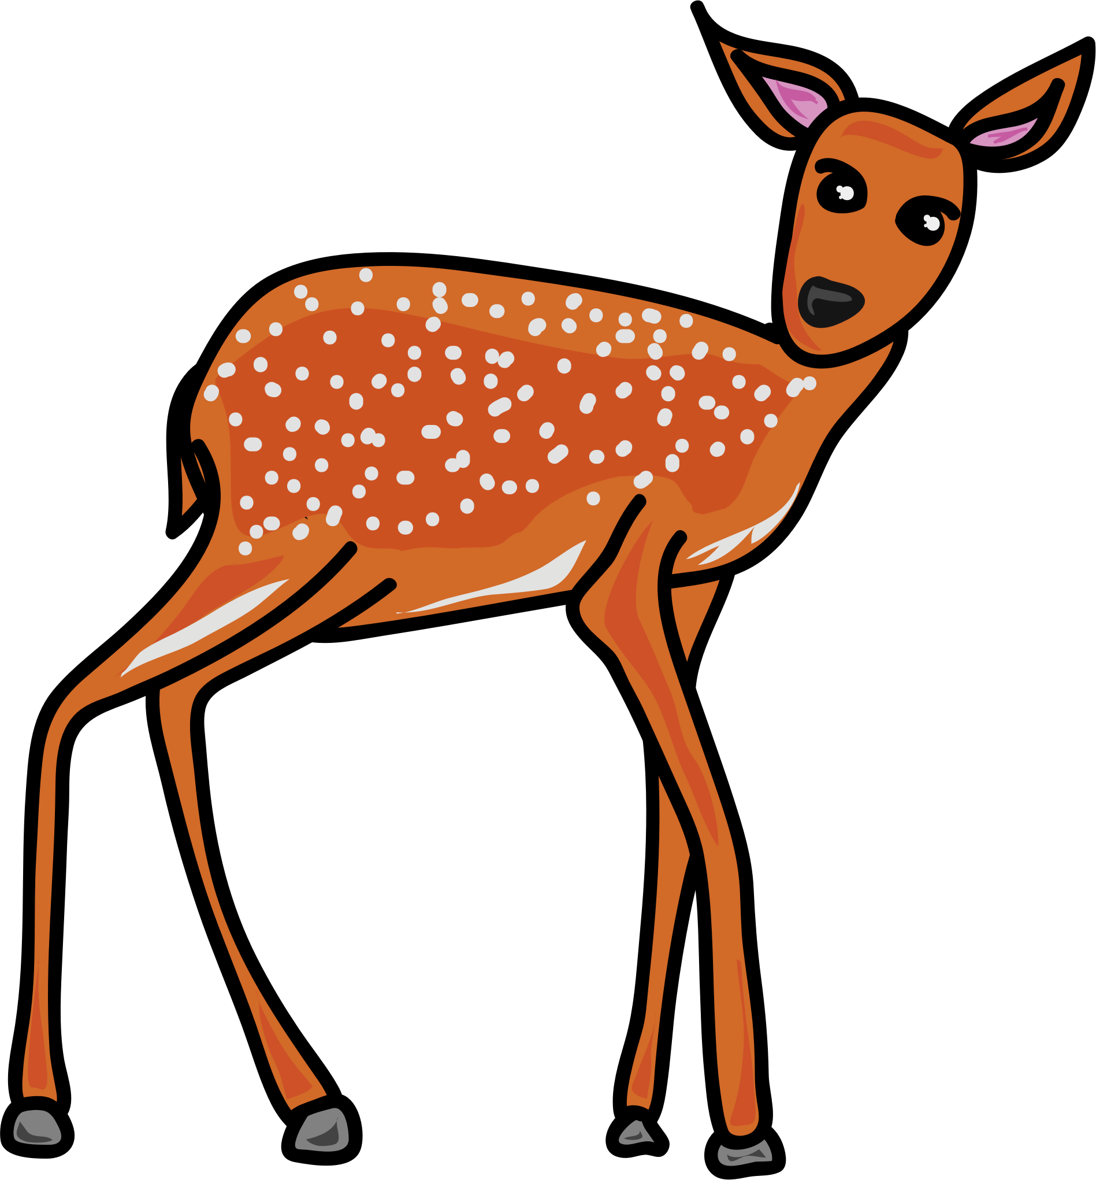
Try and spell out this word (either orally, on whiteboards, with letter fans or magnetic letters)
d
oe

Slide 9

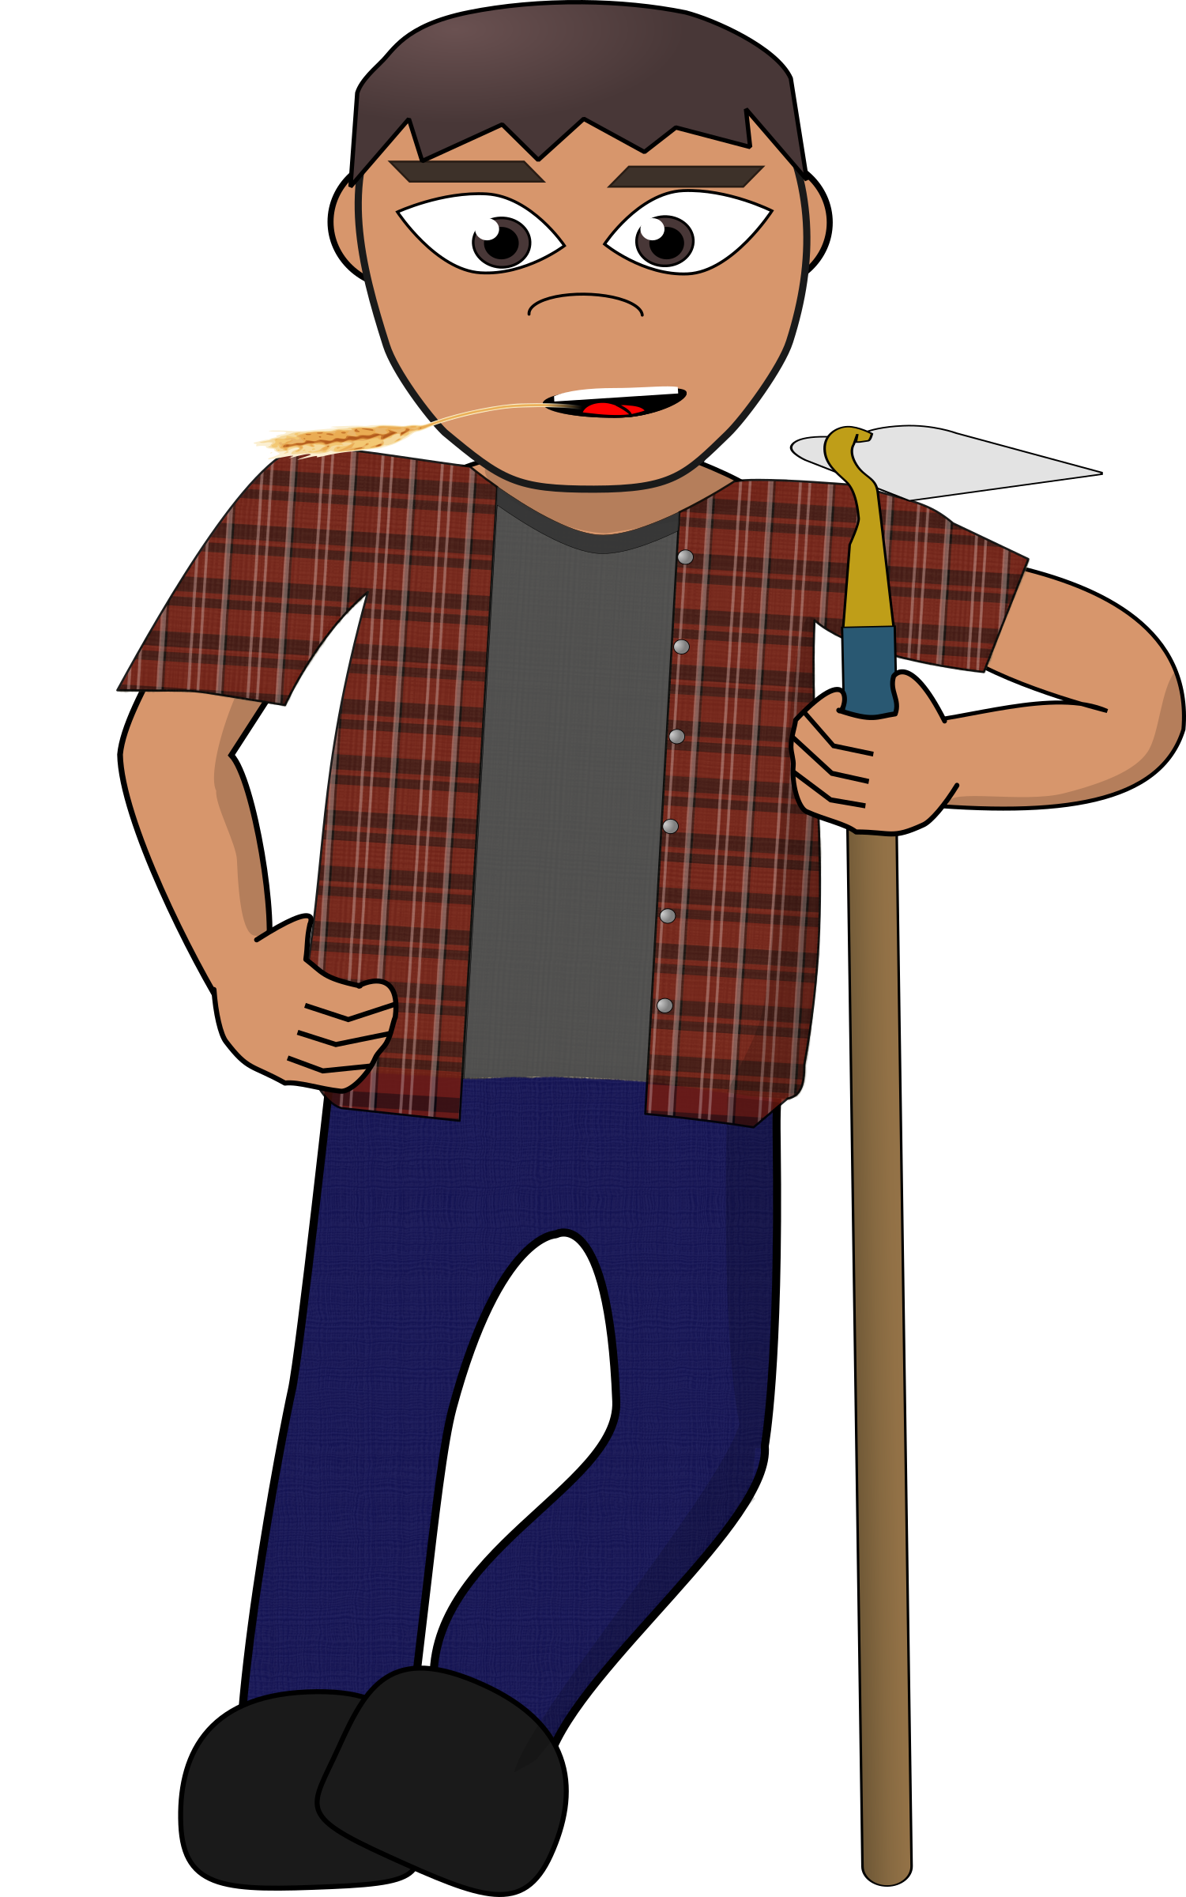


Read the sentence:
Joe hoes his tomatoes and potatoes.

Slide 10
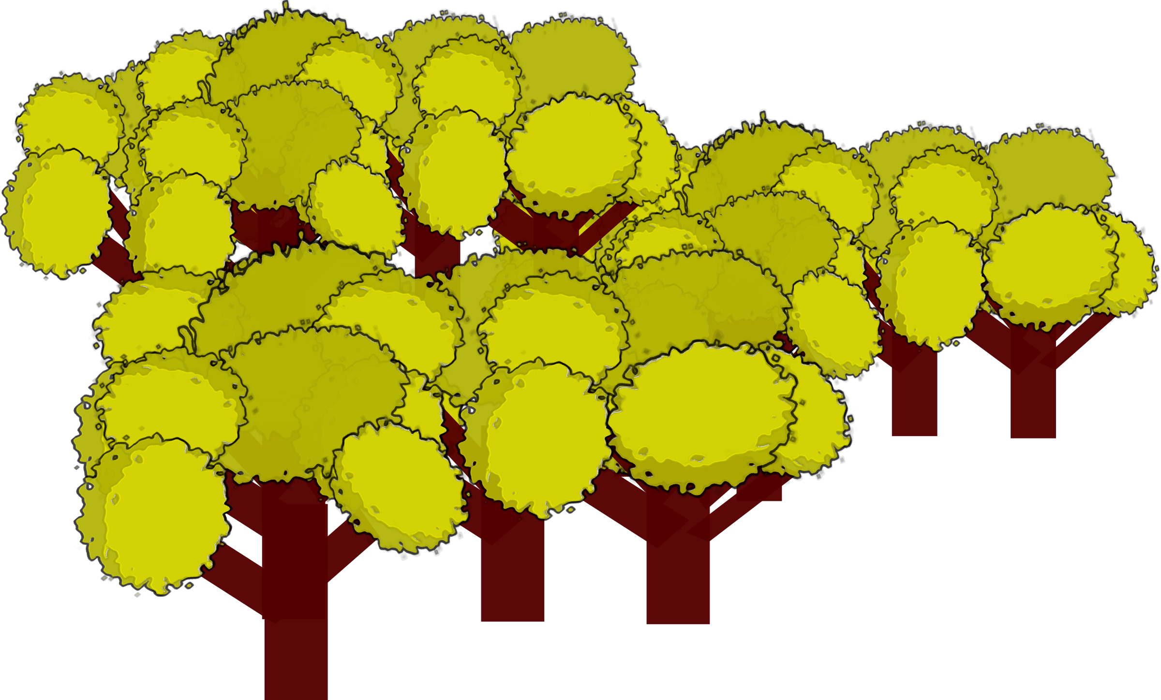
Read the sentence:
The doe goes into the trees.

