Slide 1
FIRE GOBLINS

Slide 2
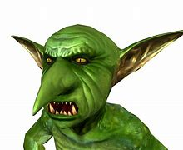
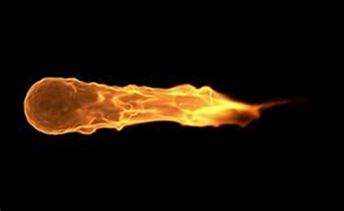
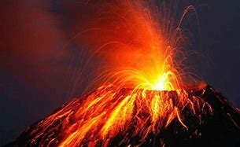
Let me tell you about Fire Goblins.
In this report I will be telling you where they live, what they look like and what they eat.

Slide 3

Fire goblins have red and orange hair that looks like flames. A bright red and orange raincoat that looks like lava and super cool black sunglasses. They have pointy ears, beady eyes and a very long nose.
They live in small dark caves on the side of active volcanoes. Obviously, this can be very dangerous at times.
They love to eat flaming hot tangy cheese Doritos which unfortunately make them fart a lot.

Slide 4
Surprisingly, they can’t drink lava because there allergic to it, they don’t drink at all! They can survive in water but not lava, but who knows why.
Fire Goblins like to play fire ball catch with each, this involves at least 3 goblins as there always needs to be at least one in the middle to try and stop them throwing to each other. The ball is an actual ball of fire.
Finally, they are very good at fighting so do not make them angry.

