Slide 1
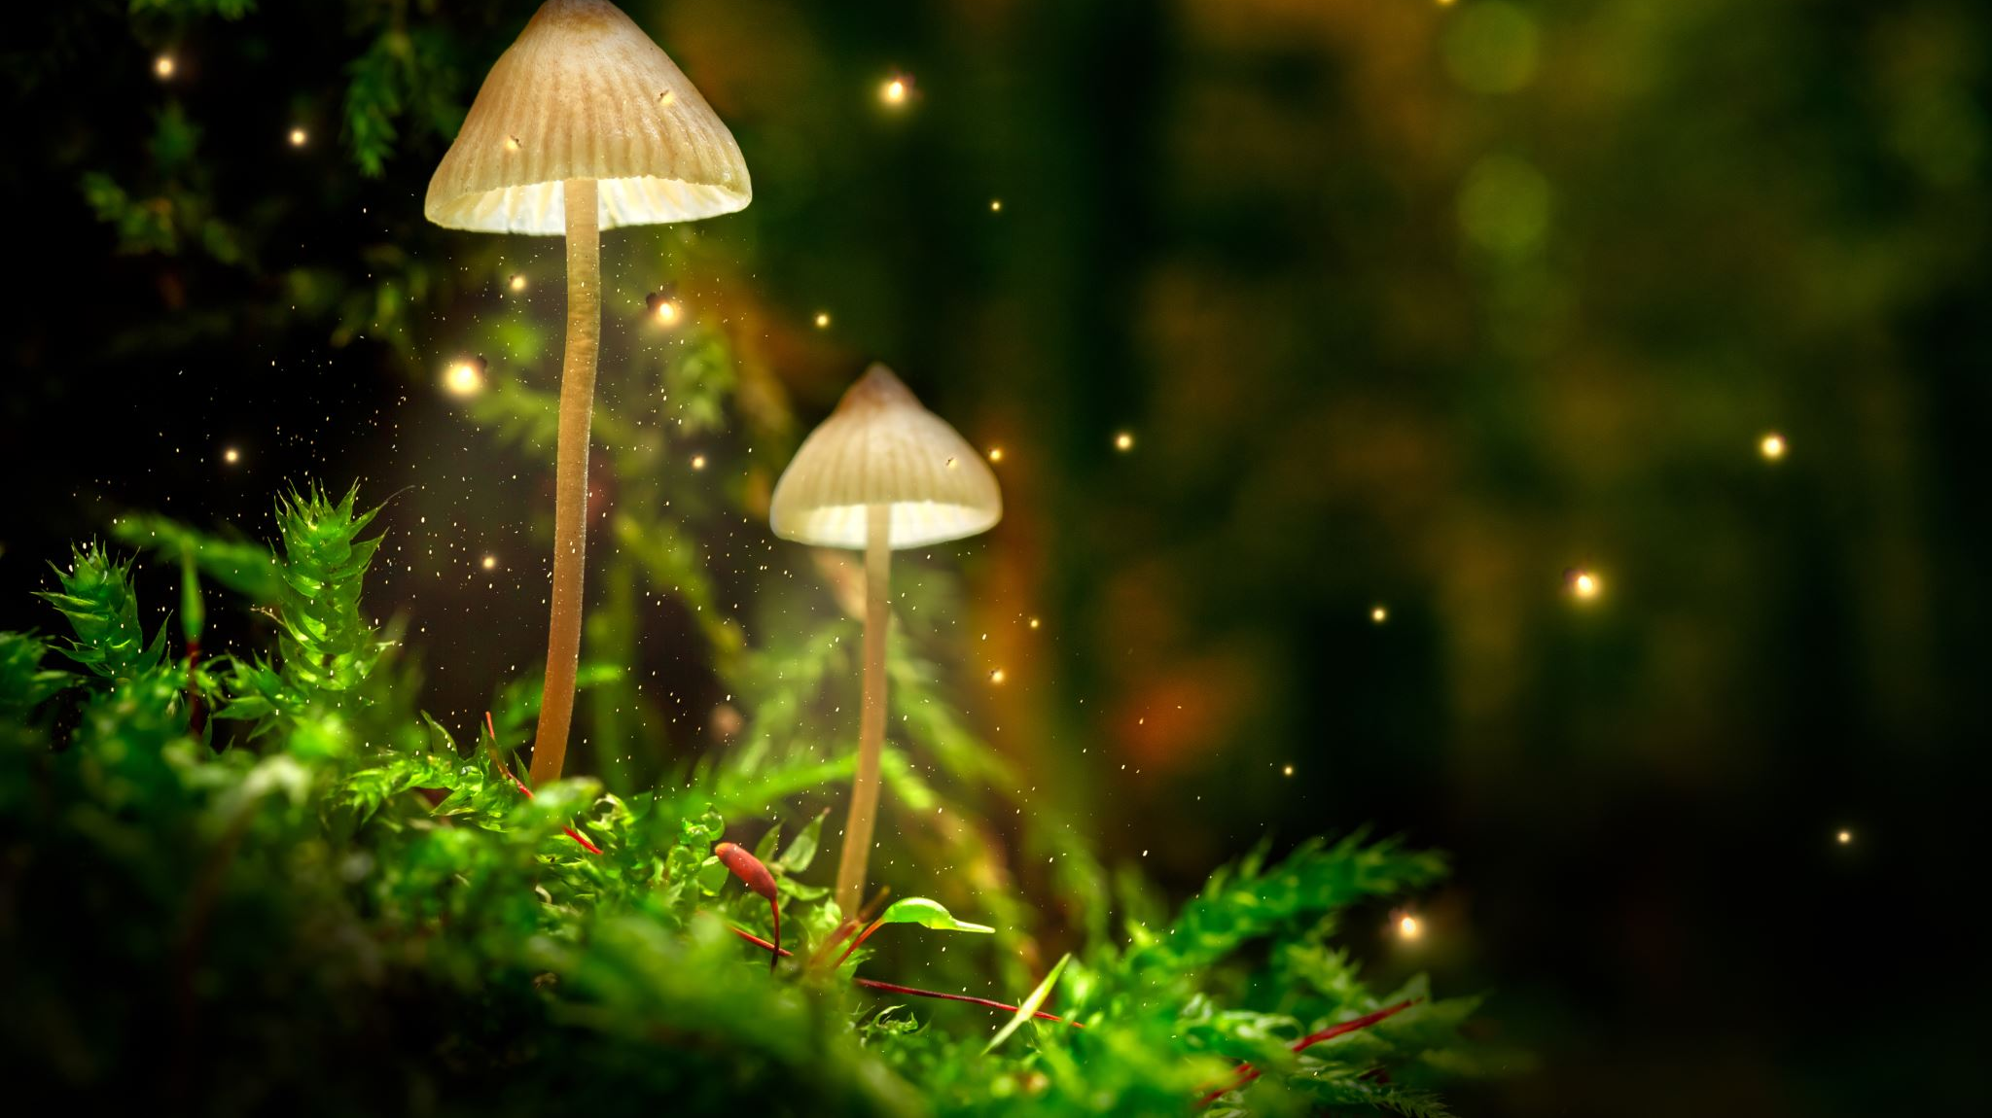
My Grass Goblin
By Tom Ibbotson

Slide 2

Did you know?
Did you know that Grass Goblins can often be found in gardens.
Also they love to steal garden gnomes.

Slide 3
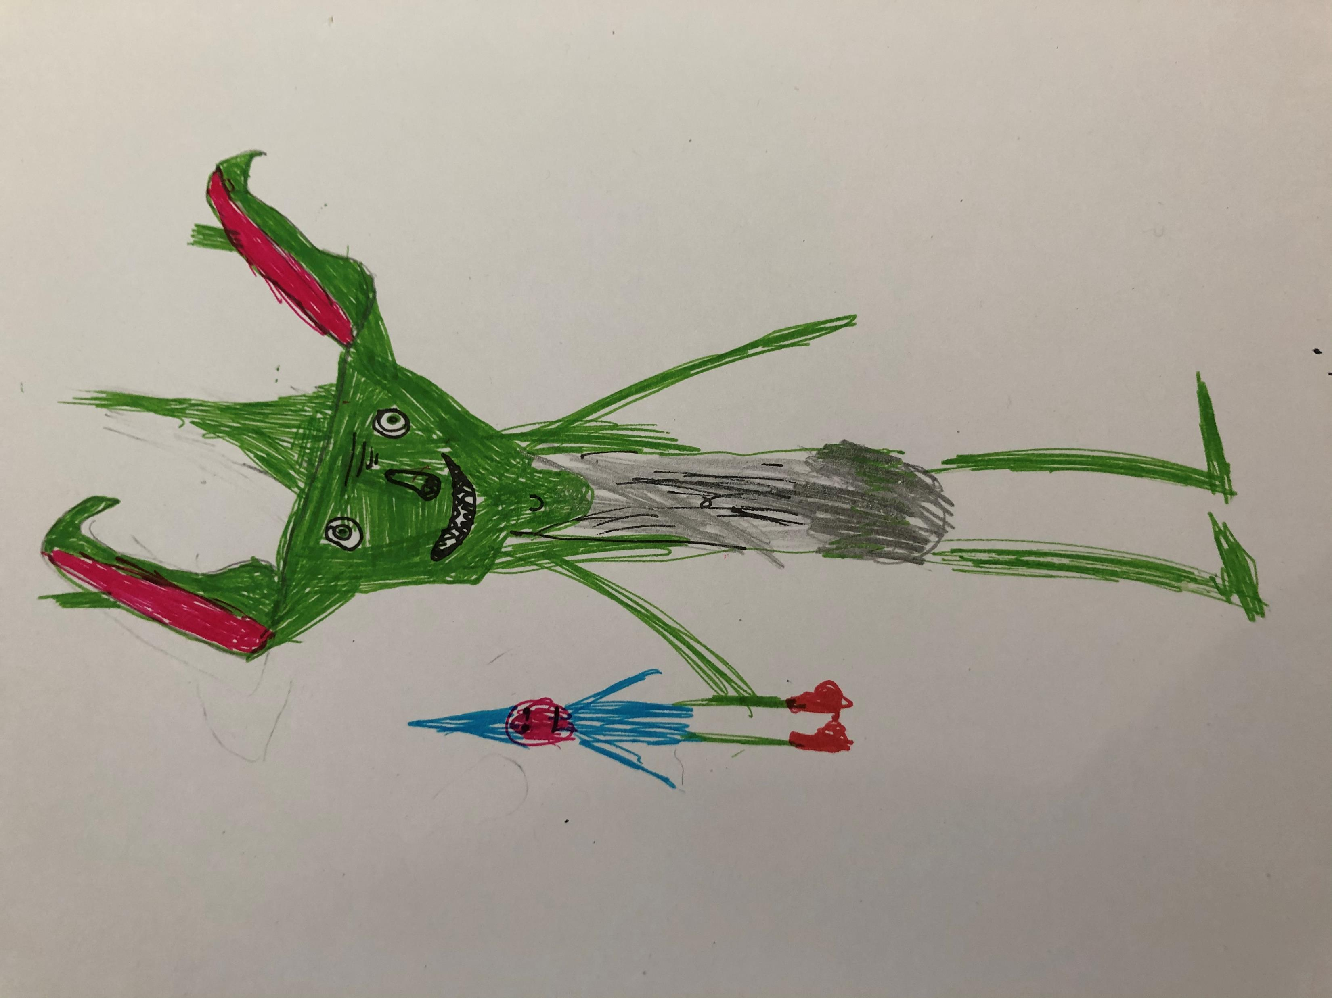
Have you ever seen a grass goblin?
Sticky out ears
Captured Gnome
They have grubby feet, sticky out ears and razor sharp fingernails. Last but not least they wear only a stained tea towel!
P.S: they never have showers or baths therefore they really stink.
Stained tea towel
Razor sharp toe nails

Slide 4

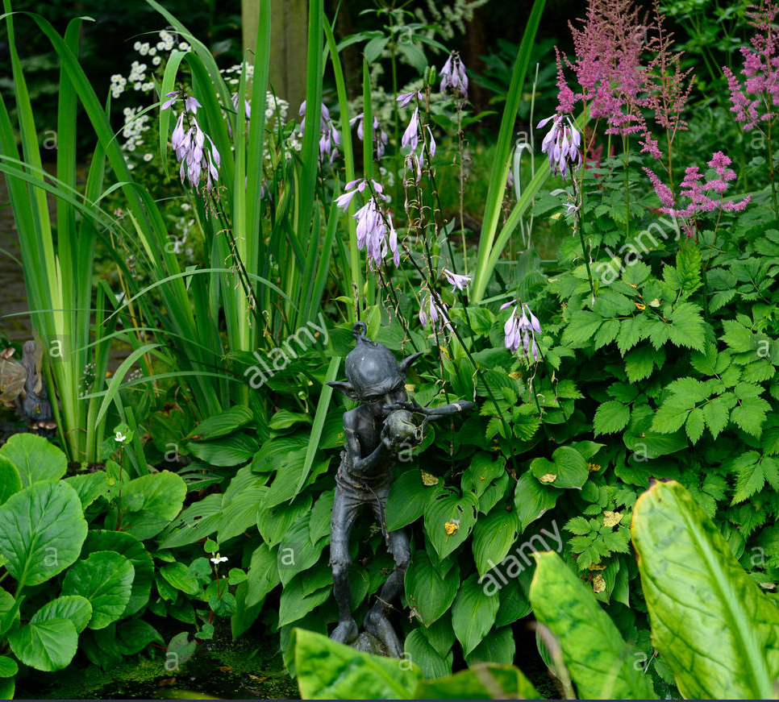
where do grass goblins live?
My Grass Goblin and his family live in gardens all around the world.
They only live in gardens with garden gnomes in them. They are normally found in bushes and trees
Can you spot 2 gnomes? I can ☺

Slide 5

What Do Grass goblins eat?
A grass goblin can eat anything in a garden except for dirt, yes grass goblins can not eat dirt! Their favourite food is yellow and red roses.

Slide 6
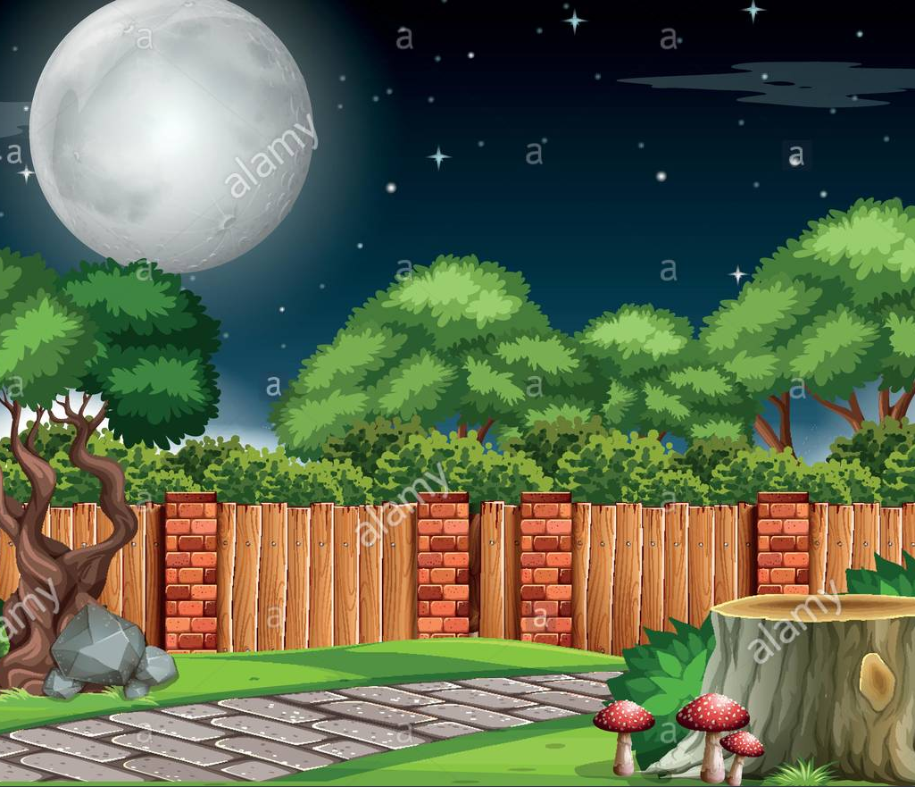
Did you know?
Did you know that Grass Goblins don’t actually like grass? I know weird right? Also they are nocturnal which means they sleep when its day and they are awake when its night. This is so they can steal garden gnomes!!!!
They are really good at being stealthy so they can steal garden gnomes. Also they are exceptional at climbing so they can climb trees and bushes.

Slide 7
So I hope you like my Grass Goblin and understand how they look and what they do.

