Slide 1

Year 4 – Spring Block 1 – Apostrophes – When Should You NOT Use an Apostrophe
About This Resource:
This PowerPoint has been designed to support your teaching of this small step. It includes a starter activity and an example of each question from the Varied Fluency and Application and Reasoning resources also provided in this pack. You can choose to work through all examples provided or a selection of them depending on the needs of your class.
National Curriculum Objectives:
  English Year 4: (4G5.8) Indicating possession by using the possessive apostrophe with plural nouns
  English Year 4: (4G5.8) The grammatical difference between plural and possessive –s
English Year 4: (4G5.8) Apostrophes to mark plural possession [for example, the girl’s name, the girls’ names]
More resources from our Grammar, Punctuation and Spelling scheme of work.
Did you like this resource? Don’t forget to review it on our website.
© Classroom Secrets Limited 2018

Slide 2
Year 4 – Spring Block 1 – Apostrophes – When Should You NOT Use an Apostrophe
Notes and Guidance:
In the previous steps, children have learned to recognise apostrophes for possession and contraction, and use apostrophes for plural possession.
In this step, children will learn when an apostrophe is not appropriate, addressing common misconceptions. This includes using an apostrophe for a plural noun. For example, There are many car’s.
Focused Questions
Has the apostrophe been used correctly?
Should there be an apostrophe in this word?
Re-write this sentence so that it uses apostrophes accurately.
© Classroom Secrets Limited 2018

Slide 3
Year 4 – Spring Block 1 – Apostrophes
Step 3: When Should You NOT Use an Apostrophe
© Classroom Secrets Limited 2018

Slide 4
Introduction
Spot the mistake in each sentence below.
A) There are far too many car’s on the road nowadays.
B) We c’ant go in there, it might be dangerous.
C) My mums’ birthday is next month.
D) The brushes’s bristles were wearing away.
E) The frightened child cry’s on my shoulder.
© Classroom Secrets Limited 2018

Slide 5
Introduction
Spot the mistake in each sentence below.
A) There are far too many car’s on the road nowadays.
B) We c’ant go in there, it might be dangerous.
C) My mums’ birthday is next month.
D) The brushes’s bristles were wearing away.
E) The frightened child cry’s on my shoulder.
© Classroom Secrets Limited 2018

Slide 6
Varied Fluency 1
True or false?
The apostrophe has been used correctly in the sentence below.
“Mum, please will you buy me some sweet’s?” asked the child.
© Classroom Secrets Limited 2018

Slide 7
Varied Fluency 1
True or false?
The apostrophe has been used correctly in the sentence below.
“Mum, please will you buy me some sweet’s?” asked the child.
False, it should be sweets.
© Classroom Secrets Limited 2018

Slide 8
Varied Fluency 2
The apostrophes in the words below have been used incorrectly. Rewrite the words correctly.
couldv’e
their’s
Jennys’
film’s
© Classroom Secrets Limited 2018

Slide 9
Varied Fluency 2
The apostrophes in the words below have been used incorrectly. Rewrite the words correctly.
couldv’e
could’ve
their’s
theirs
Jennys’
Jenny’s
film’s
films
© Classroom Secrets Limited 2018

Slide 10
Varied Fluency 3
Circle the apostrophes that have been used correctly in the sentences below.
The cake’s halve’s are not equal, so you’re getting more than me.
We had lot’s of playtime as a reward for our hard work.
© Classroom Secrets Limited 2018

Slide 11
Varied Fluency 3
Circle the apostrophes that have been used correctly in the sentences below.
The cake’s halve’s are not equal, so you’re getting more than me.
We had lot’s of playtime as a reward for our hard work.
© Classroom Secrets Limited 2018

Slide 12
Varied Fluency 4
Underline the words where an apostrophe is used incorrectly in the sentences below.
Why’re you up so early these day’s?
I sha’nt do it and you can’t make me!
The childrens’ singing was beautiful.
“That’s amazing!” Alis’ mum cried.
© Classroom Secrets Limited 2018

Slide 13
Varied Fluency 4
Underline the words where an apostrophe is used incorrectly in the sentences below.
Why’re you up so early these day’s?
I sha’nt do it and you can’t make me!
The childrens’ singing was beautiful.
“That’s amazing!” Alis’ mum cried.
© Classroom Secrets Limited 2018

Slide 14
Application 1
Rewrite these sentence and correct the apostrophe mistakes.
My brothers worrie’d about his competition as the other team’s are very good and hed’ like to win.
© Classroom Secrets Limited 2018

Slide 15
Application 1
Rewrite these sentence and correct the apostrophe mistakes.
My brothers worrie’d about his competition as the other team’s are very good and hed’ like to win.
My brother’s worried about his competition as the other teams are very good and he’d like to win.
© Classroom Secrets Limited 2018

Slide 16
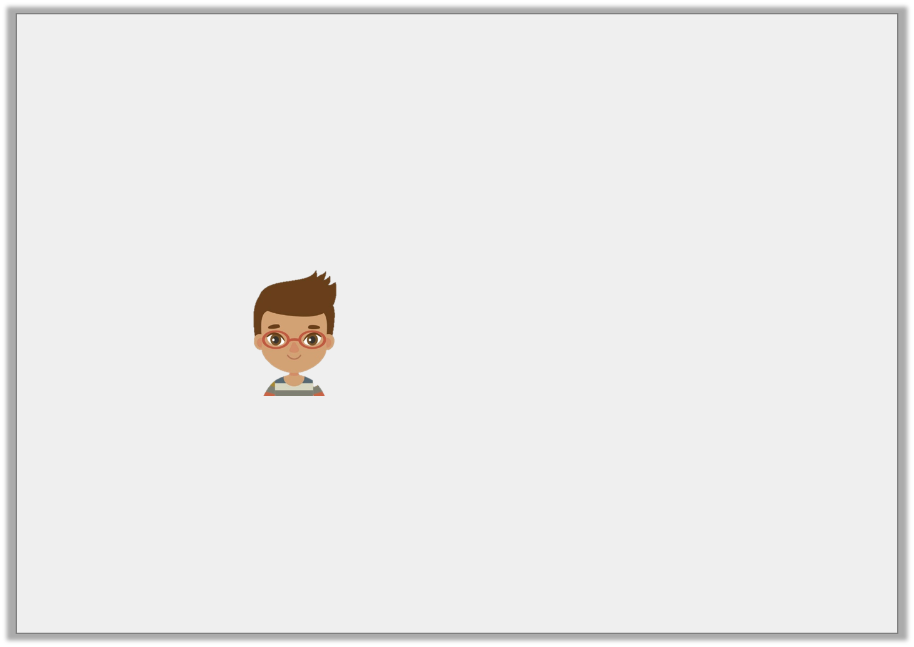
Reasoning 1
Dan is completing the following sentence.
My mum collects ______________ wherever she sees them.
Dan says,
Is Dan right? Explain your answer.
I need to write shell’s to finish the sentence.
© Classroom Secrets Limited 2018

Slide 17
Reasoning 1
Dan is completing the following sentence.
My mum collects ______________ wherever she sees them.
Dan says,
Is Dan right? Explain your answer.
Dan is not correct because…
I need to write shell’s to finish the sentence.
© Classroom Secrets Limited 2018

Slide 18
Reasoning 1
Dan is completing the following sentence.
My mum collects ______________ wherever she sees them.
Dan says,
Is Dan right? Explain your answer.
Dan is not correct because he needs to write shells instead.
I need to write shell’s to finish the sentence.
© Classroom Secrets Limited 2018

Slide 19
Reasoning 2
Have the apostrophes been used correctly in the sentence below?
Mias’ rabbits’ fur is very soft and fluffy and Il’l look after it when sh’es away.
Explain your answer.
© Classroom Secrets Limited 2018

Slide 20
Reasoning 2
Have the apostrophes been used correctly in the sentence below?
Mias’ rabbits’ fur is very soft and fluffy and Il’l look after it when sh’es away.
Explain your answer.
They have not been used correctly because…
© Classroom Secrets Limited 2018

Slide 21
Reasoning 2
Have the apostrophes been used correctly in the sentence below?
Mias’ rabbits’ fur is very soft and fluffy and Il’l look after it when sh’es away.
Explain your answer.
They have not been used correctly because it should be Mia’s, rabbit’s, I’ll and she’s.
© Classroom Secrets Limited 2018

