Slide 1
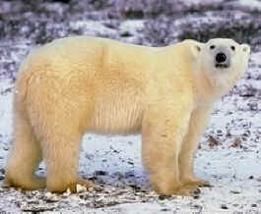
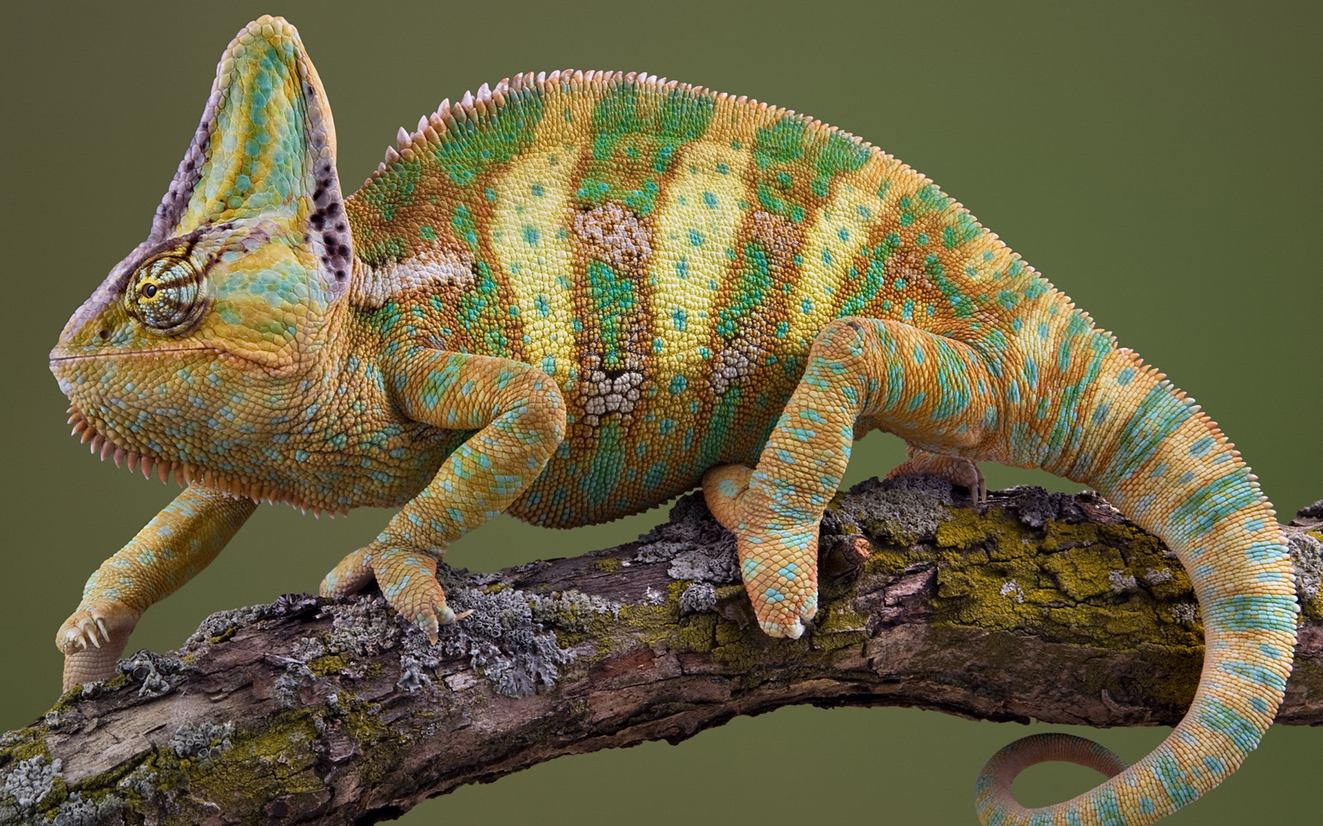
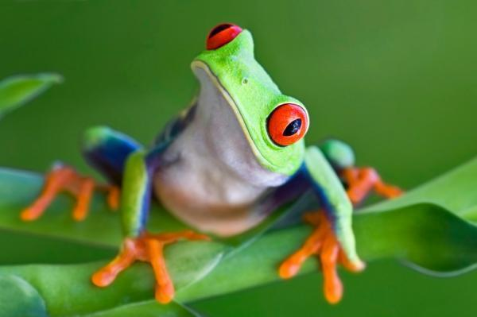
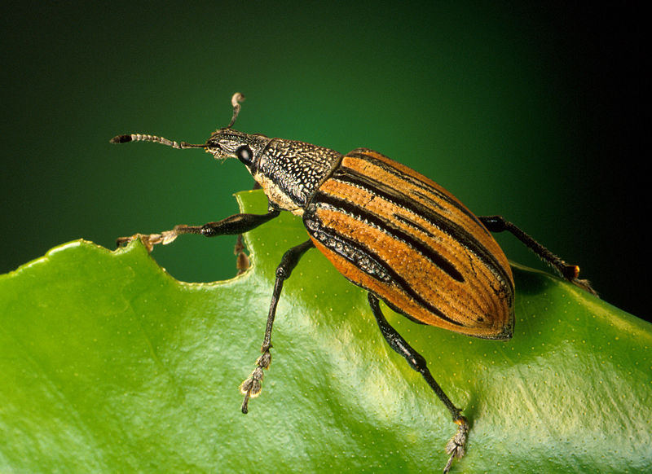
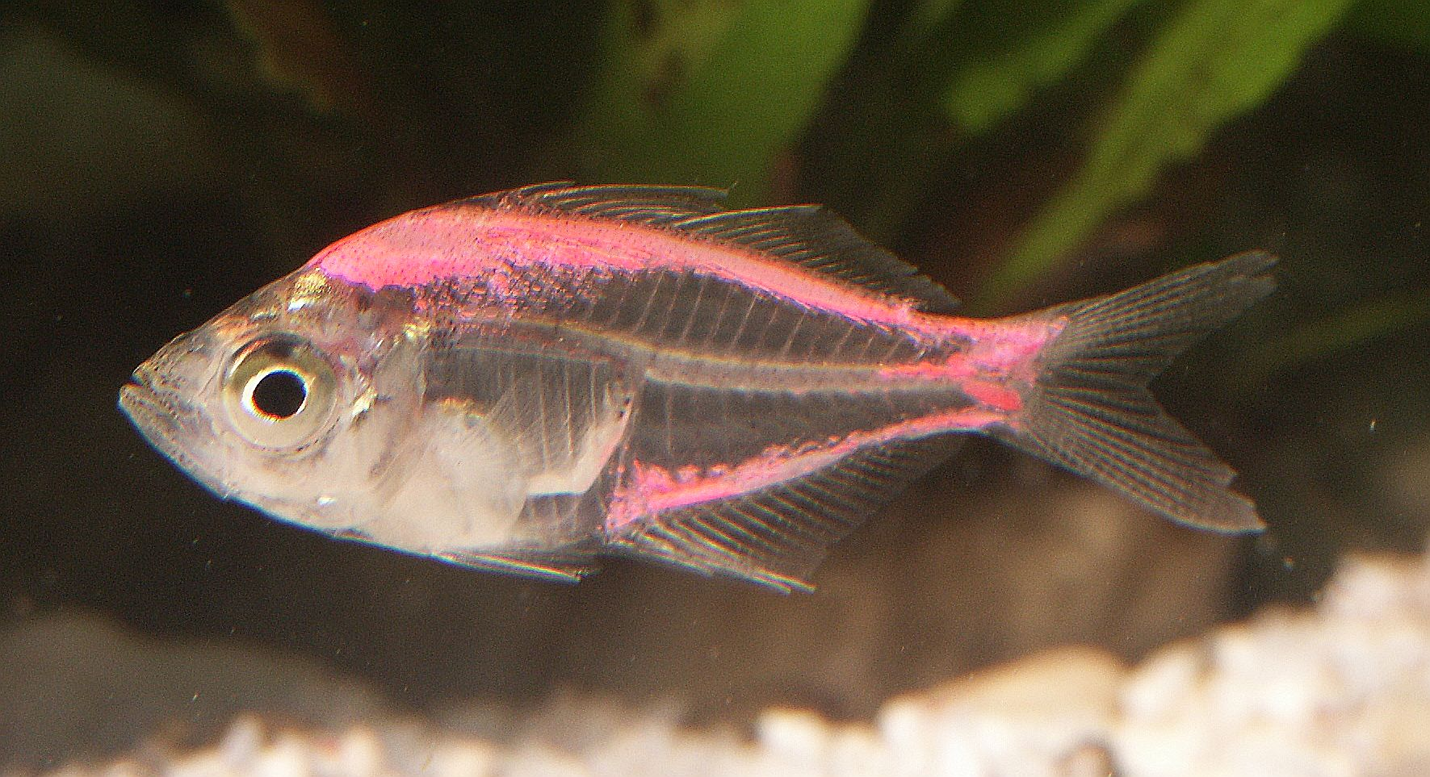
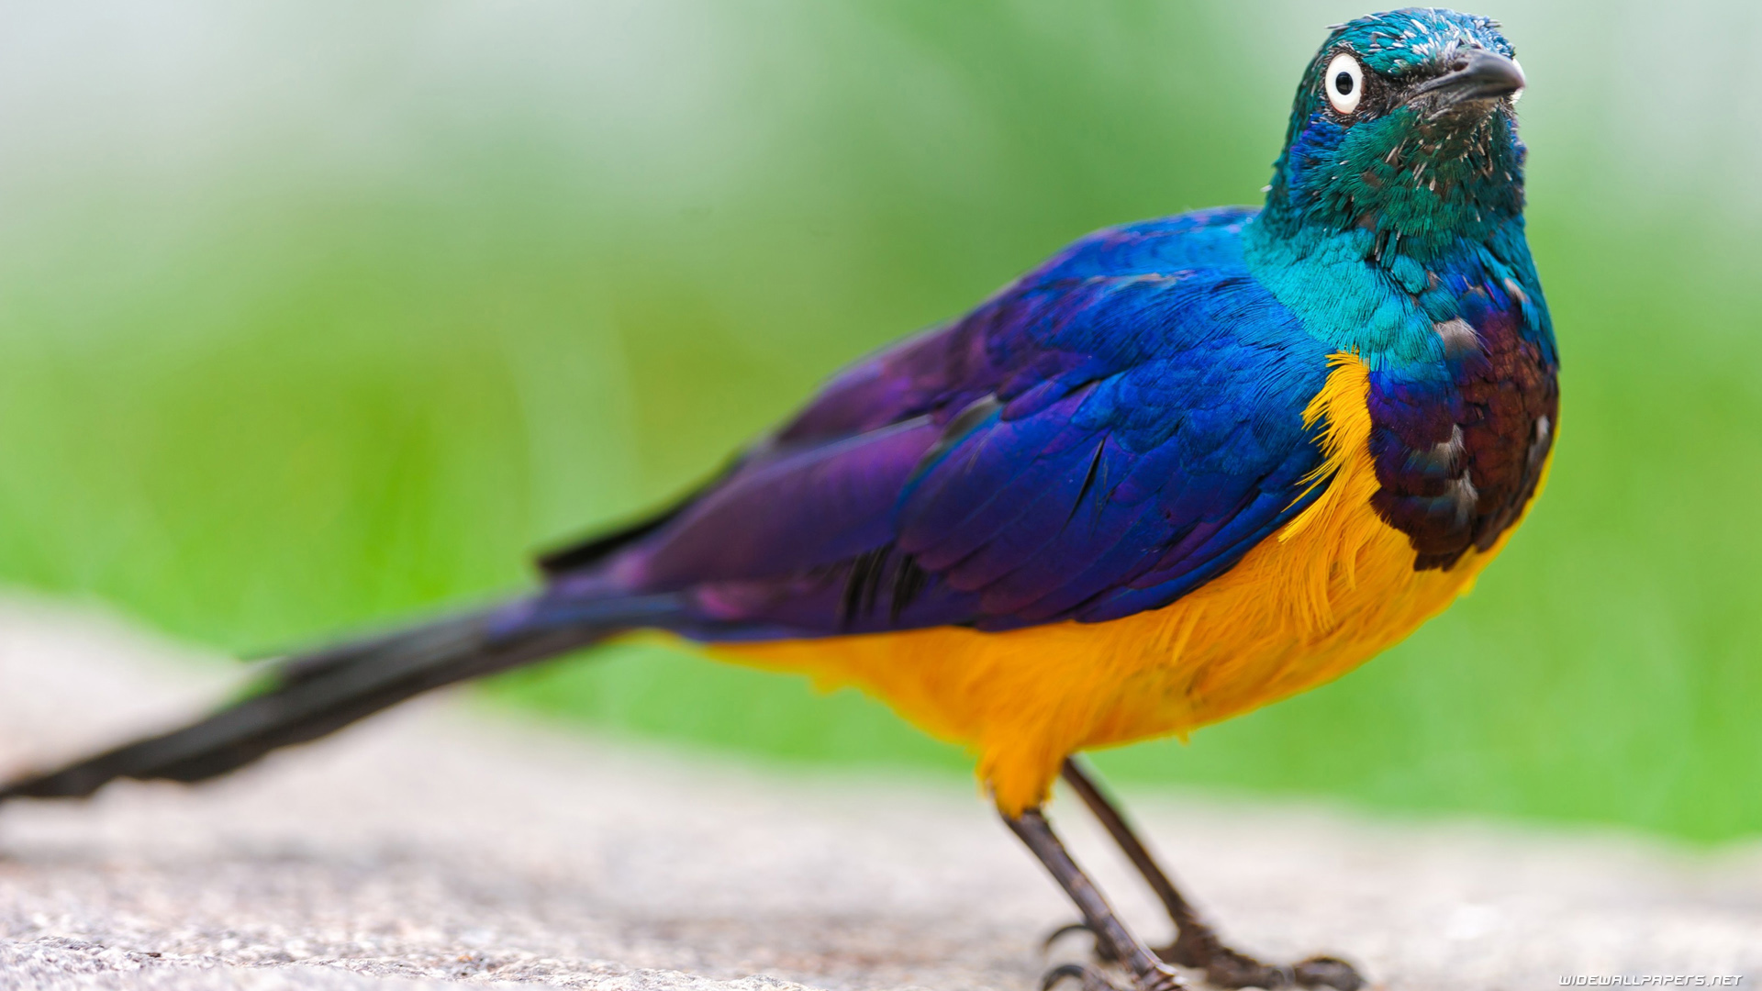
Animal groups

Slide 2
There are millions of animals in the world and they are all different from each other. Some animals are from the same species, like monkeys or dogs, but they all have their differences.
However, all animals can be split into 6 main groups to make it easy to categorize them. They are grouped by their features and characteristics.

Slide 3
The 6 groups are as follows..
Mammals
Reptiles
Amphibians
Invertebrates
Birds
Fish

Slide 4
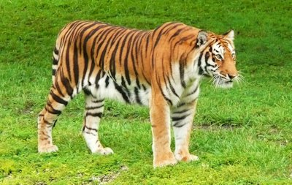
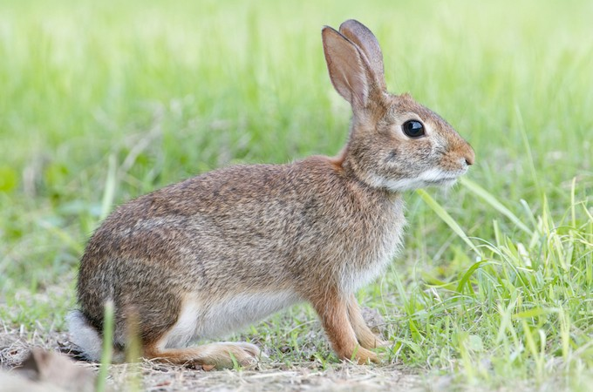
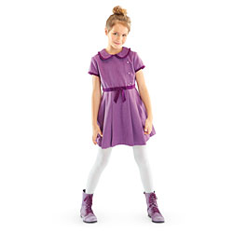
Mammals
Mammals breathe air
They have a backbone
They grow hair or fur
Female mammals produce milk for their babies
The smallest mammal is the bumblebee bat, the largest is the blue whale.
Most live on land but dolphins and whales are mammals who live in the sea.
They are warm blooded

Slide 5
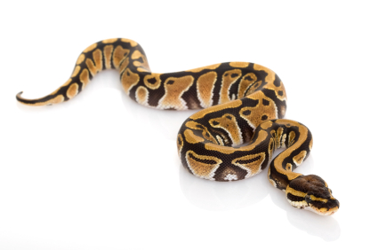
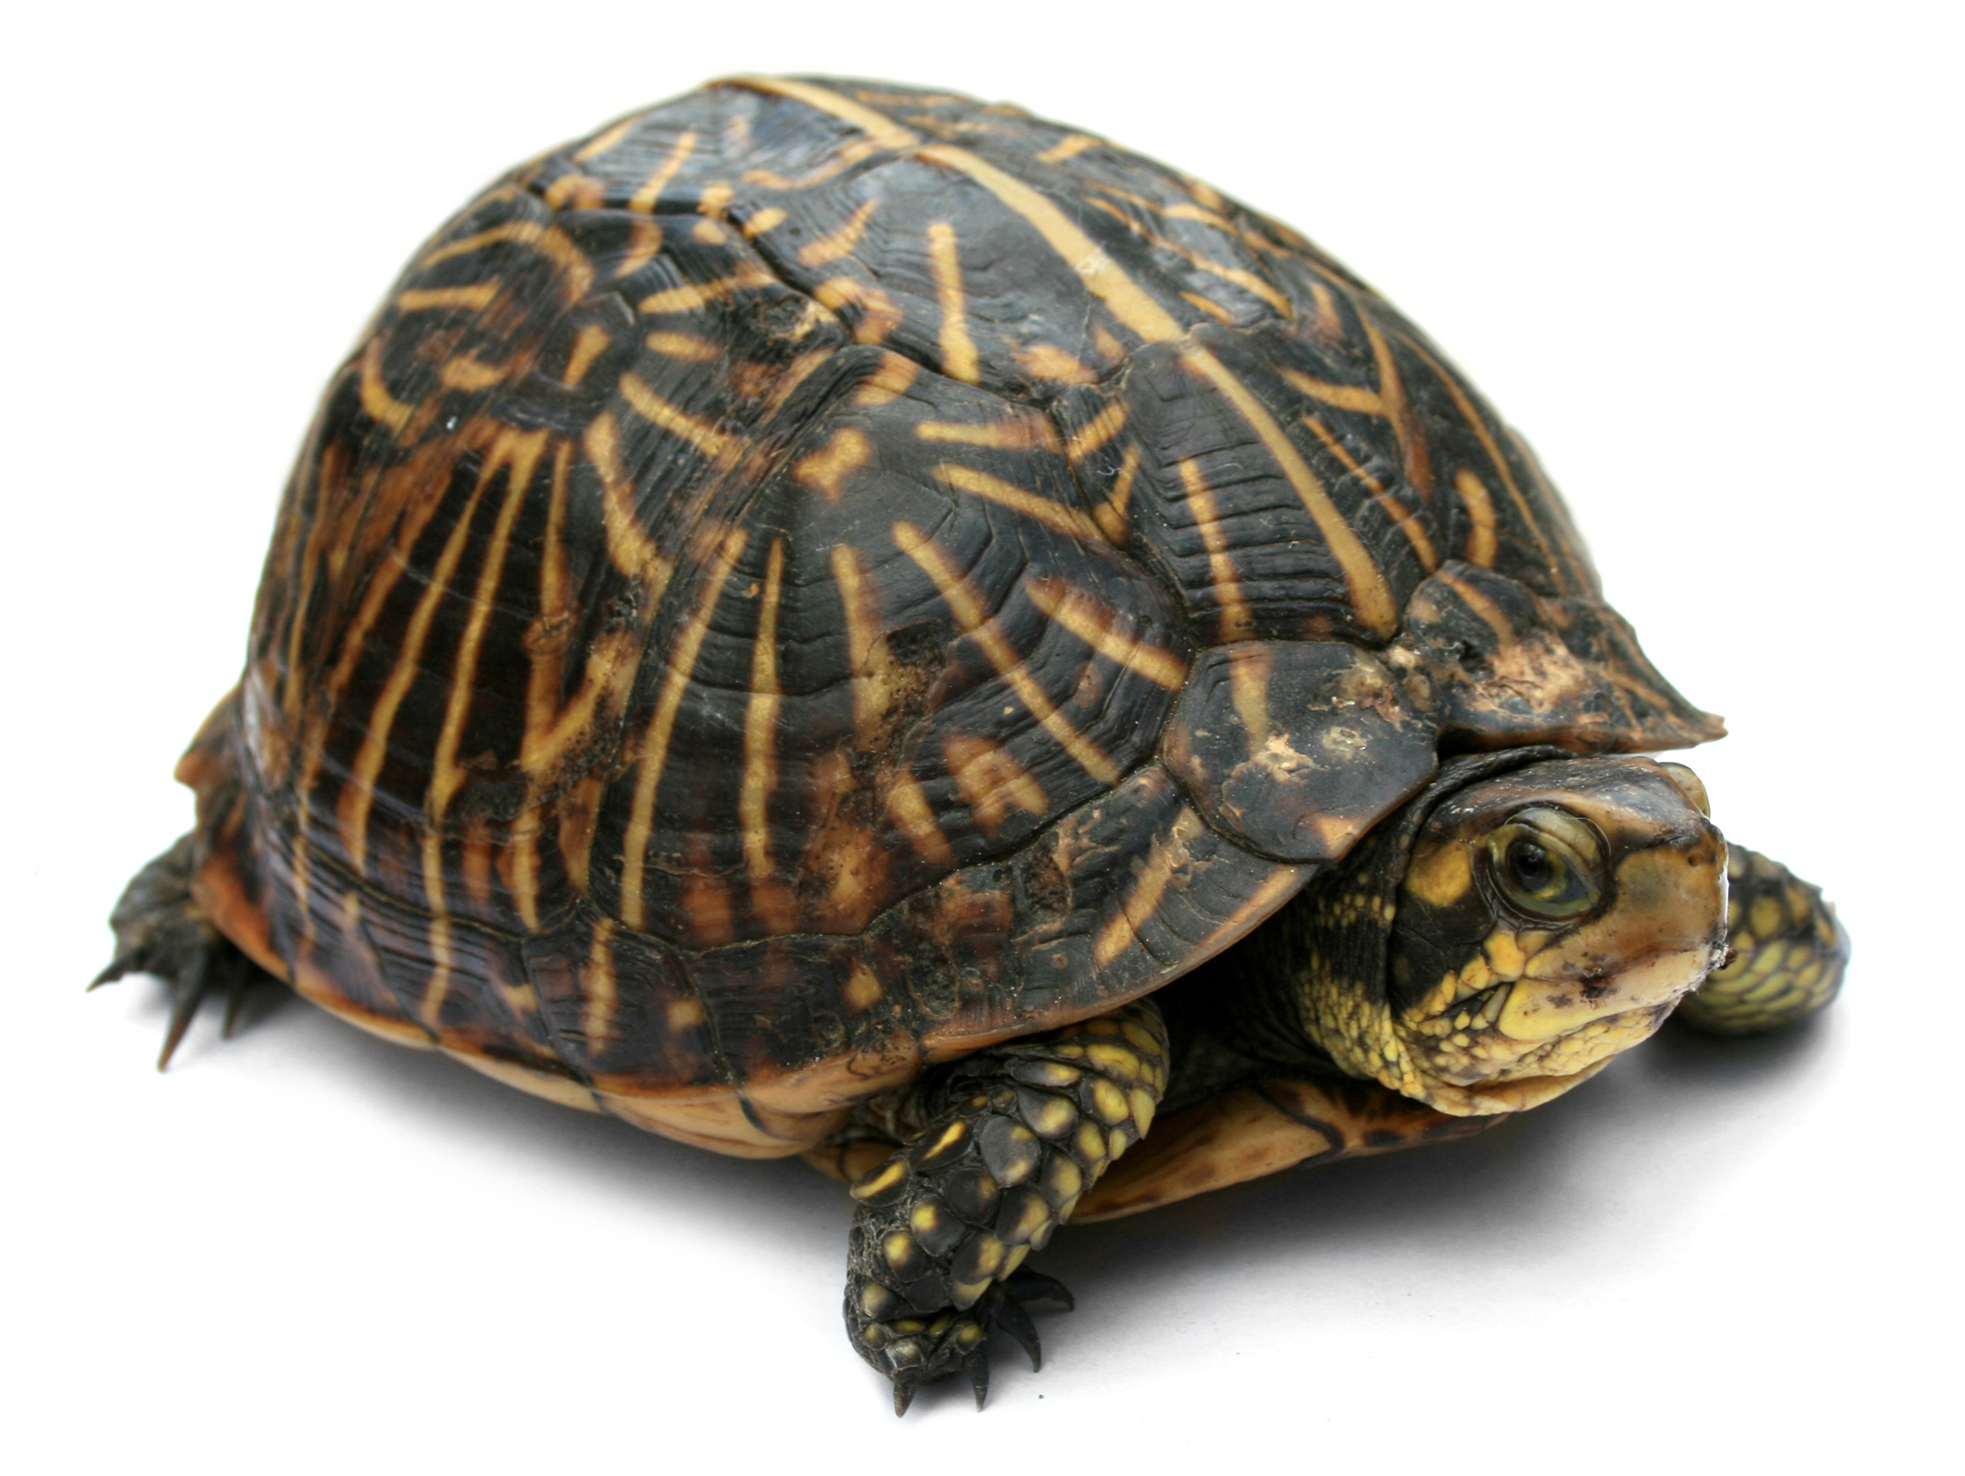
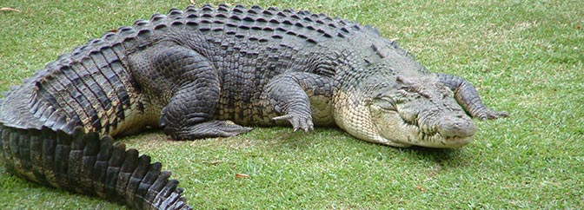
Reptiles
They are cold blooded which means their bodies
react to their surroundings. If they are
cold they can sit in the sun to warm up,
if they are hot they can go into the water
to cool down
Reptiles are have dry, rough scaly skin
Reptiles include turtles, crocodiles, lizards, snakes
They lay eggs

Slide 6
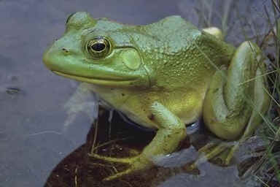
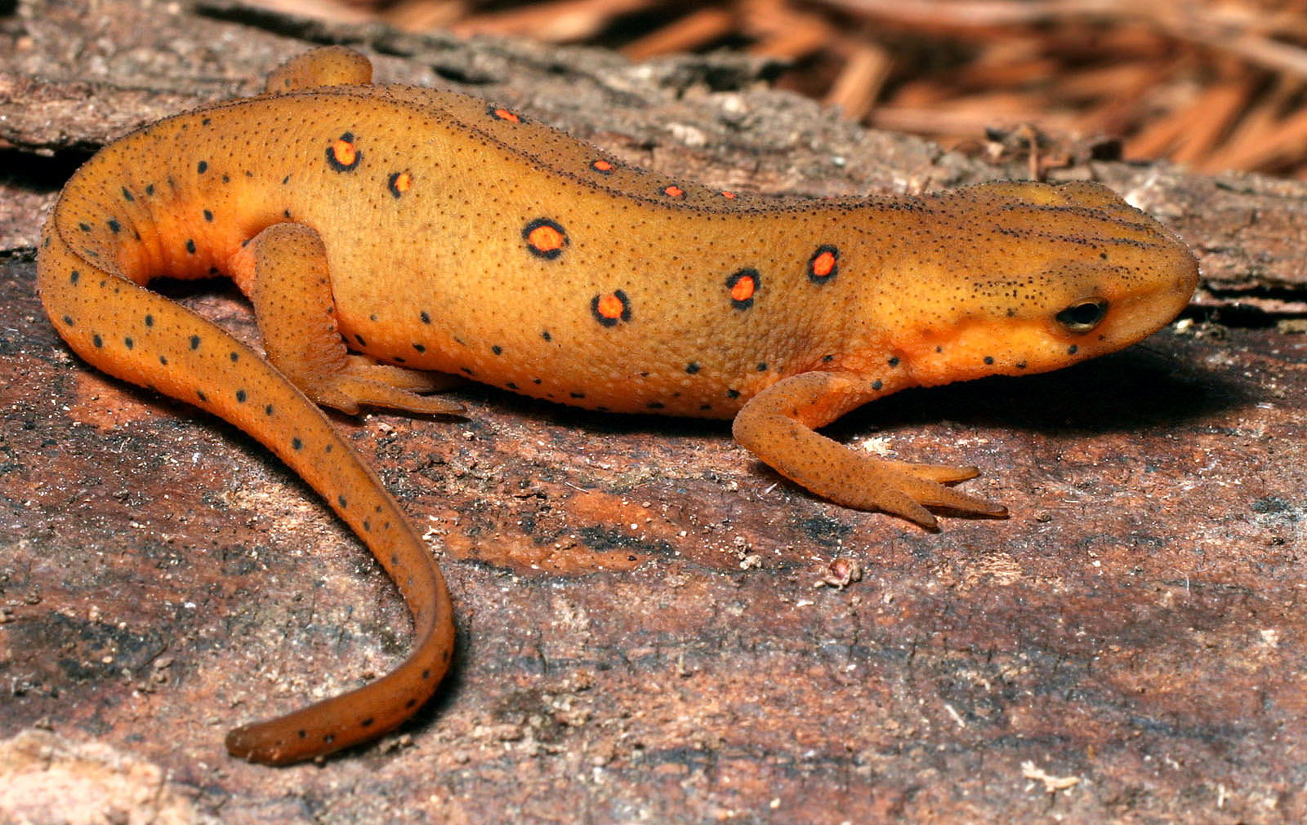
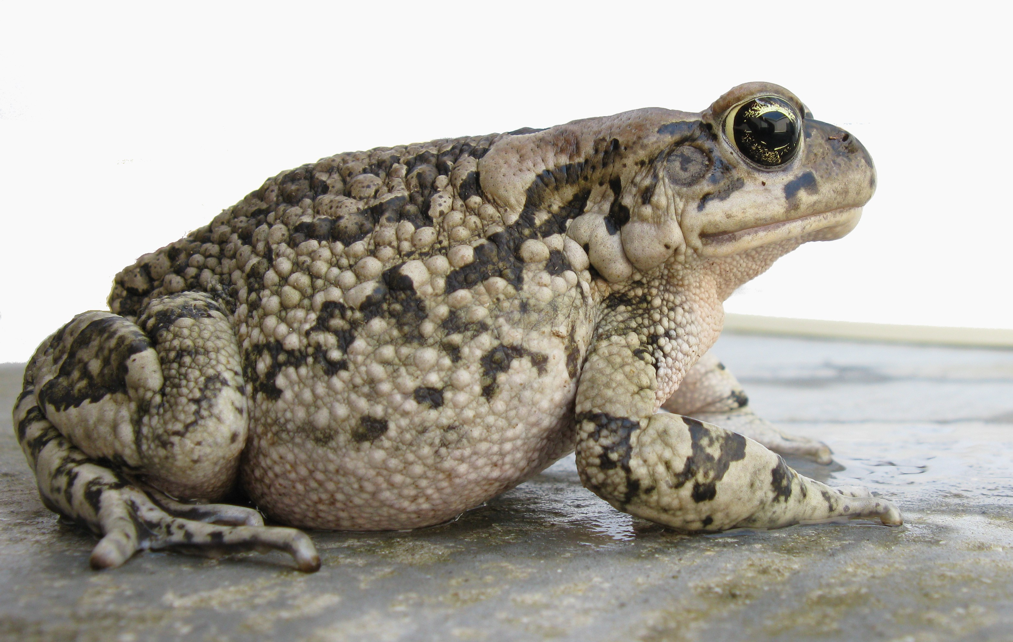
Amphibians
They live on land and in water
Frogs
They start their lives in water
with gills and tails. Then grow
lungs and legs to live on land.
They are cold blooded
Newts
There are 4000 different species
They have webbed feet and smooth skin
Toads

Slide 7
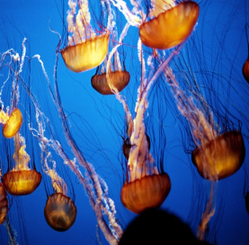
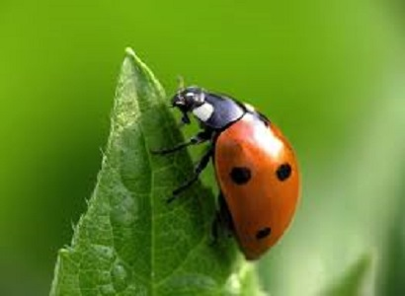
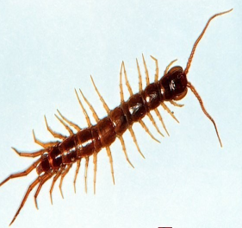
Invertebrates
Invertebrates do not have a backbone.
Invertebrates include animal groups such as insects, sponges, flatworms, molluscs (squid and octopus), arthropods and many others.
They are cold-blooded
Some examples of invertebrates are: ladybirds, squids, bees, snails, centipedes, wasps and flies.

Slide 8
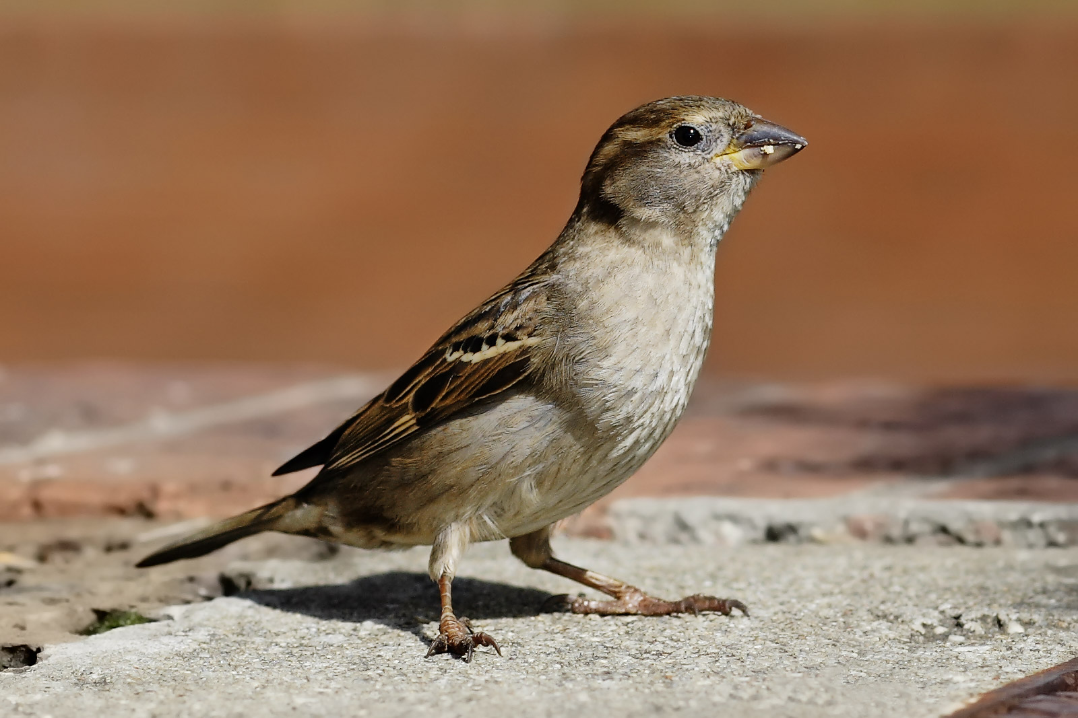
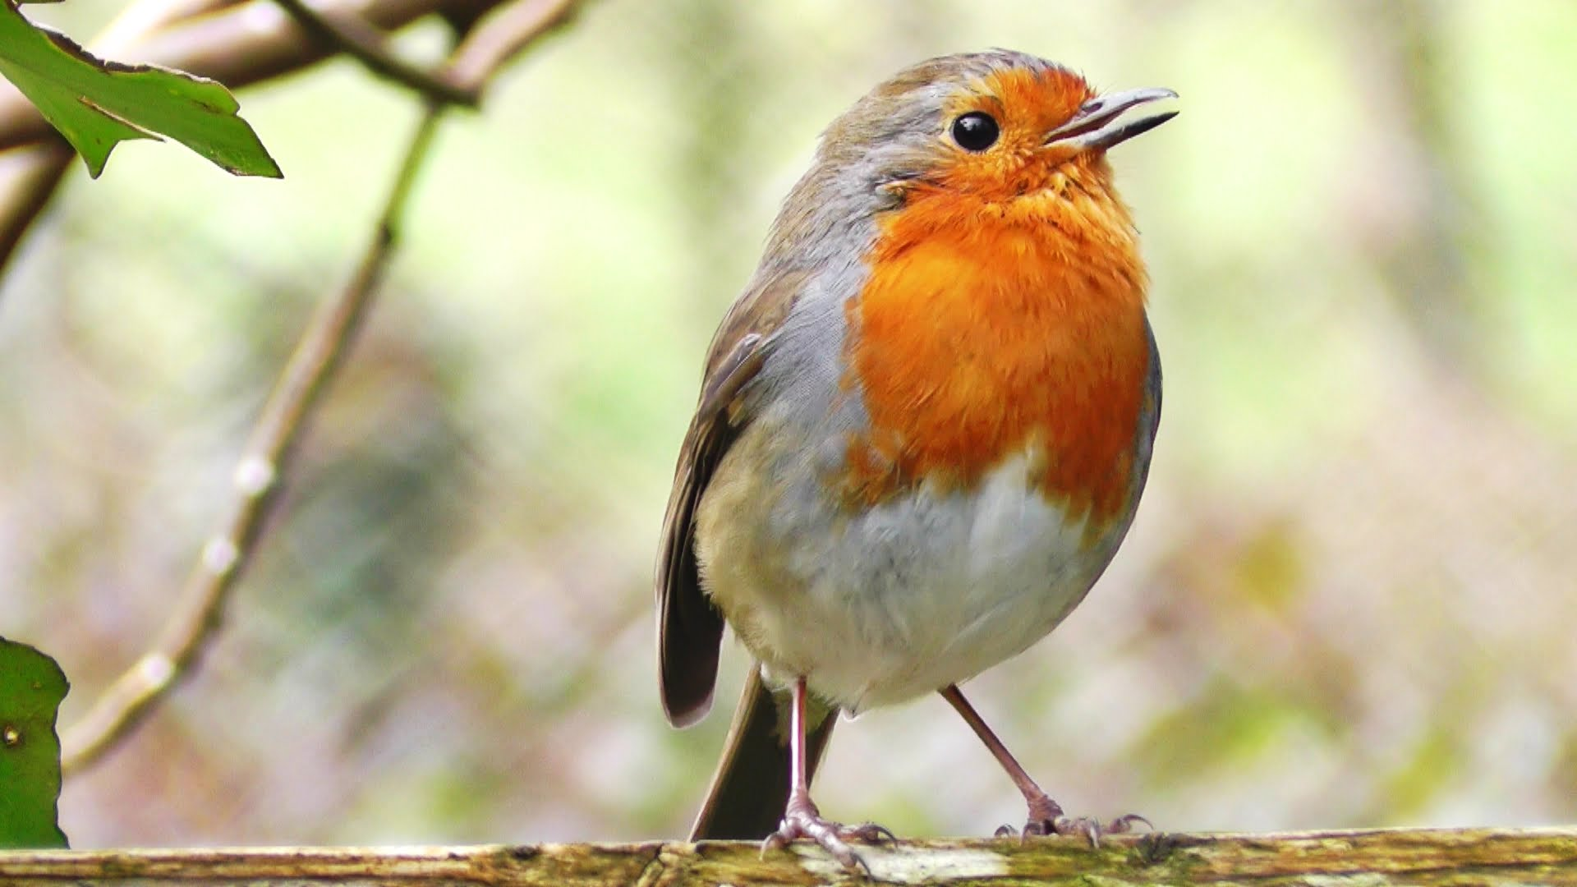
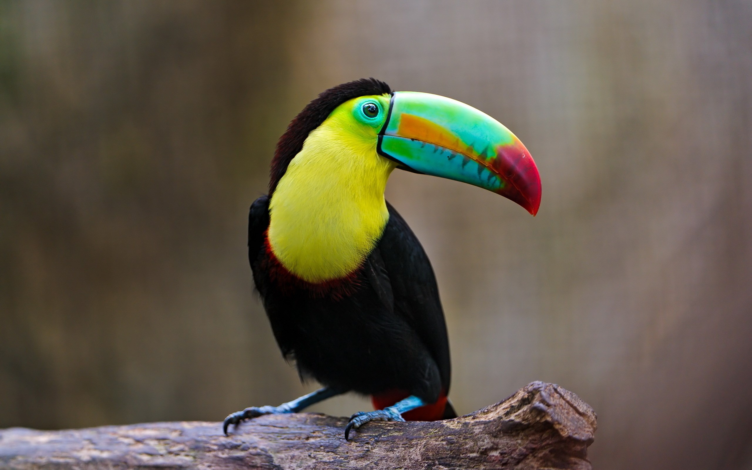
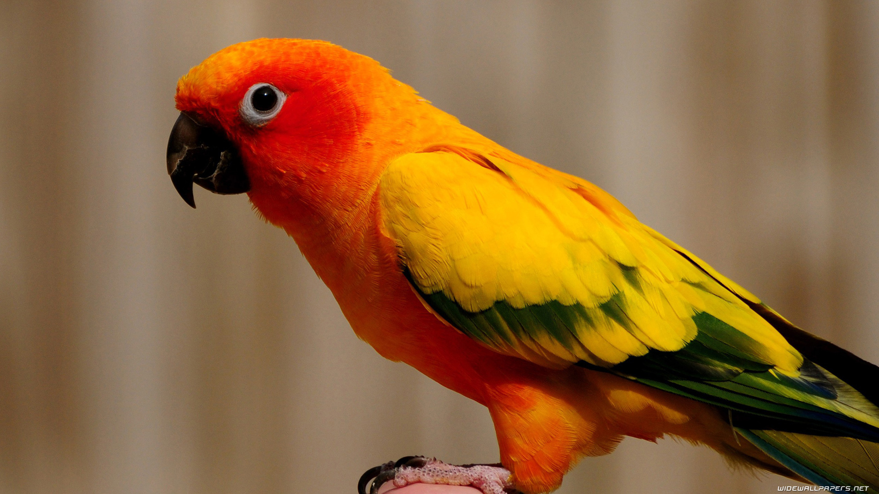
Birds
Birds are warm blooded
They have feathers and wings
Birds have a beak
Most birds can fly
Ostriches, kiwis and penguins lost their ability to fly as their lifestyles were more suited to land or water
They lay eggs

Slide 9
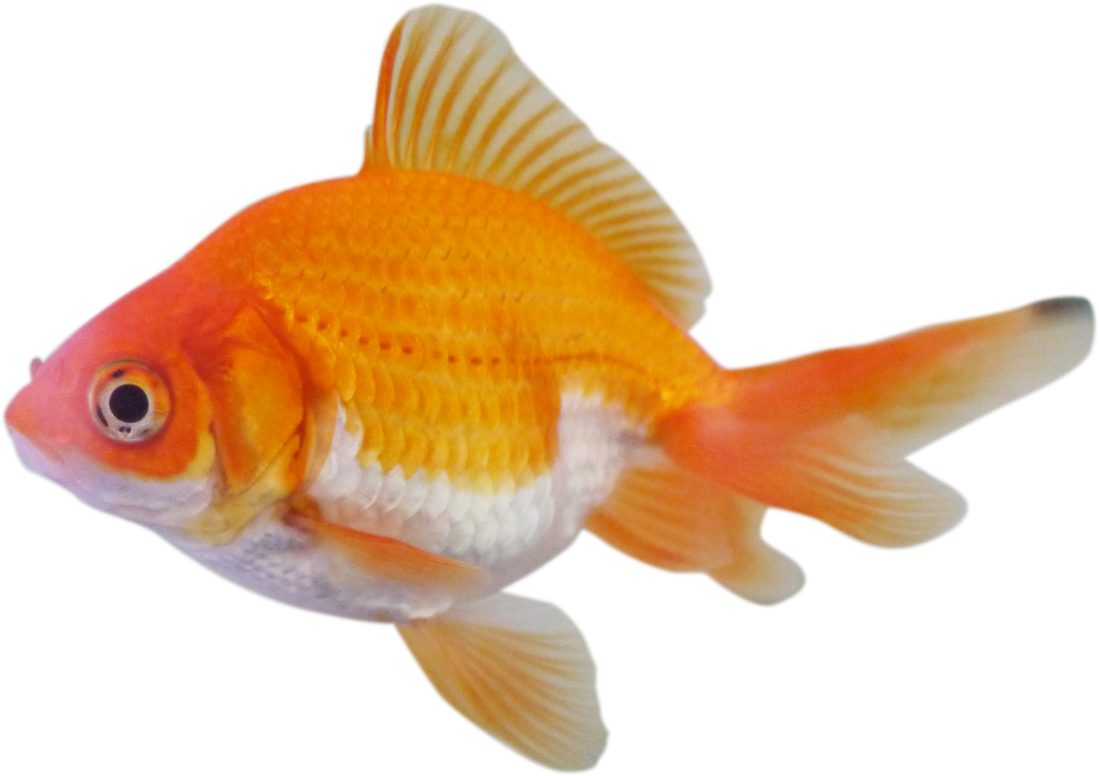
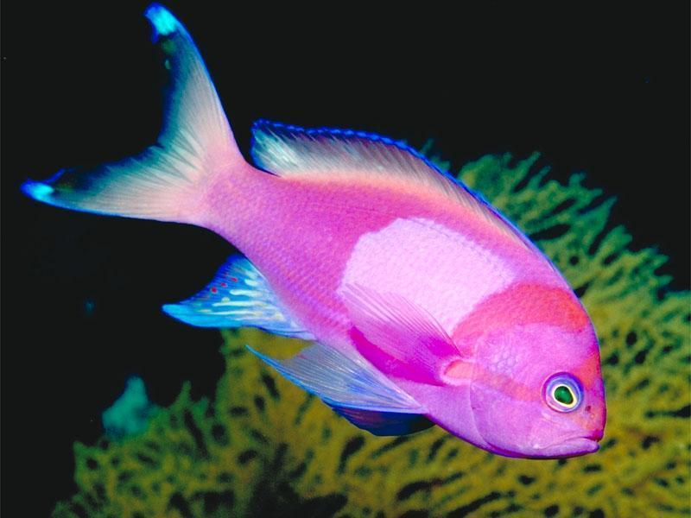
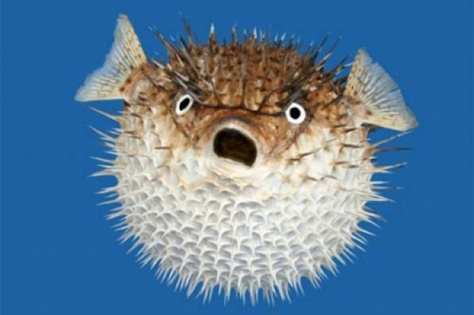
Fish
Fish live in water
They have fins for swimming
They have gills for breathing
They are cold blooded
They have skin covered with scales
They have a backbone

Slide 10
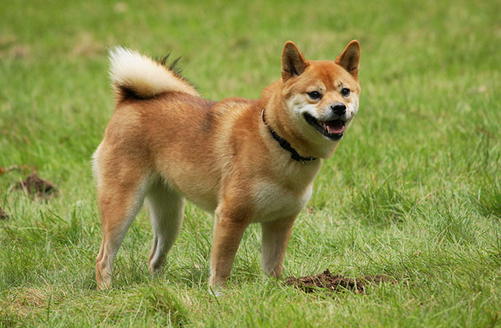
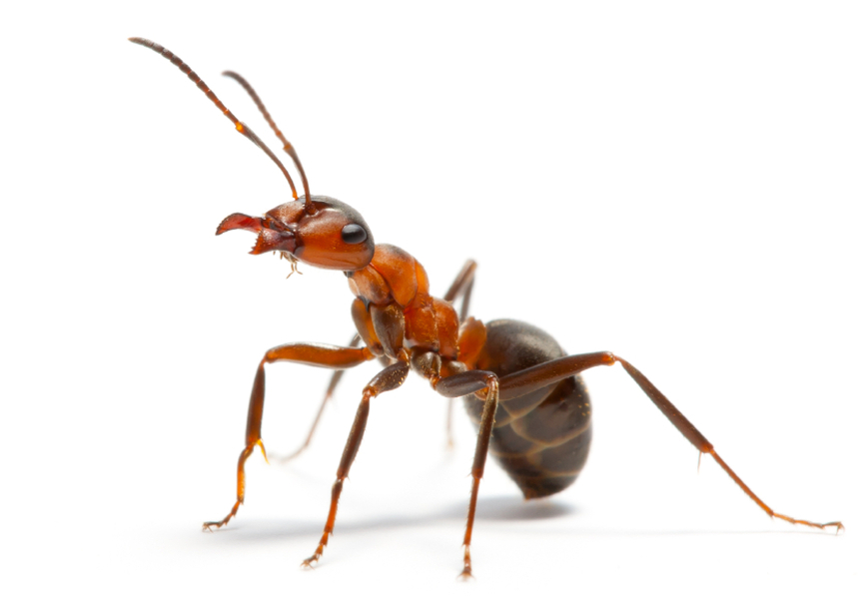
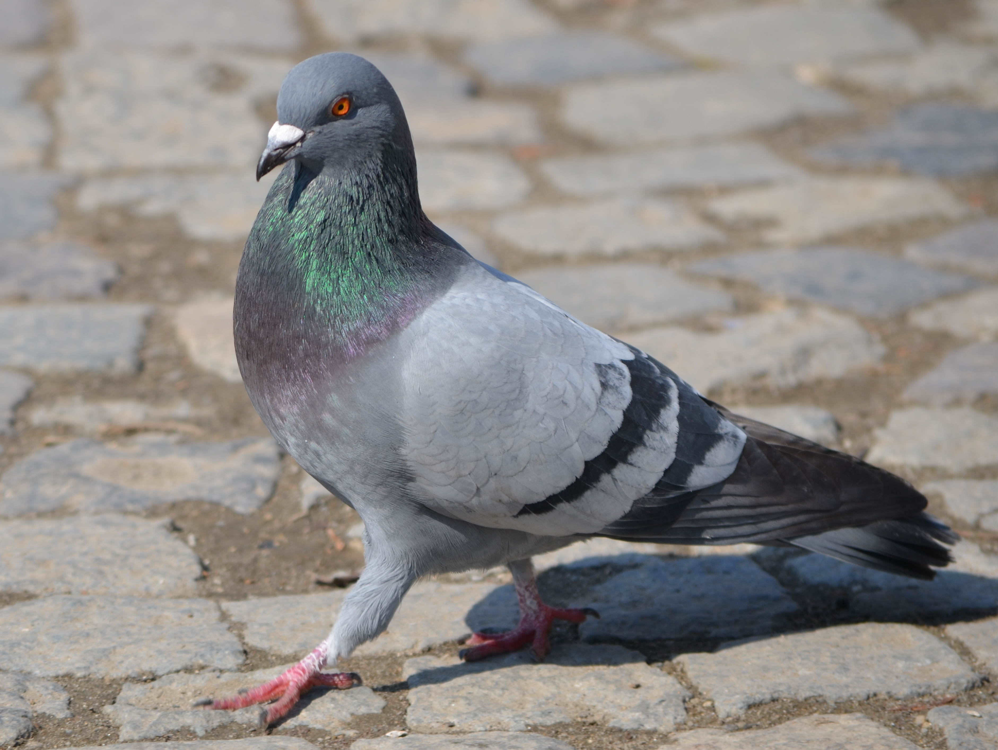
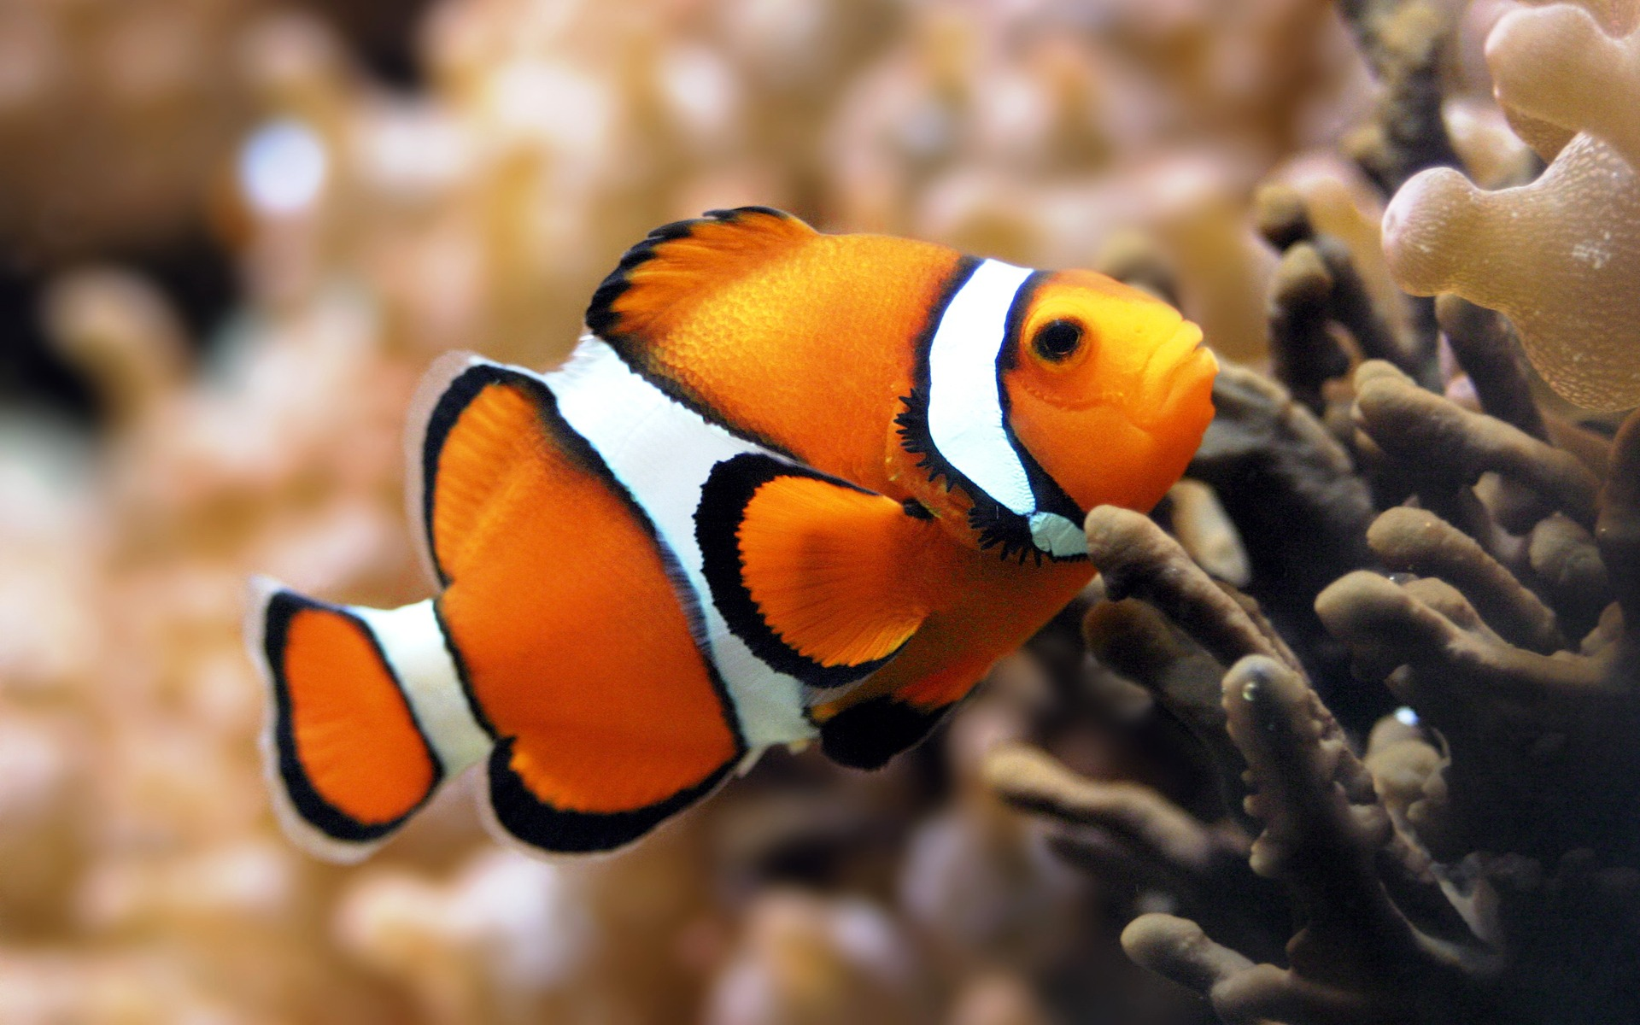
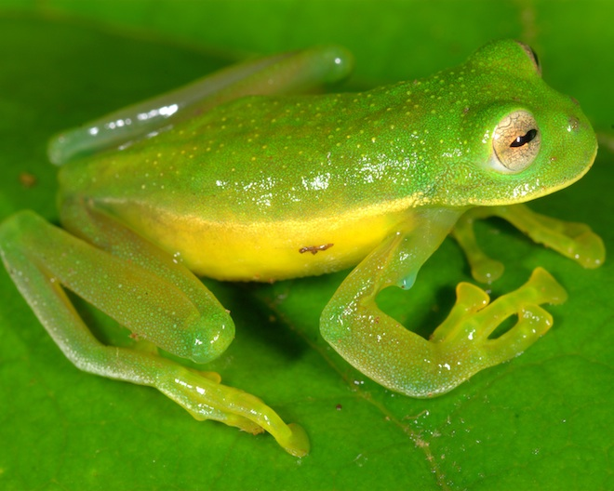
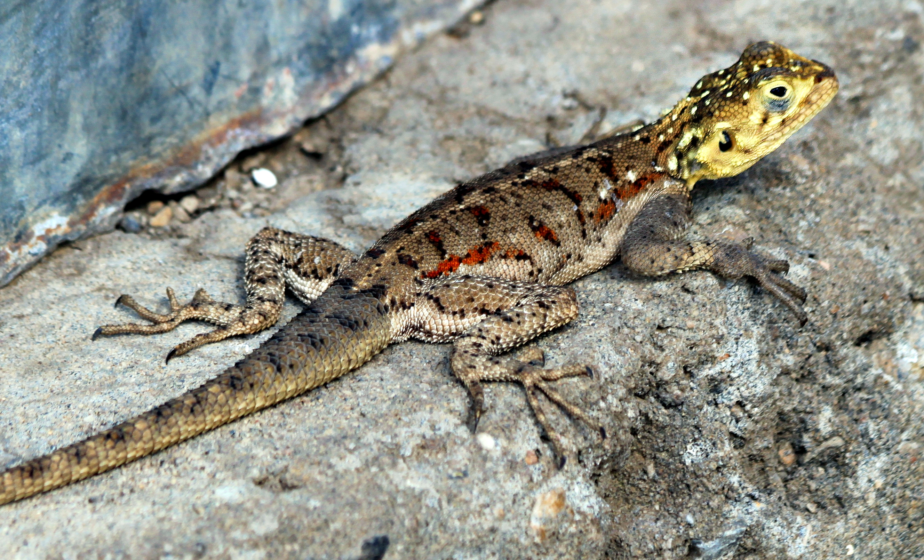
Can you decide which group each of these animals belong to?
Mammal
Invertebrate
Bird
Fish
Amphibian
Reptile

