Slide 1

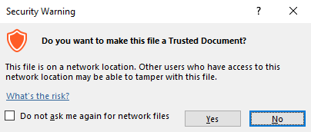
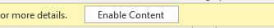
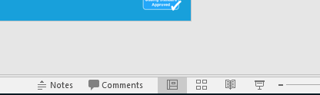
Guidance for Macros in PowerPoints
We use macros within PowerPoints to increase the interactivity of our presentations. Follow this simple process to get the most out of this resource.
What to do:
Open the PowerPoint file and enable editing.
A security warning box may appear. Click yes.
Click enable content.
Enter presentation mode (start the slide show).

Slide 2


Science
Scientists and Inventors
Year One
Science | Year 6 | Scientists and Inventors | Steve Jobs | Lesson 7

Slide 3
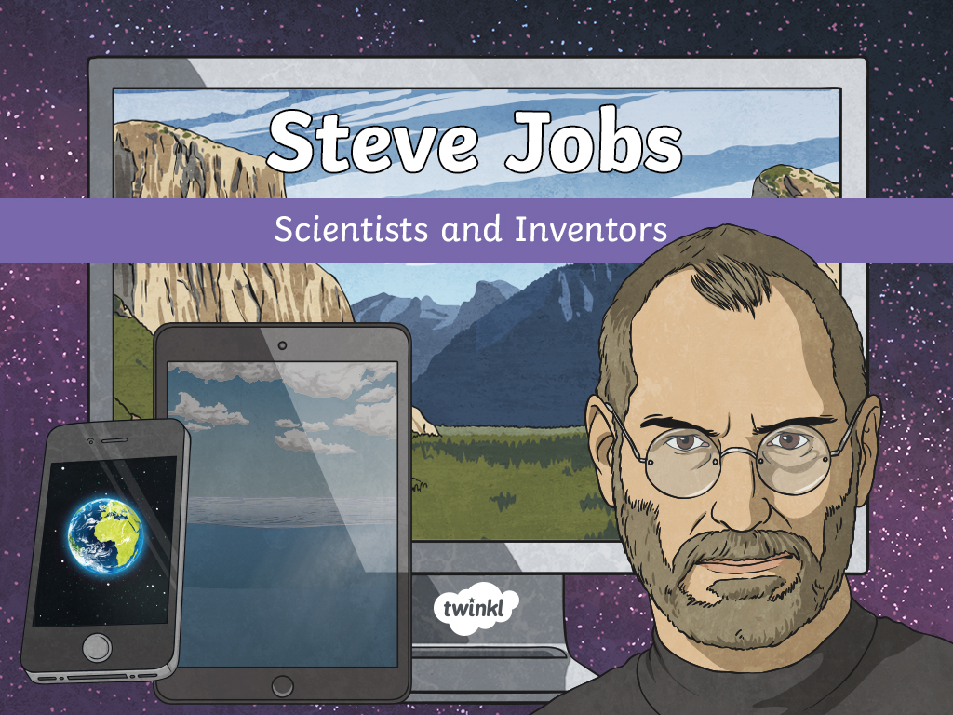

Slide 4
Aim
To explain how Steve Jobs used electronics to design computers.
To design simple circuits.
Success Criteria
I can answer questions about Steve Jobs’ life and work.
I can use recognised symbols to represent some components used to make computers.
I can build a simple circuit.

Slide 5
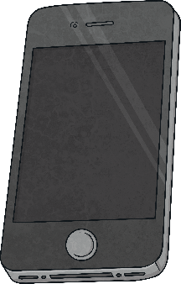


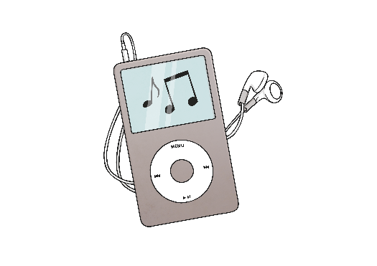
Everyday Technology
Technology is a massive part of our lives. Talk to your partner about the electronic devices that your family own and the ways technology is used everyday.

Slide 6
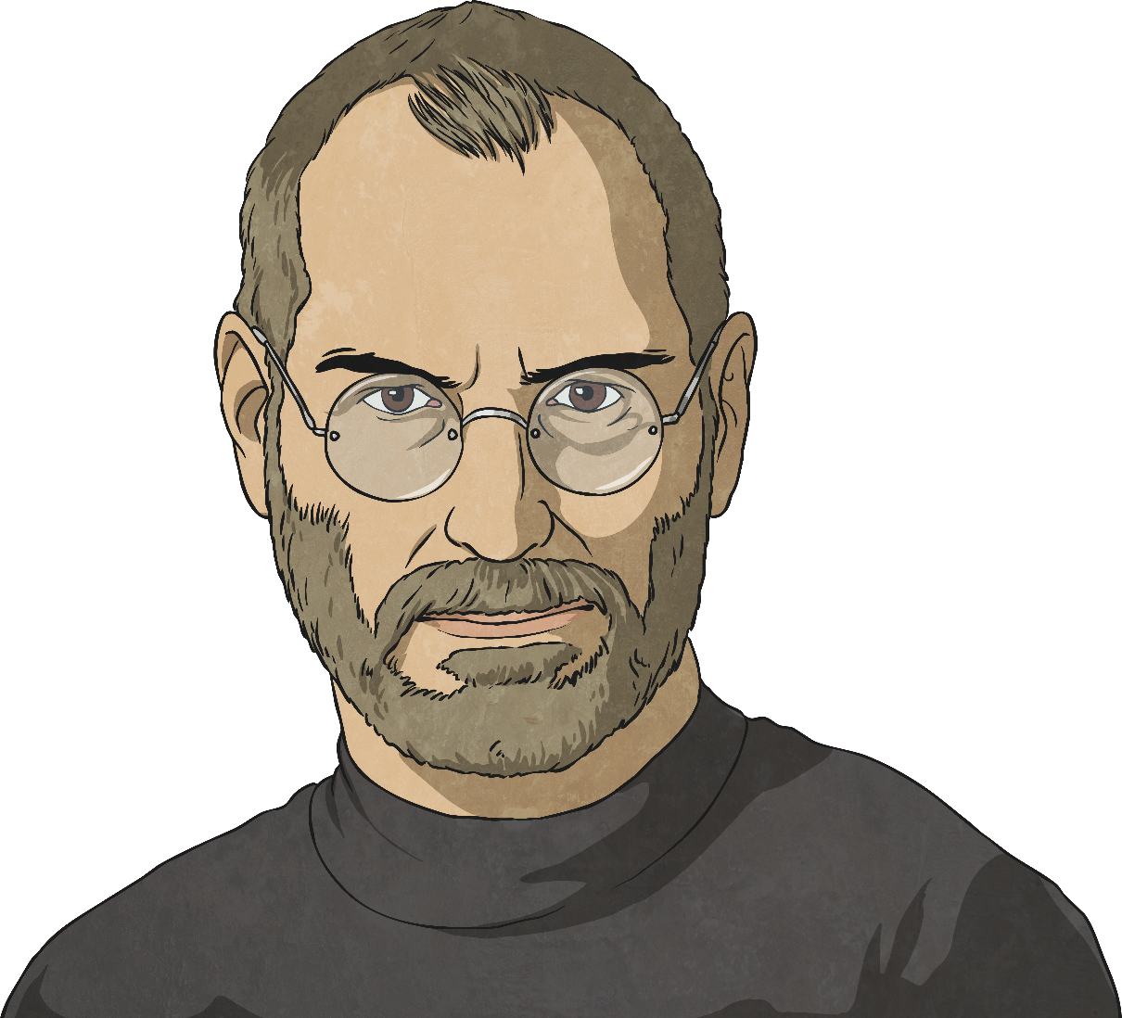
Steve Jobs
Steve Jobs was an innovator, inventor and entrepreneur who introduced new technologies to the public.
He co-founded the technology company, Apple Incorporated, and launched the iPod, iPhone and iPad.
These devices changed the way technology is used in everyday life.

Slide 7
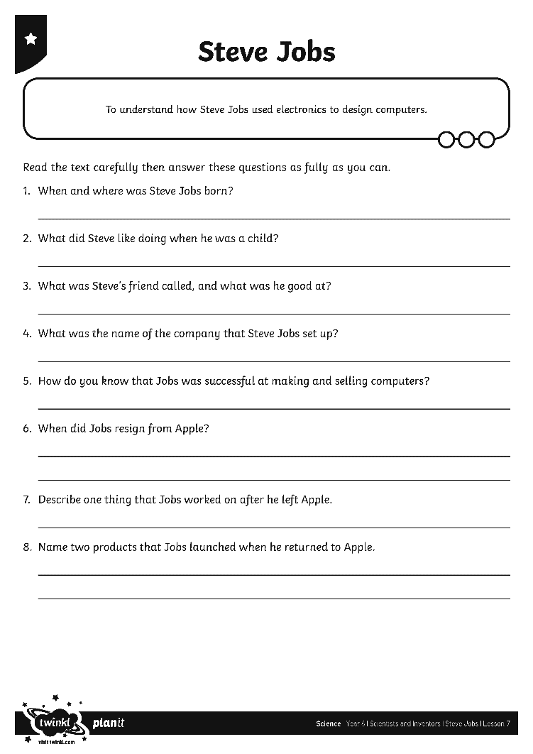
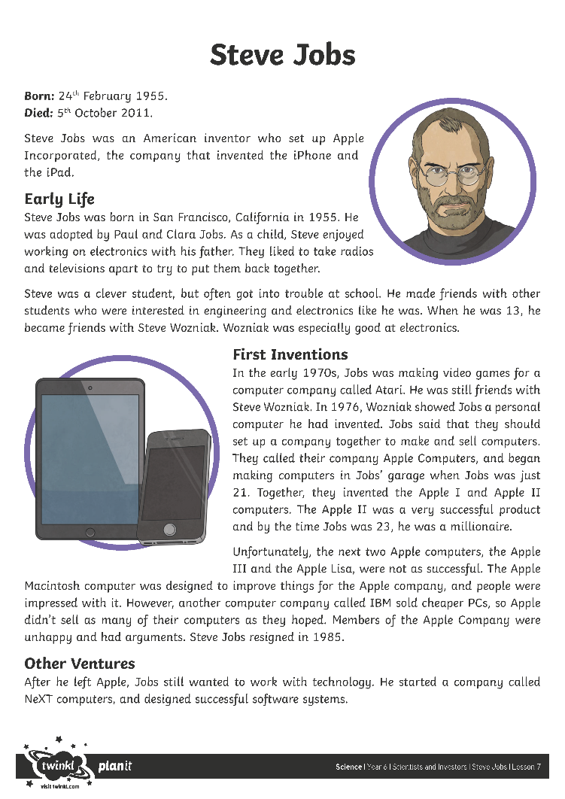
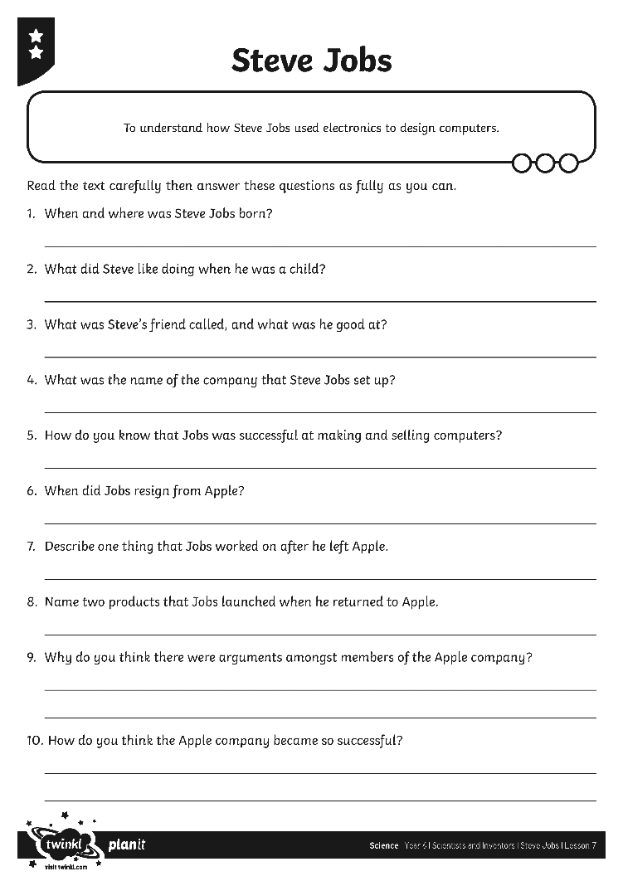
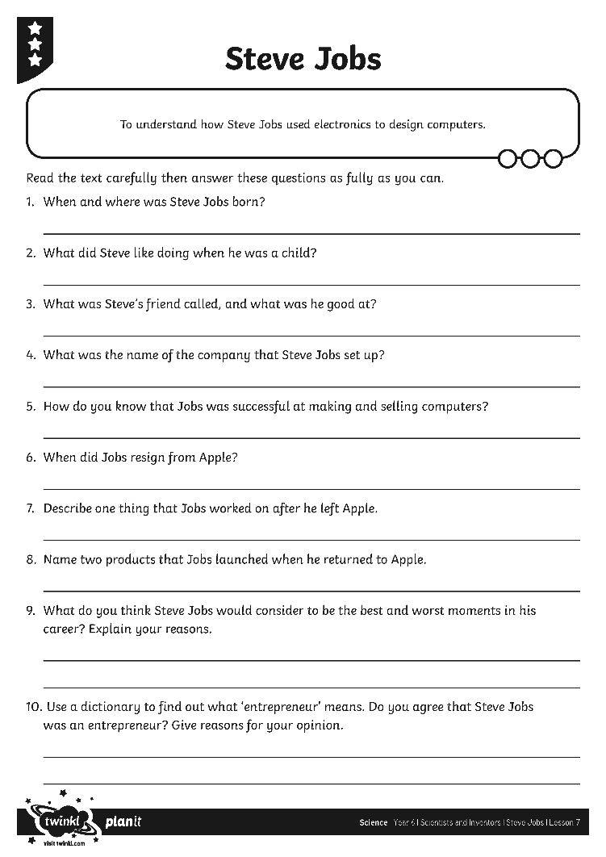
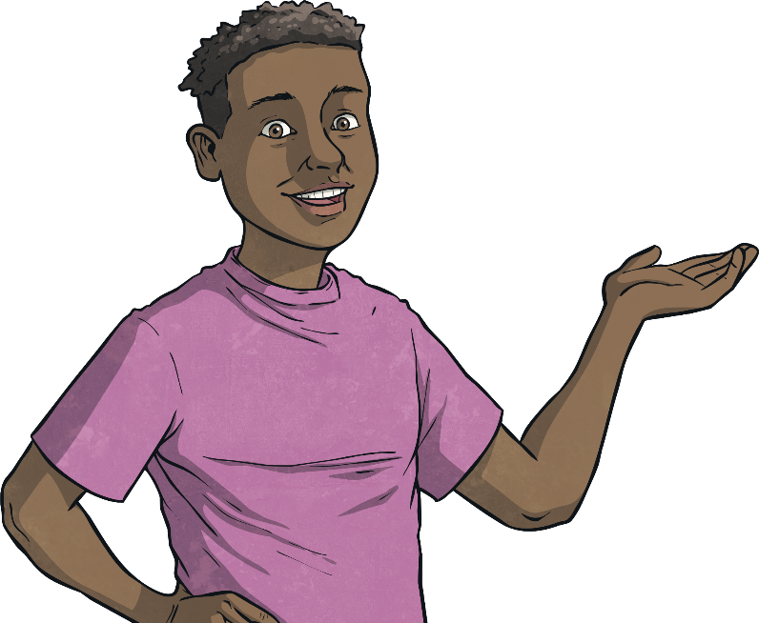
Steve Jobs Comprehension
Read the Steve Jobs Fact Sheet to find out about his life and work.
Then answer the questions on the Steve Jobs Comprehension Questions sheet.

Slide 8
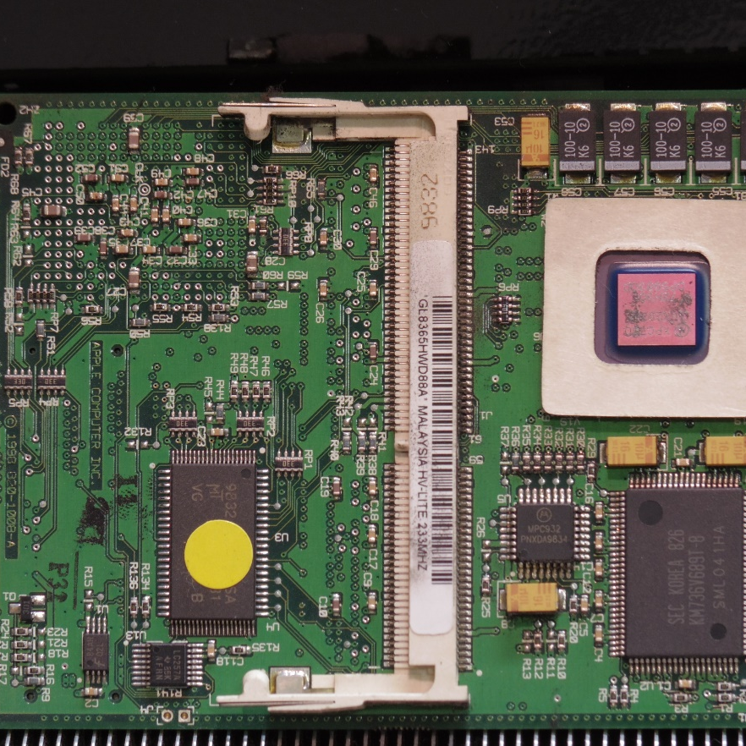
Computer Components
Steve Jobs designed the first Apple computer along with Steve Wozniak. Can you imagine how a computer is made?
A computer is an electronic machine that processes information.
It is made of different hardware, including circuit boards.
These circuit boards contain different electrical components. They are extremely complex!
‘’iMac Rev.A CPU Board 820-1008-A’’ by [htomari] is licensed under CC BY 2.0

Slide 9
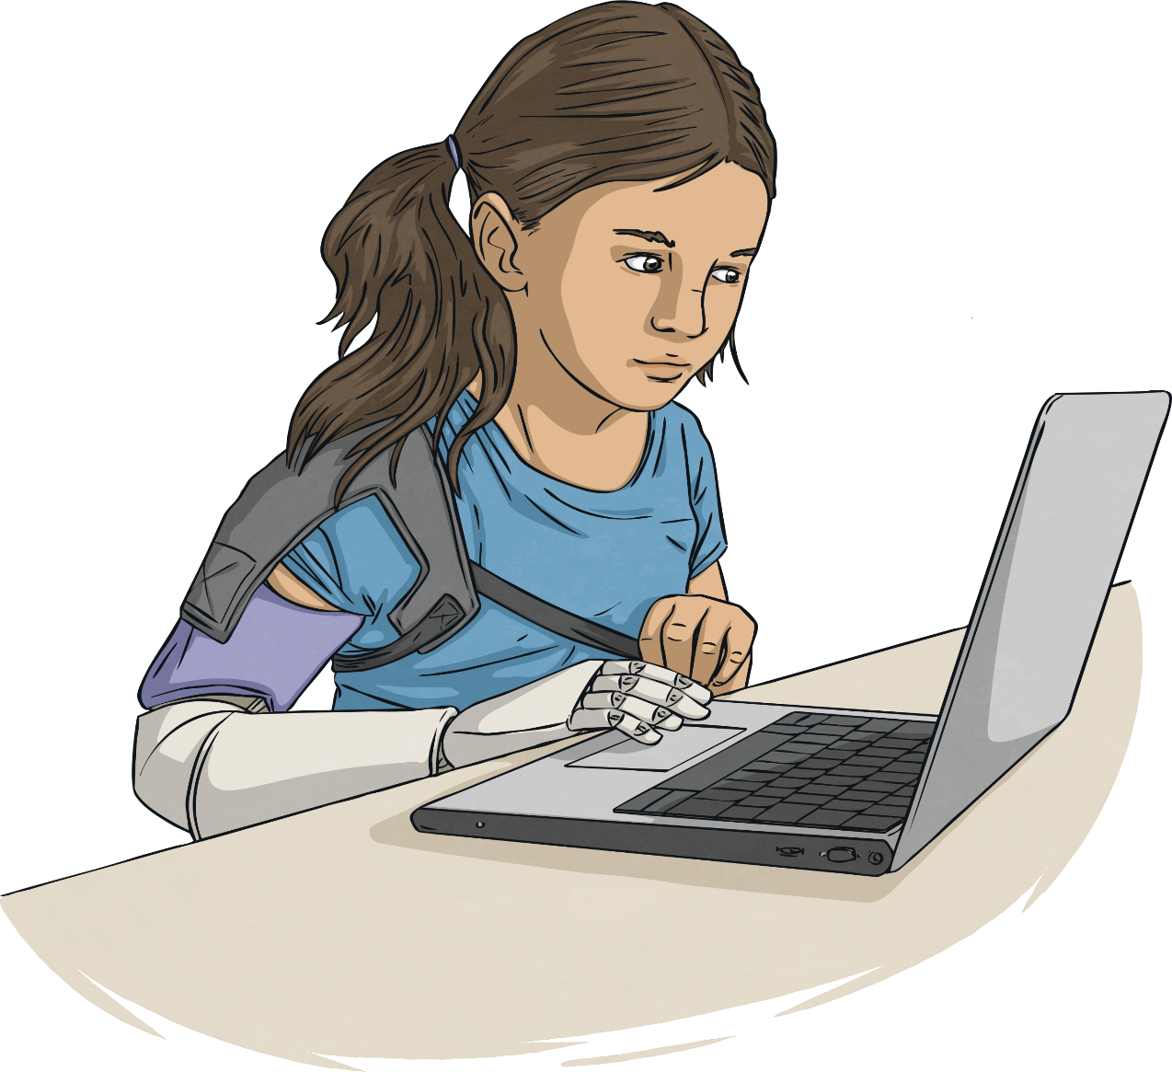
Computer Components
Despite the complexity of a computer circuit board, some of the components in a computer will be familiar to you.
battery – Powers the computer, or parts of the computer.
switch – Allows electrical current to flow or stop flowing.
motor – Moves the disk drive and the cooling fans.
bulb – Lights up when the computer is switched on.

Slide 10
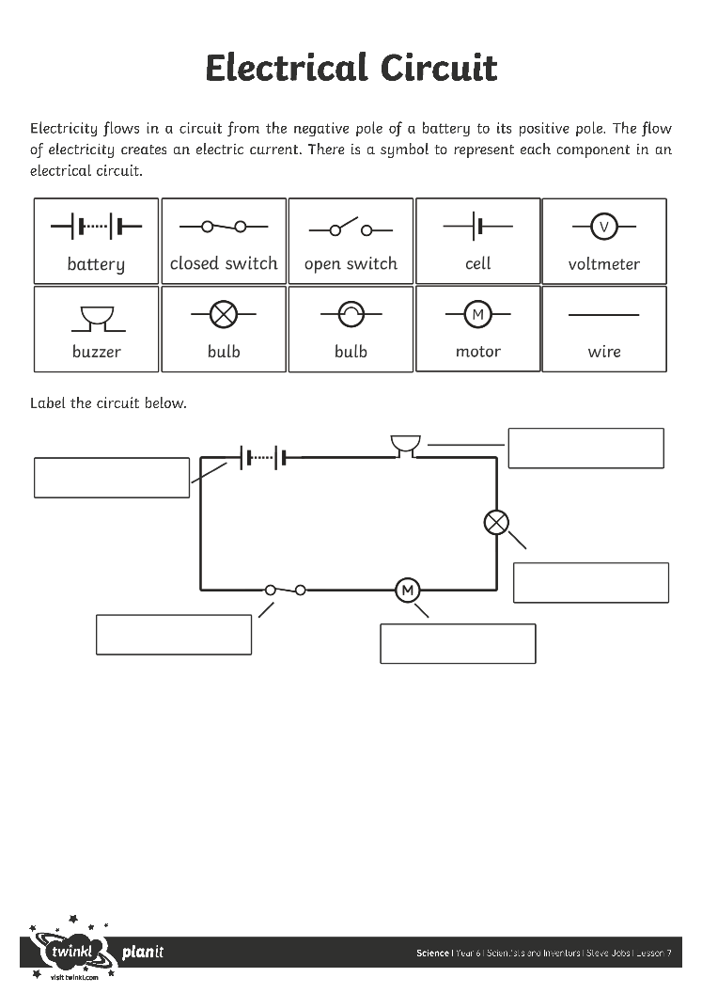
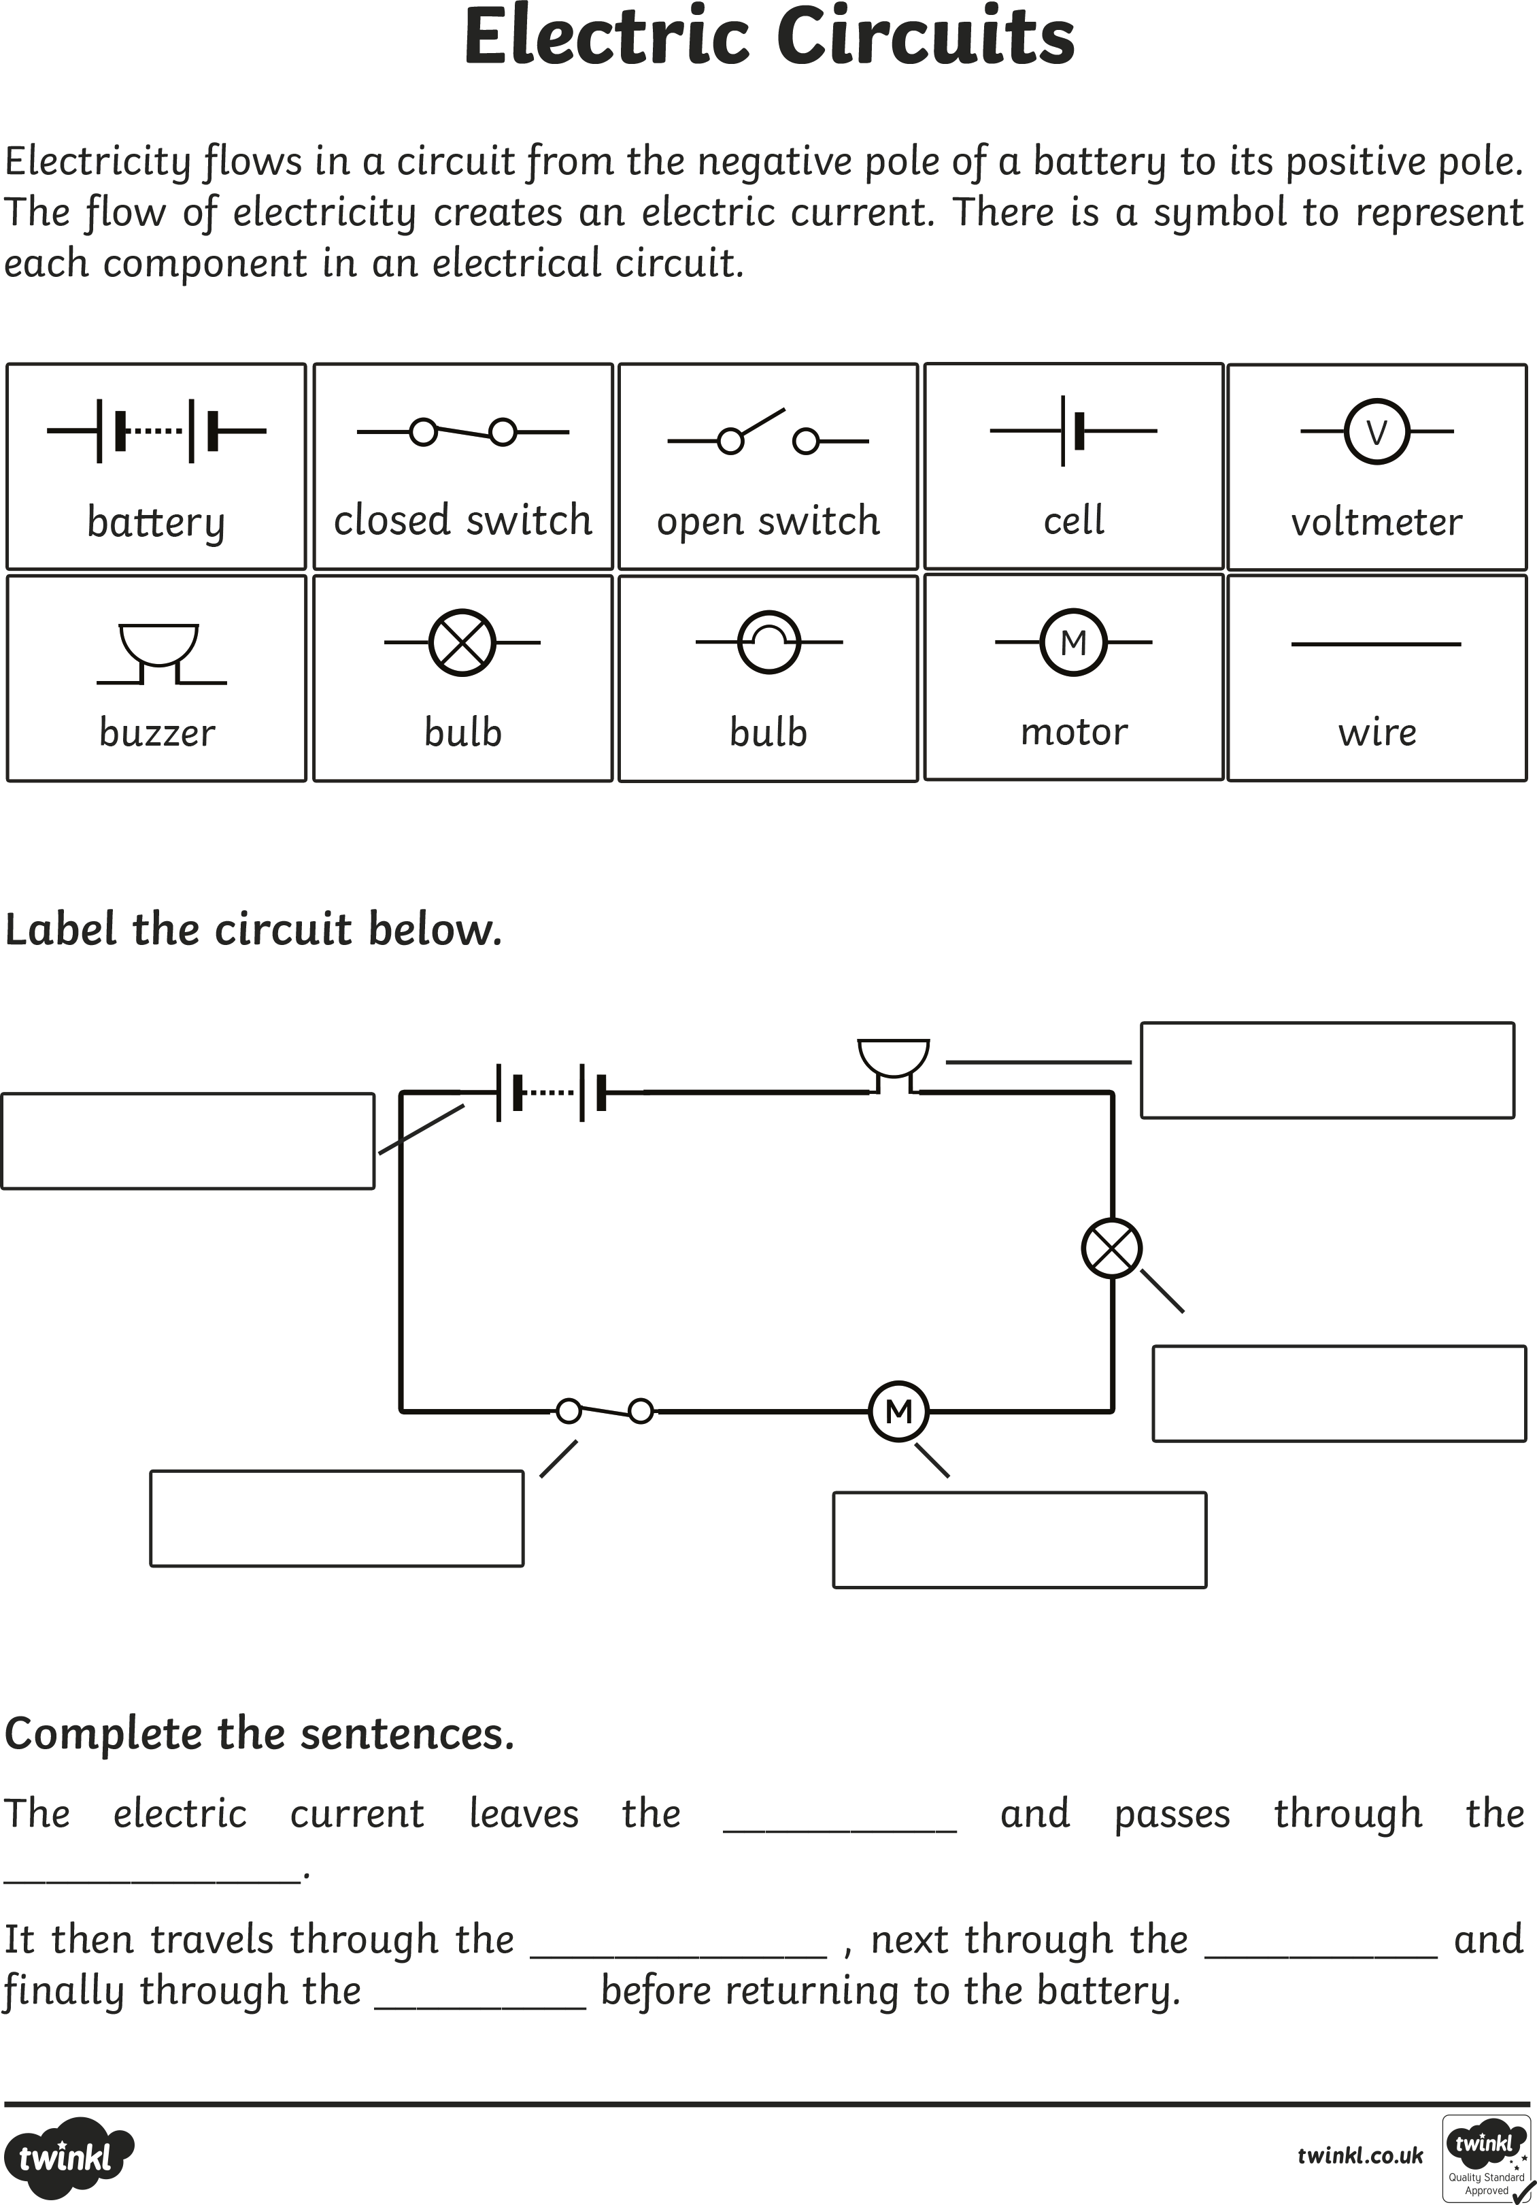

Electric Circuits
Use the Electrical Circuit Activity Sheet to make sure you are familiar with them.
A battery, switch, motor and bulb are represented using these symbols:
battery
switch
motor
bulb
Do you know any more?

Slide 11

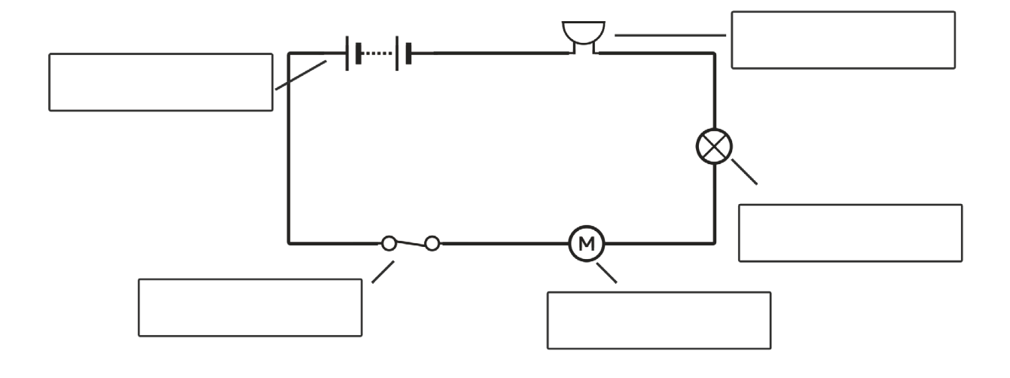
Electric Circuits
buzzer
battery
bulb
closed switch
motor
Which of these components would you need to build a fan?

Slide 12
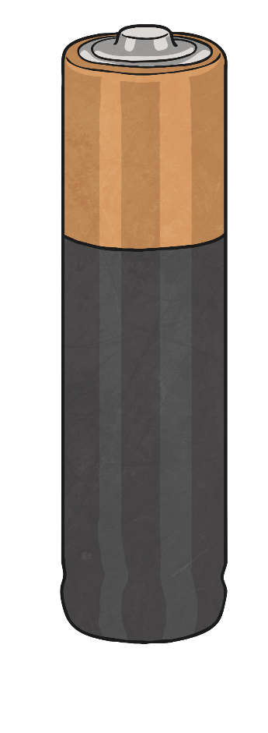
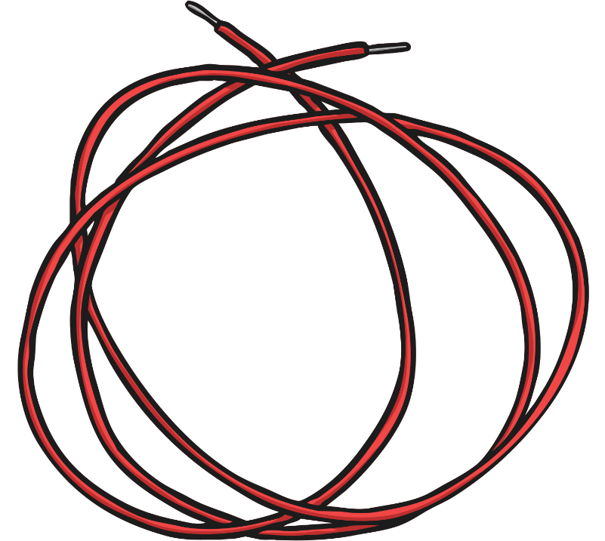
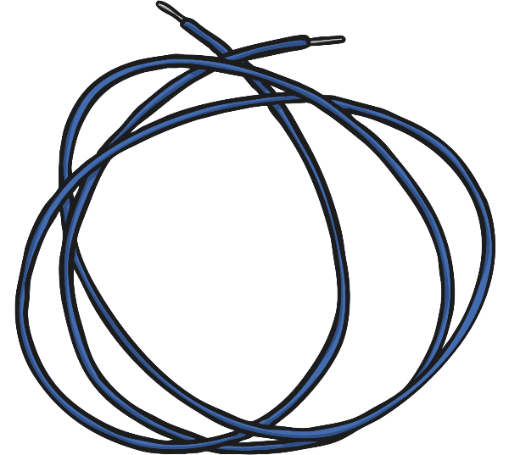
Circuit Building
Use the electrical components provided to build a circuit which could power a fan inside a computer.
When your circuit works, draw a diagram of your circuit using the correct symbols.
Remember to use a ruler as your wires should be drawn as straight lines.

Slide 13
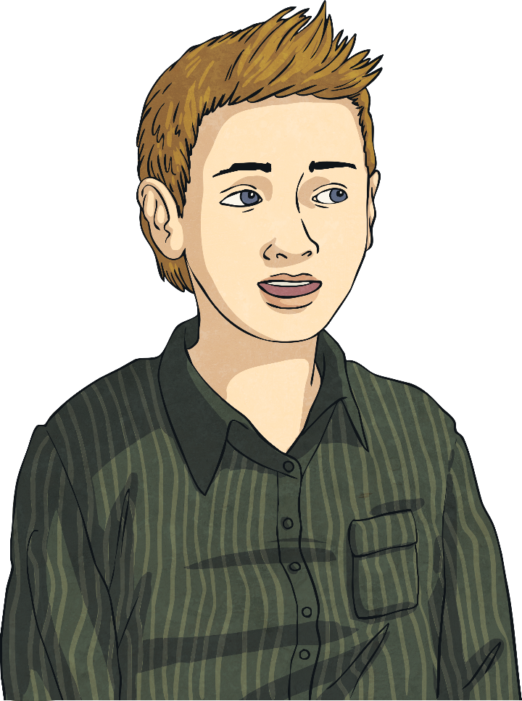
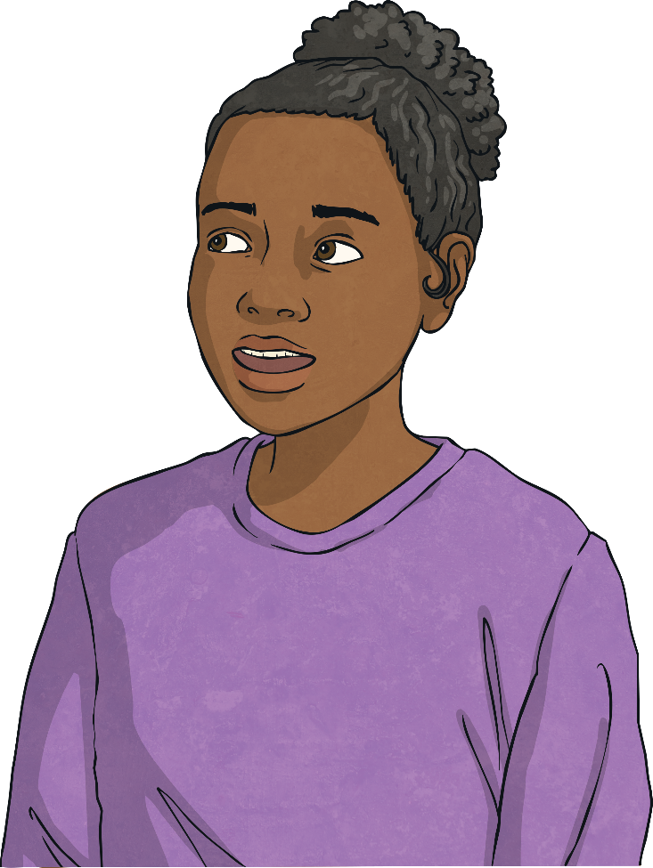
Life with Technology
Steve Jobs introduced many new technologies onto the market, including Apple computers, the iPhone and the iPad.
How have these technologies changed our lives? Talk to your partner about how life would be different without them.

Slide 14

Aim
To explain how Steve Jobs used electronics to design computers.
To design simple circuits.
Success Criteria
I can answer questions about Steve Jobs’ life and work.
I can use recognised symbols to represent some components used to make computers.
I can build a simple circuit.

