Slide 1

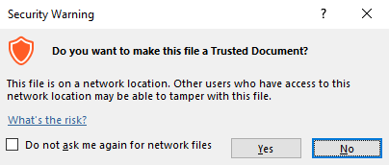
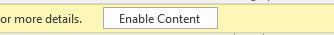

Guidance for Macros in PowerPoints
We use macros within PowerPoints to increase the interactivity of our presentations. Follow this simple process to get the most out of this resource.
What to do:
Open the PowerPoint file and enable editing.
A security warning box may appear. Click yes.
Click enable content.
Enter presentation mode (start the slide show).

Slide 2

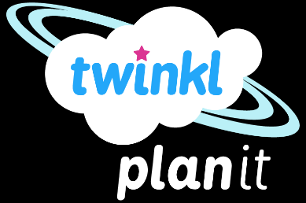
Science
Scientists and Inventors
Year One
Science | Year 6 | Scientists and Inventors | Libbie Hyman | Lesson 2

Slide 3
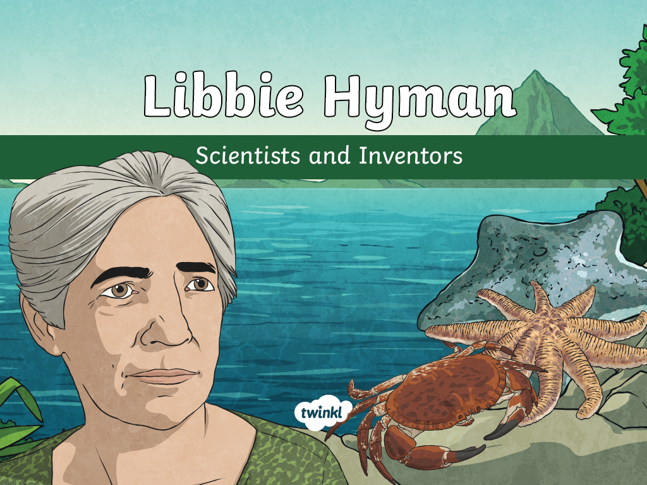

Slide 4
Aim
To understand Libbie Hyman’s work about classification.
Success Criteria
I can describe Libbie Hyman's life and her work on invertebrates.
I can classify invertebrates.
I can describe the characteristics of invertebrates.

Slide 5
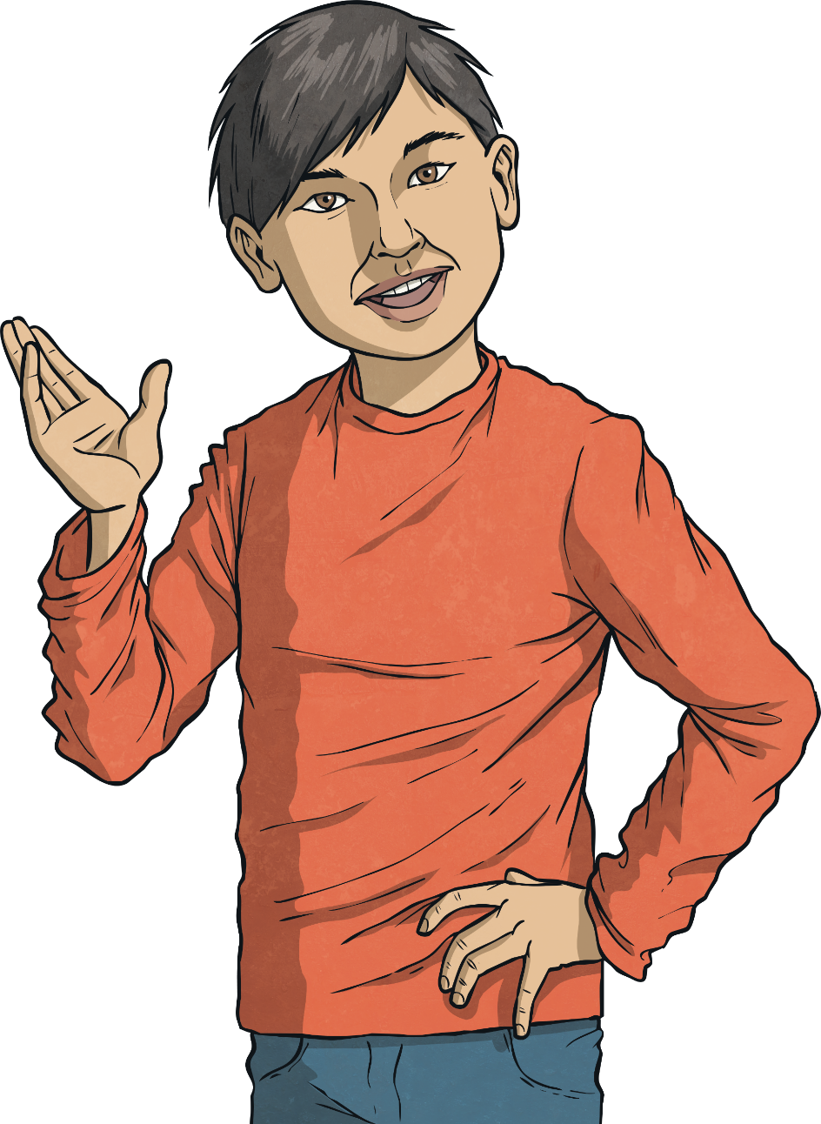

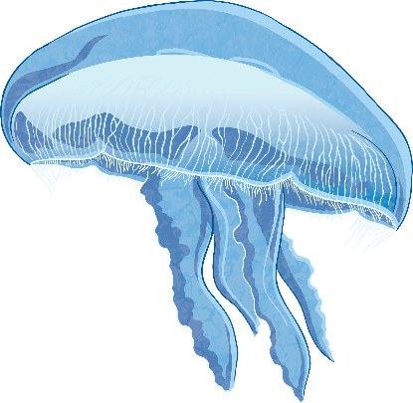
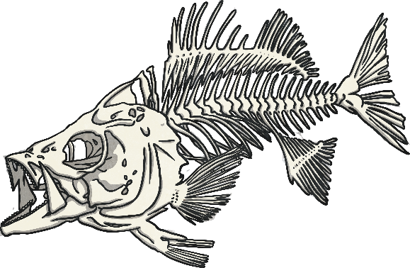
Vertebrates and Invertebrates
All animals can be classified as either vertebrates or invertebrates. What is the difference?
The difference between the two types of animals is that invertebrates do not have a backbone or spinal column.
Talk to your partner about the different phyla or classes of vertebrates and invertebrates that you can recall.

Slide 6
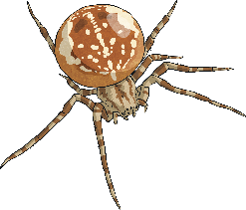
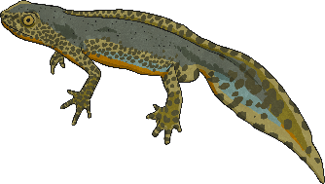
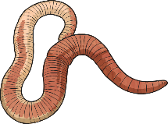
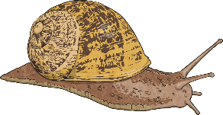
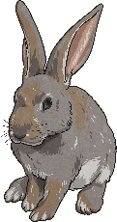
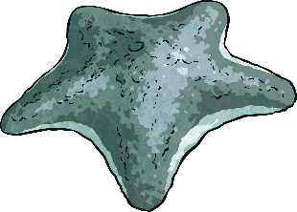
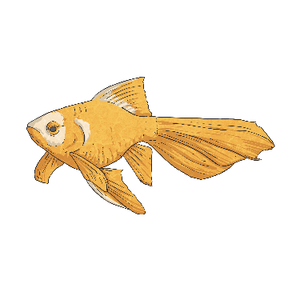
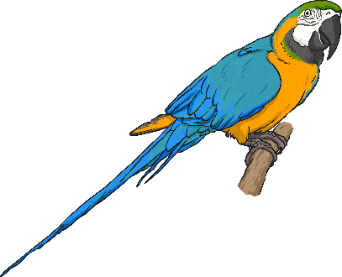
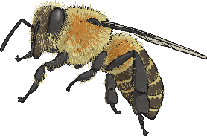
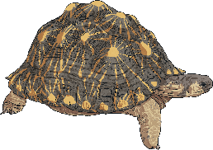
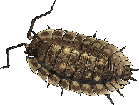
Vertebrates and Invertebrates
Did you discuss any of these phyla or classes? Which of them are vertebrates and which are invertebrates?
Class: Arachnids
Class: Amphibians
Phylum: Annelids
Phylum: Molluscs
Phylum: Echinoderms
Class: Mammals
Class: Fish
Class: Birds
Class: Insects
Class: Reptiles
Phylum: Crustaceans

Slide 7
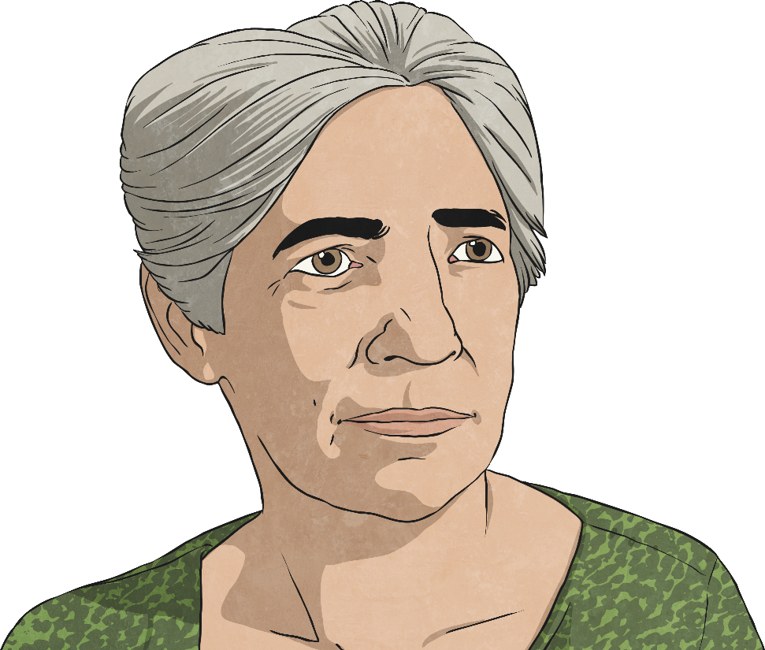
Libbie Hyman
Libbie Hyman was a zoologist who researched vertebrates and invertebrates. She published highly detailed volumes of work about the characteristics and the taxonomy of invertebrates.
Her work is widely regarded as an incredible achievement and is considered to be extremely important and useful for the study of different animals.
She described the anatomy and characteristics of different vertebrates and invertebrates and explained how they should be classified.
The books that she wrote are still used by scientists today.

Slide 8
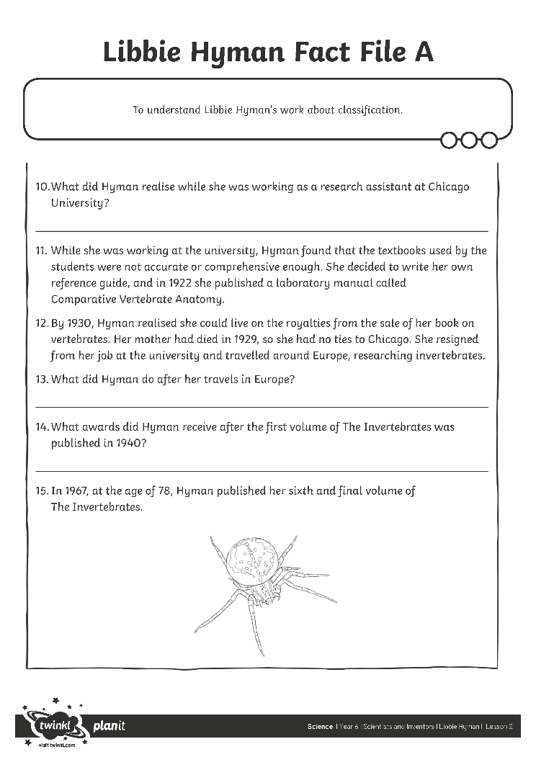
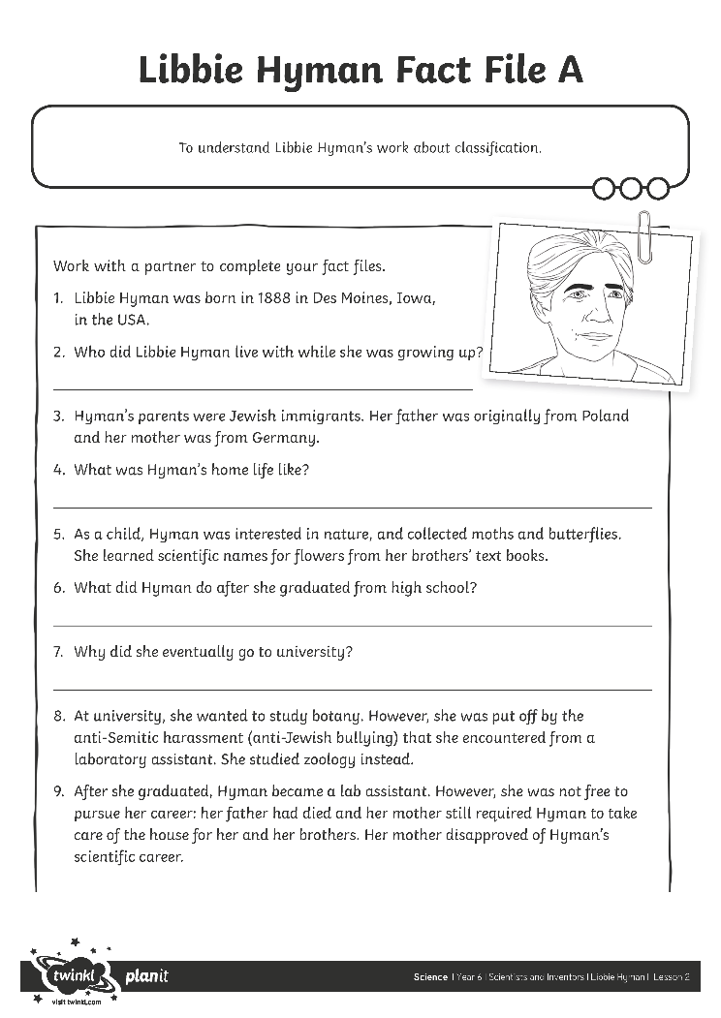
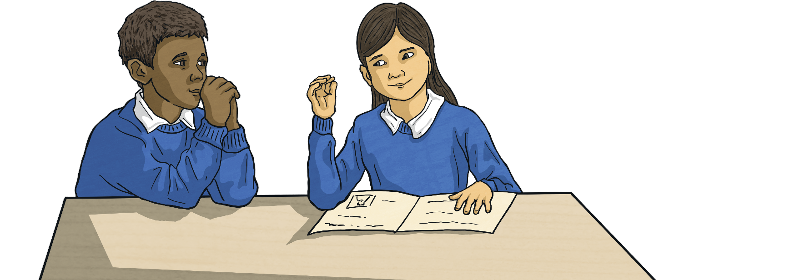
Libbie Hyman Fact File
Work with a partner to create a fact file about Libbie Hyman's life and her scientific achievements.
Use your Libbie Hyman Fact File Activity Sheet to answer their questions. Your partner will fill in their fact file with your answers.
Take it in turns to act in role as Libbie Hyman.
When your partner is in role as Hyman, you should ask them the questions on your fact file. They will answer in role, and you can complete your fact file.
When you are in role as Hyman, your partner will ask you questions.

Slide 9
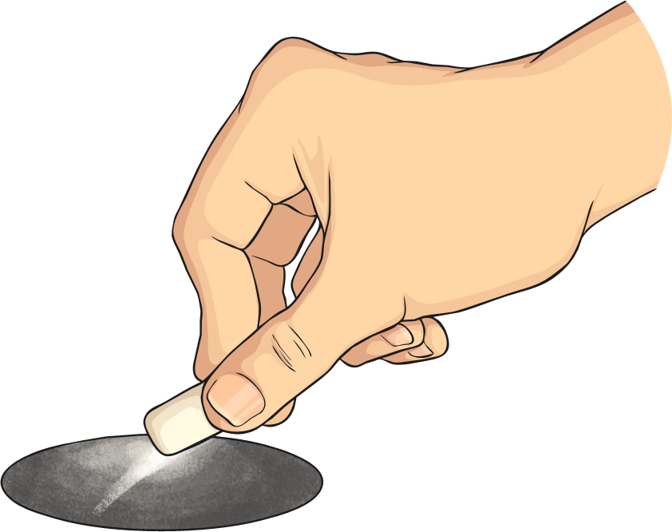
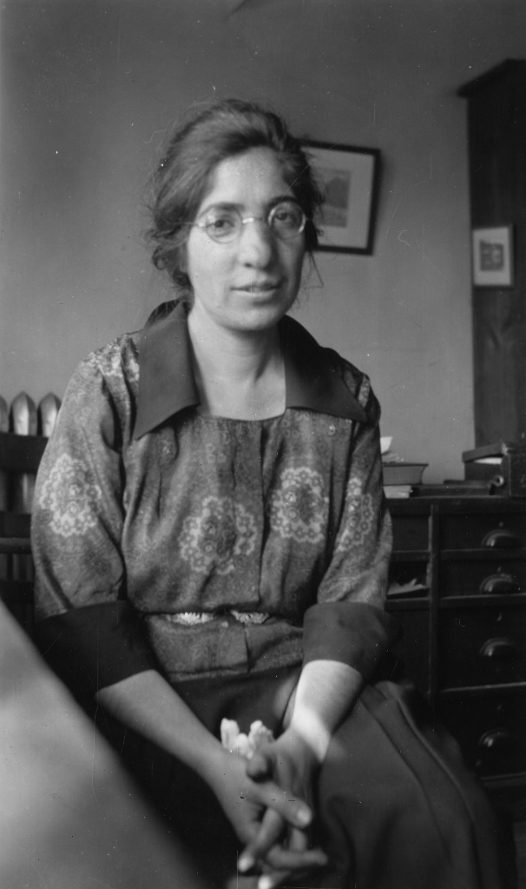

The Invertebrates
She attended art classes so that she could illustrate her own work.
Hyman's most important achievement was her publication of her six-volume work on the classification of invertebrates.
Her accomplishments are considered so great because she conducted this incredible work by herself, without a team of researchers or any partners.
The Invertebrates was published between 1940 and 1967. Hyman researched invertebrates from other scientists' papers and by analysing specimens of different animals.
She had no assistant or secretary, and typed every word of her books. This was very unusual and makes her achievements even more special.
Hyman's books are recognised as an authority on the anatomy and classification of invertebrates.

Slide 10
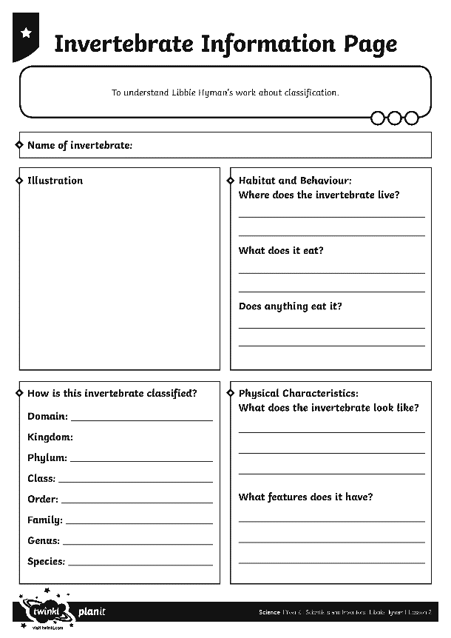
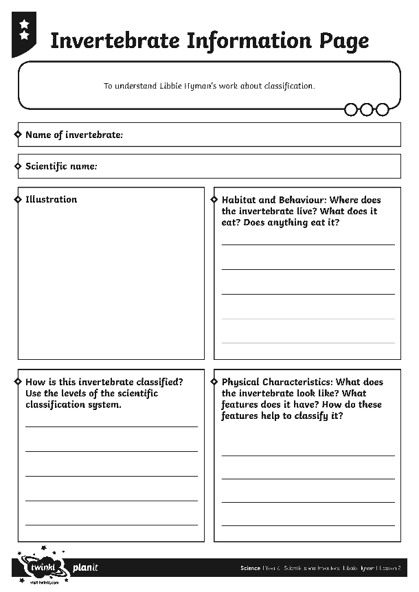
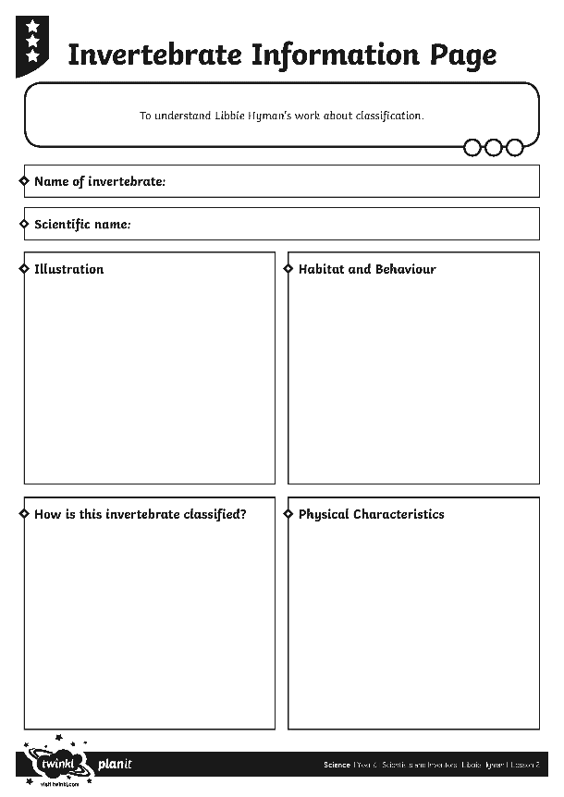
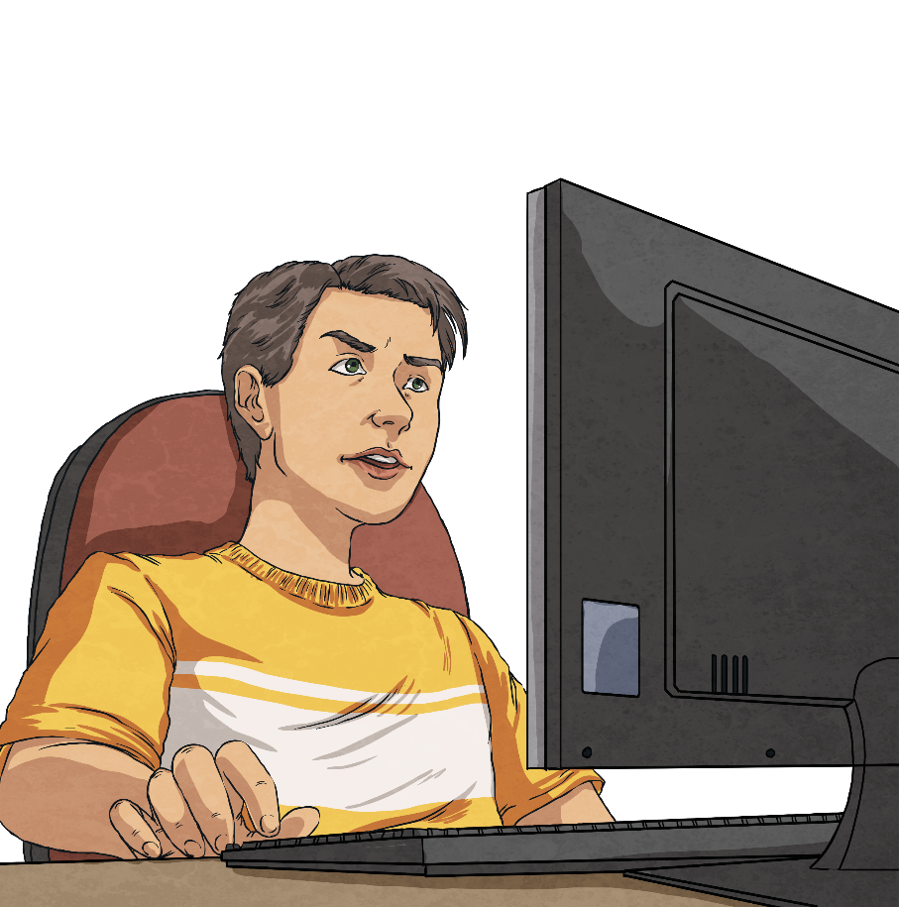
Invertebrate Information Page
Your challenge today is to research an invertebrate and create an information page that Libbie Hyman could have included in her books.
Use your Invertebrate Information Page Activity Sheet to present your research.
Choose an invertebrate from the list, or choose another invertebrate that you are interested in.
Use the Internet and books to find out about the invertebrate, including information on its classification, physical characteristics, its habitat and behaviour.
Include an illustration of the invertebrate.

Slide 11
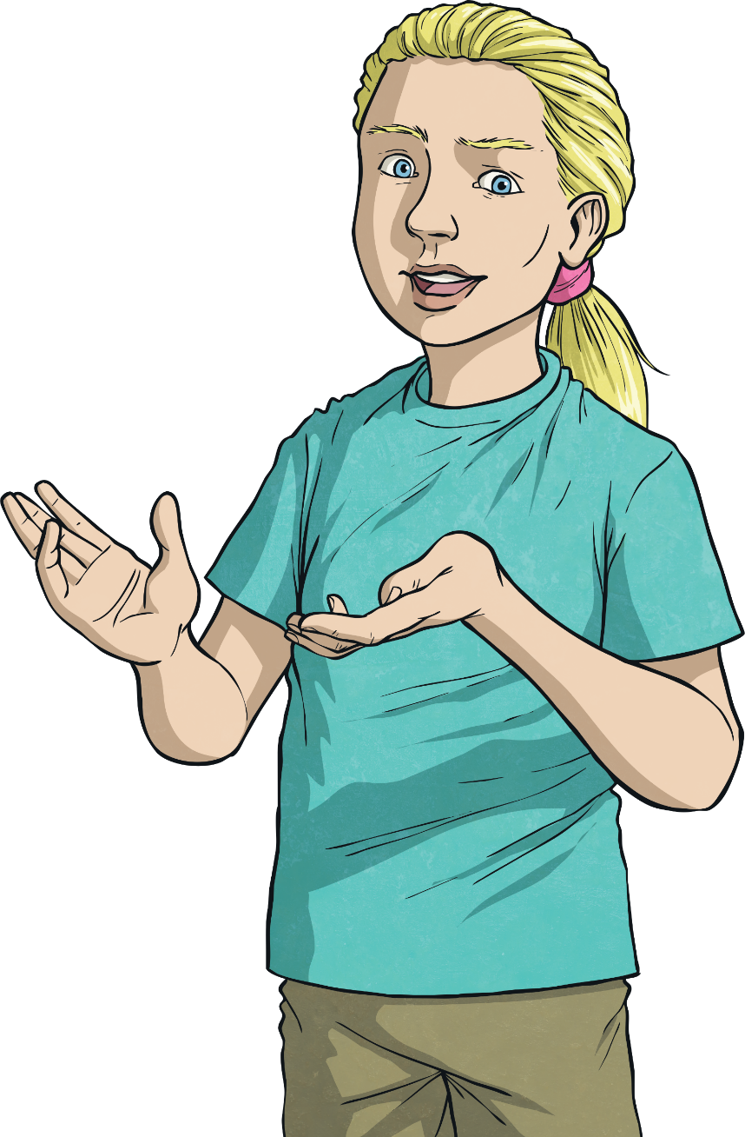
Invertebrate Information Page
Choose from this list of invertebrates, or research an invertebrate of your own choice.
seven-spot ladybird
Japanese spider crab
peacock butterfly
common octopus
lion's mane jellyfish
purple sunstar
emperor scorpion
common earthworm

Slide 12
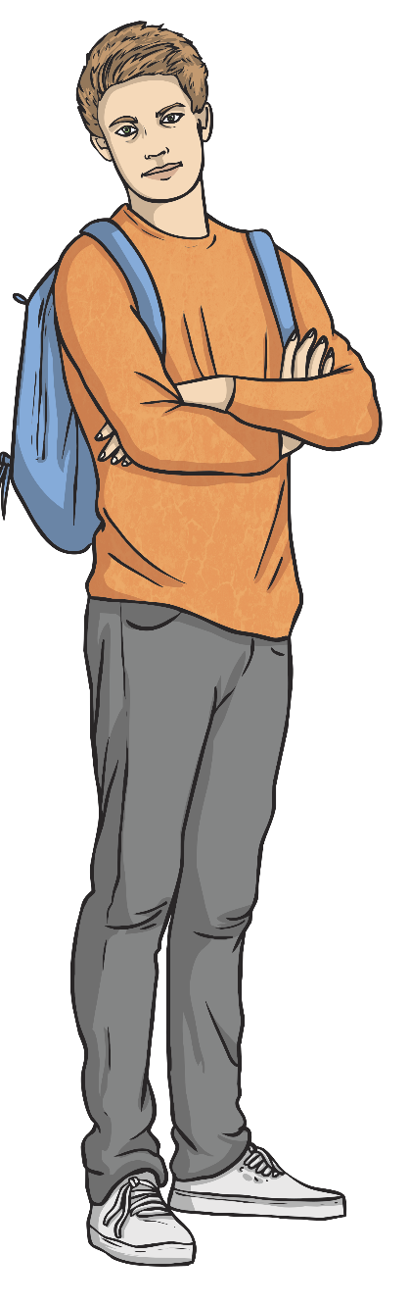
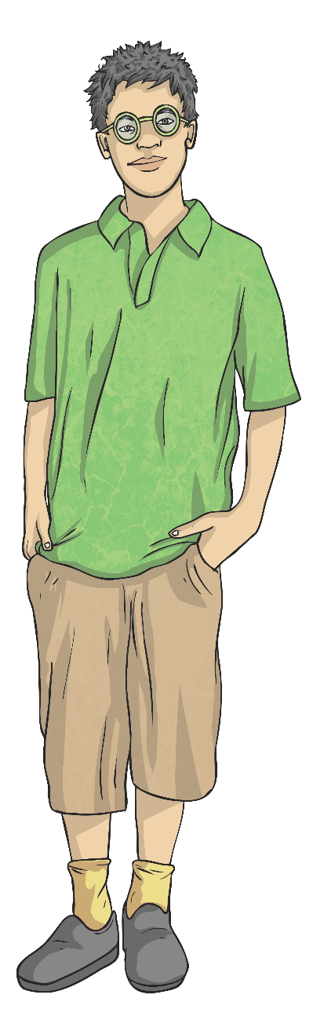
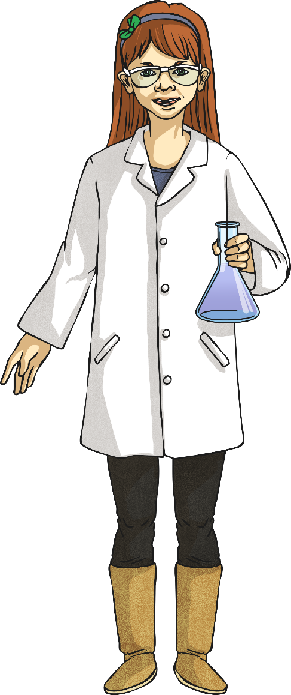
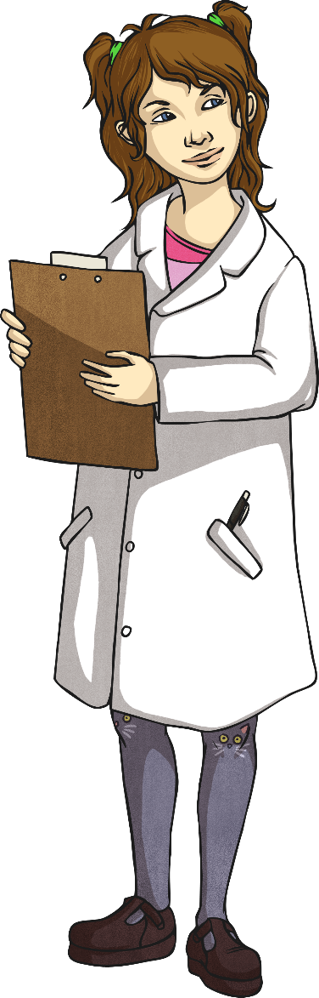
Attitudes and Obstacles
How did Hyman overcome these obstacles?
Libbie Hyman faced obstacles to her research from different people.
Hyman lived a long time ago. Do you think scientists face similar obstacles because of people's attitudes today?
Talk to your partner about the different attitudes of her family and colleagues that could have prevented her pursuing her scientific career.

Slide 13

Aim
To understand Libbie Hyman’s work about classification.
Success Criteria
I can describe Libbie Hyman's life and her work on invertebrates.
I can classify invertebrates.
I can describe the characteristics of invertebrates.

