Slide 1



LIFE/work balance
We have started a #LIFEworkbalance campaign and we need your help to complete our LIFE/work balance survey.
We hope to publish the results soon, so please give 15 minutes of your time to help us get a true picture of school life.
Want to be a part of this campaign? Take the survey on our website and share it with your colleagues!
© Classroom Secrets Limited 2018

Slide 2
Year 6 – Summer Block 3 – Statistics – Circles
About This Resource:
This PowerPoint has been designed to support your teaching of this small step. It includes a starter activity and an example of each question from the Varied Fluency and Reasoning and Problem Solving resources also provided in this pack. You can choose to work through all examples provided or a selection of them depending on the needs of your class.
National Curriculum Objectives:
Mathematics Year 6: (6G5) Illustrate and name parts of circles, including radius, diameter and circumference and know that the diameter is twice the radius
More Year 6 Statistics resources.
Did you like this resource? Don’t forget to review it on our website.
© Classroom Secrets Limited 2018

Slide 3
Year 6 – Summer Block 3 – Statistics
Step 4: Circles
© Classroom Secrets Limited 2018

Slide 4
Introduction
Challenge
How long does it take you to complete these calculations?
Double
24
47
86
19.4
62.5
94.37
Half
68
842
94
76
85
38.66
© Classroom Secrets Limited 2018

Slide 5
Introduction
Challenge
How long does it take you to complete these calculations?
Double
24 | 48
47 | 94
86 | 172
19.4 | 38.8
62.5 | 125
94.37 | 188.74
Half
68 | 34
842 | 421
94 | 47
76 | 38
85 | 42.5
38.66 | 19.33
© Classroom Secrets Limited 2018

Slide 6
Varied Fluency 1
Tick the circle which has a radius of 76mm.
A
B
76mm
76mm
© Classroom Secrets Limited 2018

Slide 7
Varied Fluency 1
Tick the circle which has a radius of 76mm.
A
B
76mm
✓
76mm
© Classroom Secrets Limited 2018

Slide 8
Varied Fluency 2
Use the measurements below to label the radius and diameter.
27.5m | 55m
© Classroom Secrets Limited 2018

Slide 9
Varied Fluency 2
Use the measurements below to label the radius and diameter.
27.5m | 55m
55m
27.5m
© Classroom Secrets Limited 2018

Slide 10
Varied Fluency 3
Match each diameter to its radius.
59m | 47.5m
95m | 63.5m
83m | 29.5m
127m | 41.5m
© Classroom Secrets Limited 2018

Slide 11
Varied Fluency 3
Match each diameter to its radius.
59m | 47.5m
95m | 63.5m
83m | 29.5m
127m | 41.5m
© Classroom Secrets Limited 2018

Slide 12
Varied Fluency 4
Use your ruler to draw and measure the radius and diameter.
© Classroom Secrets Limited 2018

Slide 13
Varied Fluency 4
Use your ruler to draw and measure the radius and diameter.
Please note this image will appear larger when
displayed on a whiteboard. You may wish to print
copies for your children to view at the correct size.
4.5cm
9cm
© Classroom Secrets Limited 2018

Slide 14
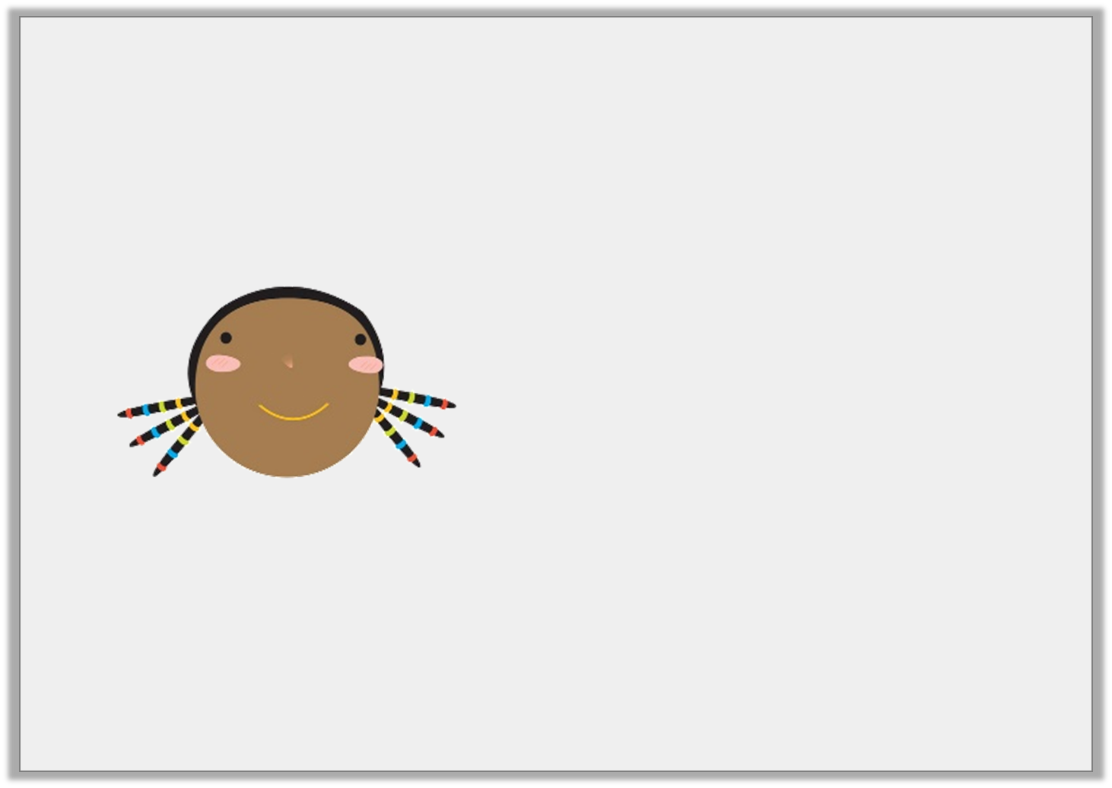
Reasoning 1
Jemima says,
Is she correct?
Explain your answer.
If the radius of a circle is 95.5mm then the diameter
must be 190mm.
© Classroom Secrets Limited 2018

Slide 15
Reasoning 1
Jemima says,
Is she correct?
Explain your answer.
Jemima is not correct because…
If the radius of a circle is 95.5mm then the diameter
must be 190mm.
© Classroom Secrets Limited 2018

Slide 16
Reasoning 1
Jemima says,
Is she correct?
Explain your answer.
Jemima is not correct because the diameter is always double the length of the radius, so it would be 191mm.
If the radius of a circle is 95.5mm then the diameter
must be 190mm.
© Classroom Secrets Limited 2018

Slide 17

Reasoning 2
Find the radius of the plate.
Explain how you know.
147mm
© Classroom Secrets Limited 2018

Slide 18
Reasoning 2
Find the radius of the plate.
Explain how you know.
The radius of the plate is 73.5mm because…
147mm
© Classroom Secrets Limited 2018

Slide 19
Reasoning 2
Find the radius of the plate.
Explain how you know.
The radius of the plate is 73.5mm because it is half of the diameter which is 147mm.
147mm
© Classroom Secrets Limited 2018

Slide 20
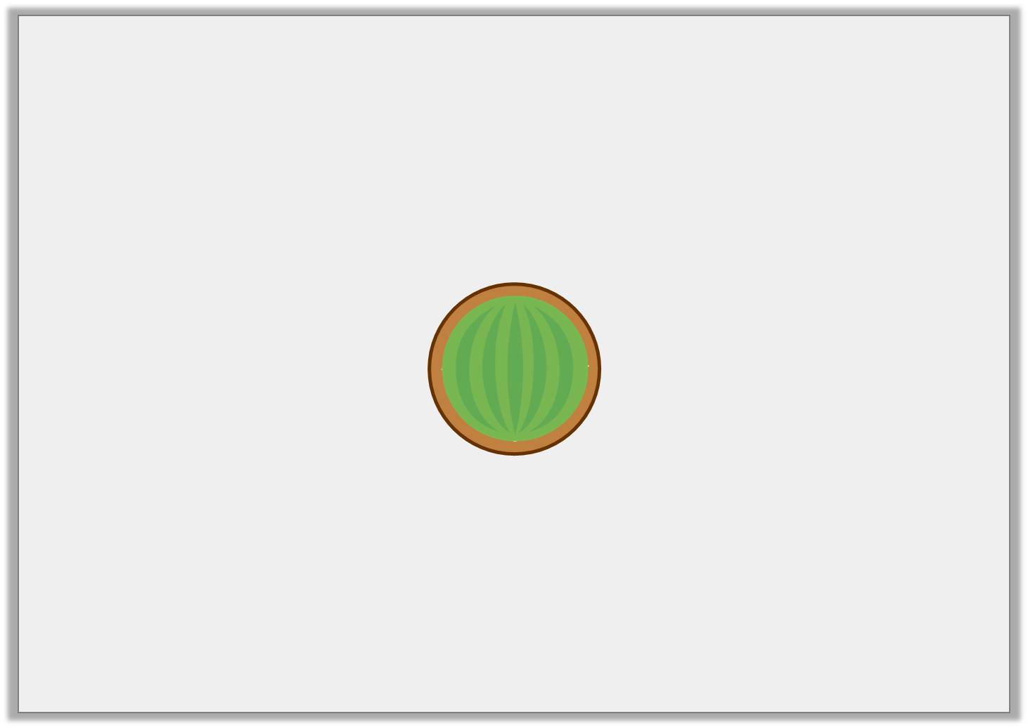
Problem Solving 1
Melons are stored in round tubs.
The tubs must be bigger than the melons.
Calculate the missing sizes.
1
5
Melon Radius | Tub Diameter
45mm
 | 80mm
© Classroom Secrets Limited 2018

Slide 21
Problem Solving 1
Melons are stored in round tubs.
The tubs must be bigger than the melons.
Calculate the missing sizes.
1
5
Melon Radius | Tub Diameter
45mm | 108mm
32mm | 80mm
© Classroom Secrets Limited 2018

