Slide 1
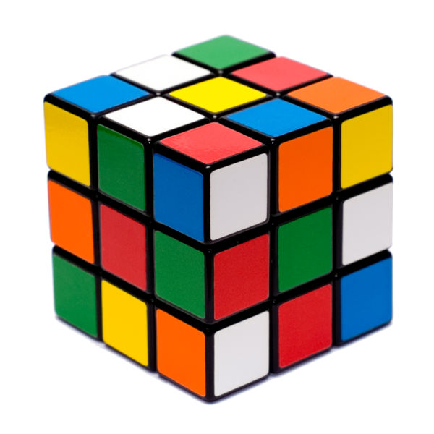
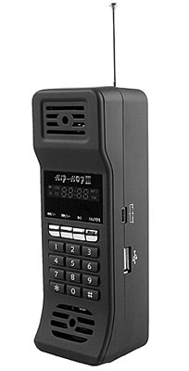
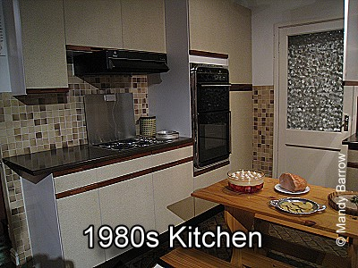
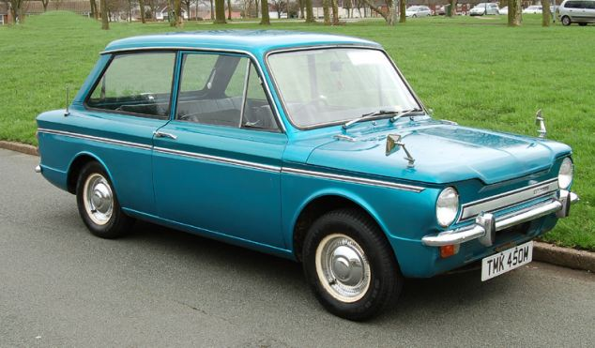
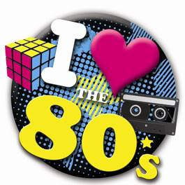
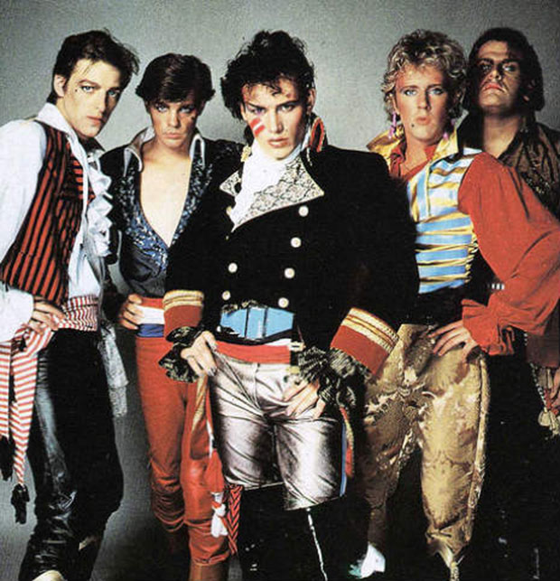
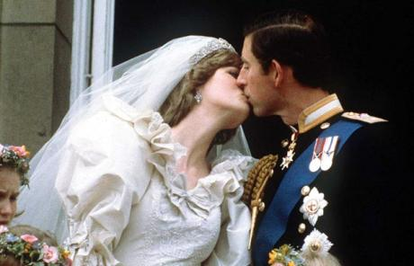
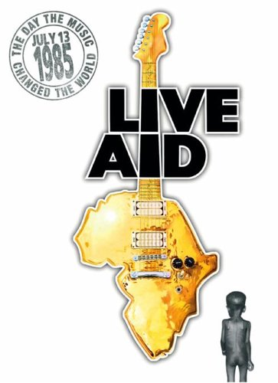
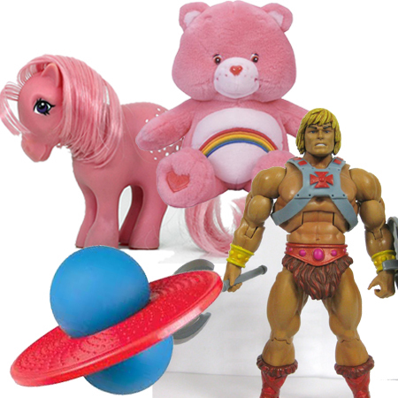
THE 1980s

Slide 2
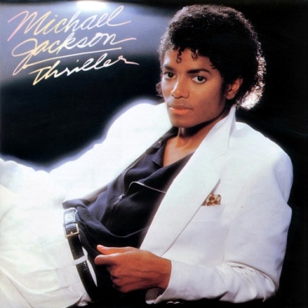
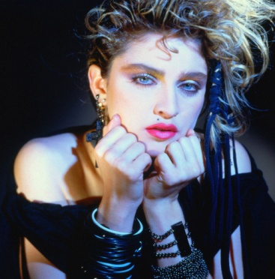
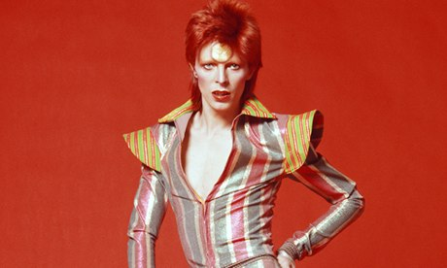
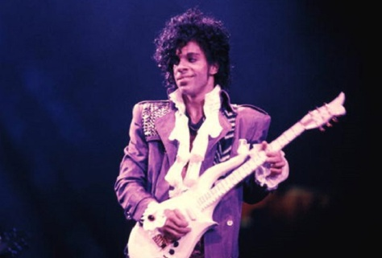
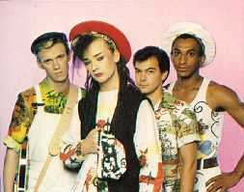
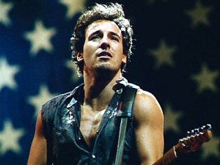
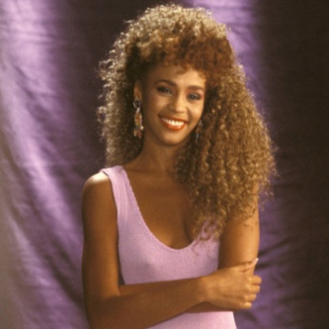
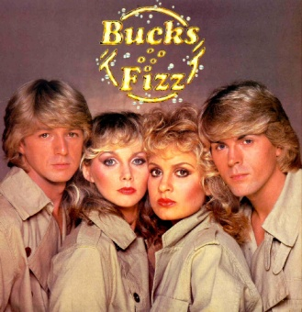
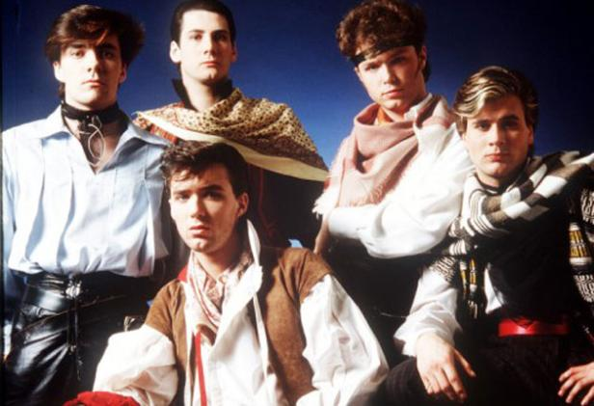
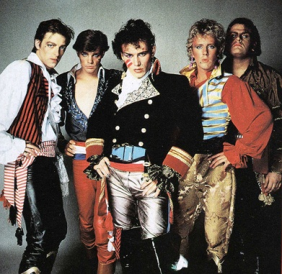
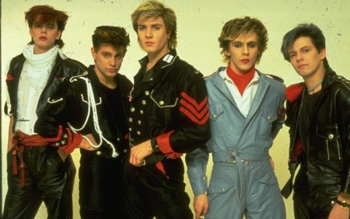
Music
In the UK:
David Bowie
Roxy Music
Adam and the Ants
Culture Club
Spandau Ballet
Duran Duran
Bucks Fizz
Frankie Goes To Hollywood
In the US.:
Whitney Houston
Michael Jackson
Bruce Springsteen
Tina Turner
Bon Jovi
Prince
Madonna

Slide 3
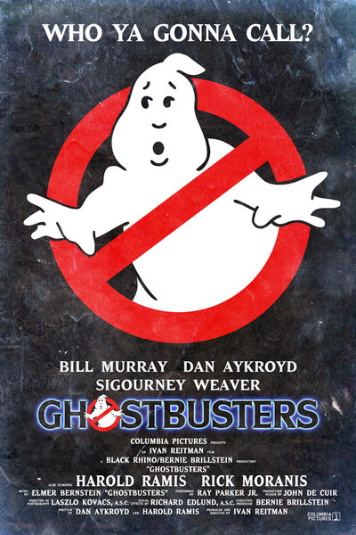
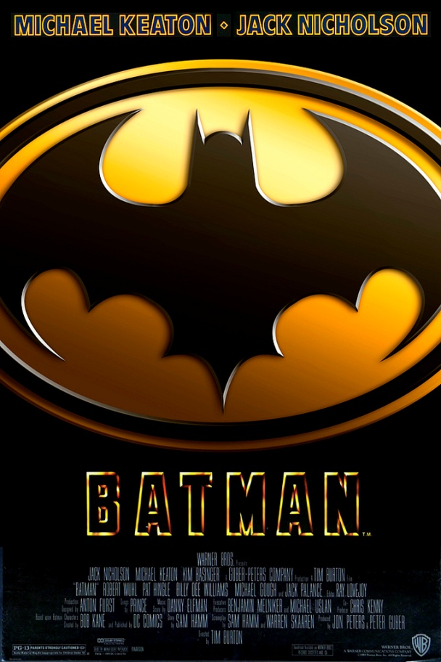
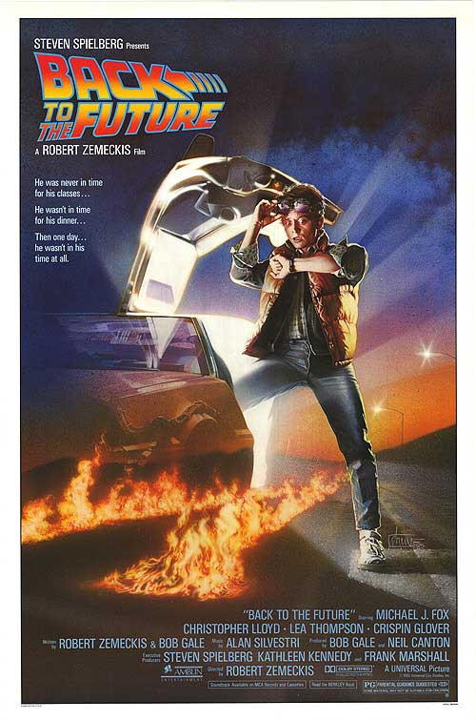
Films

Slide 4
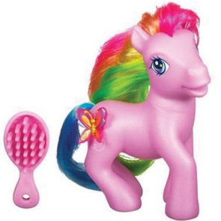
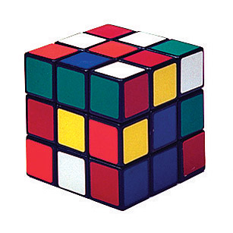
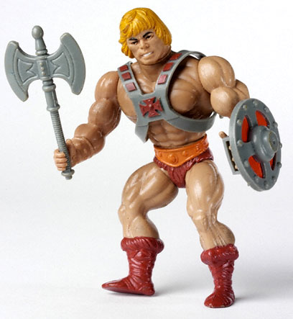
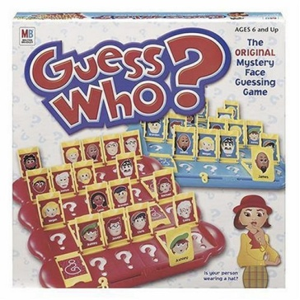
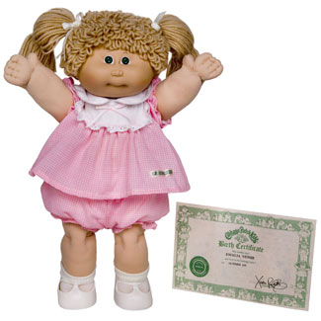
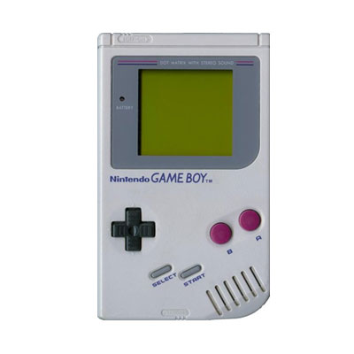
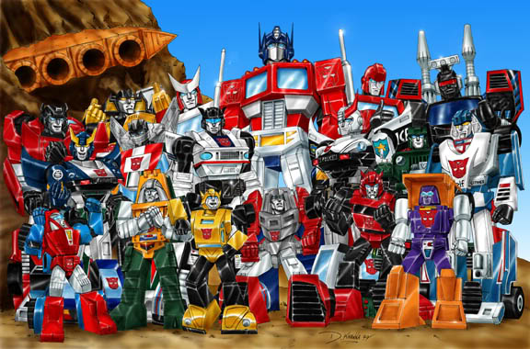

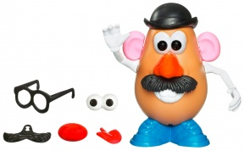
T o y s
My Little Pony
Rubik’s cube
He-Man
Guess Who? game
Cabbage Patch Kids
Game Boy
Transformers
Mr. Potato Head
Jenga

Slide 5
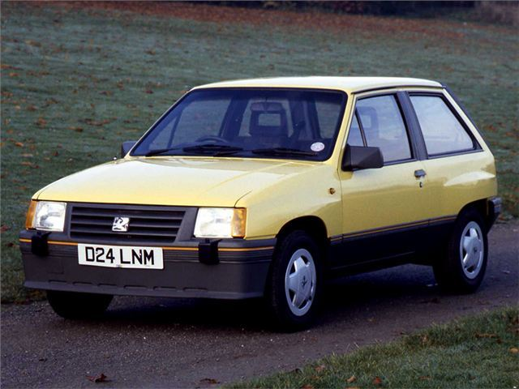
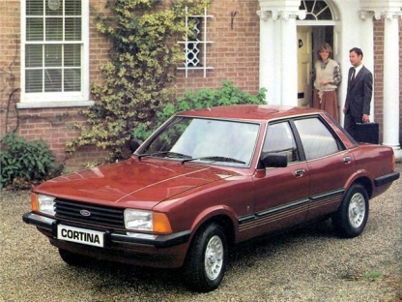
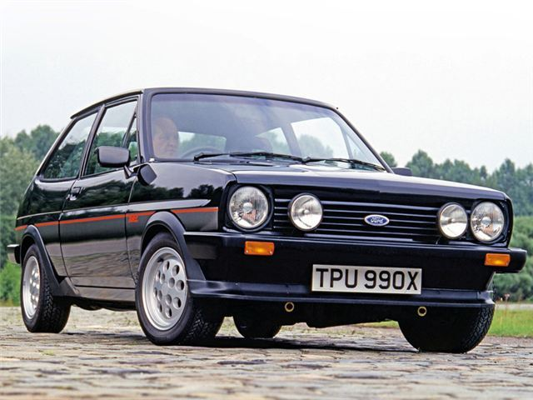
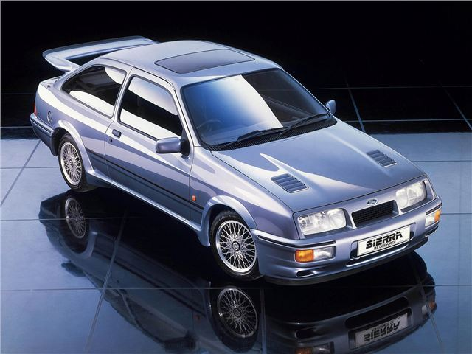
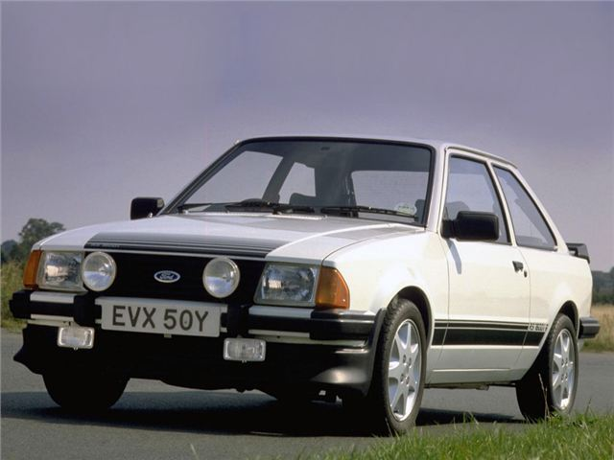
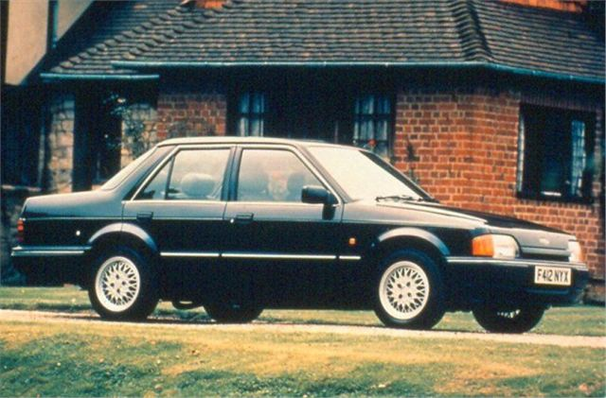
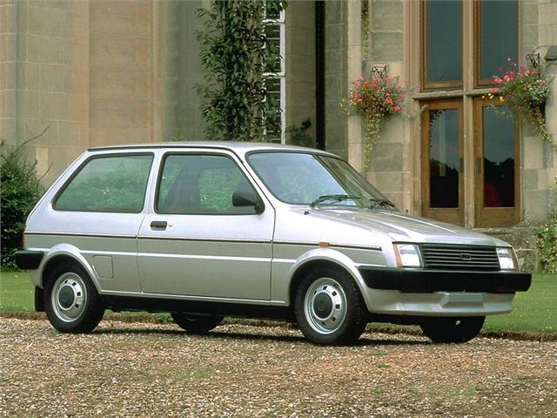
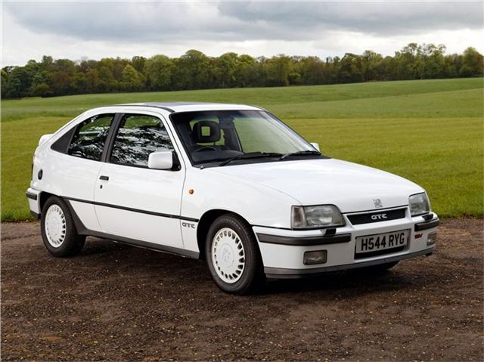
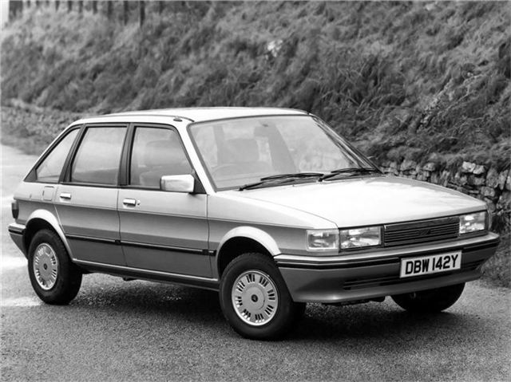
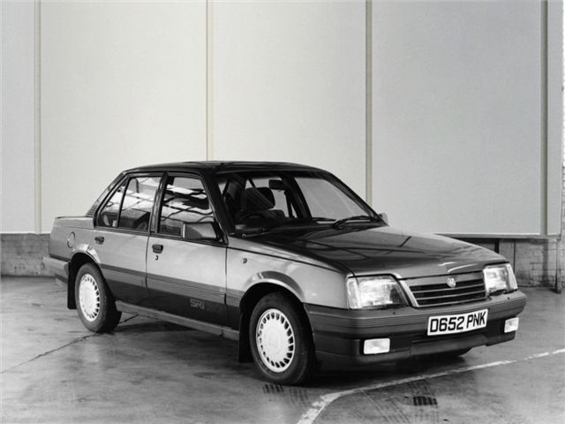
Cars
The top selling cars of the 1980s were:
9. Vauxhall Nova
7. Ford Cortina
4. Ford Sierra
2. Ford Fiesta
1. Ford Escort
8. Ford Orion
5. Austin Metro
6. Vauxhall Astra
10. Austin Maestro
3. Vauxhall Cavalier

Slide 6
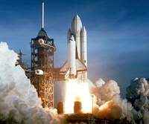
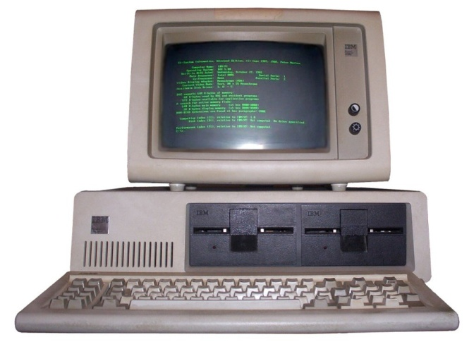
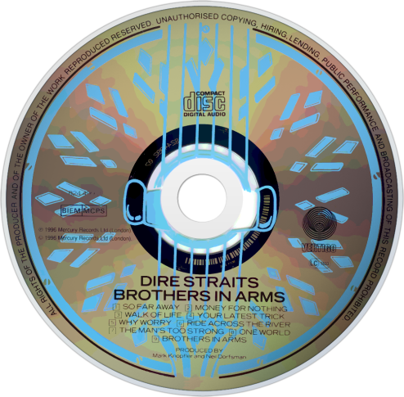
Inventions
THE CD
CDs were launched in 1982, but only 1,000 titles were available by the end of 1983.
The first album was Billy Joel's 52nd Street and the first song, released on the first CD, was The Visitors by ABBA. Dire Straits' Brothers In Arms CD was the first to sell over one million copies making it the world's most successful CD album.
SPACE SHUTTLE
The first American Space Shuttle named Columbia was launched on April12th 1981. The space journey lasted 54 hours and 21 minutes .
THE PERSONAL COMPUTER
IBM released its IBM 5150 on 12 August 1981.
The IBM 5150 had a 16-bit 8088 processor running at 4.77MHz, 16KB memory that was expandable to 256k, floppy disk drives, two RS-232 serial interfaces, and an optional colour monitor. The ROM had BASIC built-in and ran DOS 1.0, the operating system that brought us Microsoft.

Slide 7
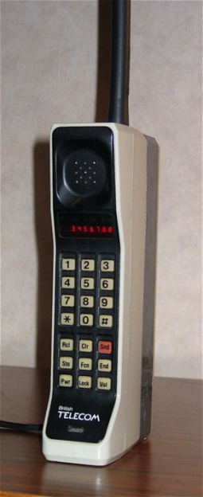
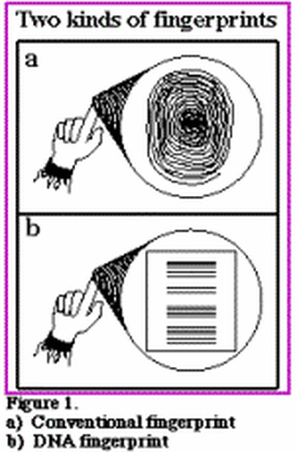
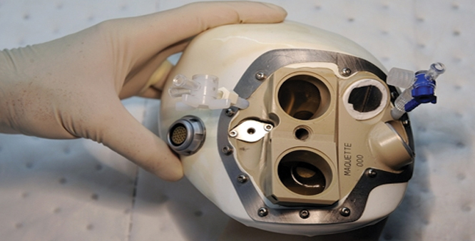
THE MOBILE PHONE
Motorola launched the DynaTAC 8000x in 1983 with the dimensions of 300x44x89mm and weighing in at a lovely and light 785g. It proudly offered you about one hour of talk time, used an LED display and had an extremely attractive aerial!
ARTIFICIAL HUMAN HEART
The first artificial heart was implanted into a man named
Dr. Barney Clark on December 2 1982. He survived for 112 days. The heart was created by Dr. Robert Jarvik and perfected over years of experimentation. The artificial heart's shape and design were oval so that it would fit into the human chest.
DNA FINGERPRINTING
In 1984, British geneticist Alec Jeffreys accidentally discovered that every person has a unique DNA profile. The unique genetic profiles are derived from the profiles of one's parents, which means that lineage can be traced back through generations with DNA testing. Alec Jeffreys was knighted for his invention that changed the face of science forever. The world of forensic science owes its development to DNA fingerprinting.
OTHER INVENTIONS INCLUDED:
Hepatitis Vaccine
Disposable Contact lenses
Disposable Cameras
Camcorder
First 3-D Video Game
Synthetic Skin

Slide 8
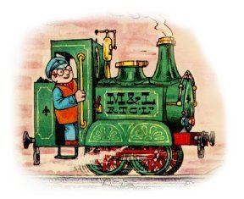
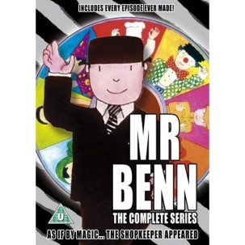
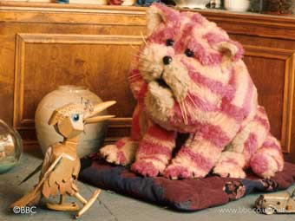









Television
Bagpuss
Ivor the Engine
The most popular TV shows were:
Scooby-Doo

Slide 9
Events of the 1980s
Oh my goodness!
WOW!
Did you see that?

Slide 10

1980
John Lennon was an English musician who gained worldwide fame as a member of The Beatles, for his subsequent solo career, and for his political activism and pacifism. He was shot by Mark David Chapman at the entrance to the building where he lived, The Dakota, in New York City on 8 December 1980. Lennon had just returned from Record Plant Studio with his wife, Yoko Ono.

Slide 11

1981
The wedding of Charles, Prince of Wales, and Lady Diana Spencer took place on Wednesday 29 July 1981 at St Paul's Cathedral, London. Their marriage was widely billed as a "fairytale wedding" and the "wedding of the century". It was watched by an estimated global TV audience of 750 million. The United Kingdom had a national holiday on that day to mark the wedding.

Slide 12


1982
On 2 April 1982, Argentine forces launched the invasion of the Falkland Islands beginning the Falklands War.

Slide 13



1985
Live Aid was a concert held on 13 July 1985. The event was organised by Bob Geldof and Midge Ure to raise funds for relief of the ongoing Ethiopian famine. The event was held simultaneously at Wembley Stadium in London and John F. Kennedy Stadium in Philadelphia, Pennsylvania, United States. It was one of the largest-scale satellite link-ups and television broadcasts of all time: an estimated global audience of 1.9 billion, across 150 nations, watched the live broadcast.

Slide 14


1989
On November 10 1989, East and West Berliners flocked to the Berlin Wall, which had separated their city for 28 years, drinking beer and champagne and chanting “Tor auf!” (“Open the gate!”). At midnight, they flooded through the checkpoints. People used hammers and picks to knock away chunks of the wall–they became known as “mauerspechte,” or “wall woodpeckers”—while cranes and bulldozers pulled down section after section. Soon the wall was gone and Berlin was united for the first time since 1945. “Only today,” one Berliner spray-painted on a piece of the wall, “is the war really over.”

