Slide 1
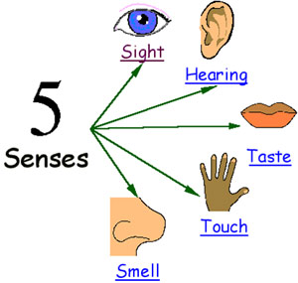
Setting
When you write about a setting, you need to make sure you use lots of description so a reader can picture themselves there.
Effective descriptions appeal to the senses.

Slide 2

One morning there was a different smell in the air, and the ship was moving oddly, with a brisker rocking from side to side instead of the plunging and soaring. Lyra was on deck a minute after she woke up, gazing greedily at the land: such a strange sight, after all that water, for though they had only been at sea a few days, Lyra felt as if they’d been on the ocean for months. Directly ahead of the ship a mountain rose, green-flanked and snow capped, and a little town and harbour lay below it: wooden houses with steep roofs, an oratory spire, cranes in the harbour, and clouds of gulls wheeling and crying. The smell was of fish, but mixed with it came land smells too: pine-resin and earth and something animal and musky, and something else that was cold and blank and wild: it might have been snow. It was the smell of the North.
SIGHT
HEARING
Seals frisked around the ship, showing their clown-faces above the water before sinking back without a splash. The wind that lifted spray off the white-capped waves was monstrously cold, and searched out every gap in Lyra’s wolfskin.
TOUCH
TASTE
SMELL

