Slide 1
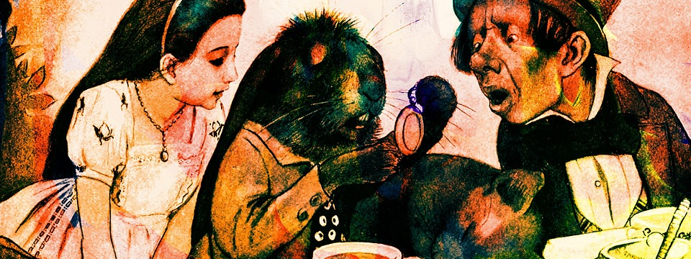
World Poetry Day
Write a nonsense poem.

Slide 2

You are all guests at the Mad Hatter’s Tea Party.
You have to bring a nonsense poem to read aloud.
Let’s see what style of nonsense he likes …

Slide 3
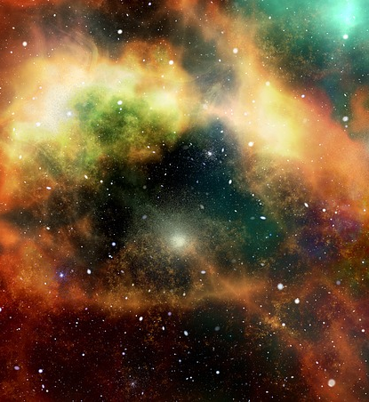
Firstly, do you know this poem?
Twinkle, twinkle, little star.
How I wonder what you are.
Up above the world so high -
Like a diamond in the sky -
Twinkle, twinkle little star -
How I wonder what you are.
Which words form rhymes here?
Which lines rhyme here?
Which lines are repeated?

Slide 4
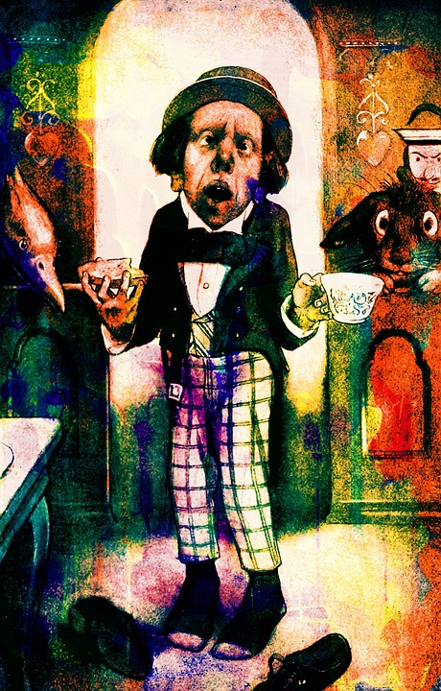
This nonsense version might be less familiar to you.
The poem is recited by the Mad Hatter from Alice in Wonderland.
Twinkle, twinkle, little bat!
How I wonder what you're at!
Up above the world you fly,
Like a tea tray in the sky.
Twinkle, twinkle, little bat!
How I wonder what you're at!

Slide 5
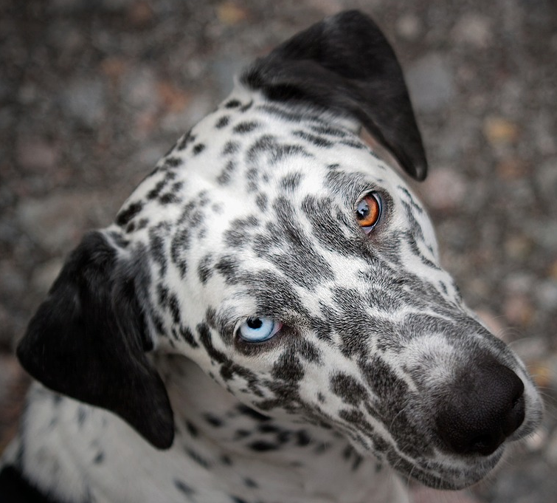
Spot the Difference
Twinkle, twinkle, little star.
How I wonder what you are.
Up above the world so high -
Like a diamond in the sky -
Twinkle, twinkle little star -
How I wonder what you are.
Twinkle, twinkle, little bat!
How I wonder what you're at!
Up above the world you fly,
Like a tea tray in the sky.
Twinkle, twinkle, little bat!
How I wonder what you're at!
Fetch!

Slide 6
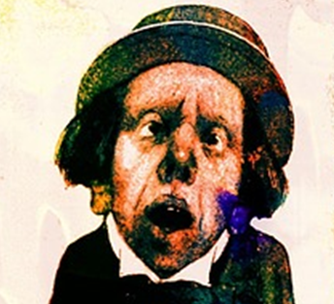
Spot the Difference
Twinkle, twinkle, little star.
How I wonder what you are.
Up above the world so high -
Like a diamond in the sky -
Twinkle, twinkle little star -
How I wonder what you are.
Twinkle, twinkle, little bat!
How I wonder what you're at!
Up above the world you fly,
Like a tea tray in the sky.
Twinkle, twinkle, little bat!
How I wonder what you're at!
The Mad Hatter’s poem is meant to be nonsense. He is playing with words in the original version. He makes it easy for himself because he doesn’t have to invent a whole poem. Get ready to try this yourself.

Slide 7

Make a list of up to ten things you find in the sky
Struggling to get to ten?
If you wrote ‘bird’, you could name some types of bird e.g. goose
Did you think sports equipment yet?

Slide 8
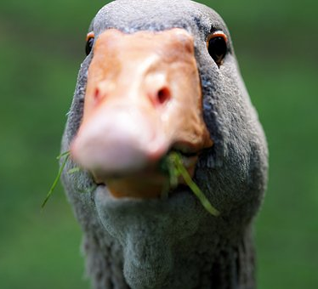
I’ll talk you through how you might do this.
Are you laughing at me?
I’m choosing ‘goose’ because they are comical to start with!

Slide 9
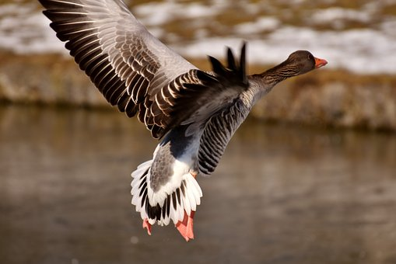
Pie? I’m out of here!
Twinkle, twinkle, little goose.
How I wonder who let you loose.
Up above the world so high -
Like a fantastic filling for a pie -
Twinkle, twinkle little _______-
How I wonder_____________ .
If I’m following the pattern of the original poem carefully, what do these words have to be?

Slide 10
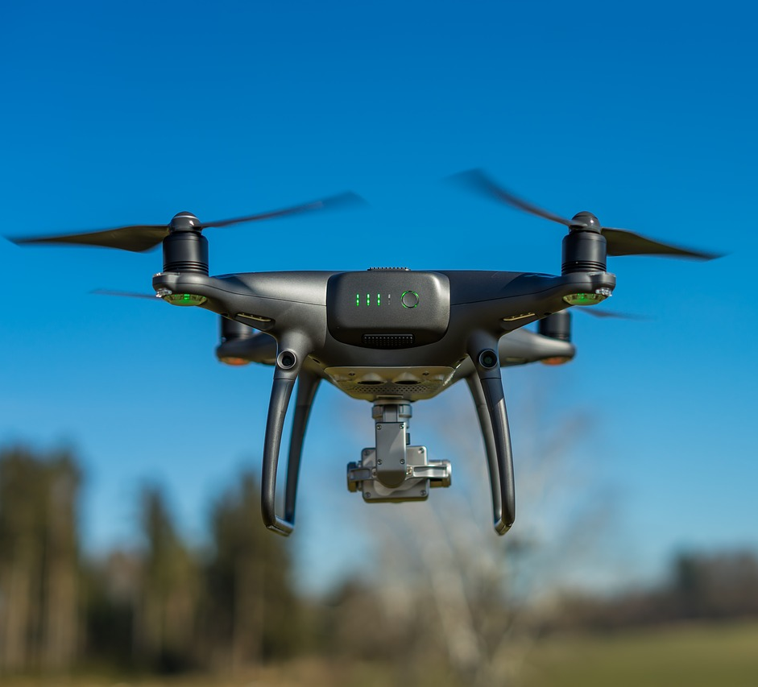
Let’s do this one together …
Twinkle, twinkle, little ______.
How I wonder _____________.
Up above the world ________ -
Like a ___________________ -
Twinkle, twinkle little _______-
How I wonder_____________ .
Tip: it might be called a nonsense poem but it still needs to make some sense to the reader. There should be a possible truth in there somewhere.
drone home foam cone loan moan bone
spy high lie cry sigh try die
OR CREATE A DIFFERENT SET OF WORDS THAT RHYME

Slide 11

Here’s your challenge: Create a new nonsense poem for the Mad Hatter’s Tea Party
Twinkle, twinkle, little ______.
How I wonder _____________.
Up ______________________ -
Like a ___________________ -
Twinkle, twinkle little _______-
How I wonder_____________ .

