Slide 1
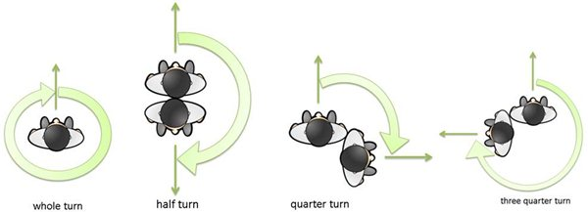
Turns
L.O. To recognise and make a quarter-turn, half-turn, three-quarter-turn and a whole-turn

Slide 2
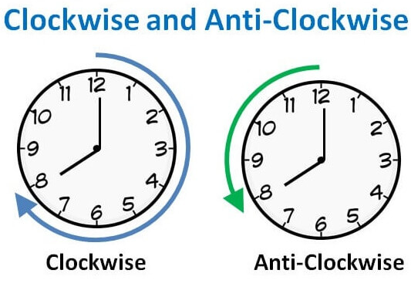
L.O. To recognise and make a quarter-turn, half-turn, three-quarter-turn and a whole-turn

Slide 3
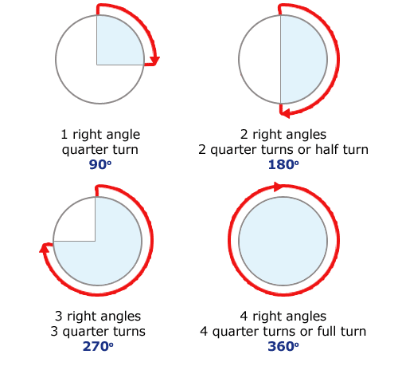
L.O. To recognise and make a quarter-turn, half-turn, three-quarter-turn and a whole-turn

Slide 4

L.O. To recognise and make a quarter-turn, half-turn, three-quarter-turn and a whole-turn
Turn 90° anticlockwise
a.
b.
c.
d.

Slide 5
L.O. To recognise and make a quarter-turn, half-turn, three-quarter-turn and a whole-turn
Turn 90° anticlockwise
a.
b.
c.
d.

Slide 6
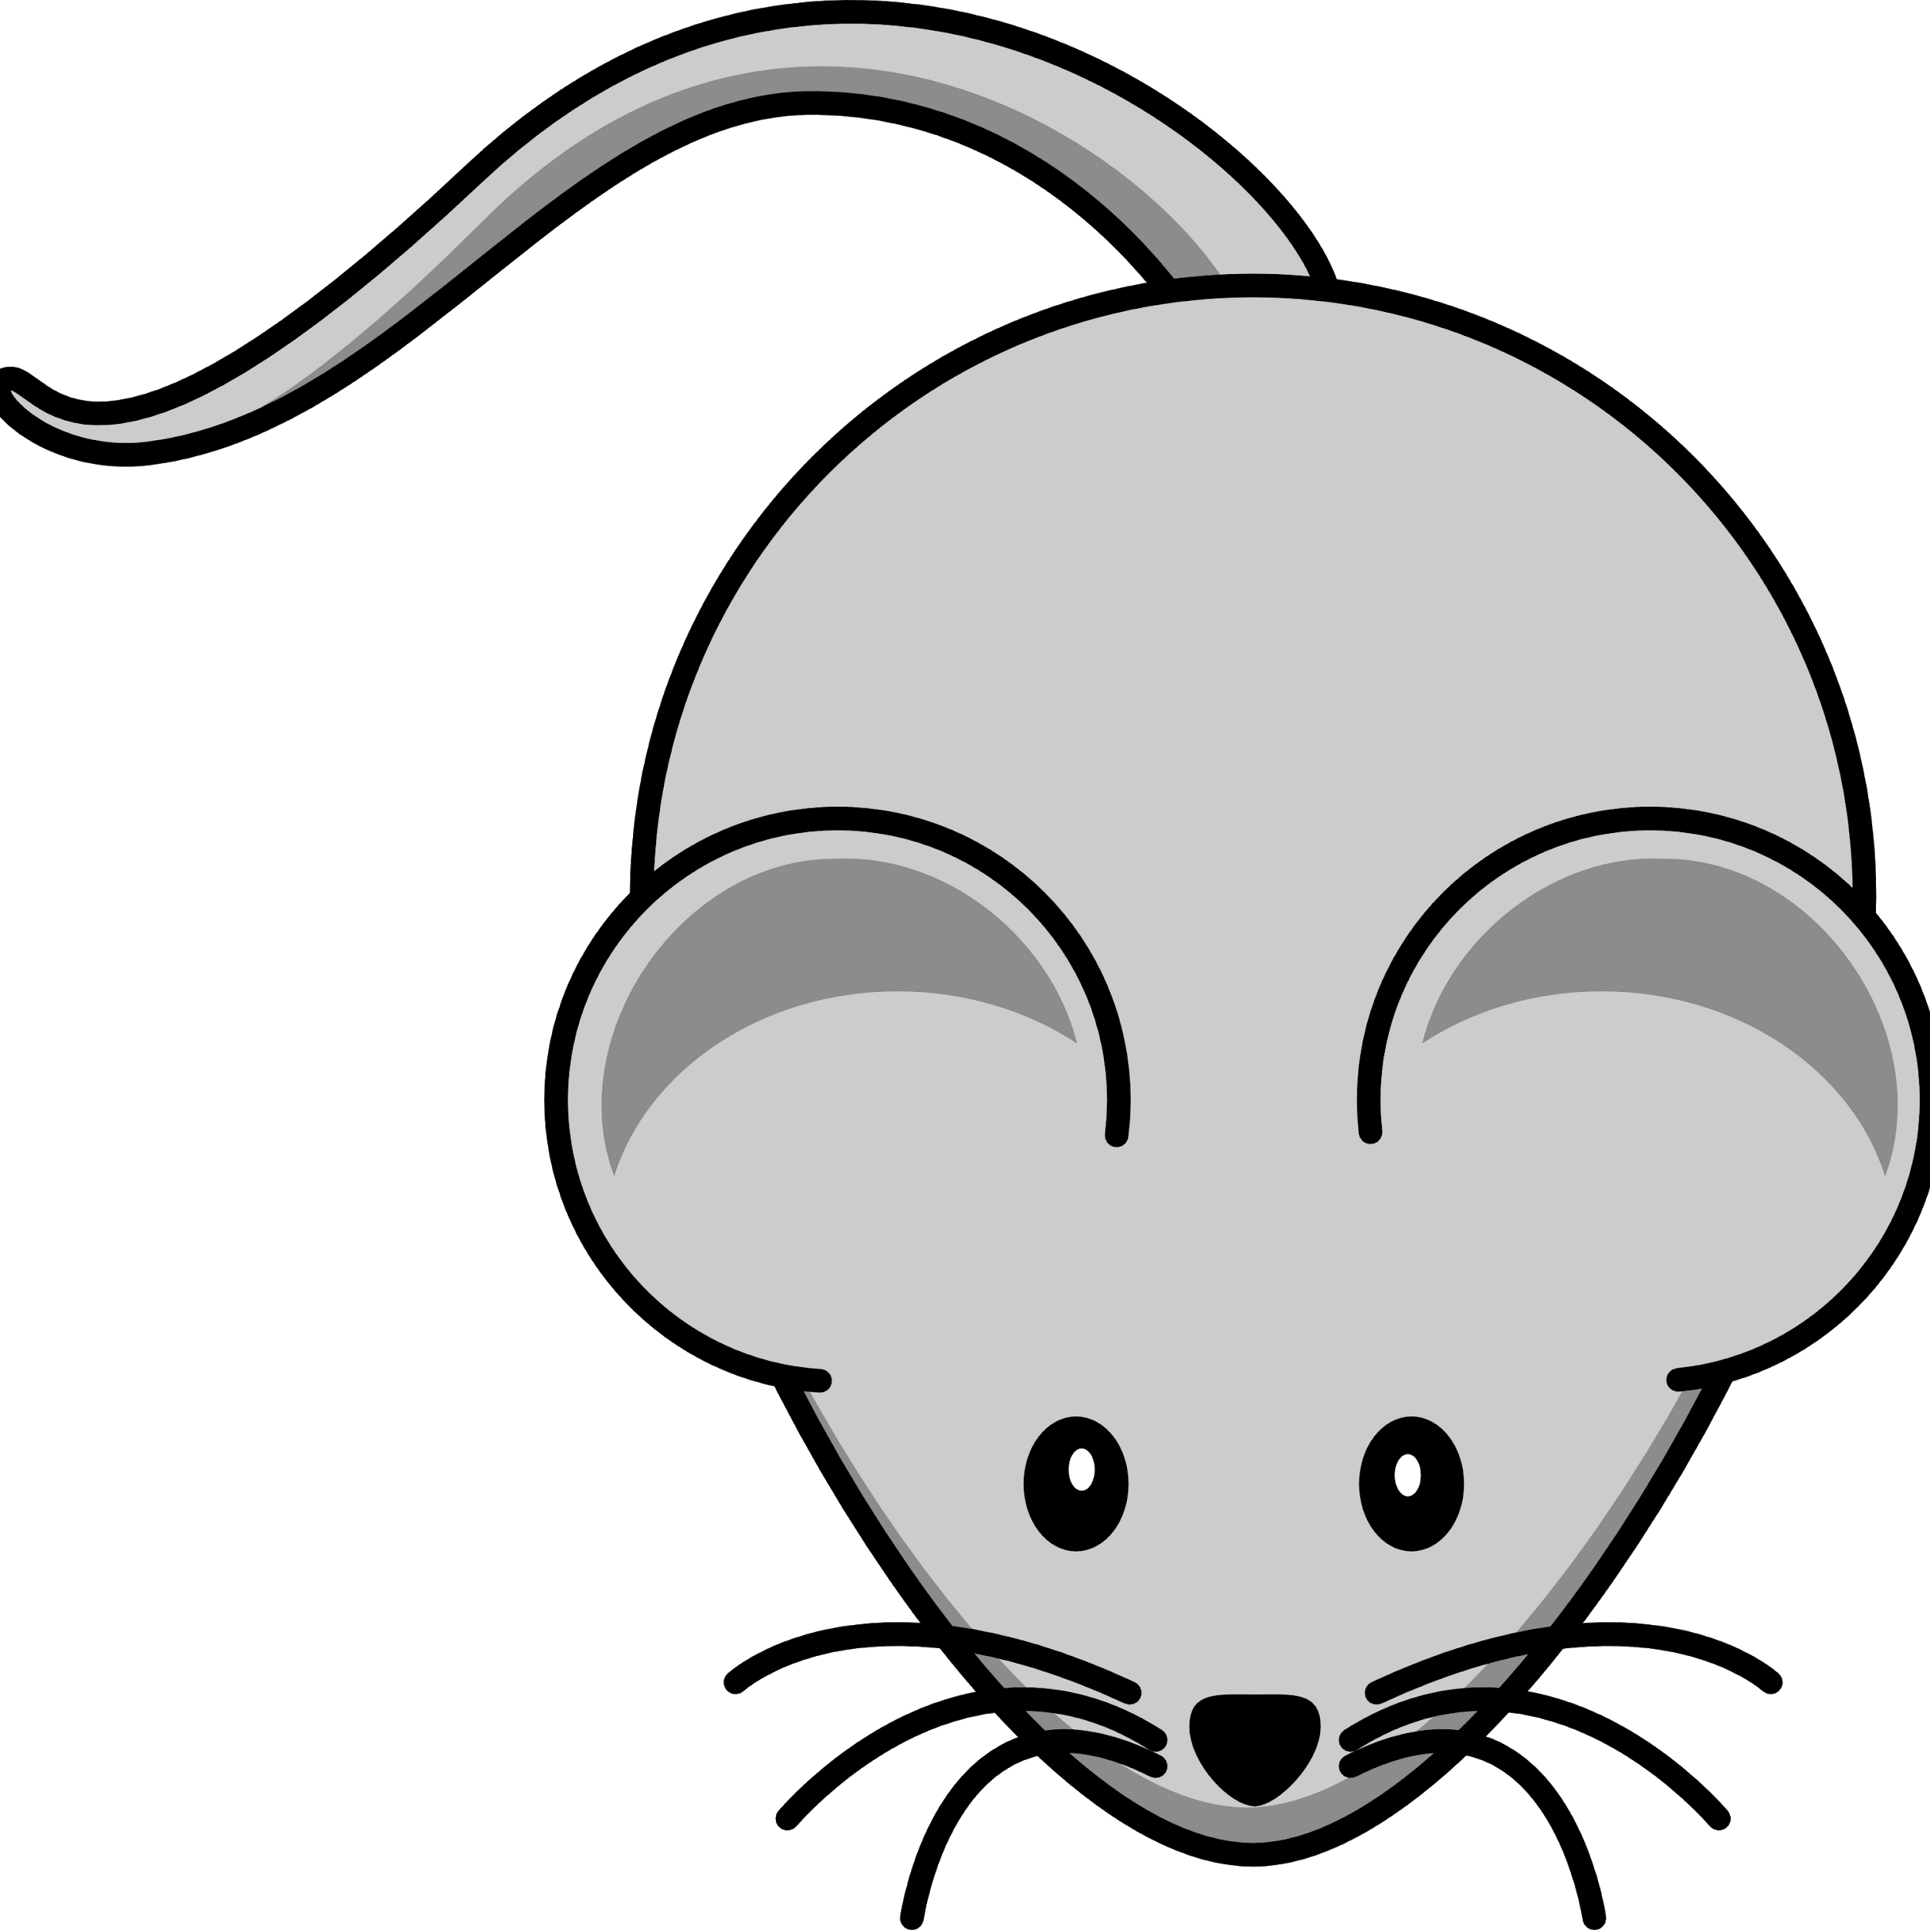
L.O. To recognise and make a quarter-turn, half-turn, three-quarter-turn and a whole-turn
Turn 180° clockwise
a.
b.
c.
d.

Slide 7
L.O. To recognise and make a quarter-turn, half-turn, three-quarter-turn and a whole-turn
Turn 180° clockwise
a.
b.
c.
d.

Slide 8
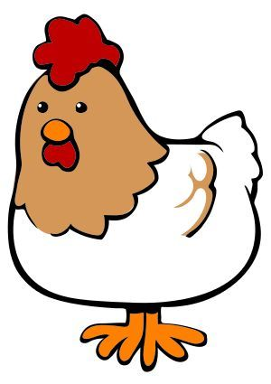
L.O. To recognise and make a quarter-turn, half-turn, three-quarter-turn and a whole-turn
Turn 270° anticlockwise
a.
b.
c.
d.

Slide 9
L.O. To recognise and make a quarter-turn, half-turn, three-quarter-turn and a whole-turn
Turn 270° anticlockwise
a.
b.
c.
d.

Slide 10
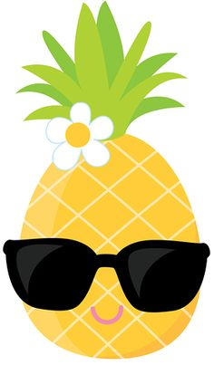
L.O. To recognise and make a quarter-turn, half-turn, three-quarter-turn and a whole-turn
Turn 90° clockwise
a.
b.
c.
d.

Slide 11
L.O. To recognise and make a quarter-turn, half-turn, three-quarter-turn and a whole-turn
Turn 90° clockwise
a.
b.
c.
d.

Slide 12
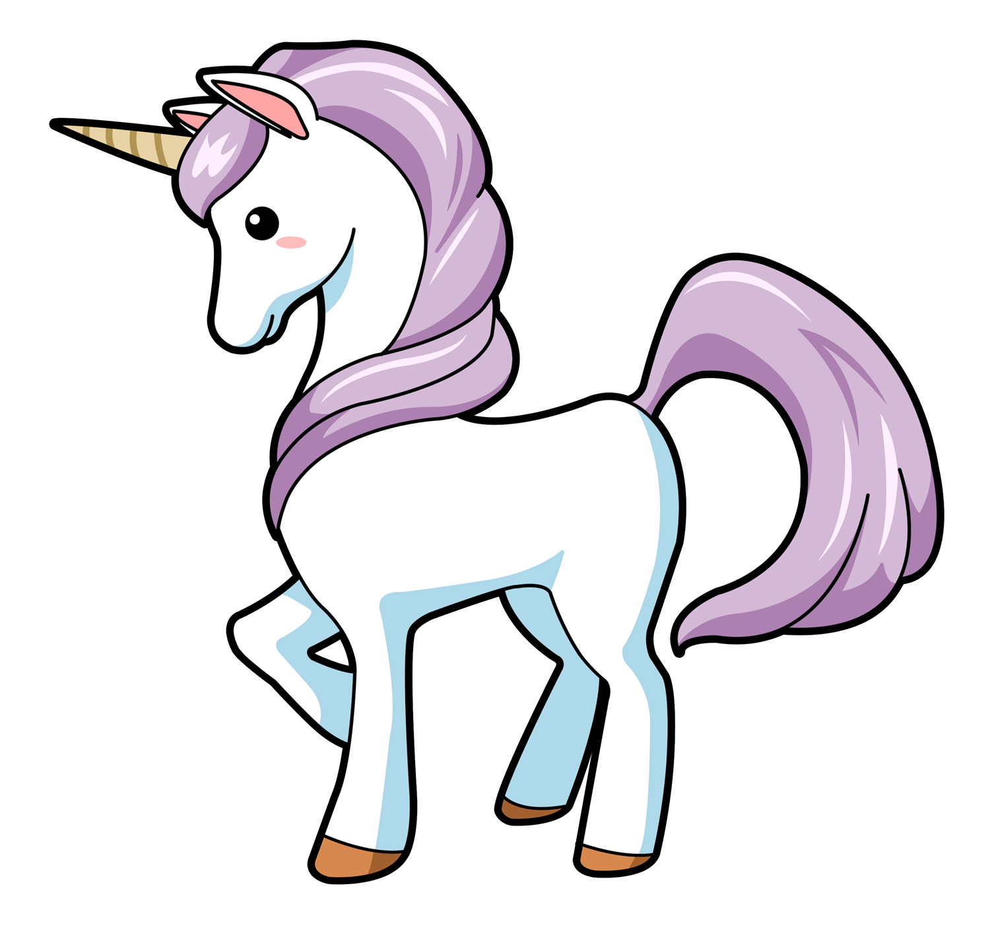
L.O. To recognise and make a quarter-turn, half-turn, three-quarter-turn and a whole-turn
Turn 360° clockwise
a.
b.
c.
d.

Slide 13
L.O. To recognise and make a quarter-turn, half-turn, three-quarter-turn and a whole-turn
Turn 360° clockwise
a.
b.
c.
d.

Slide 14
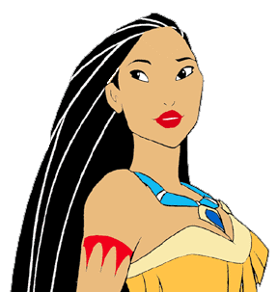
L.O. To recognise and make a quarter-turn, half-turn, three-quarter-turn and a whole-turn
Turn 180° anticlockwise
a.
b.
c.
d.

Slide 15
L.O. To recognise and make a quarter-turn, half-turn, three-quarter-turn and a whole-turn
Turn 180° anticlockwise
a.
b.
c.
d.

Slide 16

L.O. To recognise and make a quarter-turn, half-turn, three-quarter-turn and a whole-turn
Turn 270° clockwise
a.
b.
c.
d.

Slide 17
L.O. To recognise and make a quarter-turn, half-turn, three-quarter-turn and a whole-turn
Turn 270° clockwise
a.
b.
c.
d.

