Slide 1
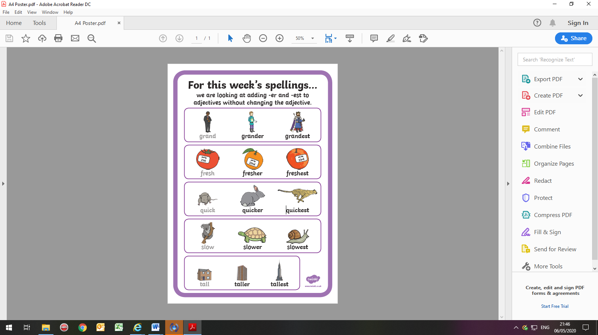
adjectives.

Slide 2
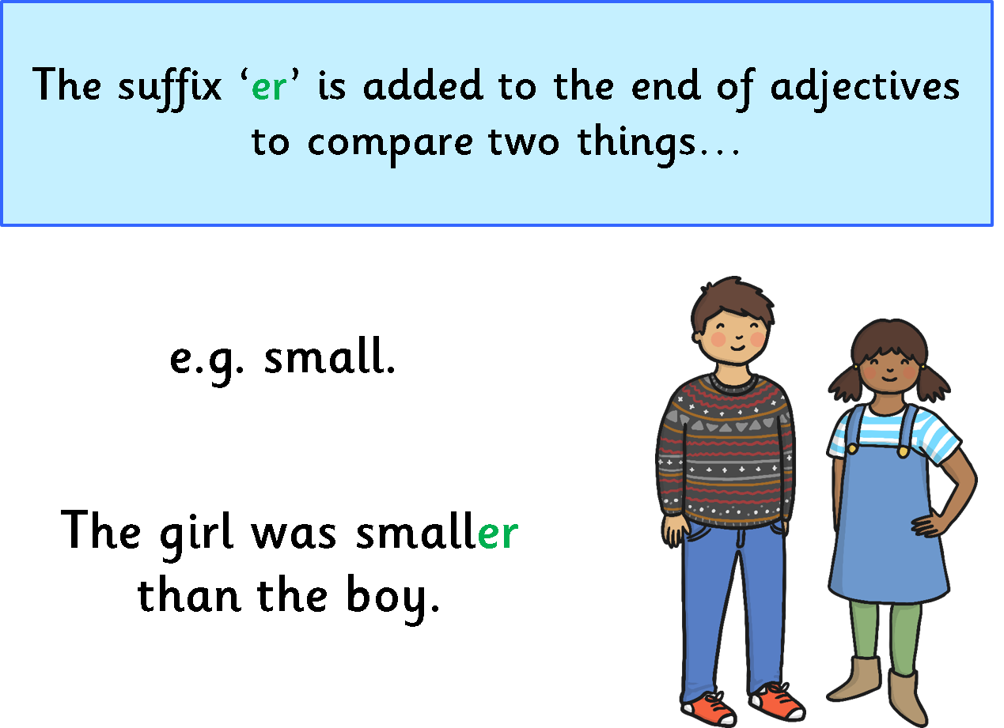


Slide 3
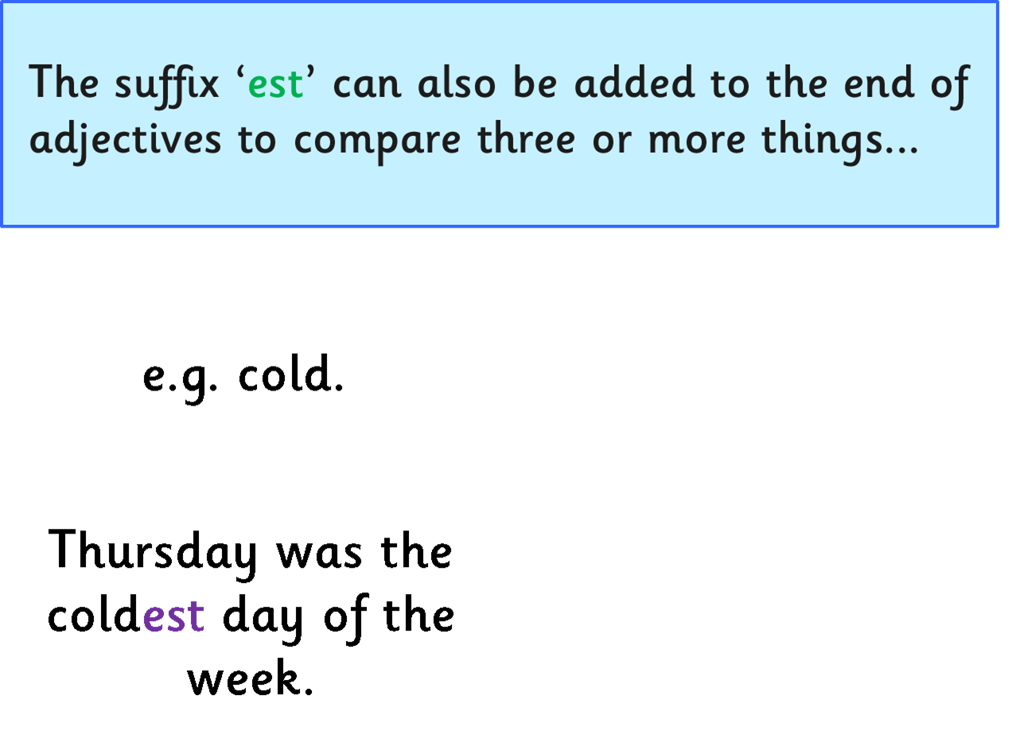
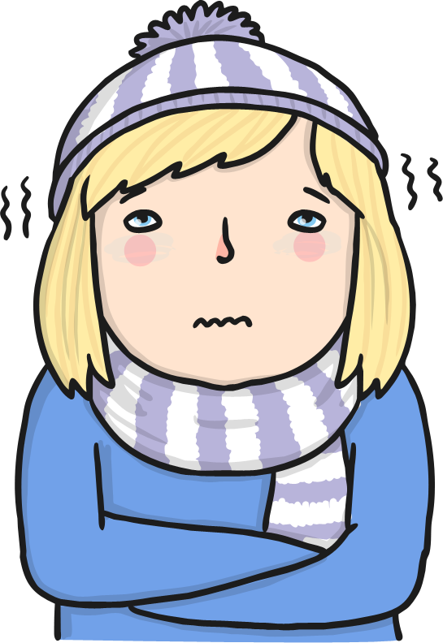

Slide 4
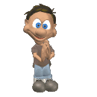


What has changed about this adjective?
small
smaller
smallest

Slide 5



What has changed about this adjective?
slow
slower
slowest

Slide 6
We add ‘er’ and ‘est to adjectives to add more detail
bright
brighter
brightest
strong
stronger
strongest
taller
tallest
tall

